Slide 1
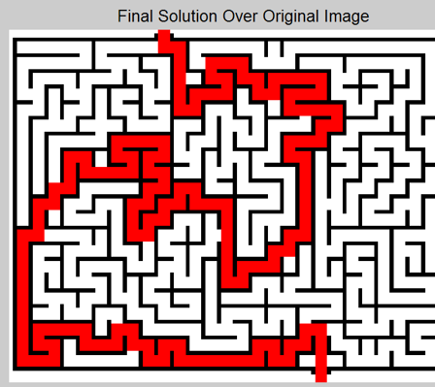
Maze Solver
Name : Hamza Jadoon
Regno: FA22-BCE-012
Section: A

Slide 2
Outline
Introduction
Literature Review
Proposed Solution
Results
Conclusion

Slide 3
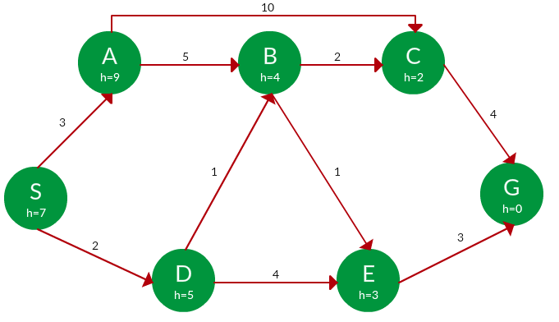
Introduction
Create a two-player maze solver game (Human vs. AI).
Uses adversarial search algorithms to find optimal moves.
Use of heuristic functions(estimate cost from current position)
Motivation:
Passion for games and challenging idea.
Opportunity to apply AI technique A* Search.
Objective:
Design a game where players find the shortest path in a 2D maze.
Implement optimal gameplay.

Slide 4
Literature Review/ breakdown of the problem
Depth-FIRST-SEARCH can also be applied to solve this problem
but it’s not guaranteed that it will give shortest or optimal solution.
May get "stuck" in one branch of the maze.
BREADTH-FIRST-SEARCH can also be applied here but the main issue will be that ;
It explore all the nodes, here it will explore all unnecessary branches in result of long-time taking, making it slower.

Slide 5

Proposed Solution
1. Initialize Maze :
2. Define Start and Goal:
Goal = (gx, gy)
3. Define A* Algorithm:
- Input: Maze, start, goal
- Initialize priority queue
- Add start_node to priority queue
- While priority_queue is not empty:
Pop node with lowest f_cost
If node == goal: Return reconstructed path
For each valid neighbor:
- Calculate g_cost, h_cost, f_cost
- Add neighbor to priority_queue
- Return None if no path exists.

Slide 6
4. Define Game func:
- Player1_pos = Player1_start
- Player2_pos = Player2_start
While True:
a. Display the Maze with Player1 and Player2 positions.
b. Check if Player1_pos == Goal or Player2_pos == Goal:
- Declare winner and break.
c. Player 1 = Me:
- Input move (w/a/s/d)
- Update Player1_pos
- Ensure move is valid
d. Player 2=Ai:
- Use A* to find path to goal.
- Move Player2_pos to the next step in the path.
5. End Game.

Slide 7
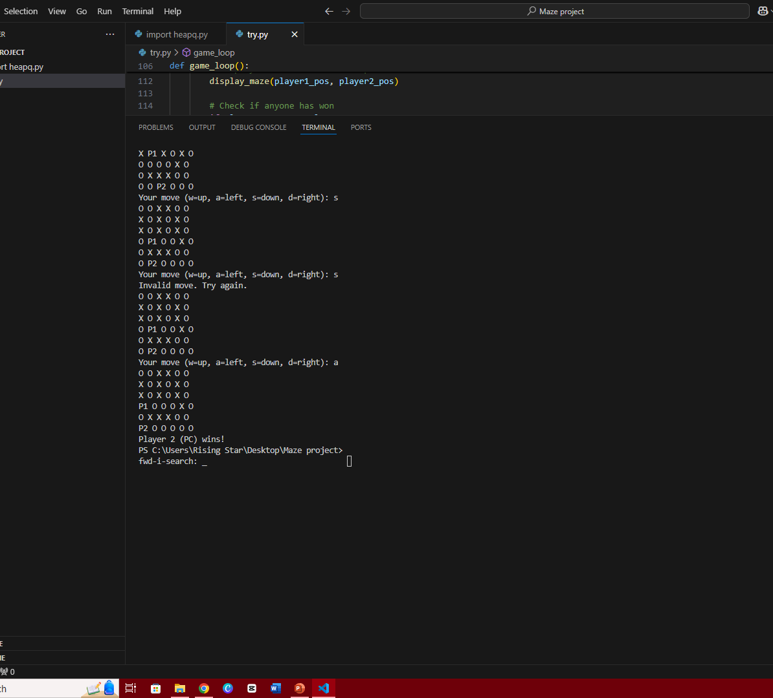
Results
Player 2 (PC) successfully reached the goal using the A* algorithm, while Player 1's moves were not fast enough.

Slide 8
Conclusion
Created a two-player maze-solving game pitting AI against humans.
The shortest path was efficiently found by the A* method.
Learning Outcome:
AI game design and adversarial search applied practically.
Learned from basics to advance of python

