Slide 1
Traffic light control system Submitted to: Sir Muhammad Arif Group Members: Hamza Jadoon (FA22-BCE-012) Ahad Abbasi(FA22-BCE-004) Fizza Razzaq(FA22-BCE-100)
Project Presentation Led’s Rhythm Light Submitted to: Dr Ahmad Fayaz Group Members: Bilal Rehman (FA22-BCE-007) Saifullah Iftikhar (FA22-BCE-022) Abdul Waseh (F22-BCE-025)

Slide 2
Introduction: Introduction: In this Project, we are going to show you how to make traffic light system with the help of 2 timer ICs used to set the led‘s on and off timings. This controlled flow of traffic enhances road safety, minimizes congestion, and facilitates the efficient movement of vehicles through intersections.

Slide 3
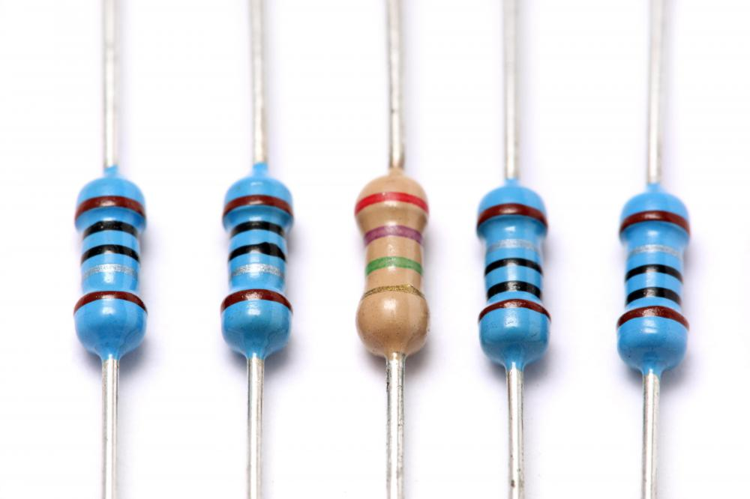
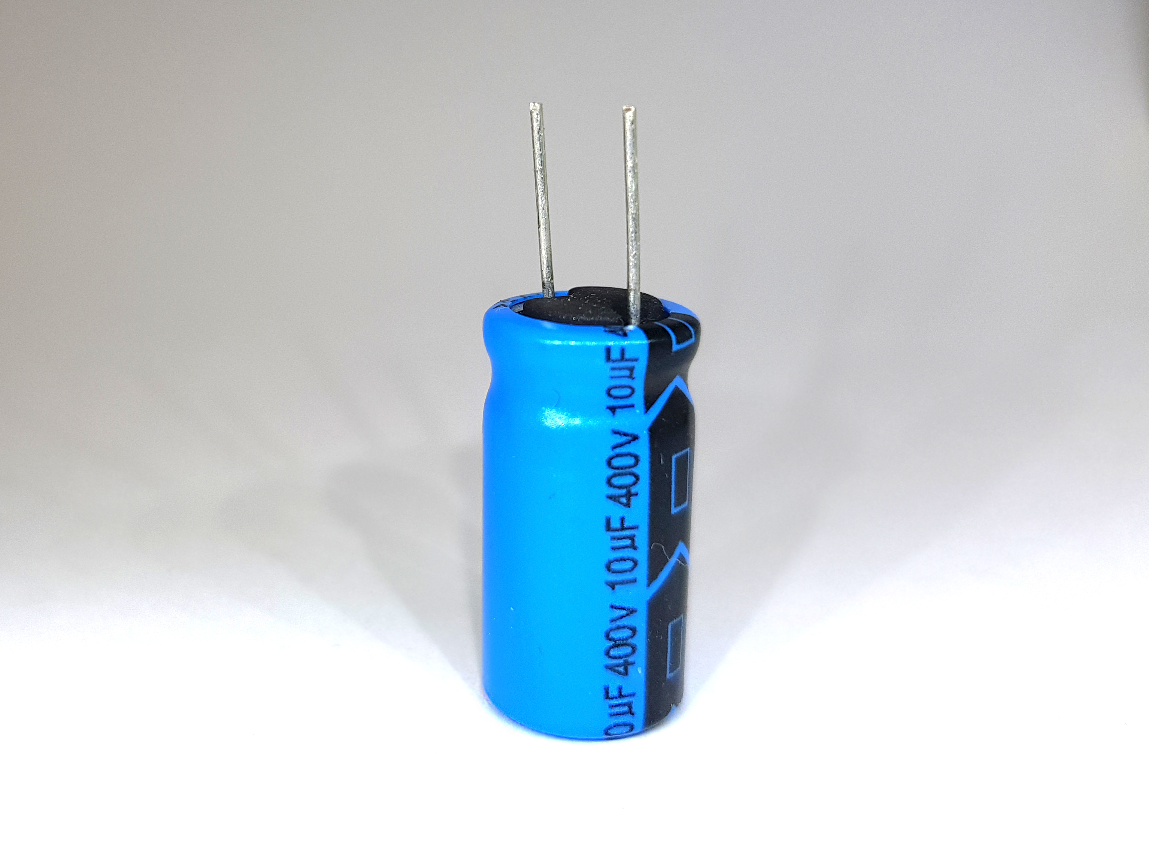
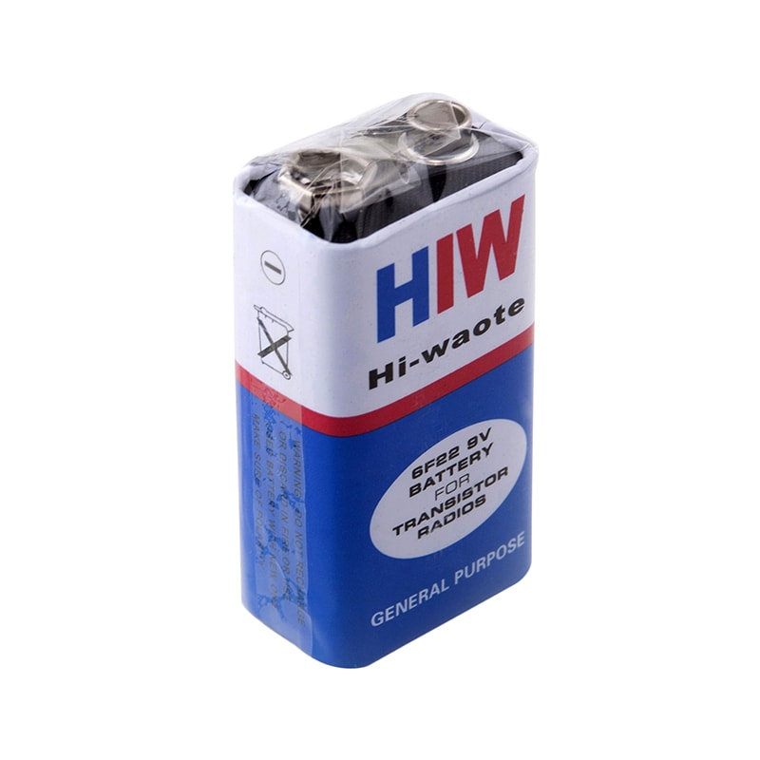
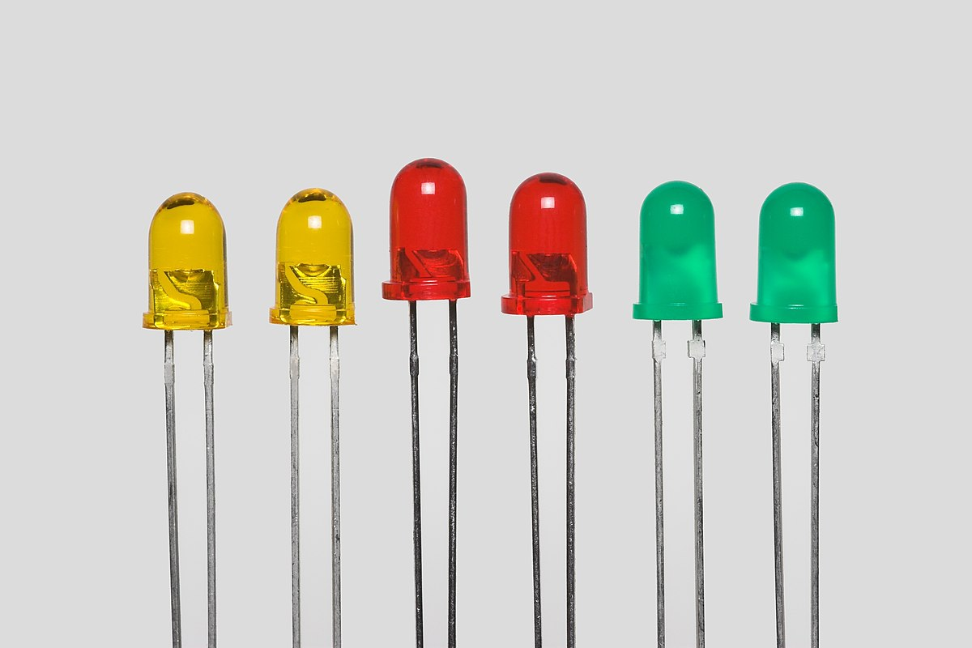
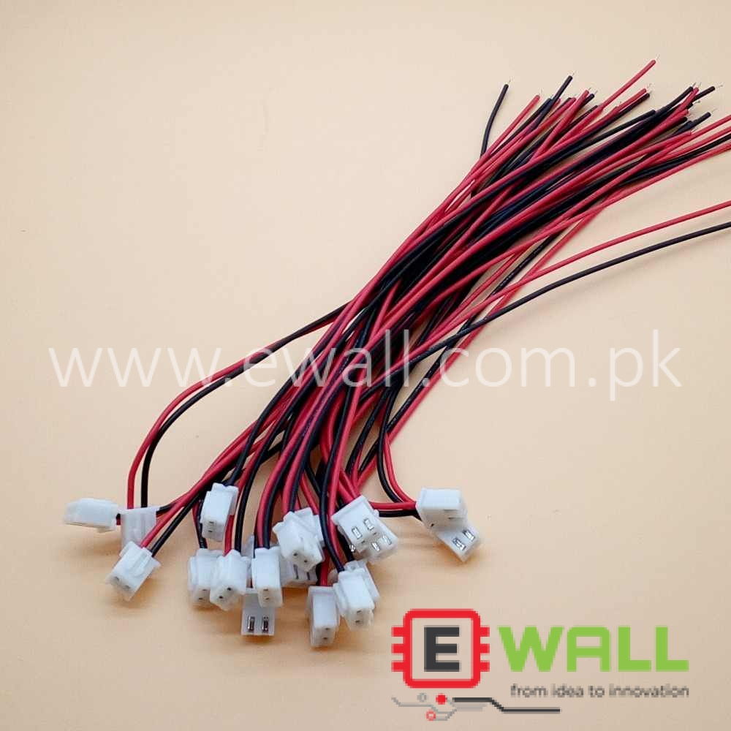
Components:
555 Timer IC x 2
100 microF Capacitor x 2
100k ohm Resistor
47k ohm Resistor
390 ohm Resistor x 2
330 ohm Resistor
Breadboard
Connecting Wires

Slide 4
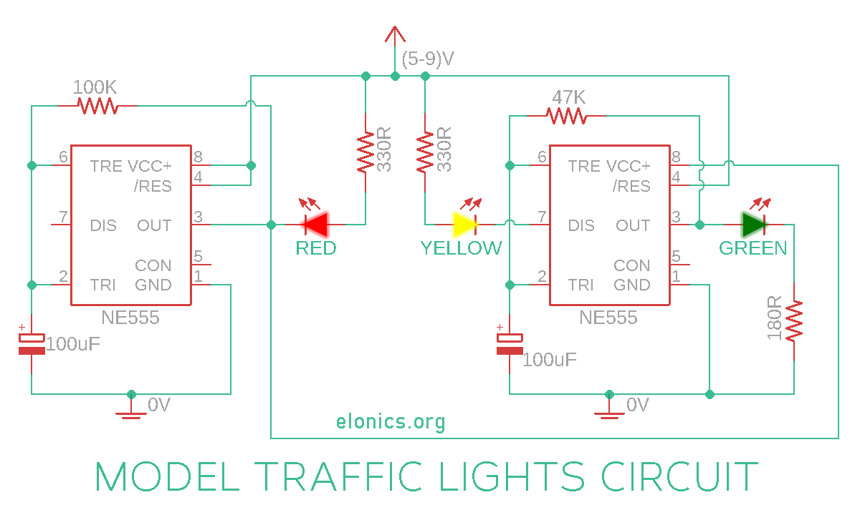
Circuit Diagram:

Slide 5
Importance:
Safety Improvement:
Traffic control systems play a fundamental role in preventing accidents and minimizing the risk of collisions at intersections. By providing clear and standardized signals to drivers and pedestrians, these systems help regulate the movement of vehicles and pedestrians, reducing the likelihood of accidents and enhancing overall road safety.
Traffic Flow Optimization:
Efficient traffic control systems contribute to the smooth and organized flow of traffic

Slide 6
Conclusion:
In conclusion, the traffic light system provides a vital framework for ensuring the safety and efficiency of vehicular and pedestrian movement.

