Slide 1

Group members Muhammad Hamza Mahmood_18F0421 Muhammad Abubakar_18F-0151 Zurriat Naveed_18F-0221
Supervisor: Ms. Anmol Bilal
Co-Supervisor(s): Dr. Uzair Iqbal

Slide 2

Project Name/Title:
Cat selling system based on Image Processing
Team/Company Name:
CodeX

Slide 3
Outline (FYP Report v 1.0)
Introduction
Use Case Diagram
Activity Diagram
Sequence Diagram
Domain Model
Class Diagram
High Level/Architecture/Block Diagram

Slide 4
Project Introduction
Explain in three ,four lines
LittlePaws is a web-based application where users can buy or sell their cats. It will contain all the regular features that an e-commerce website has, like Add to cart, ratings, transactions, etc. The unique feature of this website is that the buyer can perform value-based search as well as image-based search. It will be done using image processing techniques.
For this purpose, the buyer will have to upload the image of the cat, to find the desired cat. The system will process that image and the results will be shown to the user.It will reduce the human effort and it will save the time of the buyer.

Slide 5
Motivation
The motivation behind this project is to create easiness for the cat buyers. And help a newly obsessed cat lover, who doesn’t have any prior knowledge about the cats; to find his/her desired cat.
Through this technology, the trend of buying cats will also increase. It will be an easy source of income for too many people.

Slide 6
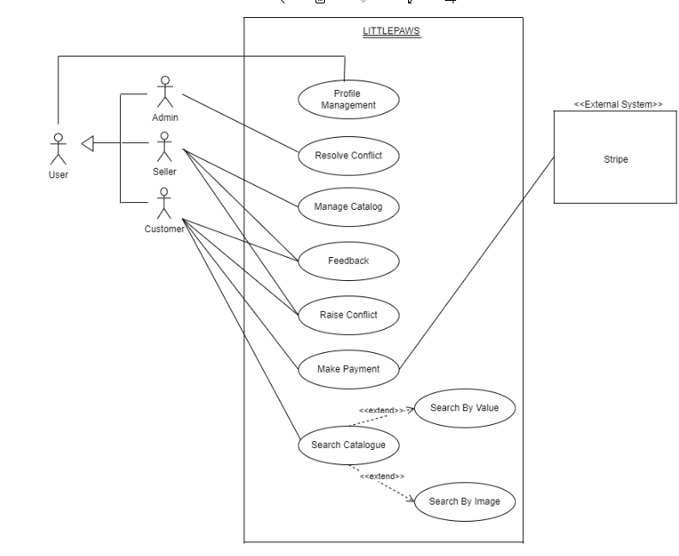
Use Case Diagram

Slide 7
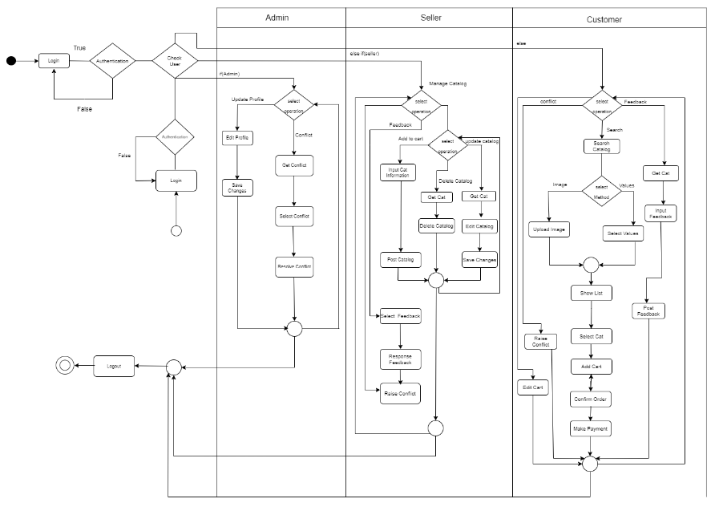
Activity Diagram

Slide 8
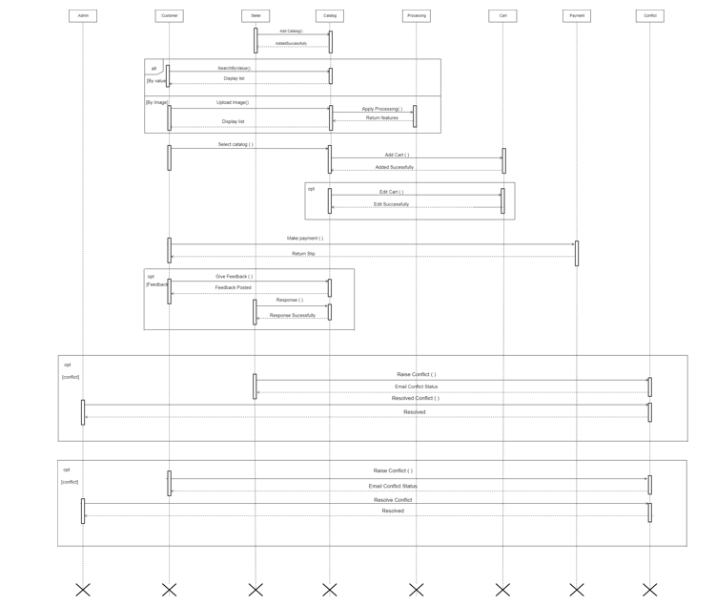
Sequence Diagram

Slide 9
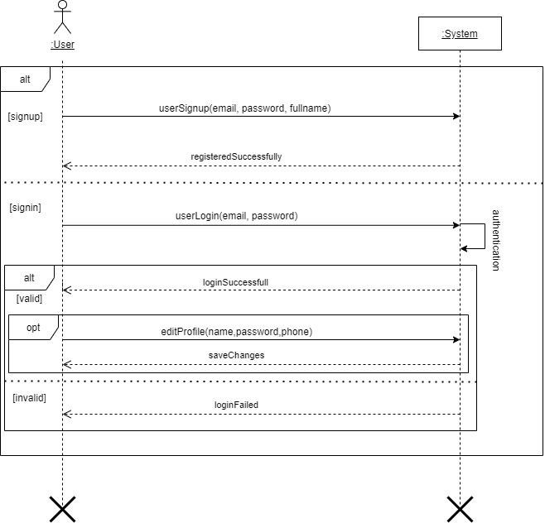
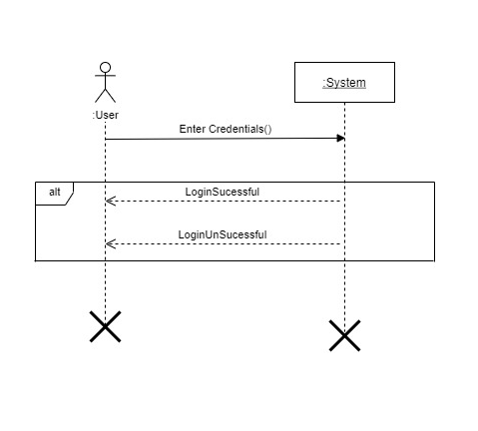
System Sequence Diagram
Login Manage Account

Slide 10
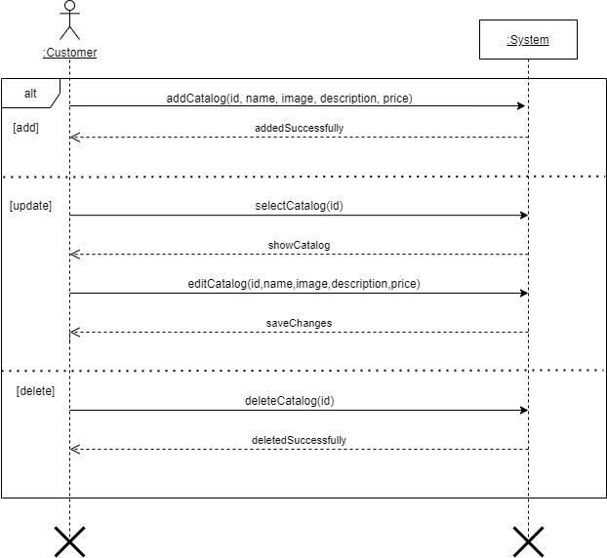
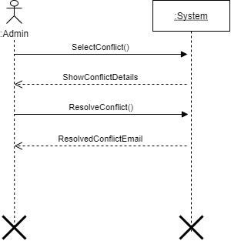
System Sequence Diagram
Resolve Conflict Manage Catalog

Slide 11
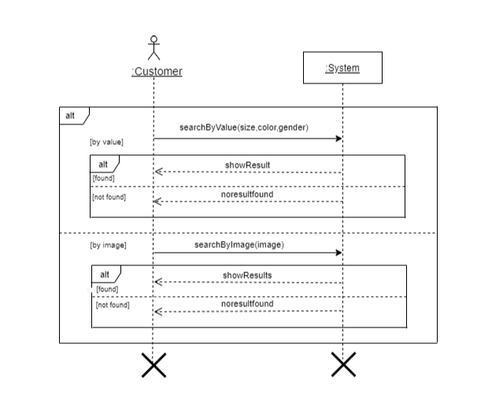
System Sequence Diagram
Search Catalogue

Slide 12
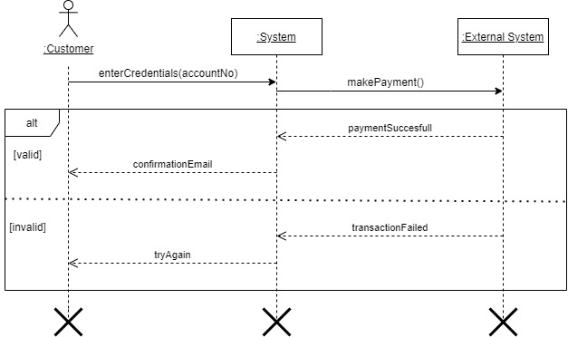
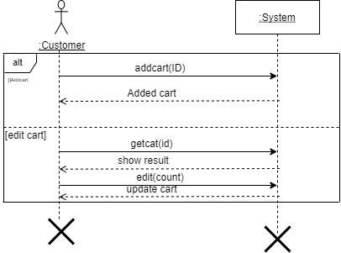
System Sequence Diagram
Make Payment Manage Cart

Slide 13
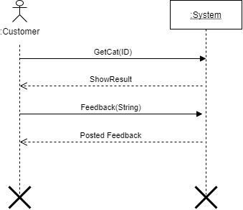
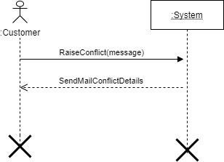
System Sequence Diagram
Give Feedback Raise Conflict

Slide 14
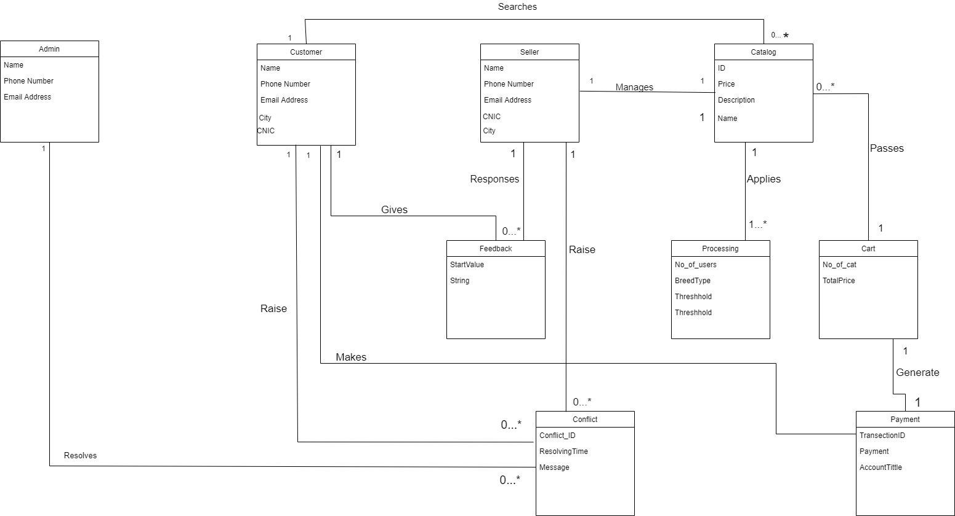
Domain Model

Slide 15
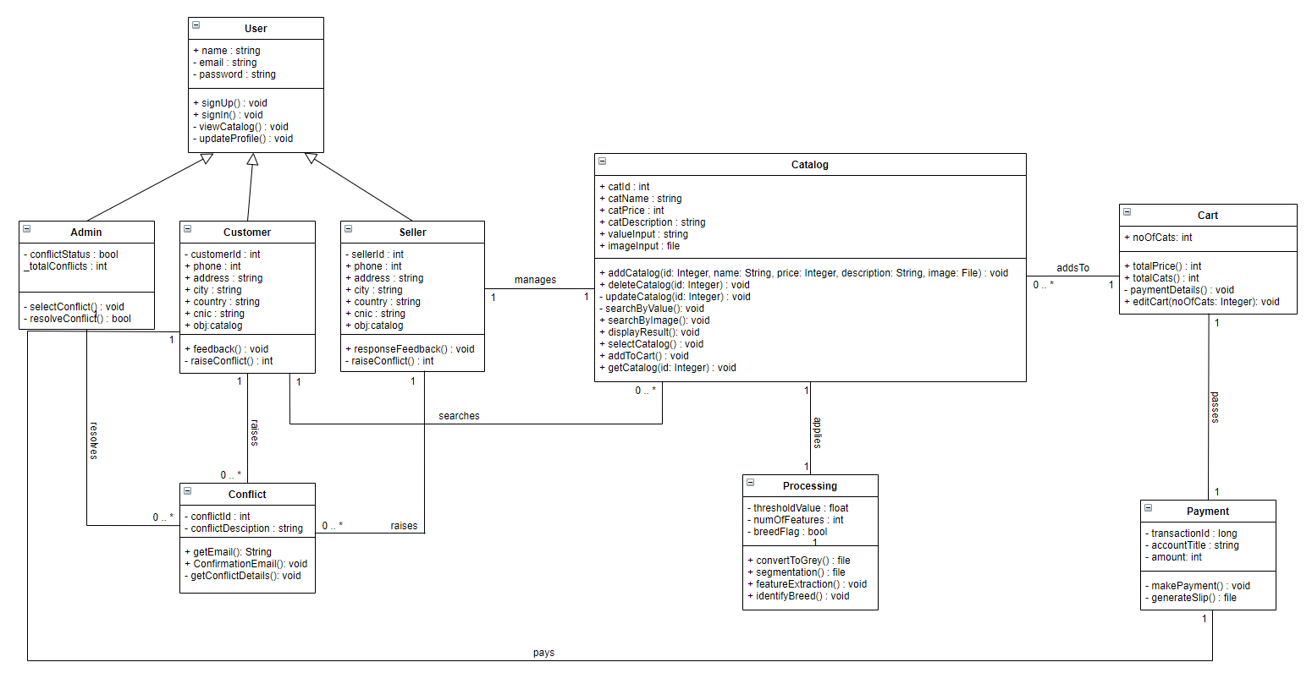
Class diagram

Slide 16
Thank You

