Slide 1
JUKEBOX

Slide 2
Features:
We can listen songs or podcasts
It contains songs as well as podcasts
We can play, pause, resume or restart the songs
Create account
Create playlist
Add songs or podcast in playlist
Search songs/podcast and sort songs
View the playlist

Slide 3
Tools Used :
Database : MySql
Backend : Language - Java
Interface
Inheritance
Dao pattern
Custom exceptions
Pojo class
Junit testing
Collection
Java 8 features

Slide 4
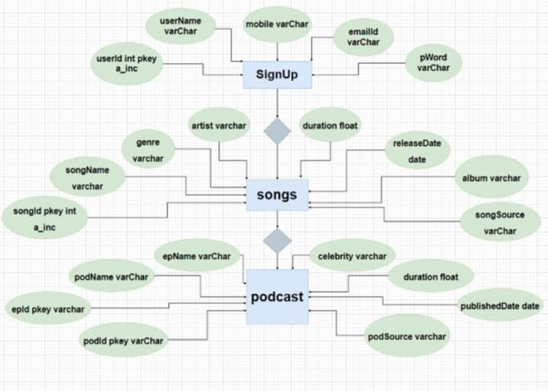

Slide 5
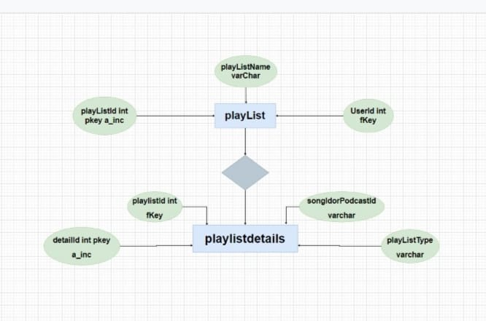

Slide 6
Future Scope :
User will be able to insert songs/podcasts from application itself in database
We can connect backend with the frontend

Slide 7
THANK YOU

