Slide 1

GYM MANAGEMENT SYSTEM
Fast-N-Fitness

Slide 2
HAMZA AMJAD (205333)

Slide 3
OBJECTIVE:
This Gym Management System shall enable the user to add members to a gym . It is a very simple interface developed using . The user of the system shall be able to add a new gym member. The tool shall add all the necessary details like name, Gender, Birthdate, and size in centimeter into the system. Then a new ID will be created. The Gym Management System shall also monitor the timings for the member. This tool shall hold all the details of gym members.

Slide 4
PROPOSED SYSTEM:
This Gym Management System tool is basically developed to aid the user to add a member to the gym. The user shall be able to add the name, date of birth, gender and their size in centimeter which is optional. It also records the height and weight, BMI, FFMI, bodybuilding, cardio, exercises, graphs, history, weight track, body track, data of the member. It stores the photo of the user, it also include the stope watch. It shall also enable the user to update information of members. This tool uses MP Android chart, Java code, XML code for UI, Millisecond-chronometer, Circular image view, Material button and TextInputLayout, smart Tab Layout, Flat icons, image cropper etc. It secures the data of each user.

Slide 5
ADVANTAGES:
No need to travel for gym, so it reduces time for you.
Users can go to settings and Enable the mp3 and can hear music of their choice, and he/she can also choose the first option that weather they want to measure their weight in kg or lbs.
Easy and simple interface so that anyone can understand.
User can create another profile or can delete the previous once.
Their data can be stored there.
Easy access.

Slide 6

DIRECTORIES:
In java class we had made the following directories and enter the specific code for specific function. Like
DAO.
Fonte.
Graph.
Intro.
Licenses.
Body Measures.

Slide 7

BODY MEASURES
In this Directory we have created 4 different java class. Namely.
BodyMeasuresCursorAdopter.
In which we used a cursor adaptor. A CursorAdapter makes it easy to use when the resource of a listview is coming from database and you can have more control over the binding of data values to layout controls. In the newView() method, you simply inflate the view and return it. In the bindView() method, you set the elements of your view.
For that we have a created a class called cursor Adapter.
public class MyCursorAdapter extends CursorAdapter { // Default constructor public MyCursorAdapter(Context context, Cursor cursor, int flags) { ... } public void bindView(View view, Context context, Cursor cursor) { ... } public View newView(Context context, Cursor cursor, ViewGroup parent) { ... return null; } }

Slide 8
BODYPARTDETAILFRAGMENT:
In this we have created a extend of Fragment.
Android Fragment is the part of activity, it is also known as sub-activity. There can be more than one fragment in an activity. Fragments represent multiple screen inside one activity.
package example.javatpoint.com.fragmentexample;
import android.os.Bundle;
import android.support.v4.app.Fragment;
import android.view.LayoutInflater;
import android.view.View;
import android.view.ViewGroup;
public class Fragment1 extends Fragment {
@Override
public void onCreate(Bundle savedInstanceState) {
super.onCreate(savedInstanceState);
}
@Override
public View onCreateView(LayoutInflater inflater, ViewGroup container,
Bundle savedInstanceState) {
// Inflate the layout for this fragment
return inflater.inflate(R.layout.fragment_fragment1, container, false);
}
}

Slide 9
BODYPARTDETAILFRAGMENT:
No. | Method | Description
1) | onAttach(Activity) | it is called only once when it is attached with activity.
2) | onCreate(Bundle) | It is used to initialize the fragment.
3) | onCreateView(LayoutInflater, ViewGroup, Bundle) | creates and returns view hierarchy.
4) | onActivityCreated(Bundle) | It is invoked after the completion of onCreate() method.
5) | onViewStateRestored(Bundle) | It provides information to the fragment that all the saved state of fragment view hierarchy has been restored.
6) | onStart() | makes the fragment visible.
7) | onResume() | makes the fragment interactive.
8) | onPause() | is called when fragment is no longer interactive.
9) | onStop() | is called when fragment is no longer visible.
10) | onDestroyView() | allows the fragment to clean up resources.
11) | onDestroy() | allows the fragment to do final clean up of fragment state.
12) | onDetach() | It is called immediately prior to the fragment no longer being associated with its activity.

Slide 10
ARRAYADAPTER:
The Adapter acts as a bridge between the UI Component and the Data Source. It converts data from the data sources into view items that can be displayed into the UI Component. Data Source can be Arrays, HashMap, Database, etc. and UI Components can be ListView, GridView, Spinner, etc. ArrayAdapter is the most commonly used adapter in android. When you have a list of single type items which are stored in an array you can use ArrayAdapter. Likewise, if you have a list of phone numbers, names, or cities. ArrayAdapter has a layout with a single TextView. If you want to have a more complex layout instead of ArrayAdapter use CustomArrayAdapter. The basic syntax for ArrayAdapter is given as:
public ArrayAdapter(Context context, int resource, int textViewResourceId, T[] objects)

Slide 11
Parameters | Description
context | The current context. This value can not be null.
resource | The resource ID for the layout file containing a layout to use when instantiating views.
textViewResourceId | The id of the TextView within the layout resource to be populated.
objects | The objects to represent in the ListView. This value cannot be null.

Slide 12
import android.os.Bundle; import android.widget.ArrayAdapter; import android.widget.ListView; import androidx.appcompat.app.AppCompatActivity; public class MainActivity extends AppCompatActivity { ListView simpleListView; // array objects String courseList[] = {"C-Programming", "Data Structure", "Database", "Python", "Java", "Operating System", "Compiler Design", "Android Development"}; @Override protected void onCreate(Bundle savedInstanceState) { super.onCreate(savedInstanceState); setContentView(R.layout.activity_main); simpleListView = (ListView) findViewById(R.id.simpleListView); ArrayAdapter<String> arrayAdapter = new ArrayAdapter<String>(this, R.layout.item_view, R.id.itemTextView, courseList); simpleListView.setAdapter(arrayAdapter); } }

Slide 13
DAO
In DAO directory I have created another directory or java classes.
Body measures.
In this directory further I have created three java classes
BodyMeasure:
In which I set the (getters and setters) for
long id; Date mDate; int mBodypart_id; float mMeasure; long mProfil_id;

Slide 14
BodyPart:
public static final int ABDOMINAUX = 0; public static final int ADDUCTEURS = 1; public static final int BICEPS = 2; public static final int TRICEPS = 3; public static final int DELTOIDS = 4; public static final int MOLLETS = 5; public static final int PECTORAUX = 6; public static final int DORSEAUX = 7; public static final int QUADRICEPS = 8; public static final int ISCHIOJAMBIERS = 9; public static final int LEFTARM = 10; public static final int RIGHTARM = 11; public static final int LEFTTHIGH = 12; public static final int RIGHTTHIGH = 13; public static final int LEFTCALVES = 14; public static final int RIGHTCALVES = 15; public static final int WAIST = 16; public static final int NECK = 17; public static final int BEHIND = 18; public static final int WEIGHT = 19; public static final int FAT = 20; public static final int BONES = 21; public static final int WATER = 22; public static final int MUSCLES = 23; private int id; // Notez que l'identifiant est un long private BodyMeasure mLastMeasure;
And then here also (setter and getters) are used and also the switch method is used for different cases like biceps,triceps, Adductuers etc.

Slide 15
DAOBODYMEASURE:
public static final String TABLE_NAME = "EFbodymeasures"; public static final String KEY = "_id"; public static final String BODYPART_KEY = "bodypart_id"; public static final String MEASURE = "mesure"; public static final String DATE = "date"; public static final String UNIT = "unit"; public static final String PROFIL_KEY = "profil_id";
And then we have used the SQLite Database in which we store data of profile, measurements, date, units etc.

Slide 16
FONTE
In this Directory I have further makes java classes, those are:-
FonteCursorAdapter
FonteGraphFragment
FonteHistoryFragment
FontesFragment
FontesPageFragment
FonteViewPagerAdapter
MachineArrayAdapter
RecordCursorAdopter

Slide 17
GRAPH
CustomMarkerView:
In this class I have used extends MarkerView in which we builed the:
private TextView tvContent; private TextView tvDate; private DecimalFormat mFormat = new DecimalFormat("#.##"); private LineChart lineChart = null;
I have intention on looking for a specific point in a line chart of MPAndroidChart and then display the the marker to highlight the point after a button is hit. The example given is where the marker is only displayed after touching event which is different in my case. I tried code below but to no avail, can some one please teach me I would appreciate.
Graph

Slide 18
public class YourMarkerView extends MarkerView {
private TextView tvContent;
public MyMarkerView(Context context, int layoutResource) {
super(context, layoutResource);
tvContent = (TextView) findViewById(R.id.tvContent);
}
@Override
public void refreshContent(Entry e, Highlight highlight) {
tvContent.setText("" + e.getY());
super.refreshContent(e, highlight);
}
private MPPointF mOffset;
@Override
public MPPointF getOffset() {
if(mOffset == null) {
// center the marker horizontally and vertically
mOffset = new MPPointF(-(getWidth() / 2), -getHeight());
}
return mOffset;
}
}
Graph

Slide 19
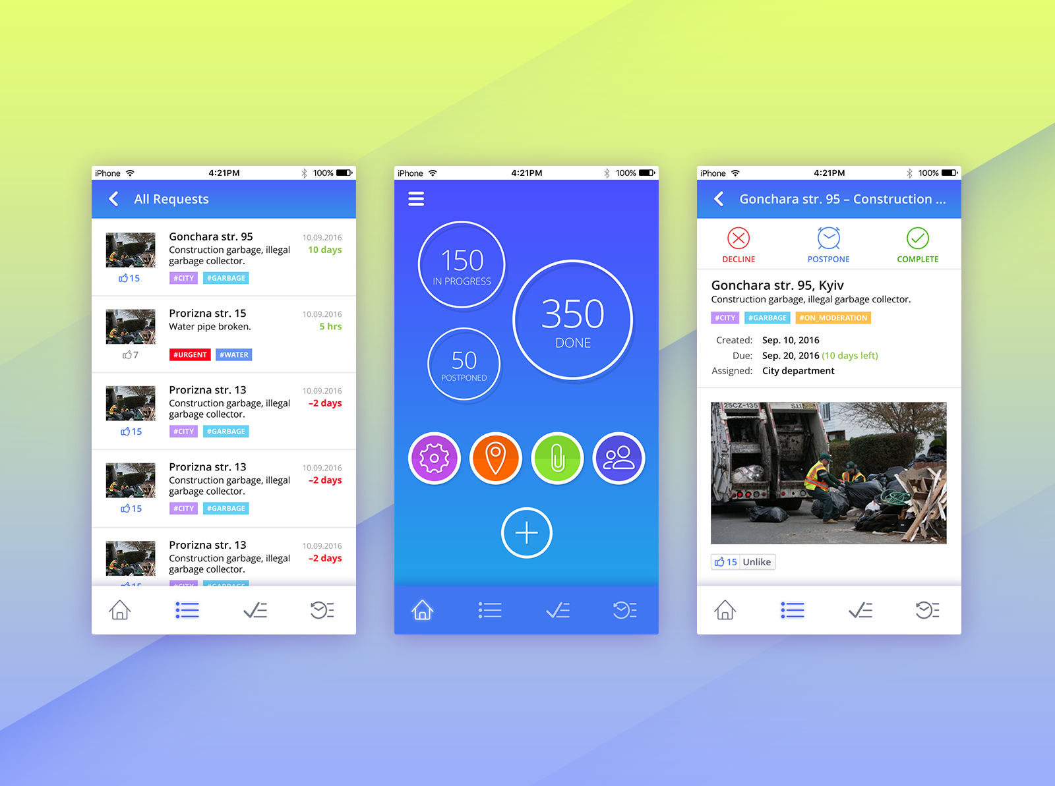
INTRO
MainIntroActivity
NewProfileFragment

Slide 20
LICENCE
private static final long serialVersionUID = 5165684351346813168L; private String mLicenseName = ""; private String mLicenseURL = ""; public CustomLicense(String pName, String pURL) { mLicenseName = pName; mLicenseURL = pURL; }
Further I have used (setter and getter) i-e setName,getName,url.

Slide 21
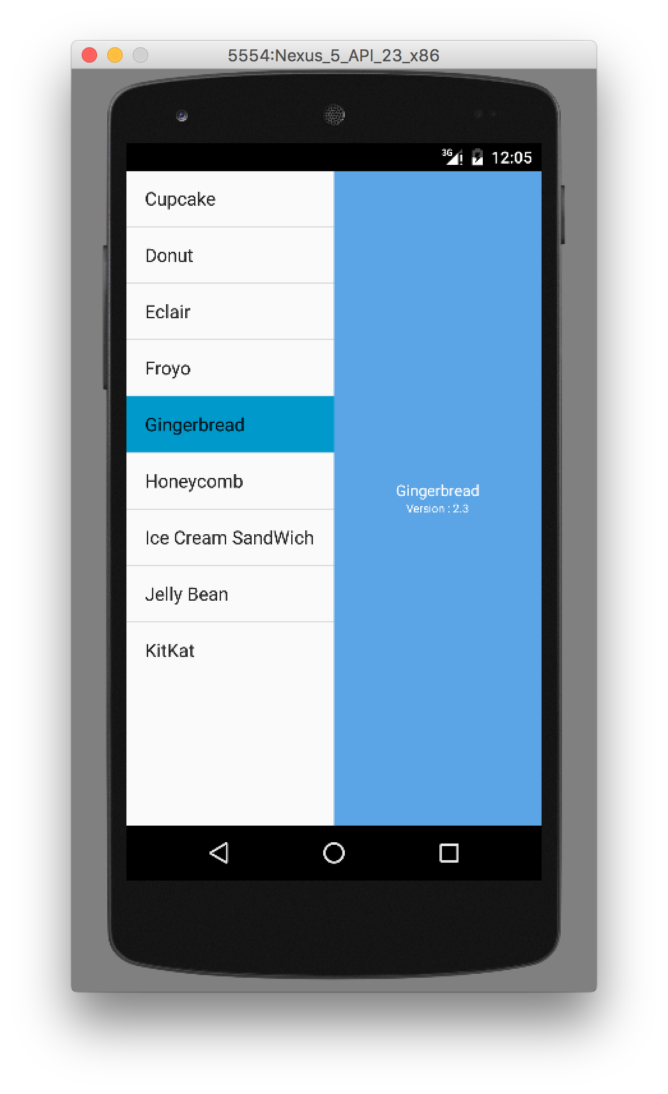
MACHINE
EexrciseDetailsPager.
MachineArrayFullAdapter
MachineCursorAdapter.
MachineDetailFragment.
MachineFragment.

Slide 22
EDITABLEINPUTLAYOUT
EditableInputView
EditableInputViewWithDate
import java.util.Calendar; /** * A simple {@link Fragment} subclass. */ public class TestFragment extends Fragment implements View.OnClickListener{ private ImageView calendarOne_ime; Context context; public static TextView tv_dateone;

Slide 23
public TestFragment() { } @Override public View onCreateView(LayoutInflater inflater, ViewGroup container, Bundle savedInstanceState) { View rootview = inflater.inflate(R.layout.fragment_payment, container, false); calendarOne_ime = (ImageView)rootview. findViewById(R.id.cone); tv_dateone = (TextView)rootview. findViewById(R.id.dateone_txt); calendarOne_ime.setOnClickListener(this); return rootview; } @Override public void onClick(View v) { switch (v.getId()) { case R.id.cone: android.support.v4.app.DialogFragment newFragment = new SelectDateFragment(); newFragment.show(getFragmentManager(), "DatePicker"); break; } } public static class SelectDateFragment extends android.support.v4.app.DialogFragment implements DatePickerDialog.OnDateSetListener { @Override public Dialog onCreateDialog(Bundle savedInstanceState) { final Calendar calendar = Calendar.getInstance(); int yy = calendar.get(Calendar.YEAR); int mm = calendar.get(Calendar.MONTH); int dd = calendar.get(Calendar.DAY_OF_MONTH); return new DatePickerDialog(getActivity(), this, yy, mm, dd); } public void onDateSet(DatePicker view, int yy, int mm, int dd) { populateSetDate(yy, mm+1, dd); } public void populateSetDate(int year, int month, int day) { tv_dateone.setText(month+"/"+day+"/"+year); }}} }

Slide 24

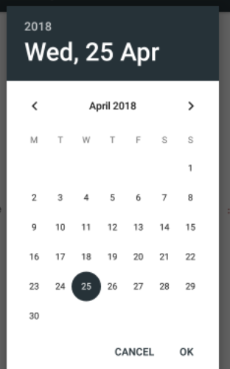
OUTPUT:

Slide 25
JAVA CLASSSES:
AlarmReciever.
CustomExceptionHandler.
DateConverter.
DirectoryChooserDialog.
ExitUtil.
ExpandedListView.
FileChooserDialog.
Gender.
ImageUtil.
Keyboard.
MusicController.
RealPathUtil.

Slide 26
UnitConverter.
AboutFragment.
CardioCursorAdapter.
CardioFragment.
ChronoDialogBox.
CountdownDialogBox.
CustomDrawerAdapter.
DateGraphData.
DatePickerDialogFragment.
DrawerItem.
MainActivity.
NumberPickerDialogBox.
ProfileFragment.
ProfileWeightCursoeAdapter

Slide 27
SettingFragment.
SpinnerItem.
TimePickerDialogFragment.
WeightCursorAdapter.
WeightFragment.

Slide 28
OUTPUT:

Slide 29
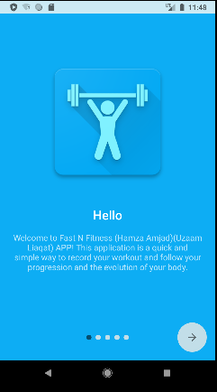
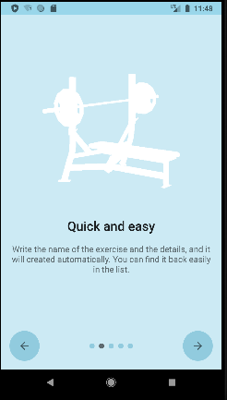
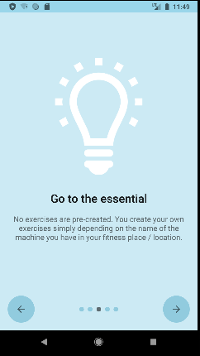

Slide 30
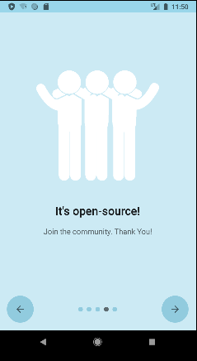
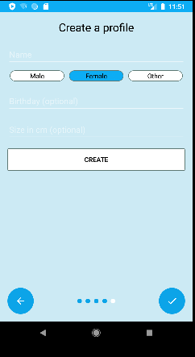
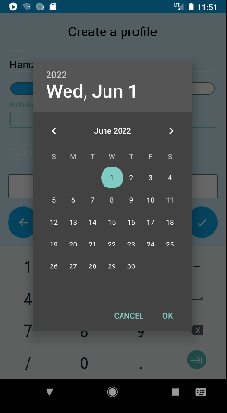

Slide 31
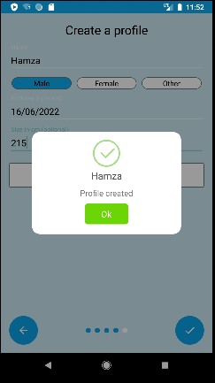
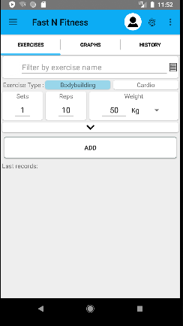
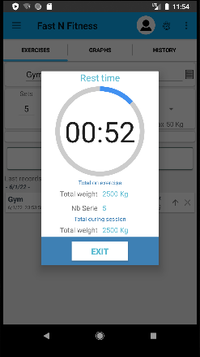

Slide 32
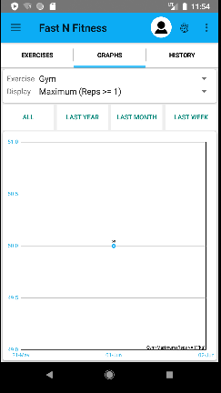
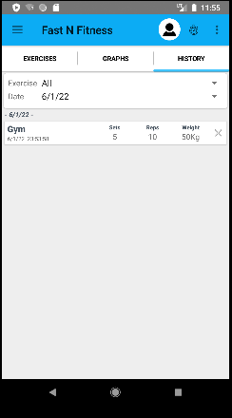
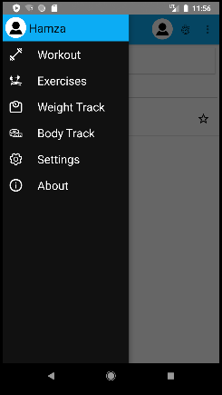

Slide 33
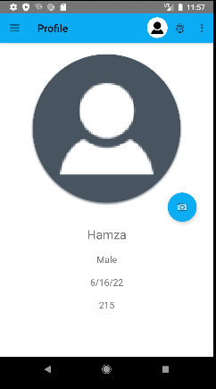
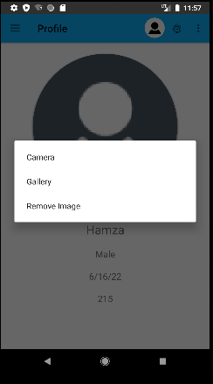
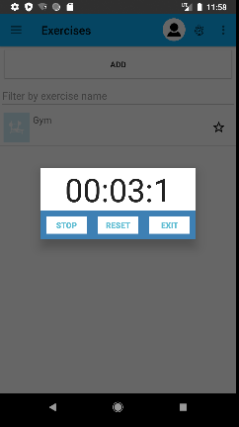

Slide 34
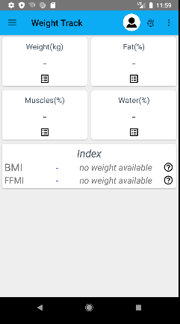
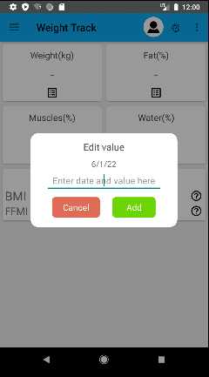
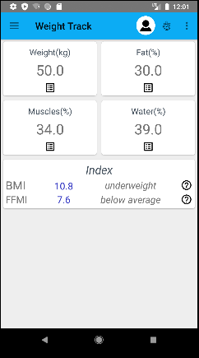

Slide 35
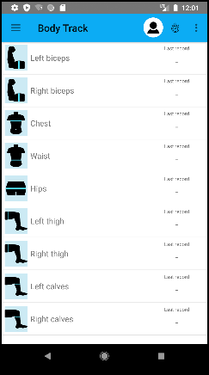
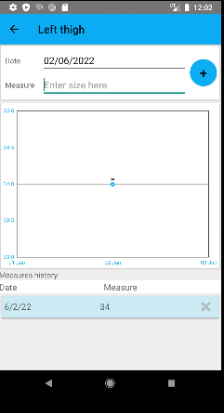
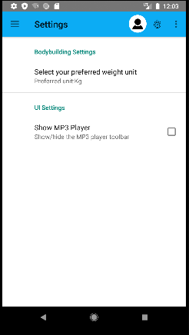

Slide 36
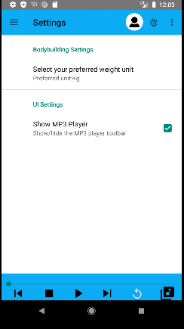
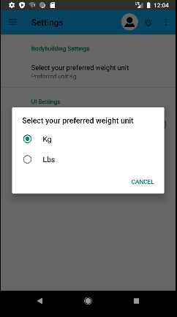
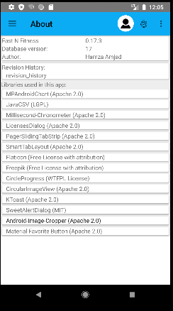

Slide 37
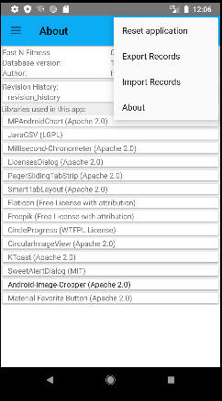
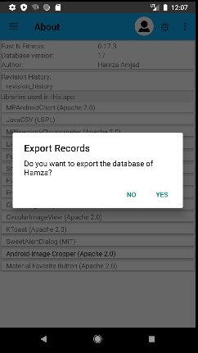
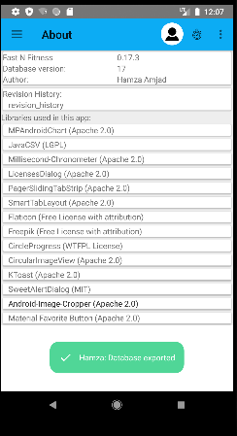

Slide 38
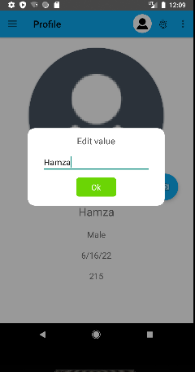
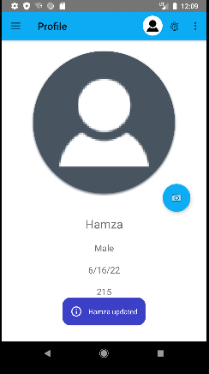
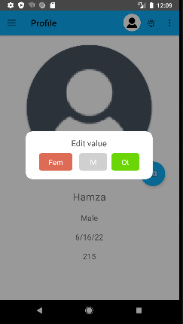

Slide 39
