Slide 1


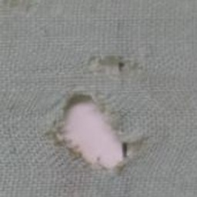
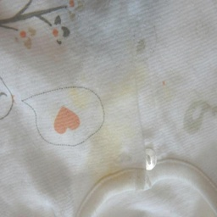
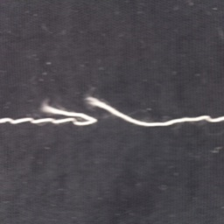
FabricScan AI
Deep Learning semester project
Good
Hole
AI-based fabric defect detection with an automatic inspection report
Hamza
Superior University, Gold Campus · Instructor: Dr. Munir Ahmed
fabricscan-ai.vercel.app
Stain
Broken thread
Notes:
Assalam-o-Alaikum. My name is Hamza, and this is my Deep Learning semester project at Superior University, Gold Campus, under the supervision of Dr. Munir Ahmed. The project is called FabricScan AI. It looks at a photo of a fabric or a garment, finds defects, and writes an inspection report automatically.

Slide 2
Fabric is still inspected by eye
Slow
GOAL
1
An inspector checks every metre of fabric by hand.
A phone photo in.
Defect type, location, severity and an inspection note out.
Inconsistent
2
Results change with fatigue and from one inspector to the next.
Costly
In seconds, on any device, without uploading the photo.
3
Defects that slip through return as complaints, rework and waste.
Notes:
In the textile industry, fabric is still mostly inspected by eye. It is slow, it is tiring, and the result depends on the inspector. Defects that slip through come back as complaints and waste. My goal was simple: a phone photo goes in, and the defect type, its location, its severity and an inspection note come out, in seconds.

Slide 3
From photo to inspection report
1
2
3
4
5
Photo
Classify
Locate
Grade
Report
Upload, camera or a sample image
MobileNetV2 scores the four classes
Activation map plus colour contrast
Area, severity, causes and action
Copy, or download PDF / PNG
Runs entirely in the browser. The trained model is exported to ONNX and executed with ONNX Runtime Web, so the photo never leaves the device and no server is needed.
Notes:
Here is how it works. You upload a photo, use the camera, or pick a sample. A neural network sorts the image into one of four classes: good, hole, stain or broken thread. Its activation map shows where the defect is. From that, the app estimates the affected area and the severity, adds likely causes and a recommended action, and creates a report you can copy or download as PDF or PNG. Everything runs inside the browser, so no photo is uploaded anywhere.

Slide 4

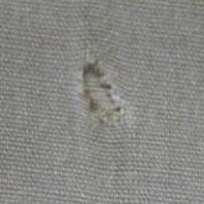
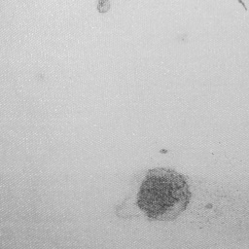
1,025 images, four classes, five public datasets
Good
Hole
Kaggle sources: Fabric Defect (without augmentation) (CC BY 4.0) · Clothes Stain/Defect Detection (CC BY 4.0) · Fabric Defects Dataset (CC BY 4.0) · StitchingNet (CC BY-NC 4.0) · People Clothing Segmentation (CC0)
Stain
Broken thread
Notes:
The dataset has 1,025 images in four classes. They come from five public Kaggle datasets: close-ups of woven and knitted fabric, garment seams, stained clothes, and clean clothes as people wear them. The origin and licence of every image is recorded, and the whole cleaned dataset can be downloaded from the website as one ZIP file.

Slide 5
From raw downloads to a clean, leak-free split
1
2
3
4
Import
Clean
Split
Augment
Defect boxes cut into square close-ups; clean garments cropped with clothing masks.
Corrupt, tiny and duplicate images removed (53); square 256 px, EXIF stripped.
70 / 15 / 15 by source image, then a leakage audit across the splits.
Rotation, zoom, flips, 90° turns, brightness, contrast and noise. No hue changes.
715
155
155
training images
validation images
test images (never trained on)
Notes:
To prepare the data, labelled defect boxes were cut into square close-ups, so the defect stays visible at the model's input size. A cleaning step then removed corrupt, very small and duplicate images, 53 in total. The images were split into 70, 15 and 15 percent by their source image, so no near-copy appears in both training and test, and a leakage audit checks this. During training I used augmentation: small rotations, zoom, flips, brightness, contrast and noise.

Slide 6

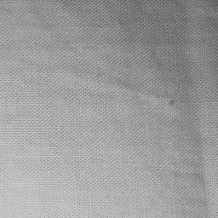
Testing exposed two shortcuts, fixed in the data
Shortcut 1
Shortcut 2
FIELD TEST
“A photo of a shirt = stain”
“Plain grey cotton = stain”
92 %
Every worn-garment photo in the data was a stain, so a clean checked shirt scored over 99 % stain.
Grey stain photos came from one camera, so 60 of 70 clean grey cotton photos were called stain.
of 150 clean worn garments the model had never seen are now classified as Good.
Fix: clean worn garments and clean clothes added to Good.
Fix: all plain grey cotton photos from that camera added to Good.
Notes:
Testing with my own phone camera exposed a real problem. A clean checked shirt was classified as a stain with more than 99 percent confidence. The model had learned a shortcut: in the data, every photo of a worn garment was a stain, and plain grey cotton appeared mostly in the stain class. I fixed this in the data, by adding clean worn garments and plain grey cotton to the good class. Now, on 150 photos of clean worn garments that the model has never seen, 92 percent are classified as good.

Slide 7
Two models, trained on the same data
Custom CNN, from scratch
MobileNetV2, transfer learning
4 convolution stages: 32 → 64 → 128 → 256 filters
Batch normalisation, spatial dropout, L2 1e-5
Global max pooling → softmax over 4 classes
1.18 M parameters · Adam 1e-3 · up to 60 epochs
Backbone pre-trained on ImageNet
12 epochs with the backbone frozen (Adam 1e-3)
Top 40 layers fine-tuned (Adam 1e-5, BatchNorm frozen)
2.26 M parameters · global average pooling → softmax
Shared: 224 × 224 RGB input · class weights · same augmentation · early stopping on validation loss · batch 16 · seed 42 · TensorFlow 2.20 on a laptop CPU
Notes:
I compared two models on exactly the same data. The first is a custom convolutional network trained from scratch, with four convolution stages, batch normalisation, dropout and L2 regularisation. The second uses transfer learning: MobileNetV2, pre-trained on ImageNet. It is first trained with its base frozen, and then the top 40 layers are fine-tuned with a very small learning rate. Both models use class weights, early stopping and the same augmentation.

Slide 8
Transfer learning learns faster
Training time on a laptop CPU: Custom CNN 29 min, MobileNetV2 13 min (early stopping). MobileNetV2 is fine-tuned from epoch 13.
Notes:
These curves show the accuracy during training. MobileNetV2 learns much faster, because it starts from features learned on millions of images, and the fine-tuning phase gives it another boost. The custom network needs all 60 epochs and still ends lower. On my laptop CPU, the custom network trained for about 29 minutes, and MobileNetV2 for about 13.

Slide 9
MobileNetV2 is clearly the better model
81.3 %
test accuracy, MobileNetV2 (deployed)
0.82
macro F1 score
Custom CNN, for comparison
68.4 % accuracy · macro F1 0.69
Notes:
On the test set, 155 images that were never used for training, MobileNetV2 reaches 81.3 percent accuracy and a macro F1 score of 0.82. The custom network reaches 68.4 percent. That is why MobileNetV2 is the model that runs on the website.

Slide 10
Where the model is right and where it slips
True ↓ / Predicted → | Good | Hole | Stain | Broken thread
Good | 42 | 0 | 3 | 7
Hole | 0 | 24 | 0 | 2
Stain | 6 | 1 | 28 | 8
Broken thread | 1 | 1 | 0 | 32
Hole
F1 0.92: the easiest class
Stain
recall 0.65: faint stains taken for broken thread (8) or good (6)
Good
7 clean fabrics with seams or folds taken for broken thread
MobileNetV2 on the 155 test images. Diagonal = correct.
Notes:
The confusion matrix shows where the model is right and where it slips. Holes are recognised best, with an F1 score of 0.92. The hardest class is stain: some faint stains are taken for broken threads or for good fabric, and some clean fabrics with seams or folds are taken for broken threads. These are clear targets for the next version.

Slide 11
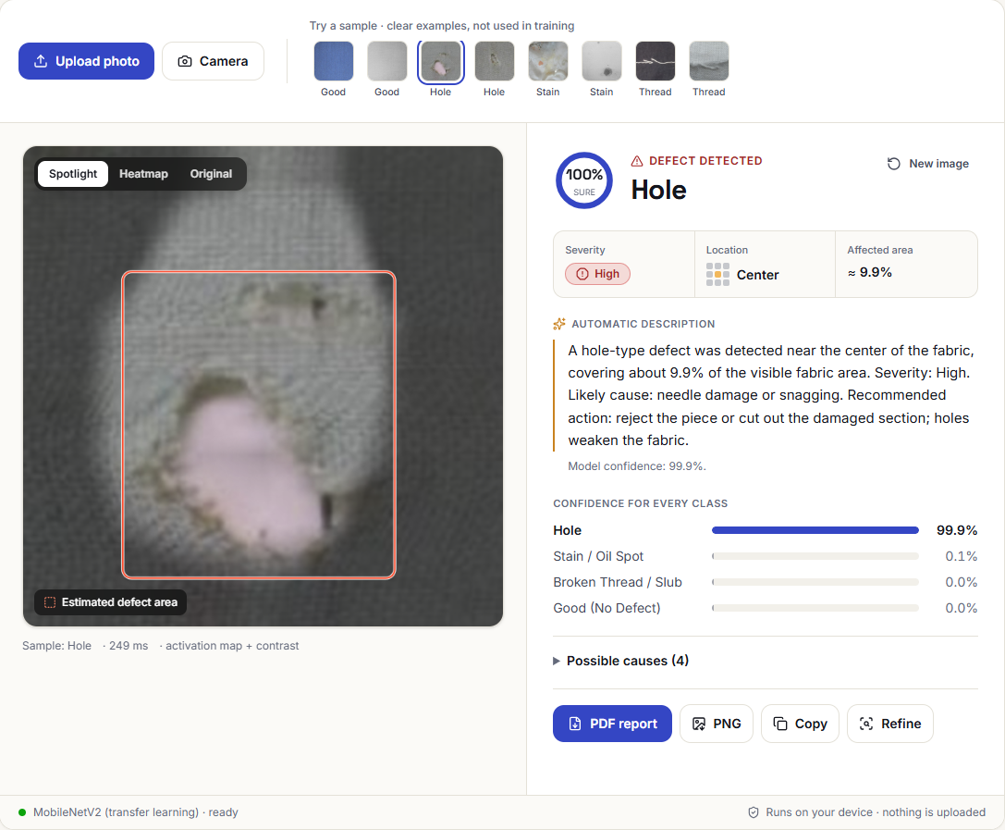
The web app: a photo in, an inspection report out
Upload a photo, use the camera or pick a sample
Class and confidence for all four classes
Location on a 3 × 3 grid, affected area and severity
Automatic description: likely causes and recommended action
Report as PDF, PNG or text
Runs on the device with ONNX Runtime Web: nothing is uploaded
fabricscan-ai.vercel.app
Notes:
This is the web app. After a photo is analysed, it shows the class with its confidence, the location on a three by three grid, the affected area and the severity, followed by an automatic description with likely causes and a recommended action. The report can be downloaded as a PDF or a PNG image.

Slide 12
Open, reproducible and ready for automatic testing
weights/
both models in ONNX and Keras, with metrics
$ pip install numpy pillow onnxruntime
$ python predict.py test_samples --eval
Accuracy: 0.8250 (33/40 images)
predict.py
one-command inference and evaluation
test_samples/
labelled test images for a quick check
Live: fabricscan-ai.vercel.app
Code: github.com/hamzaDeploys/fabricscan-ai
dataset ZIP
all images, train / val / test, SOURCES.csv
README
results, method and how to run everything
Notes:
The project is public on GitHub and deployed on Vercel. The repository contains the source code, the trained weights in ONNX and Keras format, the dataset, and a predict script. Anyone can test the model with one command, and the website links to the code, the dataset, the model, the report and this video.

Slide 13
Limitations and next steps
Limitations
Next steps
Only four classes: tears or colour bleeding are unknown to the model
Stain is the weakest class (recall 0.65)
Very different lighting or distance can mislead the model
Location and area are estimates from an activation map
More classes and own photos from real production
Segmentation masks for exact defect outlines
Longer fine-tuning at a higher resolution
A camera mode for continuous inspection on a line
Main lesson: a good test score is not enough. Early tests with real camera photos exposed shortcuts the test set hid.
Notes:
There are limitations. The model knows only four classes, so defects like tears or colour bleeding are outside what it has learned, and very different lighting or distance can mislead it. Next, I would add more classes and my own photos, use segmentation for exact defect outlines, and build a camera mode for production lines. The main lesson for me: a good test score is not enough. Testing early with real camera photos showed problems that the test set could not show.

Slide 14
Thank you
Try FabricScan AI yourself
Live website
fabricscan-ai.vercel.app
Code, dataset and model
github.com/hamzaDeploys/fabricscan-ai
Notes:
Thank you for watching. You can try FabricScan AI yourself at fabricscan-ai dot vercel dot app, and the full code, dataset and model are on GitHub under hamzaDeploys slash fabricscan-ai.

