Slide 1
Project
Details & Quotation

Slide 2
Scraping Details
Main Scraping Script
Filter Active Links
Filter MD Names
Scrape LinkedIn Links

Slide 3
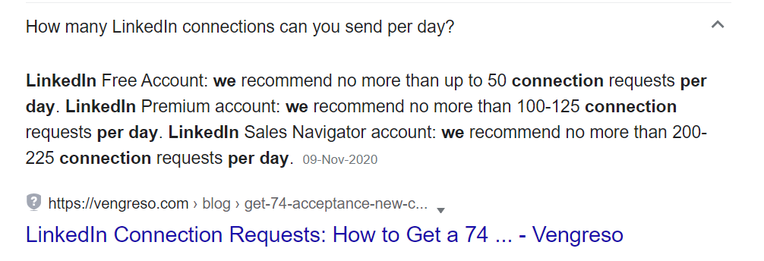
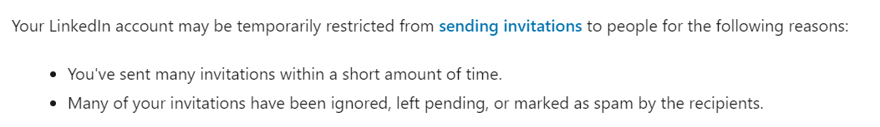
Adding Connections
Restrictions
Our Approach
Sending Invites with the time interval of at least 5 minutes.
Sending at most 20 connections per day.
Stop sending invites if the unanswered invitations reaches to the count of 40.
Still a risky approach and can get the account banned as LinkedIn has very strict policies

Slide 4
Project Details
GUI Interface
(Sample Attached)
Sraping (LinkedIn Links)
Connections (Adding To LinkedIn)

Slide 5
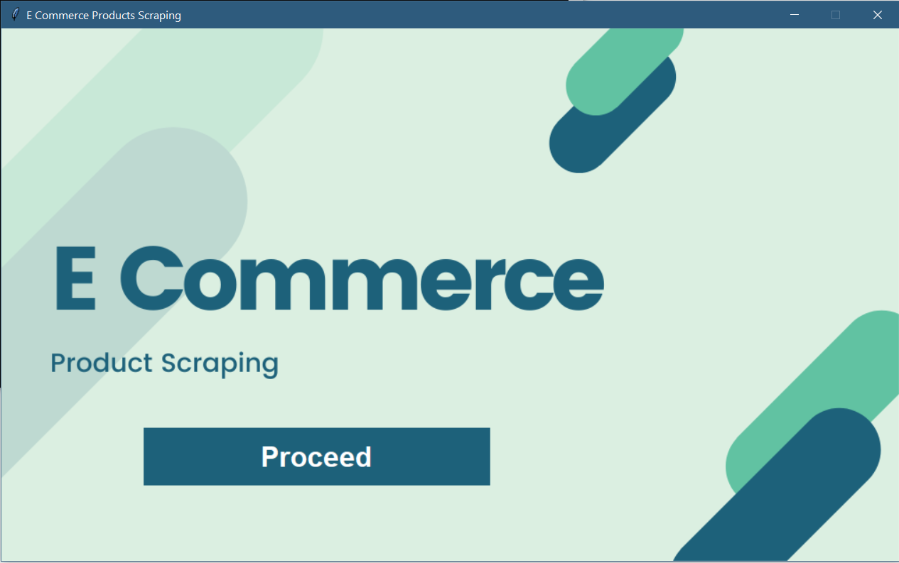
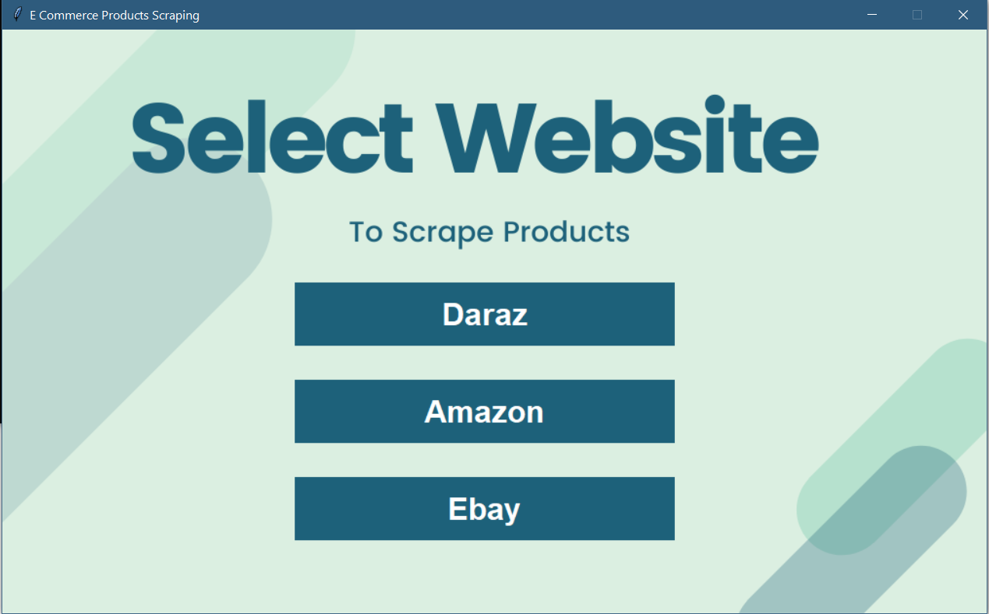
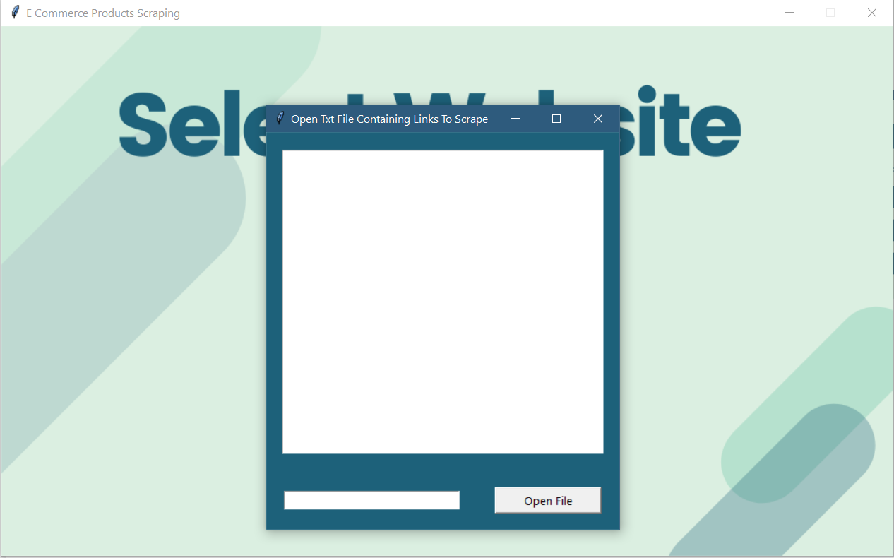
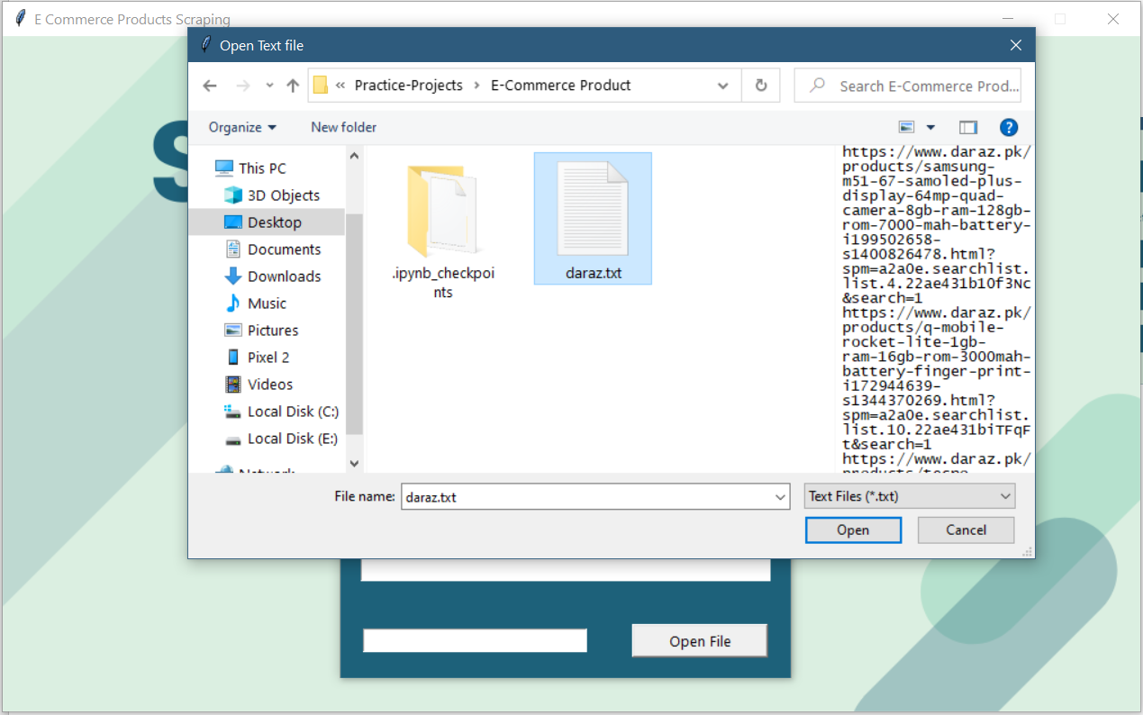
GUI Interface (Previous Product)
* Output will be in excel format containing the data

Slide 6
Project Quotation
Complete Setup on your PC including the test run and material.
250 $

