Slide 1
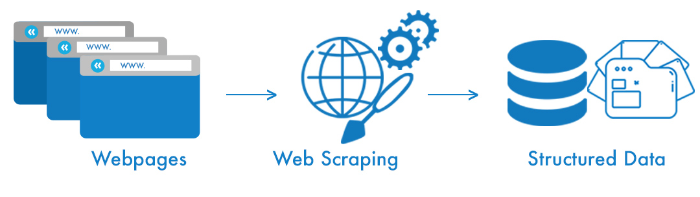
TESTING DATA ANALYSIS
FRONTIER TECHNOLOGY INSTITUTE

Slide 2
task
METHODOLOGY
OUTCOME
The task provided to us was to find Name, MD and Marketing or Sales from the provided data which contains URLs of almost 850+ shopify stores.
We extracted out all the links from each web URL one by one then we search all over those pages if Owner, MD or Marketing/Sales could be found or not.
Outcome was not a bit satisfying because we can’t find any information from those links because owner or MD are usually not shown on a website.

Slide 3
OTHER APPROACH
METHODOLOGY
OUTCOME
We have then decided that if the relevant information is not extracting so we extracted email and contact info from those URLs so they can be contacted.
So basically the contact info is either available in home page, either on the footer or on the contact page. So we traversed all over these pages and collected the relevant data for all URLs which was available.
We were successful to gather the contact information for many URLs either their email or their contact number and all data were placed in a csv file. (Contact Info was collected of almost 300+ URLs)
Note: There are some other approaches also to cover the task like search on LinkedIn
for these stores and gather relevant information from LinkedIn if available.

Slide 4
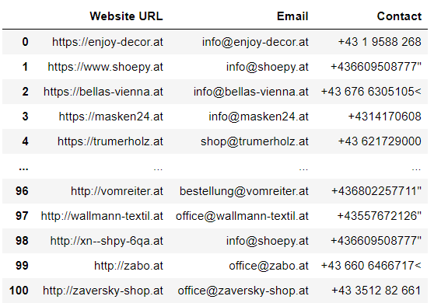
OUTPUT
Note: Just a sample of 100 URL’s. Many URL’s have only email available or only contact number
Available and many don’t have any contact information available on their website.

Slide 5
Thank you ☺
frontier technology institute

