Slide 1
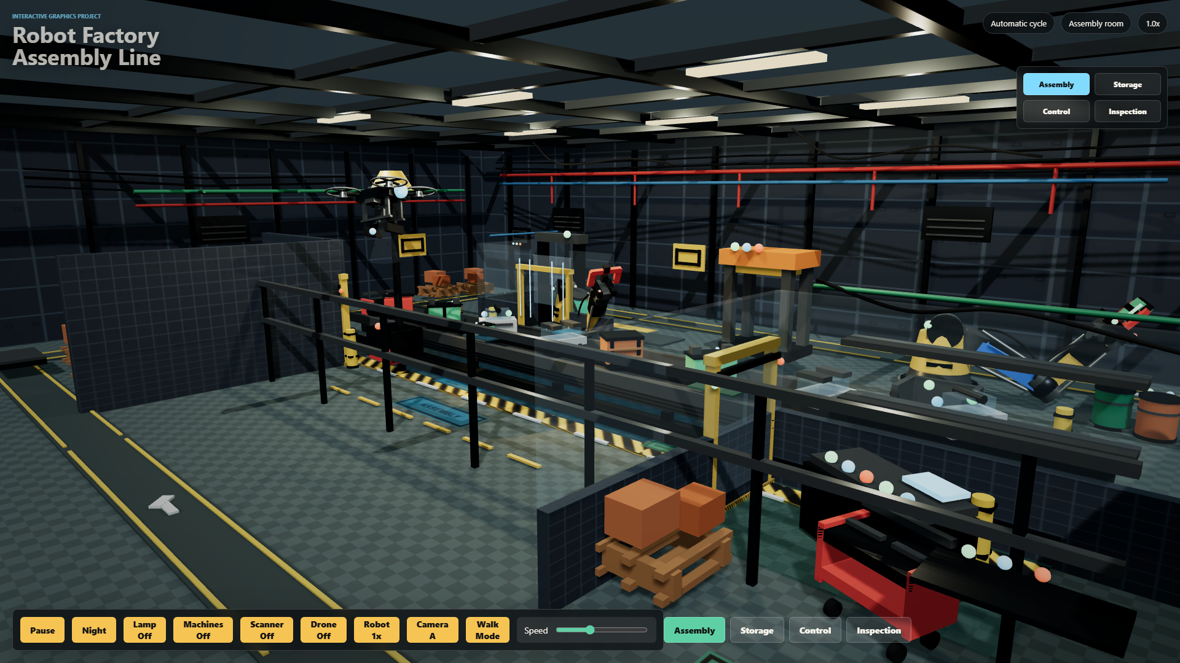
INTEGRATED DEMO
The robot factory is a compact demonstrator of the course concepts.
Course evidence
Hierarchical robot arms and technician use parent-child transforms.
Procedural textures, UV mapping, materials, lights, and shadows are visible.
Animations are authored in JavaScript: keyframes, loops, and simulation.
New mesh and spring stations make triangle/physics lessons explicit.
User controls expose viewpoint, lighting, machine, drone, and walk-mode interaction.
Sources: professor course slides, project source code, README, course concept map
01

Slide 2
CONCEPT COVERAGE
Almost every practical slide topic now has a visible project artifact.
Geometry and View
Rendering and Materials
Motion and Systems
3D transformations
Robot joints, doors, cameras
GPU/WebGL
Three.js renderer and canvas
Keyframes
Robot pick/place poses
Cameras/projection
Perspective camera, presets, walk mode
Textures
CanvasTexture, repeat wrapping, offsets
Procedural animation
Drone, AGV, belt, scanner, doors
Surfaces/meshes
Primitives plus manual BufferGeometry
Shading
Standard, Physical, custom ShaderMaterial
Physics
Mass-spring cable with Euler integration
Triangle data
Positions, UVs, indices, normals
Shadows
PCF soft shadow maps
Interaction
Toggles, speed, room map, orbit/walk
Presentation strategy: name the class concept first, then point to the exact object or code path in the factory.
Sources: professor course slides, project source code, README, course concept map
02

Slide 3
TRANSFORM HIERARCHY
The main models animate by moving parents, children, and local pivots.
Robot arm
Technician
robot root
technician root
Keyframe poses interpolate waist, shoulder, elbow, wrist, and claw offsets.
Idle motion updates head, arm, leg, and tablet rotations.
waistPivot rotation.y
body group
shoulderPivot rotation.z
head, arms, legs
The object transfer is synchronized with the robot cycle.
This mirrors skeletal animation ideas without importing a model.
elbow -> wrist -> gripper
tablet and accessories
Sources: professor course slides, project source code, README, course concept map
03

Slide 4
TEXTURE AND SHADING PIPELINE
The visual system uses course texture, material, light, and shader ideas directly.
CPU / JS
GPU path
Rendered scene
Canvas textures
Texture coordinates
Materials
Lights and shadows
Checker, stripe, panel, hazard, label, fabric, skin, helmet, scuff and bump maps are generated in JavaScript.
UVs and repeat wrapping map generated rasters onto floor, wall, belt, labels, and the custom mesh.
MeshStandard and MeshPhysical encode roughness, metalness, glass opacity, emissive indicators, and rubber.
Hemisphere, directional, point, and spot lights feed soft shadow-mapped real-time rasterization.
Custom shader
The operator jacket ShaderMaterial samples a fabric texture, computes a diffuse term from a light direction, and adds a rim term from the view direction.
This is the clearest place to mention vertex/fragment shader logic from the WebGL and shading slides.
Sources: professor course slides, project source code, README, course concept map
04

Slide 5
NEW EXPLICIT EVIDENCE
The latest additions make triangle meshes, normals, and physics simulation easy to point at.
TRI MESH
SPRING SIM
Manual BufferGeometry exhibit
Physics-based cable animation
The table uses explicit position, UV, and index buffers, then calls computeVertexNormals().
Each particle stores position and velocity; forces update every frame.
position
uv
index
normal
gravity + wind
spring force
Wireframe and normal rods make the hidden mesh data visible in the scene.
damping
semi-implicit Euler
simple floor collision
Sources: professor course slides, project source code, README, course concept map
05

Slide 6
ANIMATION SYSTEM
The main loop separates global time, machine time, robot time, and simulation state.
Timeline
Update loop
0s
2s
4s
6s
8s
clock.getDelta()
robotElapsed
Robot keyframes
update state clocks
machineElapsed
Conveyor, scanner, press
animateRobot()
machineElapsed
move production systems
Drone patrol and cargo
machineElapsed
simulate spring cable
AGV load/drop route
controls.update()
elapsed
Technician idle and spring simulation
renderer.render()
Sources: professor course slides, project source code, README, course concept map
06

Slide 7
FINAL MESSAGE
Concept coverage is strong; the remaining work is delivery and evidence packaging.
Already strong
Do before hand-in
Say honestly
Hierarchy
GitHub Pages
No imported animation
Robot arms and technician
Verify fresh browser and add README link
All motion is JavaScript-authored
Textures and shading
Final report
No full ray tracing
Procedural maps plus custom shader
5-10 page technical/user manual
We use real-time rasterization and shadow maps
Animations
Visual QA
No full physics engine
Keyframes, procedural loops, simulation
Camera views, walk mode, intersections
Small custom mass-spring simulation instead
Interaction
Library packaging
No imported models
Controls, cameras, rooms, walk mode
Vendor Three.js if required by professor
Geometry is built procedurally in code
Sources: professor course slides, project source code, README, course concept map
07

