Slide 1
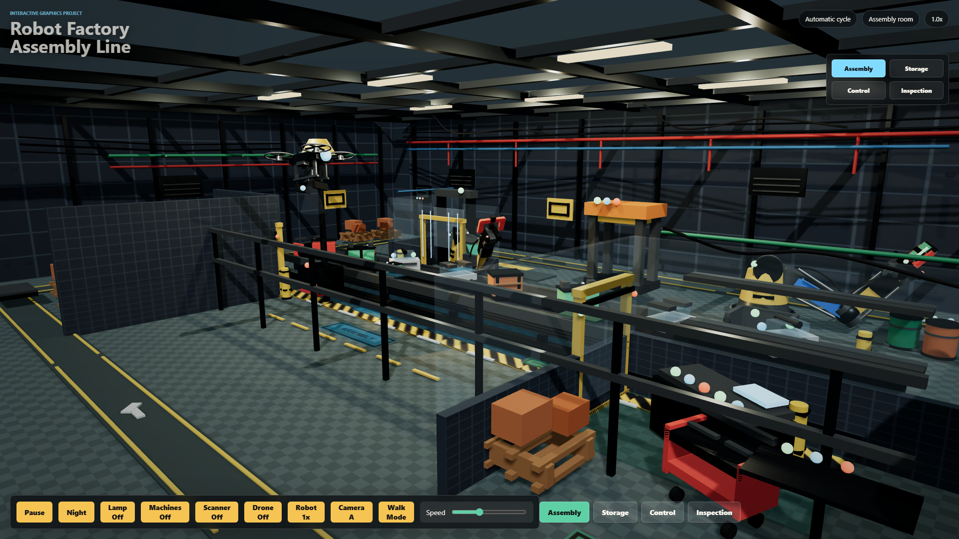
COURSE COVERAGE
The factory is built as a course-concept demo, not only a nice scene.
We mapped the professor's 21 lecture decks to concrete Three.js/WebGL evidence and added code-traceable examples for each concept family.
21 lecture decks mapped
Renderer, camera, rasterization, GPU pipeline
Scene-graph transforms and articulated robots
Manual mesh with UVs, indices, normals
Procedural textures, PBR materials, custom shader
Keyframe and procedural animation
Mass-spring physics simulation
Honest boundary for ray tracing/path tracing
Implemented
Approximated
Explained honestly
Deck update: each concept family now includes an example from the code with file/line evidence.
Robot Factory Assembly Line - course concept evidence from code
01

Slide 2
FULL MAP
All 21 lecture topics are traceable to the project.
The matrix is the professor-facing answer to: did we use the course material?
01 Intro
Full interactive scene and final project framing
02 Math
Vector3, sin/cos, lerp, clamp, normalized motion
03 Raster images
Canvas labels, procedural textures, opacity
README, project docs
src/main.js:2147, 2352-2365
src/main.js:105-367
04 2D transforms
Rotated floor labels, UV repeat, animated texture offset
05 3D transforms
Scene graph groups, translation, rotation, scale
06 GPU/WebGL
WebGLRenderer, render loop, canvas output
src/main.js:719-729, 2409-2410
src/main.js:1672-1754
src/main.js:5-10, 2576
07 Surfaces
Primitive surfaces plus authored factory objects
08 Triangle meshes
Manual BufferGeometry, indices, normals, wireframe
09 Textures
CanvasTexture, wrap, repeat, UV mapping
src/main.js:542-581
src/main.js:983-1068
src/main.js:105-185, 1008-1041
10 GPU textures
Textures bound to materials and shader sampler
11 Shading
PBR materials, emissive surfaces, custom shader
12 Shading transforms
Normals, view direction, computed normals
src/main.js:432, 459-496
src/main.js:388-531
src/main.js:492-496, 1042
13 Rendering equation
PBR lighting approximation via Standard/Physical materials
14 Rendering algorithms
Real-time rasterization, depth, shadow mapping
15 Ray tracing
Not implemented; explained as outside real-time WebGL scope
src/main.js:388-531
src/main.js:5-10, 2576
slide 10
16 Shadows/reflections
PCF shadow maps, glass/physical/specular materials
17 Sampling
Antialiasing, pixel ratio cap, texture filtering/repeat
18 Animations
Keyframes, easing, procedural updates
src/main.js:7-8, 433-450, 1574-1608
src/main.js:5-6, 105-185
src/main.js:2164-2200, 2397-2576
19 Physics animation
Mass-spring cable with gravity, damping, collision
20 Simulation
State update loop for forces, particles, AGV/drone systems
21 Three.js final
Camera, controls, lights, materials, meshes, interaction
src/main.js:1077-1172
src/main.js:1126-1192, 2459-2552
full project
Important wording: ray tracing/path tracing are not claimed as full implementations; they are compared against our real-time rasterization pipeline.
Robot Factory Assembly Line - course concept evidence from code
02

Slide 3
RENDERER
WebGL rasterization is visible from setup to the render loop.
This covers the GPU pipeline, camera/projection, rendering algorithms, shadows, and sampling choices.
const renderer = new THREE.WebGLRenderer({ canvas, antialias: true });
renderer.setPixelRatio(Math.min(window.devicePixelRatio, 2));
renderer.shadowMap.enabled = true;
renderer.shadowMap.type = THREE.PCFSoftShadowMap;
renderer.toneMapping = THREE.ACESFilmicToneMapping;
const camera = new THREE.PerspectiveCamera(50, aspect, 0.1, 100);
function animate() {
requestAnimationFrame(animate);
...
renderer.render(scene, camera);
}
JavaScript scene
Three.js renderer
GPU pipeline
Raster output
Groups, meshes, materials, lights
Builds WebGL draw calls
Vertices -> fragments -> depth
Canvas pixels in the browser
Sampling evidence
Shadow evidence
Antialiasing is enabled and device pixel ratio is capped, so quality is balanced against browser performance.
PCF soft shadow maps are enabled globally, then lights and meshes opt into cast/receive shadows.
src/main.js:5-16, 2397-2576
Presenter line: the project uses the standard real-time WebGL rasterization path; it does not replace Three.js with a custom renderer.
Robot Factory Assembly Line - course concept evidence from code
03

Slide 4
TRANSFORMS
Scene-graph hierarchy turns matrix math into visible robot motion.
The code uses parent-child groups for local coordinate systems, then animates rotations on the joints.
const robot = new THREE.Group();
robot.position.set(...position);
robot.rotation.y = rotationY;
scene.add(robot);
robot.add(waistPivot);
waistPivot.add(shoulderPivot);
shoulderPivot.add(upperArm);
upperArm.add(elbowPivot);
forearm.add(wristPivot);
robotRig.waistPivot.rotation.y = pose.waist;
robotRig.elbowPivot.rotation.z = pose.elbow;
robot
Camera transform
PerspectiveCamera plus OrbitControls and room presets demonstrate view/projection control.
waistPivot
shoulderPivot
2D transform echo
src/main.js:1672-1754, 2194-2200
Floor labels and texture offsets show rotations/repeated coordinates on surfaces.
upperArm
const forward = new THREE.Vector3(
-Math.sin(state.walkYaw), 0, -Math.cos(state.walkYaw)
);
camera.position.add(movement);
camera.position.x = THREE.MathUtils.clamp(...);
elbow/wrist
src/main.js:2352-2365
Robot Factory Assembly Line - course concept evidence from code
04

Slide 5
MESHES
The TRI MESH exhibit makes vertices, UVs, indices, and normals explicit.
This is our direct answer to the Surfaces and Triangular Meshes lectures.
const geometry = new THREE.BufferGeometry();
geometry.setAttribute(
"position",
new THREE.Float32BufferAttribute(positions, 3)
);
geometry.setAttribute(
"uv",
new THREE.Float32BufferAttribute(uvs, 2)
);
geometry.setIndex(indices);
geometry.computeVertexNormals();
prototype.add(mesh);
prototype.add(wire);
prototype.add(new THREE.LineSegments(normalGeometry, ...));
v1
v0
v2
v3
v4
src/main.js:983-1068
VISUAL PROOF IN SCENE: VERTEX MARKERS + WIREFRAME + NORMAL RODS
Robot Factory Assembly Line - course concept evidence from code
05

Slide 6
TEXTURES
Procedural raster images become GPU textures and animated UV coordinates.
This connects raster images, UV mapping, textures on GPU, and 2D texture-coordinate motion.
const texture = new THREE.CanvasTexture(canvasTexture);
texture.wrapS = THREE.RepeatWrapping;
texture.wrapT = THREE.RepeatWrapping;
texture.repeat.set(4, 1);
texture.colorSpace = THREE.SRGBColorSpace;
geometry.setAttribute(
"uv",
new THREE.Float32BufferAttribute(uvs, 2)
);
beltTexture.offset.x = -machineElapsed * 0.58;
Floor/walls
procedural scuffs, repeated surface detail
src/main.js:372-379
Conveyor
animated belt texture offset
src/main.js:2409
Hazard stripes
repeat wrapping and time offset
src/main.js:124-128, 2410
Technician fabric
texture + roughness map on material
src/main.js:501-507
Manual mesh
UV buffer proves texture mapping
src/main.js:1008-1041
src/main.js:105-185, 1008-1041, 2409
Presenter line: our textures are generated from 2D canvas rasters, then sampled by WebGL through Three.js materials; the mesh exhibit proves UV coordinates directly.
Robot Factory Assembly Line - course concept evidence from code
06

Slide 7
SHADING
Materials, lights, shadows, normals, and a custom shader are all visible in code.
This is where the lighting, shading, rendering-equation, normal-transform, and shadow lectures meet the project.
operatorJacket: new THREE.ShaderMaterial({
uniforms: { ... },
vertexShader: `
vNormal = normalize(normalMatrix * normal);
`,
fragmentShader: `
vec3 viewDirection = normalize(cameraPosition - vWorldPosition);
float diffuse = max(dot(normalDirection, lightDirection), 0.0);
float rim = pow(1.0 - max(dot(normalDirection, viewDirection), 0.0), 2.6);
`
});
PBR materials
Normal logic
MeshStandardMaterial and MeshPhysicalMaterial encode roughness, metalness, glass, and emissive surfaces.
Manual mesh normals plus shader normalMatrix show normal handling after transforms.
src/main.js:459-496
Lights
Shadows
Hemisphere, directional, point, and spot lights create layered illumination.
PCFSoftShadowMap plus cast/receive flags create real-time shadow evidence.
const sun = new THREE.DirectionalLight(...);
sun.castShadow = true;
const lampLight = new THREE.SpotLight(...);
lampLight.castShadow = true;
mesh.castShadow = true;
mesh.receiveShadow = true;
src/main.js:536-537, 1572-1608
Rendering-equation link: Three.js PBR materials approximate light transport in real time rather than solving the full integral manually.
Robot Factory Assembly Line - course concept evidence from code
07

Slide 8
ANIMATION
The scene combines keyframes, easing, and procedural update logic.
Robot pick/place motion is keyframed; drones, AGV, doors, conveyor, lights, and technician motion are time-based.
const ROBOT_CYCLE_DURATION = 8.4;
const keyframes = [
{ at: 0, waist: -0.58, shoulder: -0.48, elbow: 1.38 },
{ at: 1.95, waist: -0.94, shoulder: -0.70, claw: 0.13 },
{ at: 5.8, waist: -3.34, shoulder: -0.70, claw: 0.42 },
{ at: 8.4, waist: -0.58, shoulder: -0.48, elbow: 1.38 },
];
robotRig.waistPivot.rotation.y = pose.waist;
robotRig.elbowPivot.rotation.z = pose.elbow;
0.0s
1.95s
5.8s
8.4s
requestAnimationFrame
Procedural motion
The whole scene advances every browser frame using delta time from THREE.Clock.
Conveyor offsets, drone patrol, AGV path, doors, scan rings, and lights are calculated from elapsed time.
src/main.js:58, 2164-2200
function animate() {
requestAnimationFrame(animate);
const delta = clock.getDelta();
...
updateAgv(machineElapsed);
updateSlidingDoors(delta);
animateTechnician(technician, elapsed);
updateMassSpringCable(springCable, state.running ? delta * state.speed : 0, elapsed);
}
src/main.js:2397-2552
Robot Factory Assembly Line - course concept evidence from code
08

Slide 9
PHYSICS
The SPRING SIM cable is a small custom physics simulation.
It demonstrates particles, velocities, forces, springs, damping, integration, wind, and collision response.
const gravity = new THREE.Vector3(0, -3.4, 0);
particle.force.addScaledVector(gravity, cable.userData.mass);
const relativeVelocity = new THREE.Vector3()
.subVectors(b.velocity, a.velocity);
particle.velocity.addScaledVector(acceleration, step);
particle.velocity.multiplyScalar(0.992);
particle.position.addScaledVector(particle.velocity, step);
if (particle.position.y < cable.userData.floorY) {
particle.velocity.y *= -0.28;
particle.velocity.x *= 0.8;
}
fixed top particle
Integrator
Semi-implicit Euler style update: force -> acceleration -> velocity -> position.
Collision
A floor constraint flips/damps velocity when a particle falls below floorY.
sensor follows final particle
src/main.js:1077-1172
Honest scope: this is not a full rigid-body engine, cloth solver, or fluid simulation; it is a focused mass-spring example that fits the browser scene.
Robot Factory Assembly Line - course concept evidence from code
09

Slide 10
ADVANCED RENDERING
We explain ray tracing and path tracing without pretending we implemented them.
The project uses real-time rasterization, shadow maps, and PBR approximations because it must remain interactive in the browser.
Implemented directly
Real-time approximation
Not full implementation
WebGLRenderer raster pipeline
Rendering equation through Three.js lighting/material model
No custom ray tracer
PCF soft shadow maps
Reflection-like response via roughness, metalness, glass
No Monte Carlo path tracer
PBR materials and custom shader
Sampling via antialiasing and texture filtering
No full global illumination solver
Texture sampling in materials
No full rigid-body/cloth/fluid engine
renderer.shadowMap.type = THREE.PCFSoftShadowMap;
const glass = new THREE.MeshPhysicalMaterial({ transparent: true, roughness: 0.02 });
renderer.render(scene, camera);
Presenter line: the ray tracing lecture helps us explain what our renderer is not doing, and why rasterization is the correct choice for this project.
src/main.js:7-8, 433-450, 2576
Robot Factory Assembly Line - course concept evidence from code
10

Slide 11
INTERACTION
The final app is controllable, inspectable, and requirement-ready.
The project requirements ask for user interaction, lights/textures, hierarchical objects, and authored animations; the code exposes all of them.
<button id="toggle-animation">Pause</button>
<button id="toggle-night">Night</button>
<button id="toggle-drone">Drone Off</button>
<button id="toggle-walk">Walk Mode</button>
<input id="speed-control" type="range" ... />
toggleNight.addEventListener("click", () => { ... });
speedControl.addEventListener("input", () => { ... });
window.addEventListener("keydown", (event) => { ... });
Hierarchical models
Lighting/textures
robot arm, technician, drone, AGV
PBR materials, CanvasTexture, shadows
User interaction
Animations
buttons, range slider, room map, walk mode
robot keyframes, conveyor, drone, spring sim
index.html:42-59, src/main.js:1982-2143
Submission angle: the presentation can now point from each requirement to both a visible object in the scene and a code location.
Robot Factory Assembly Line - course concept evidence from code
11

Slide 12
FINAL WORDING
We used almost everything from class where it belongs in a real-time project.
This is the clean summary to say in the presentation.
Our project implements the course concepts that fit an interactive WebGL scene: transformations, scene hierarchy, surfaces, triangle meshes, UV textures, GPU rendering, lighting, shading, shadows, animation, interaction, and a focused physics simulation. For advanced topics such as ray tracing and path tracing, we explain the concept and contrast it with our real-time rasterization pipeline rather than claiming a fake implementation.
Implemented
Approximated
Explained carefully
Meshes, transforms, textures, shader, lights, shadows, animation, UI, spring simulation.
Rendering equation, reflections/specular response, sampling and filtering via Three.js/WebGL.
No full ray tracer, path tracer, global illumination solver, full rigid-body engine, cloth, or fluids.
Backup reference file for the report: COURSE_CONCEPT_MAP.md. Main evidence file: src/main.js.
Robot Factory Assembly Line - course concept evidence from code
12

