Slide 1

Comparison between PostgreSQL and Neo4j
OpenAlex AI research paper retrieval and knowledge graph analysis
Group members
Hamza Abdul Kader - 2230150 Leonardo Marasca - 2217140
Data Management Project
Sapienza Universita di Roma

Slide 2

Project Goal
What we compare and why
Main question
Which database model is more suitable for AI research paper data: a relational DBMS or a graph database?
Comparison dimensions
- Data modeling - Query expressiveness - Query complexity - Execution time - Fit for relationship-heavy analysis
OpenAlex AI DBMS Comparison
2
2

Slide 3
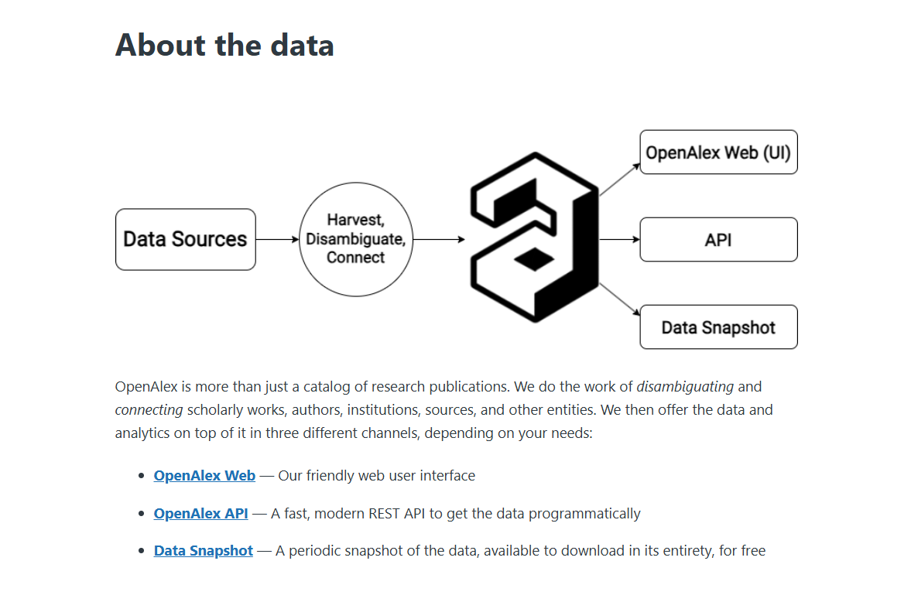
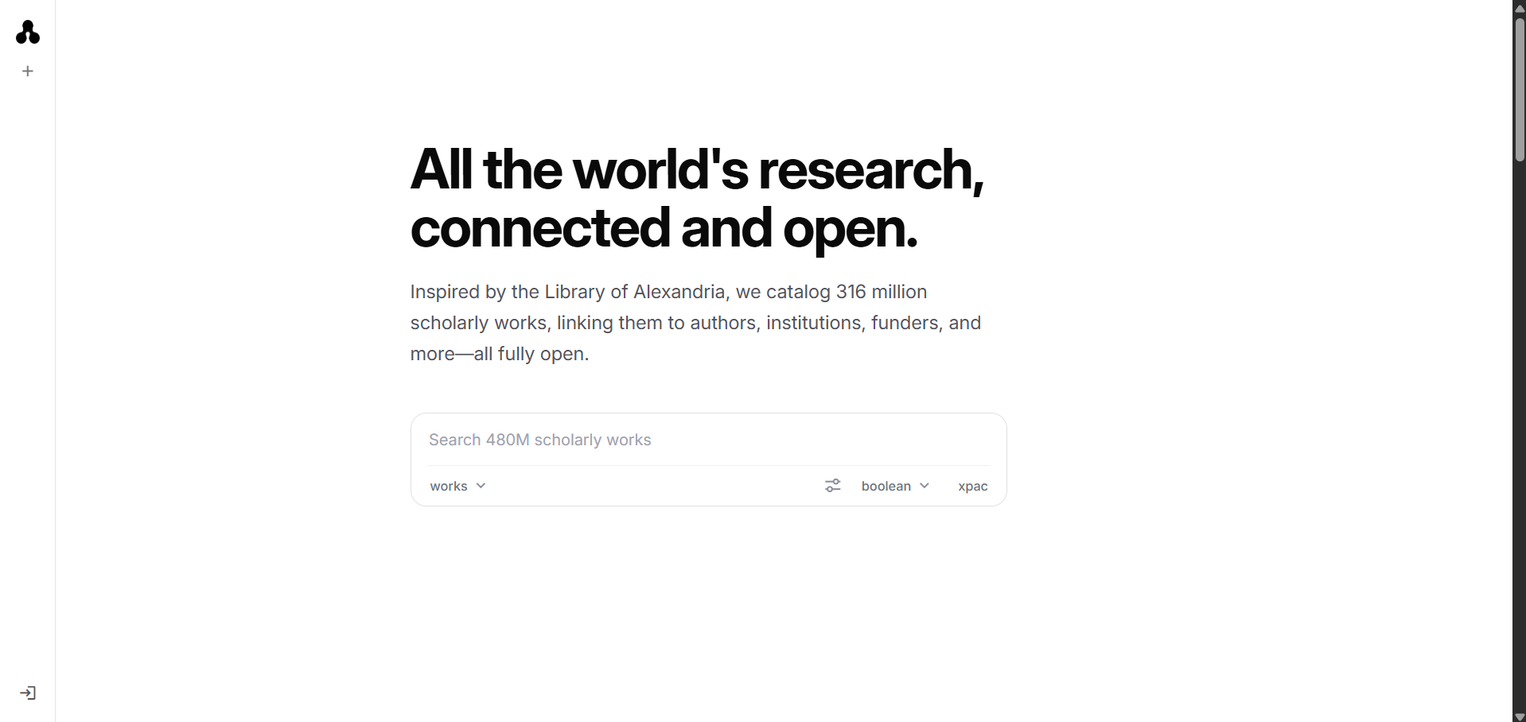
Dataset Source: OpenAlex
Open catalog of scholarly works, authors, topics, and citations
Used through the OpenAlex API; subset focused on AI, ML, LLM, and RAG-related papers.
OpenAlex AI DBMS Comparison
3
3

Slide 4
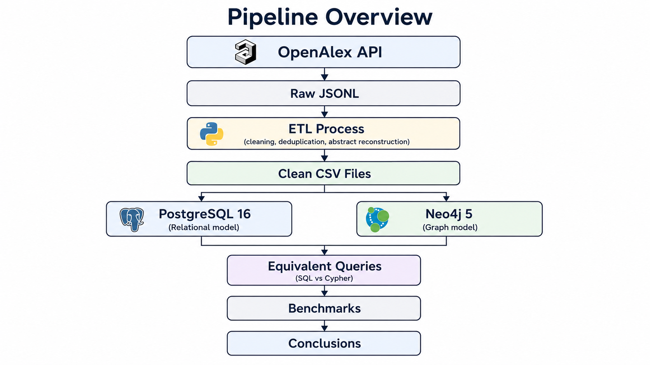
Pipeline Followed
From data source to benchmark conclusions
OpenAlex AI DBMS Comparison
4
4

Slide 5
ETL Process
How raw OpenAlex data became database-ready files
Python script
Problems solved
- Search OpenAlex works by AI/RAG terms - Store raw API responses as JSONL - Normalize nested JSON into CSV files - Reconstruct abstracts from inverted indexes - Load the same CSVs into both databases
Problem | Solution
Missing abstracts | Reconstruct from inverted index
Nested JSON | Normalize into CSV tables
External citations | Keep internal citation links
OpenAlex AI DBMS Comparison
5
5

Slide 6
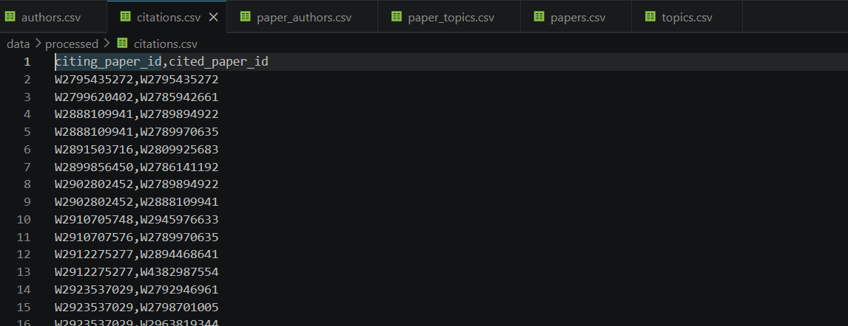
Normalized Dataset
Current OpenAlex sample used in both databases
299
Papers
1,966
Authors
1,104
Topics
2,077
Paper-author links
4,288
Paper-topic links
392
Citation links
OpenAlex AI DBMS Comparison
6
6

Slide 7
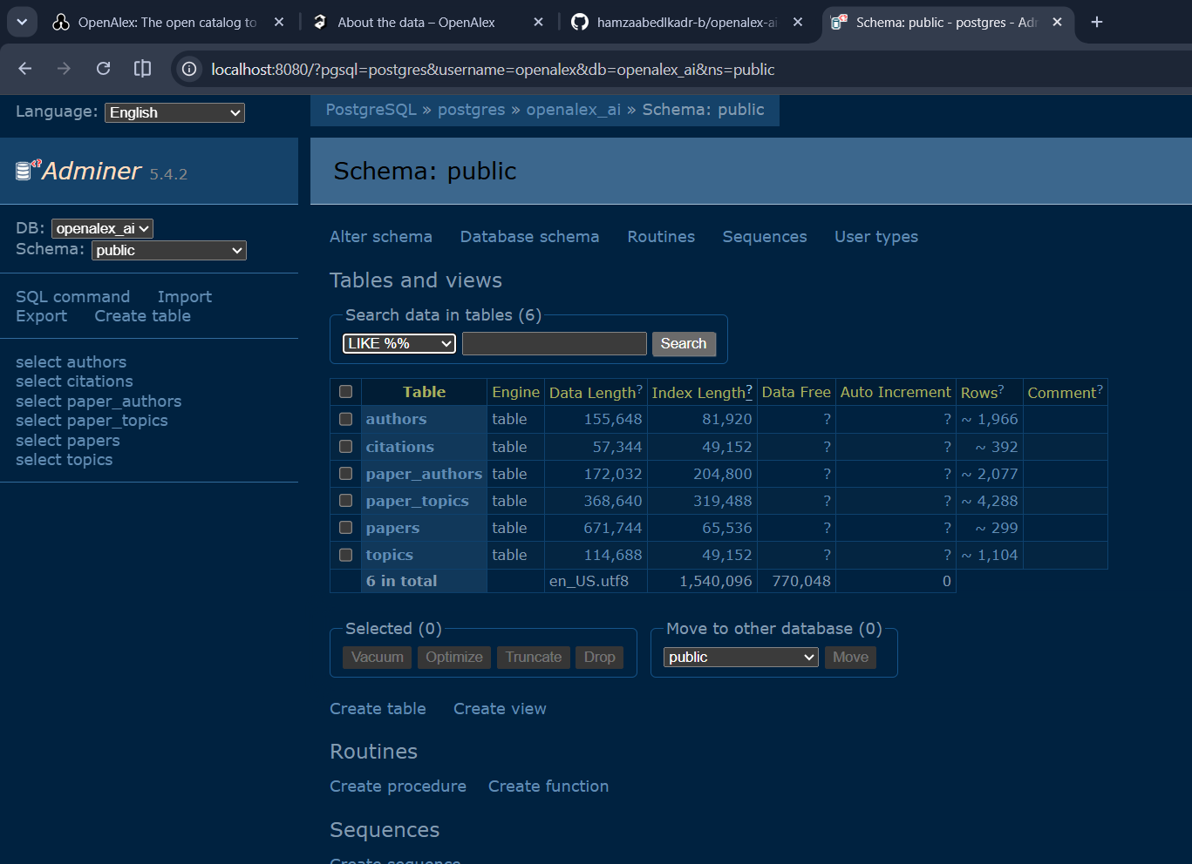
PostgreSQL Relational Model
Normalized tables and bridge tables
Tables
- papers - authors - topics - paper_authors - paper_topics - citations
Strength: structured joins and aggregations with SQL.
OpenAlex AI DBMS Comparison
7
7

Slide 8
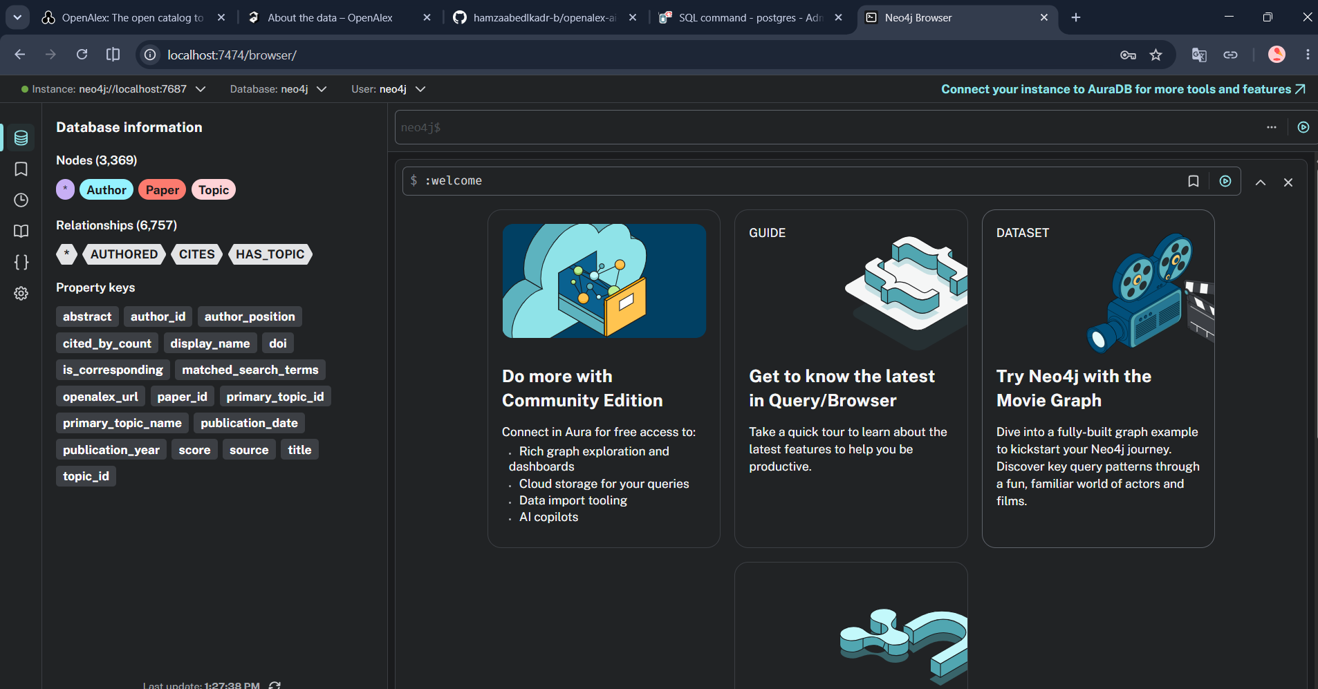
Neo4j Graph Model
Nodes and relationships are first-class objects
Graph schema
- (Author)-[:AUTHORED]->(Paper) - (Paper)-[:HAS_TOPIC]->(Topic) - (Paper)-[:CITES]->(Paper)
Strength: relationship-heavy traversal and visual graph exploration.
OpenAlex AI DBMS Comparison
8
8

Slide 9
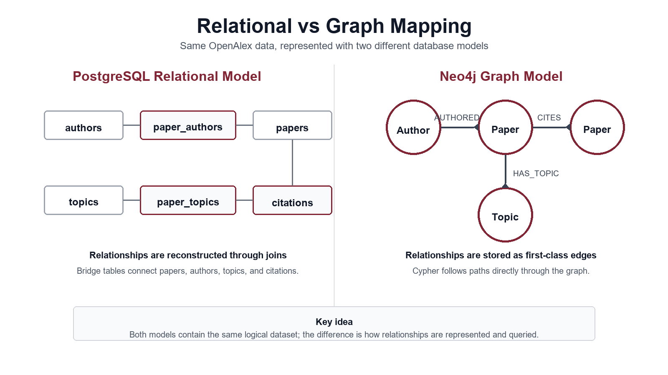
Same Data, Two Representations
Why the model changes the query shape
OpenAlex AI DBMS Comparison
9
9

Slide 10
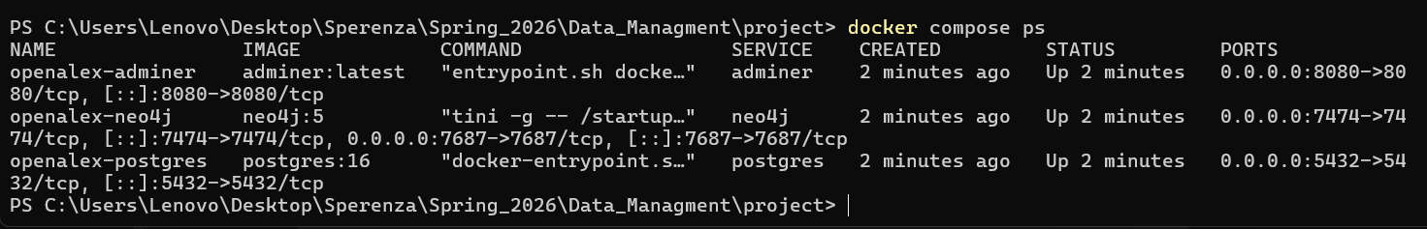
Implementation Setup
Local reproducible environment with Docker Compose
PostgreSQL 16
Neo4j 5
Adminer
Relational DBMS
Graph database
PostgreSQL UI
OpenAlex AI DBMS Comparison
10
10

Slide 11
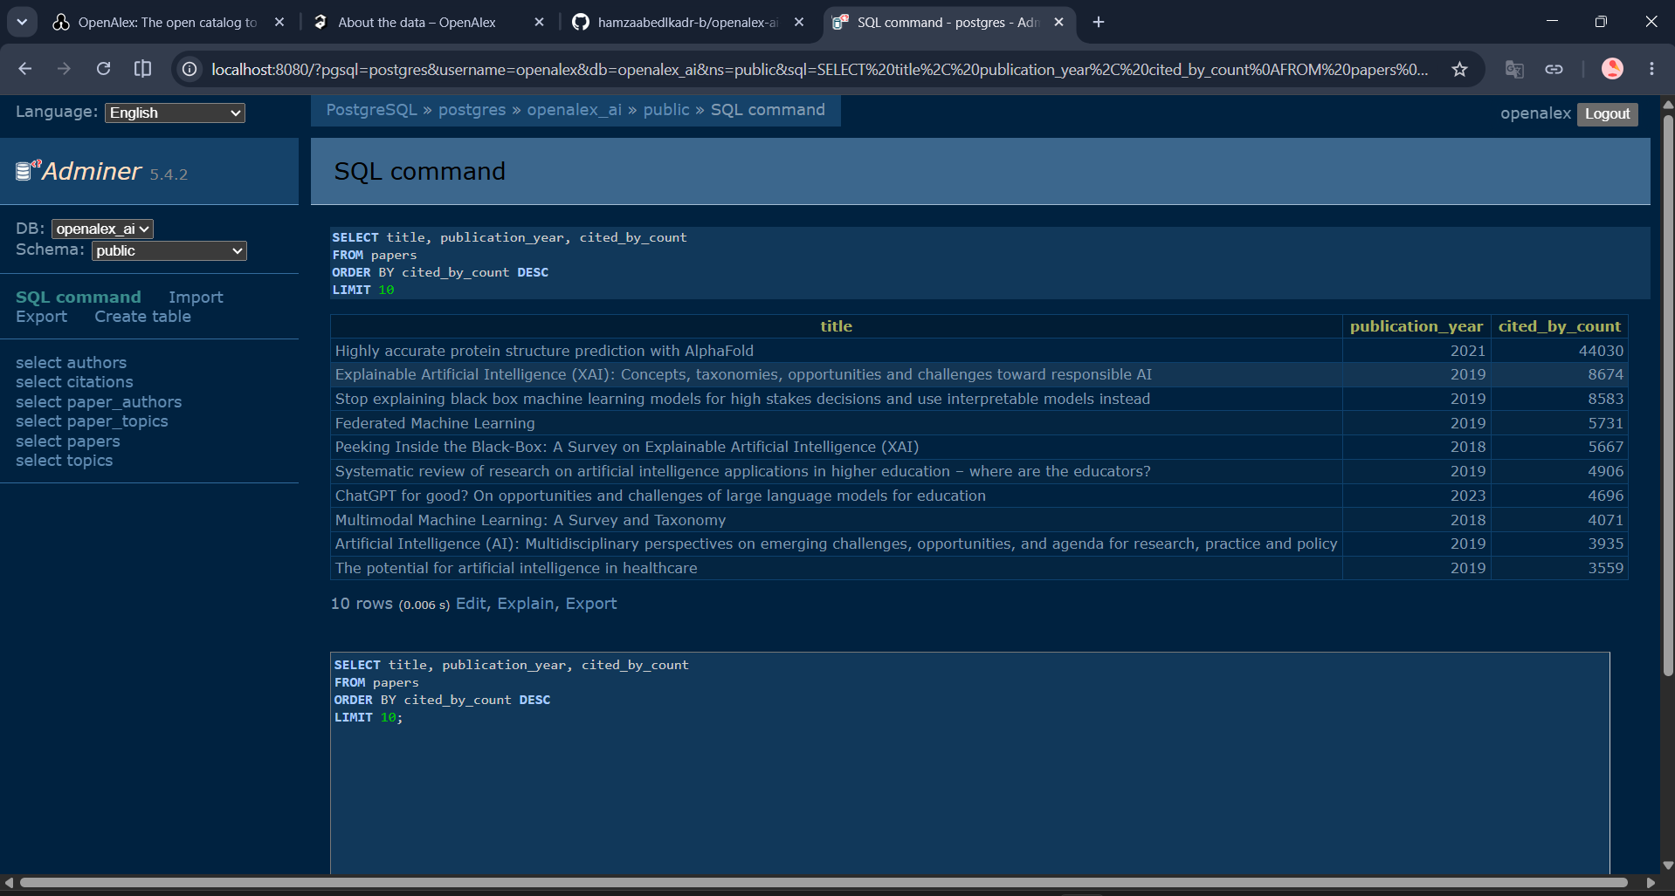
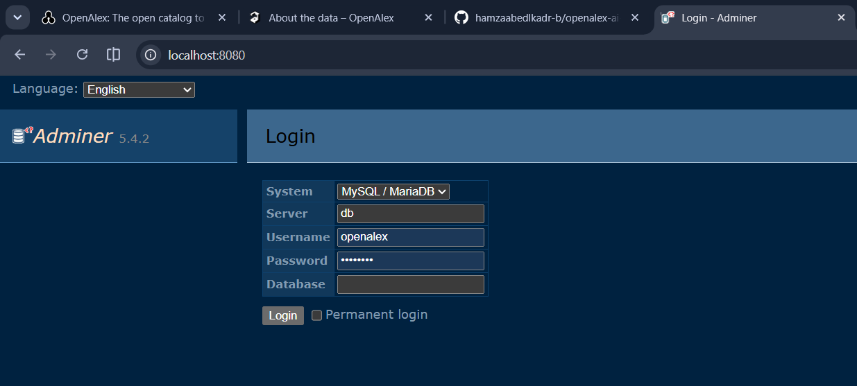
PostgreSQL Evidence
Tables and SQL query result in Adminer
SELECT title, publication_year, cited_by_count FROM papers ORDER BY cited_by_count DESC LIMIT 10;
This query uses the relational table of papers and orders by citation count.
OpenAlex AI DBMS Comparison
11
11

Slide 12
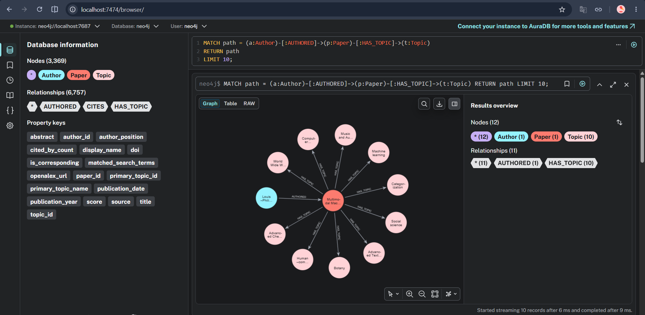
Neo4j Evidence: Author-Paper-Topic
Graph query with visible relationships
MATCH path = (a:Author)-[:AUTHORED]-> (p:Paper)-[:HAS_TOPIC]-> (t:Topic) RETURN path LIMIT 10;
The query returns paths, so Neo4j shows both nodes and relationships.
OpenAlex AI DBMS Comparison
12
12

Slide 13
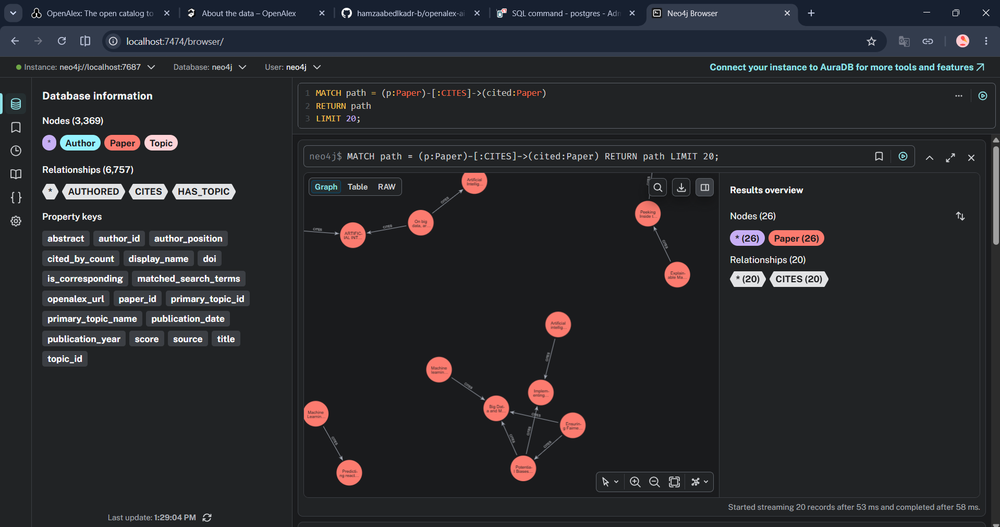
Neo4j Evidence: Citation Network
Paper-to-paper CITES relationships
MATCH path = (p:Paper)-[:CITES]-> (cited:Paper) RETURN path LIMIT 20;
This is the graph-style view that is hard to understand from raw citation table rows alone.
OpenAlex AI DBMS Comparison
13
13

Slide 14
Equivalent Query Example
Same analytical question, SQL vs Cypher
Question: which authors cite other authors through their papers?
PostgreSQL SQL
Neo4j Cypher
SELECT source_author.display_name AS citing_author, target_author.display_name AS cited_author, COUNT(*) AS citation_edges FROM paper_authors source_pa JOIN citations c ON c.citing_paper_id = source_pa.paper_id JOIN paper_authors target_pa ON target_pa.paper_id = c.cited_paper_id GROUP BY source_author.display_name, target_author.display_name;
MATCH (source:Author)-[:AUTHORED]->(:Paper) -[:CITES]->(:Paper)<-[:AUTHORED]-(target:Author) WHERE source.author_id <> target.author_id RETURN source.display_name AS citing_author, target.display_name AS cited_author, count(*) AS citation_edges;
OpenAlex AI DBMS Comparison
14
14

Slide 15
Benchmark Methodology
How the comparison was measured
Measurement setup
Important interpretation
- 11 main equivalent query pairs - 9 supplemental graph-focused query pairs - 1 warmup run and 5 measured runs - Same generated CSV dataset - PostgreSQL measured with EXPLAIN ANALYZE - Neo4j measured with PROFILE
This is not a universal ranking of PostgreSQL and Neo4j.
It is a local comparison on the same OpenAlex AI subset, hardware, indexes, and query workload.
The main goal is to connect query shape to database model.
OpenAlex AI DBMS Comparison
15
15

Slide 16
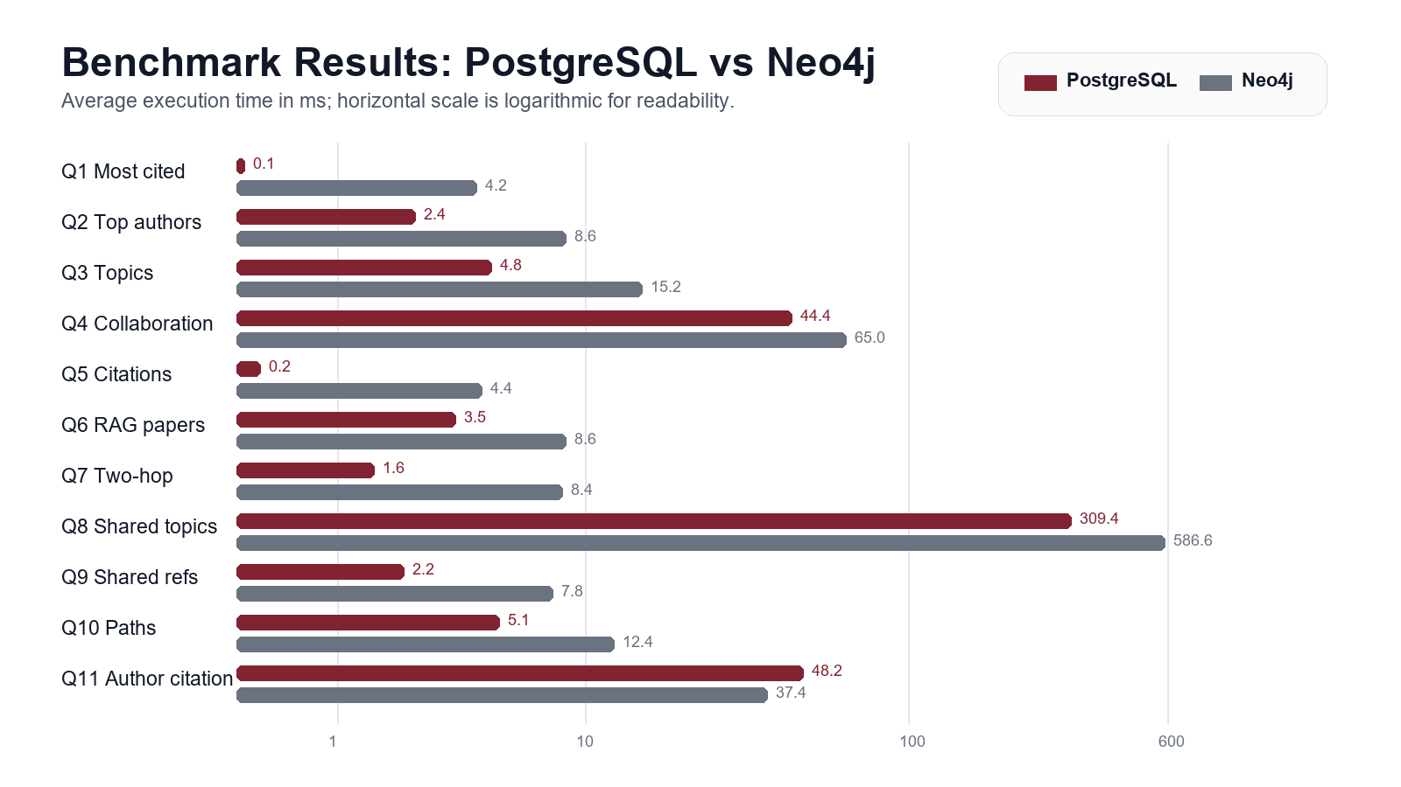
Main Benchmark Results
Average execution time across 11 equivalent query pairs
OpenAlex AI DBMS Comparison
16
16

Slide 17
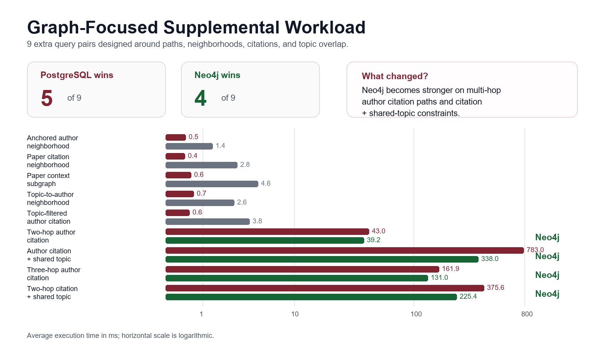
Supplemental Graph-Focused Results
Graph-focused workload: PostgreSQL 5/9, Neo4j 4/9
OpenAlex AI DBMS Comparison
17
17

Slide 18
Interpretation
The better database depends on the query type
PostgreSQL performed best for
Neo4j performed best for
Main lesson
- Ranking and aggregation - Small selective lookups - Traditional joins - Main workload: 10 of 11 wins - Combined: 15 of 20 wins
- Author citation network - Multi-hop citation paths - Citation + topic overlap - Graph workload: 4 of 9 wins - Combined: 5 of 20 wins
- Relational models are efficient for structured analysis. - Graph models are expressive for relationship-heavy questions. - Use the model that matches the query shape.
OpenAlex AI DBMS Comparison
18
18

Slide 19
Limitations and Future Work
What could be improved with more time
Limitations
Future work
- The dataset is a selected OpenAlex subset, not full OpenAlex - Benchmark results depend on local hardware and cache state - Neo4j overhead is visible on small datasets - No advanced full-text/vector search layer was added
- Increase dataset size - Add full-text search and vector retrieval - Tune indexes and constraints further - Build a simple RAG search demo on top of the databases
OpenAlex AI DBMS Comparison
19
19

Slide 20
Final Conclusions
From requirements to results
What we delivered
Final answer
- OpenAlex ETL pipeline - PostgreSQL and Neo4j data models - Docker-based reproducible setup - Equivalent SQL and Cypher query set - Benchmark results and interpretation - Project report and README
PostgreSQL wins most tabular analysis. Neo4j wins on graph-heavy traversal.
- Main workload: PostgreSQL 10/11 - Graph-focused workload: Neo4j 4/9 - Combined result: PostgreSQL 15/20, Neo4j 5/20 - The best choice depends on query shape
Balanced conclusion: no system is universally better.
OpenAlex AI DBMS Comparison
20
20

Slide 21
Backup: Project Scope Choice
Why this is not an OLAP/data-warehouse project
Approved scope
Therefore
- Project type: DBMS / NoSQL comparison - Systems compared: PostgreSQL 16 and Neo4j 5 - Same OpenAlex CSV dataset loaded into both systems - Evaluation: modeling, query expression, and benchmark behavior
We did not design a DFM, Star schema, Snowflake schema, or OLAP sessions because those belong to a Data Warehousing project. Our equivalent analysis uses SQL and Cypher workloads instead.
If asked: the comparable concept in this project is not OLAP cubing, but relational joins versus graph traversal over the same scholarly network.
OpenAlex AI DBMS Comparison
21
21

