Slide 1
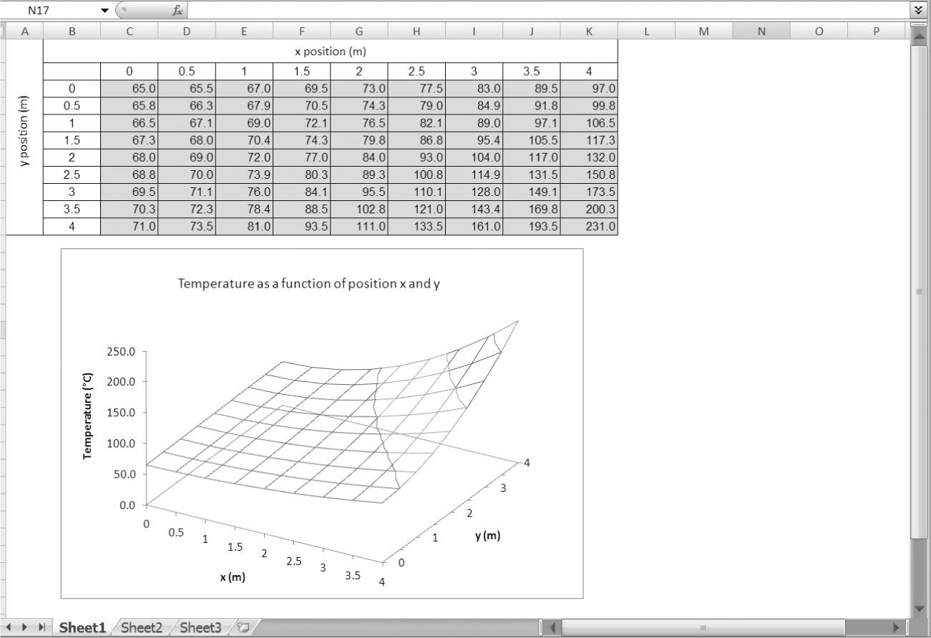
CHAPTER 14
Electronic Spreadsheets
© 2011 Cengage Learning Engineering. All Rights Reserved.
© 2011 Cengage Learning Engineering. All Rights Reserved.
14-<number>

Slide 2
Computational Engineering Tools
Using Available Software to Solve Engineering Problems:
Electronic Spreadsheets
MATLAB
© 2011 Cengage Learning Engineering. All Rights Reserved.
© 2011 Cengage Learning Engineering. All Rights Reserved.
14-<number>

Slide 3
Outline
In this chapter we will
discuss basic makeup of Microsoft Excel
explain how a spreadsheet is divided into rows and columns, and how to input data or a formula into an active cell
explain the use of other tools such as Excel’s mathematical, statistical, and logical functions
explain how to plot results of an engineering analysis
© 2011 Cengage Learning Engineering. All Rights Reserved.
© 2011 Cengage Learning Engineering. All Rights Reserved.
14-<number>

Slide 4
Objectives
The objective of this chapter is to introduce the Excel spreadsheet, which is commonly used in solving engineering problems
© 2011 Cengage Learning Engineering. All Rights Reserved.
© 2011 Cengage Learning Engineering. All Rights Reserved.
14-<number>

Slide 5
Microsoft Excel – an Electronic Spreadsheet
A tool that can be used to solve an engineering problem
Used to solve simpler engineering problems instead of using computer programs
Commonly used to record, organize, and analyze data using formulas
Used to present results of an analysis in chart form
© 2011 Cengage Learning Engineering. All Rights Reserved.
© 2011 Cengage Learning Engineering. All Rights Reserved.
14-<number>

Slide 6
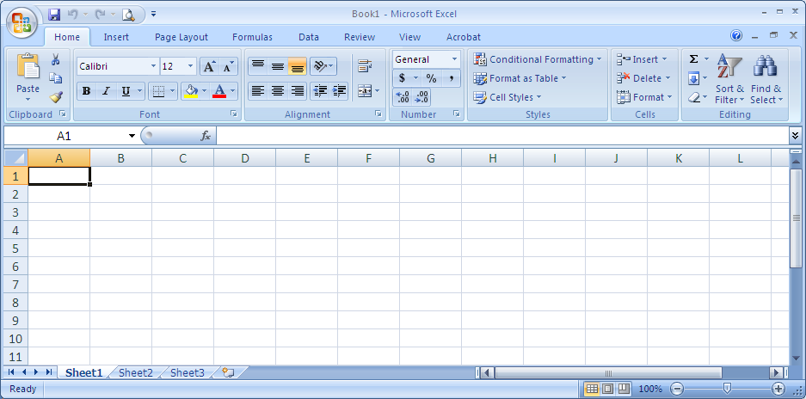
Microsoft Excel – Basic Ideas
Formula bar
Title bar
Toolbar button
Menu bar
Name box
Column header
Row header
Active cell
Worksheet tabs
Status bar
© 2011 Cengage Learning Engineering. All Rights Reserved.
© 2011 Cengage Learning Engineering. All Rights Reserved.
14-<number>

Slide 7
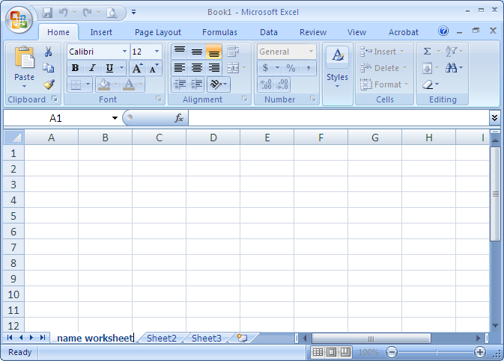
Naming Worksheets
Double click this tab, type the name, hit the Enter key
© 2011 Cengage Learning Engineering. All Rights Reserved.
© 2011 Cengage Learning Engineering. All Rights Reserved.
14-<number>

Slide 8
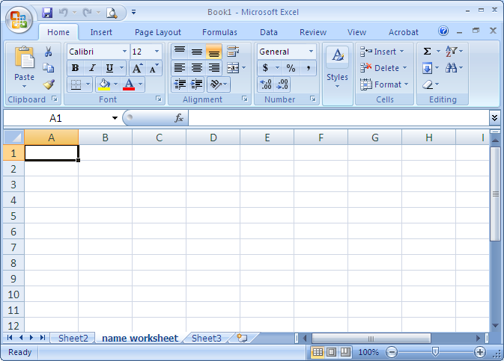
Moving Worksheets
Hold down the left button on the mouse
and drag the tab to the desired location
© 2011 Cengage Learning Engineering. All Rights Reserved.
© 2011 Cengage Learning Engineering. All Rights Reserved.
14-<number>

Slide 9
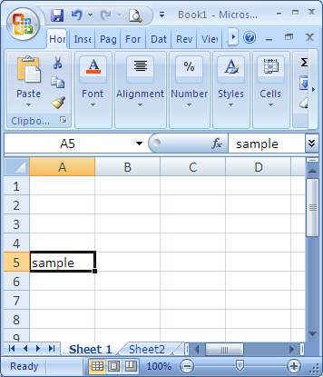
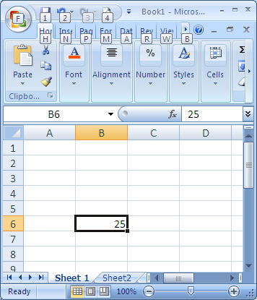
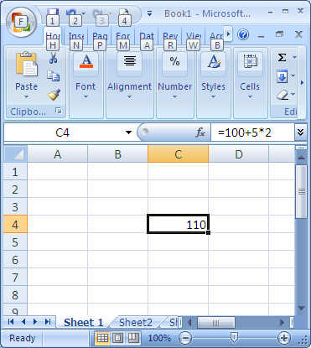
Cell and Address
Cell – represents the box that one sees as the result of the intersection of a row and a column
Cell C4
What you get in active cell
What you type in formula bar
© 2011 Cengage Learning Engineering. All Rights Reserved.
© 2011 Cengage Learning Engineering. All Rights Reserved.
14-<number>

Slide 10
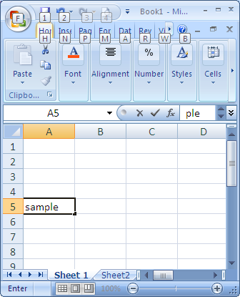
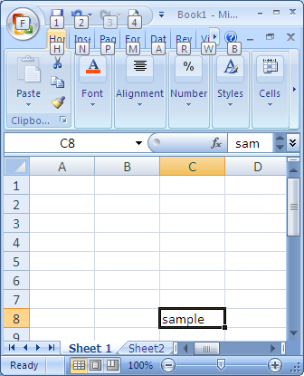
Moving a Cell
Move content in cell A5 to cell C8
Move the mouse over cell A5 until the pointer becomes
while holding down the left button drag the mouse until the content of A5 is in C8, release the mouse button
© 2011 Cengage Learning Engineering. All Rights Reserved.
© 2011 Cengage Learning Engineering. All Rights Reserved.
14-<number>

Slide 11
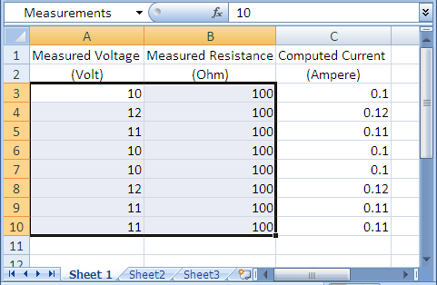
A Range
Range – cells that are selected simultaneously
After the range is selected, click the “name box” and type the name of range
Click on A3, drag the mouse while pressing down the left button to the last cell in the range B10
© 2011 Cengage Learning Engineering. All Rights Reserved.
© 2011 Cengage Learning Engineering. All Rights Reserved.
14-<number>

Slide 12
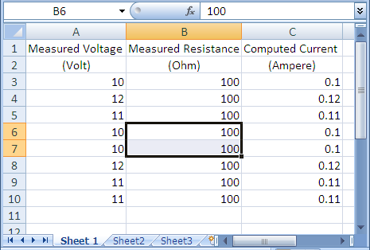
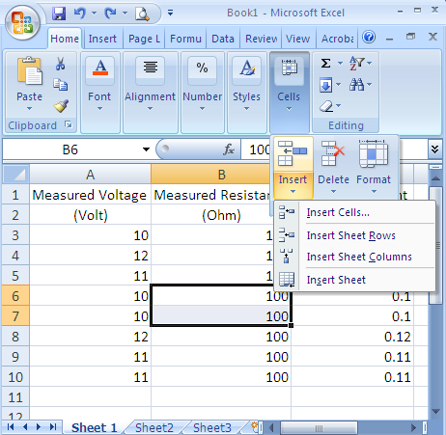
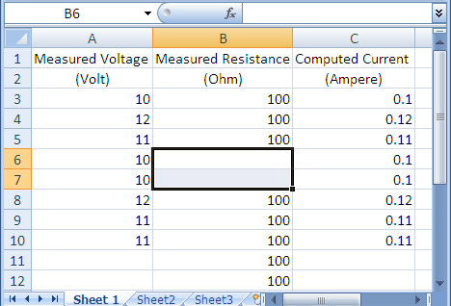
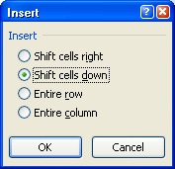
Inserting Cells
select the cells where the new cells are to be inserted
cells inserted
select shift cells down
select Insert, then Insert Cells…
At Home
click on Cells
© 2011 Cengage Learning Engineering. All Rights Reserved.
© 2011 Cengage Learning Engineering. All Rights Reserved.
14-<number>

Slide 13
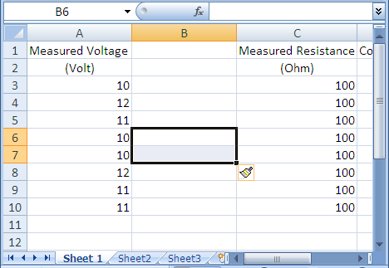
Inserting Columns
select Insert
select the column(s) where the new column(s) is to be inserted
click on Cells
column inserted
At Home
select Insert Sheet Columns
© 2011 Cengage Learning Engineering. All Rights Reserved.
© 2011 Cengage Learning Engineering. All Rights Reserved.
14-<number>

Slide 14
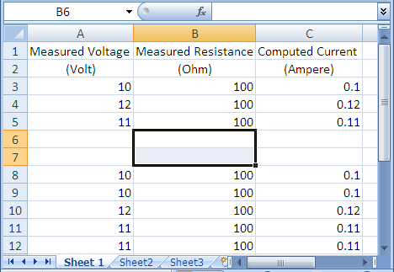
Inserting Rows
select Insert
select the row(s) where the new row(s) is to be inserted
click on Cells
rows inserted
At Home
select Insert Sheet Rows
© 2011 Cengage Learning Engineering. All Rights Reserved.
© 2011 Cengage Learning Engineering. All Rights Reserved.
14-<number>

Slide 15
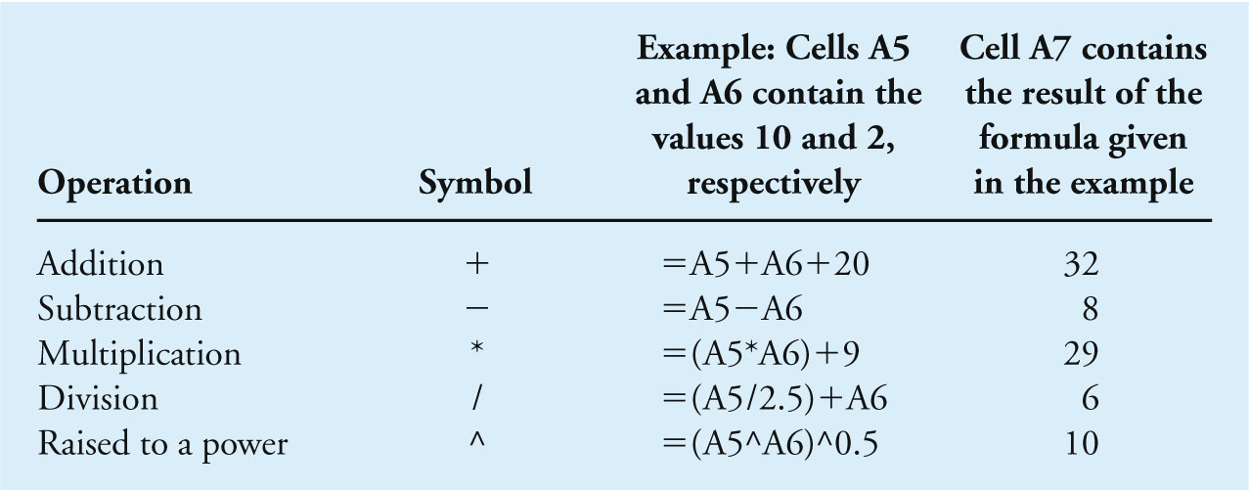
Creating Formulas in Excel
Basic Excel Arithmetic Operations
© 2011 Cengage Learning Engineering. All Rights Reserved.
© 2011 Cengage Learning Engineering. All Rights Reserved.
14-<number>

Slide 16
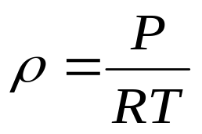
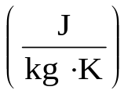
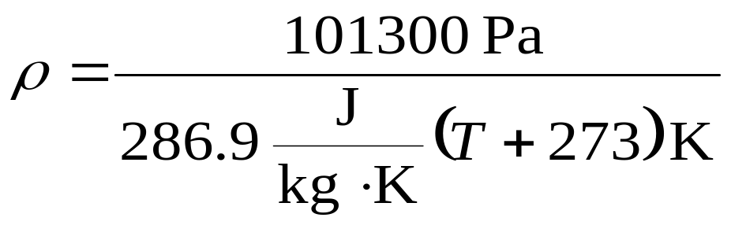
Example 14.1 – Creating Formulas
Given: standard air using the ideal gas law
where
P = standard atmosphere pressure = 101.3 kPa
R = gas constant for air = 286.9
T = air temperature in Kelvin (K)
Find: use Excel to create a table that shows the density of air as a function of temperature in the range of 0°C (273.15 K) to 50°C (323.15 K) in increment of 5°C.
© 2011 Cengage Learning Engineering. All Rights Reserved.
© 2011 Cengage Learning Engineering. All Rights Reserved.
14-<number>

Slide 17
Example 14.1 – Creating Formulas (continued)
Solution:
Substituting the values of R and P in the standard gas law yields,
Now we can use the above equation to create the table in Excel.
© 2011 Cengage Learning Engineering. All Rights Reserved.
© 2011 Cengage Learning Engineering. All Rights Reserved.
14-<number>

Slide 18
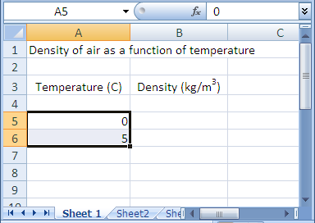
Example 14.1 – Creating Formulas (continued)
In cell A1, type Density of air as a function of temperature
In cells A3 and B3, type Temperature (C), Density (kg/m³), respectively.
In cells A5 and A6, type 0 and 5, respectively
© 2011 Cengage Learning Engineering. All Rights Reserved.
© 2011 Cengage Learning Engineering. All Rights Reserved.
14-<number>

Slide 19
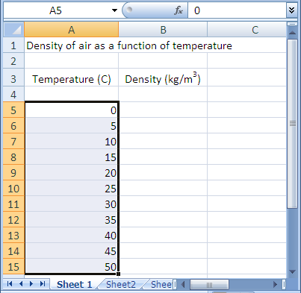
Example 14.1 – Creating Formulas (continued)
Pick cells A5 and A6 and use the fill command with the + handle to copy the pattern into cells A7 through A15
© 2011 Cengage Learning Engineering. All Rights Reserved.
© 2011 Cengage Learning Engineering. All Rights Reserved.
14-<number>

Slide 20
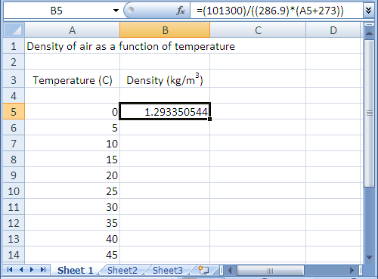
Example 14.1 – Creating Formulas (continued)
In cell B5, type the formula =(101300)/((286.9)*(A5+273))
Result of formula
© 2011 Cengage Learning Engineering. All Rights Reserved.
© 2011 Cengage Learning Engineering. All Rights Reserved.
14-<number>

Slide 21
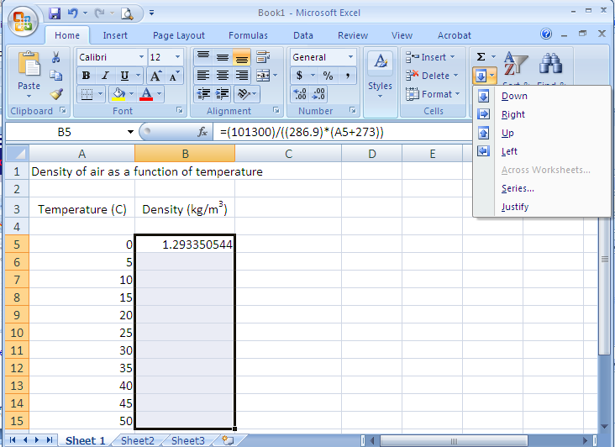
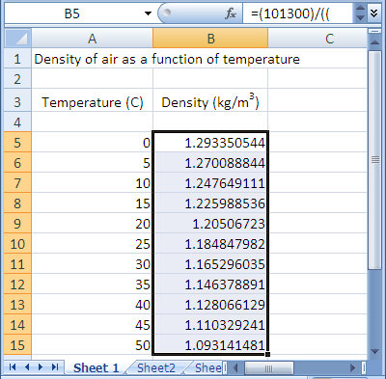
Example 14.1 – Creating Formulas (continued)
Select the Fill icon
At Home menu
6. Select range B5 to B15
Select Down to copy formulas to cells B5 to B15
Resulting density
© 2011 Cengage Learning Engineering. All Rights Reserved.
© 2011 Cengage Learning Engineering. All Rights Reserved.
14-<number>

Slide 22
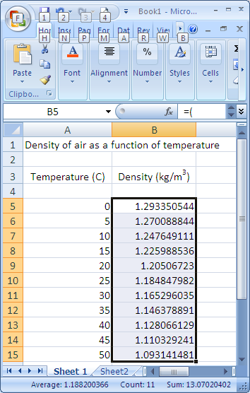
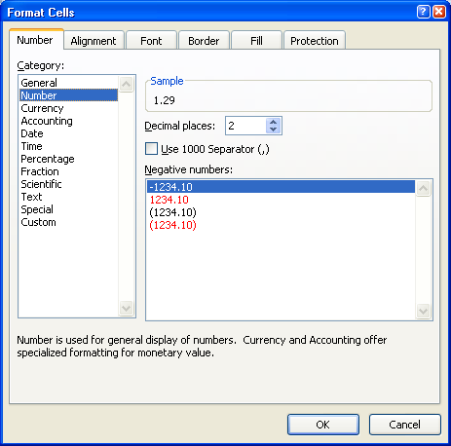

Example 14.1 – Creating Formulas (continued)
At Home menu, click Number button
Or use decimal icon to reduce # of decimal places
Select “Number”
Click on Number tab
Select Number of decimal places
© 2011 Cengage Learning Engineering. All Rights Reserved.
© 2011 Cengage Learning Engineering. All Rights Reserved.
14-<number>

Slide 23
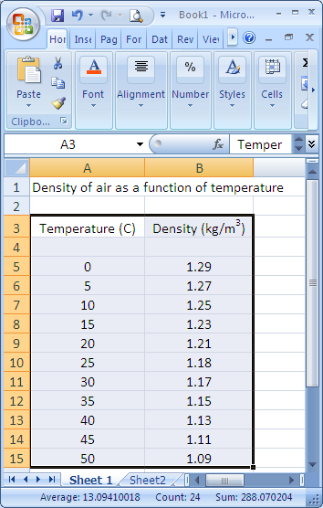

Example 14.1 – Creating Formulas (continued)
Final results, cell contents were centered using the Alignment button from the Home menu
Final results
Then, click the Center icon
© 2011 Cengage Learning Engineering. All Rights Reserved.
© 2011 Cengage Learning Engineering. All Rights Reserved.
14-<number>

Slide 24
Cell Reference
When creating formulas, there are 3 ways to address a cell especially if the Fill command is used
  Absolute cell reference
  Relative cell reference
  Mixed cell reference
© 2011 Cengage Learning Engineering. All Rights Reserved.
© 2011 Cengage Learning Engineering. All Rights Reserved.
14-<number>

Slide 25
Absolute Reference
Absolute cell reference does not change when Fill command is used to copy the formula into other cells
Absolute cell reference is made by $column-letter$row-number, e.g., $A$3
Formulas will always refer to the content of the absolute cell regardless how the formulas are copied
© 2011 Cengage Learning Engineering. All Rights Reserved.
© 2011 Cengage Learning Engineering. All Rights Reserved.
14-<number>

Slide 26
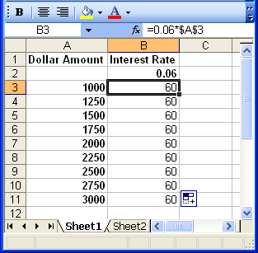
Absolute Reference (continued)
Absolute cell reference
Content of $A$3
Note the results of the formulas copied from cell B3.
© 2011 Cengage Learning Engineering. All Rights Reserved.
© 2011 Cengage Learning Engineering. All Rights Reserved.
14-<number>

Slide 27
Relative Reference
Relative reference changes in the formula when the Fill command is used to copy the formula into other cells
To make a relative reference, $ sign is not needed in the cell address
© 2011 Cengage Learning Engineering. All Rights Reserved.
© 2011 Cengage Learning Engineering. All Rights Reserved.
14-<number>

Slide 28
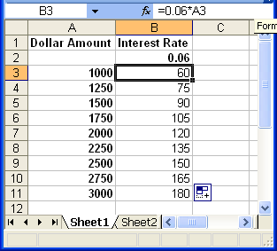
Relative Reference (continued)
Relative cell reference
Content of A3
Fill command was used to copy the formula in cell B3 to B4 to B11.
=0.06*A7
© 2011 Cengage Learning Engineering. All Rights Reserved.
© 2011 Cengage Learning Engineering. All Rights Reserved.
14-<number>

Slide 29
Mixed Reference
Mixed reference can be done in one of two ways:
  keep column absolute and row relative, e.g., $A3
  keep column relative and row absolute, e.g., A$3
© 2011 Cengage Learning Engineering. All Rights Reserved.
© 2011 Cengage Learning Engineering. All Rights Reserved.
14-<number>

Slide 30
Example 14.2 – Cell Reference
Given: interest rate ranges from 6% to 8% and principle ranges from $1000 to $3000.
Find: Using Excel, create a table that shows the relationship between the interest earned and the amount deposited in increments shown in the table
© 2011 Cengage Learning Engineering. All Rights Reserved.
© 2011 Cengage Learning Engineering. All Rights Reserved.
14-<number>

Slide 31
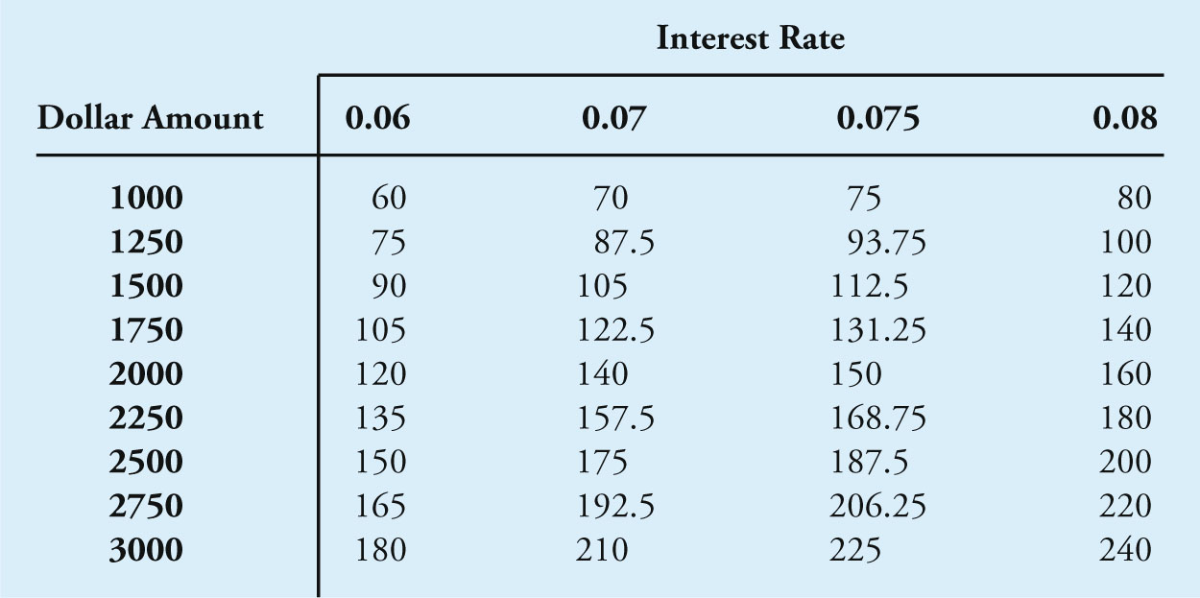
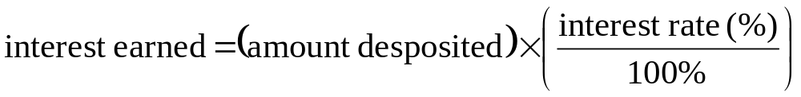
Example 14.2 – Cell Reference (continued)
Find (continued):
Solution:
Relationship between interested earned and amount deposited
© 2011 Cengage Learning Engineering. All Rights Reserved.
© 2011 Cengage Learning Engineering. All Rights Reserved.
14-<number>

Slide 32
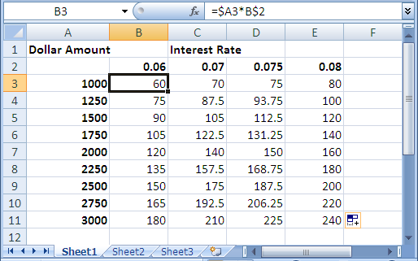
Example 14.2 – Cell Reference (continued)
Type cell formula, note the use of mix reference
Solution (continued):
Use Fill command to copy formula from cell B3 to cells C3:E3
Use Fill command to copy formulas from cells B3:E3 to cells B4:E11
© 2011 Cengage Learning Engineering. All Rights Reserved.
© 2011 Cengage Learning Engineering. All Rights Reserved.
14-<number>

Slide 33
Excel Functions
Excel functions are grouped into categories
  Mathematical
  Trigonometric
  Statistical
  Financial
  Logical
Function can be entered in any cell by
  typing the function name
  using the Paste Function (f_{x}) button
© 2011 Cengage Learning Engineering. All Rights Reserved.
© 2011 Cengage Learning Engineering. All Rights Reserved.
14-<number>

Slide 34
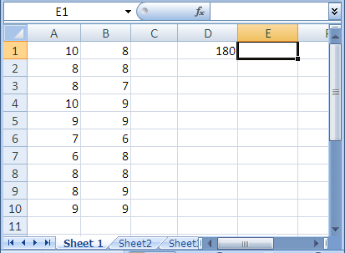
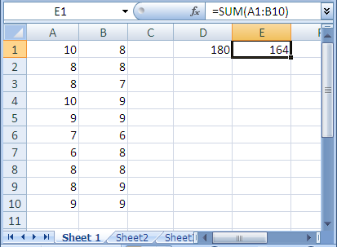
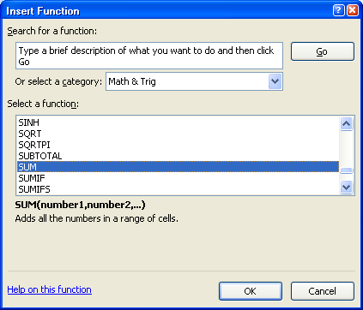
Excel Function
Click the Function button in the Home menu
Select a function category
the answer
Type in formula with SUM function
Select function SUM for cell E1
Help link
© 2011 Cengage Learning Engineering. All Rights Reserved.
© 2011 Cengage Learning Engineering. All Rights Reserved.
14-<number>

Slide 35
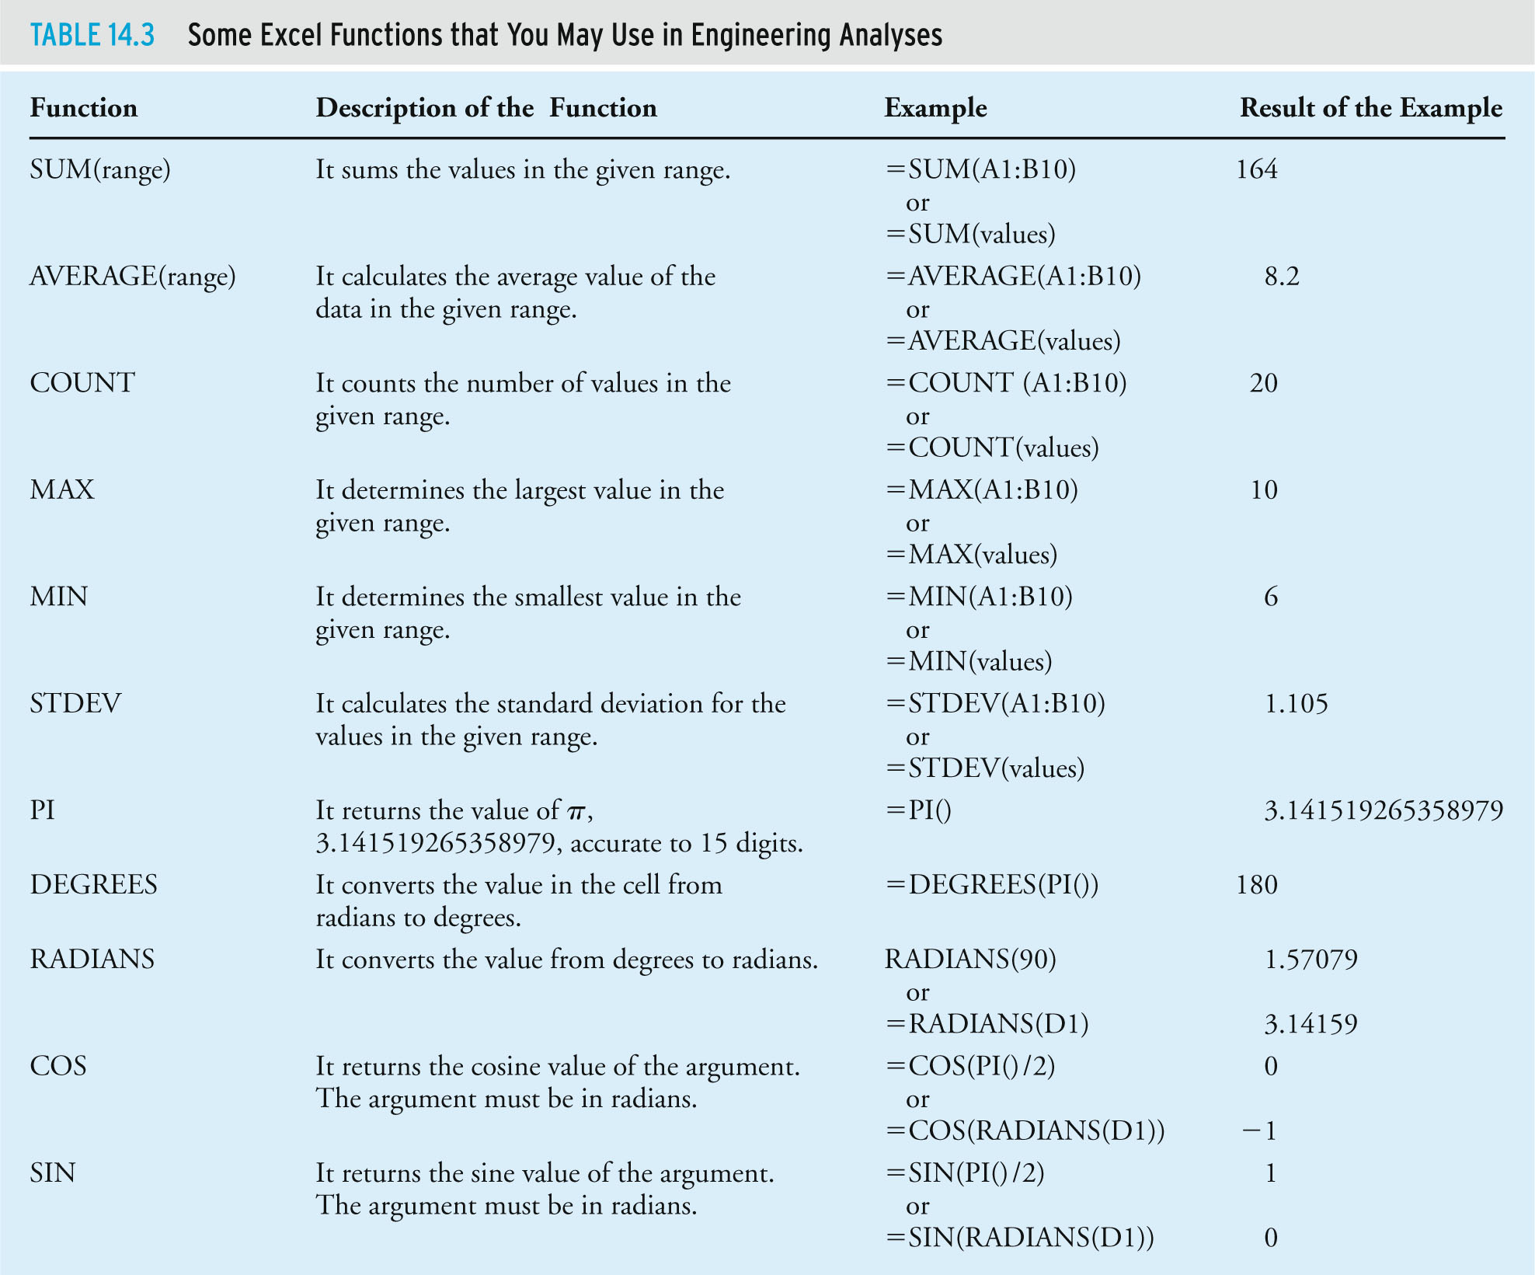
Some Excel Functions
© 2011 Cengage Learning Engineering. All Rights Reserved.
© 2011 Cengage Learning Engineering. All Rights Reserved.
14-<number>

Slide 36
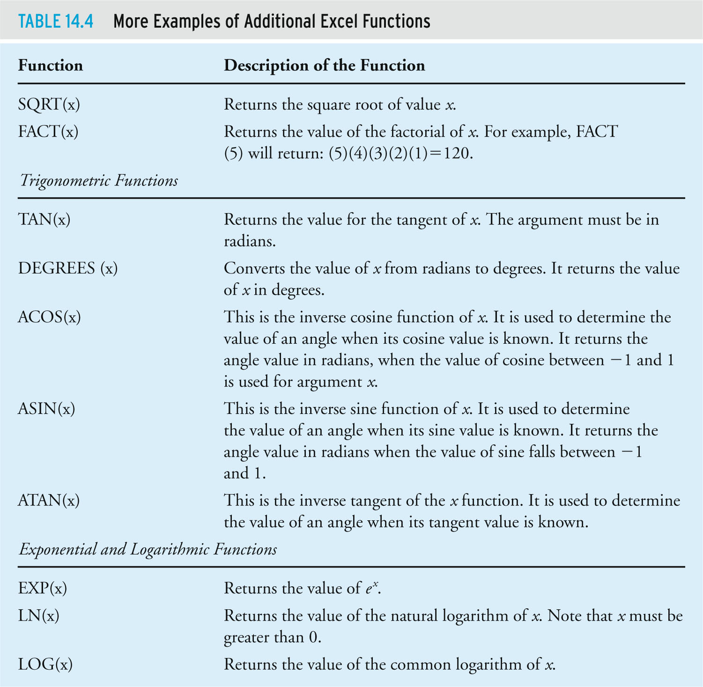
Additional Excel Functions
© 2011 Cengage Learning Engineering. All Rights Reserved.
© 2011 Cengage Learning Engineering. All Rights Reserved.
14-<number>

Slide 37
Example 14.3 – Excel Functions
Given: an Excel worksheet shown in which columns A and B contain the data range which we have named values; cell D1 contains the angle 180.
Find: familiarize yourself with some of the Excel functions used in the cells E1 through E14.
Solution: see Excel functions listed in the next slide
© 2011 Cengage Learning Engineering. All Rights Reserved.
© 2011 Cengage Learning Engineering. All Rights Reserved.
14-<number>

Slide 38
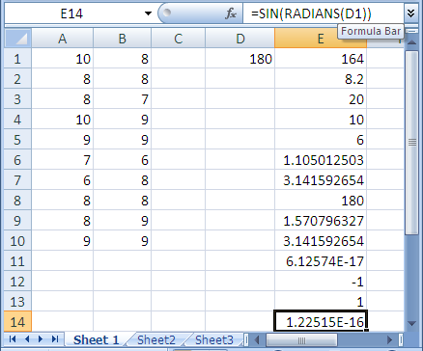
Example 14.3 – Excel Functions (continued)
E1: =SUM(A1:B10)
E2: =AVERAGE(A1:B10)
E3: =COUNT(A1:B10)
E4: =MAX(A1:B10)
E5: =MIN(A1:B10)
E6: =STDEV(A1:B10)
E7: =PI()
E8: =DEGREES(PI())
E9: =RADIANS(90)
E10: =RADIANS(D1)
E11: =COS(PI()/2)
E12: =COS(RADIANS(D1))
E13: =SIN(PI()/2)
E14: =SIN(RADIANS(D1))
© 2011 Cengage Learning Engineering. All Rights Reserved.
© 2011 Cengage Learning Engineering. All Rights Reserved.
14-<number>

Slide 39
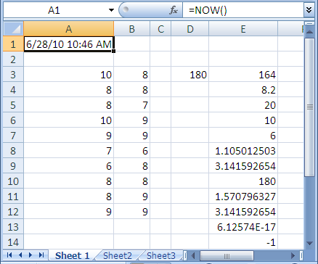
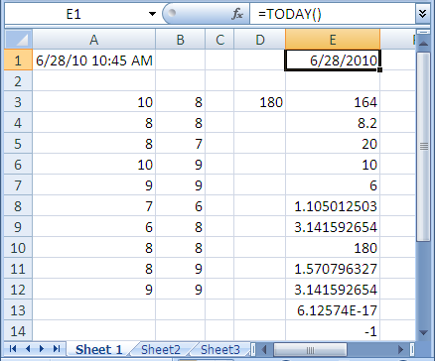
Now and Today Functions
Now and Today functions
Now and Today function values updated automatically
© 2011 Cengage Learning Engineering. All Rights Reserved.
© 2011 Cengage Learning Engineering. All Rights Reserved.
14-<number>

Slide 40
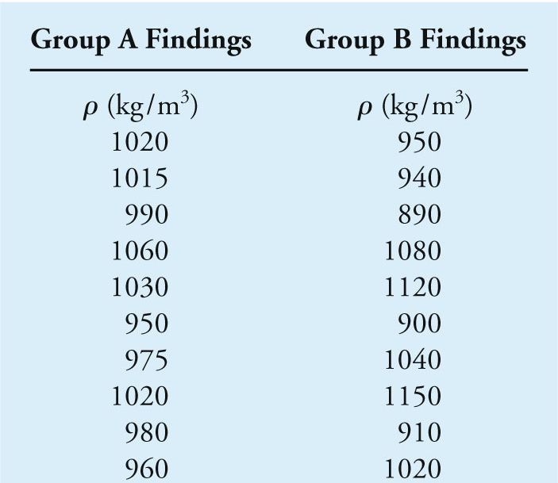
Excel Functions – Example
Given: the water data shown below
Find: use Excel to compute the average and standard deviation of the density of water data
© 2011 Cengage Learning Engineering. All Rights Reserved.
© 2011 Cengage Learning Engineering. All Rights Reserved.
14-<number>

Slide 41
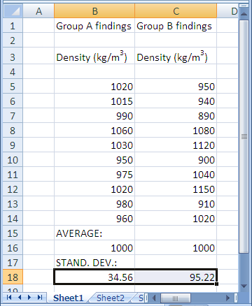
Excel Functions – Example
Solution:
Step 1, type headings
Step 2, type headings
Step 4, type AVERAGE
Step 3, type in the density values
Step 6, type STAND. DEV.
Step 5
B16: =average(B5:B14)
C16: =average(C5:C14)
Step 7
B18: =stdev(B5:B14)
C18: =stdev(C5:C14)
© 2011 Cengage Learning Engineering. All Rights Reserved.
© 2011 Cengage Learning Engineering. All Rights Reserved.
14-<number>

Slide 42
Excel Logical Functions
Logical functions allow us to test various conditions when programming formulas to analyze data
Relational or comparison operators allow us to test relative magnitude of various arguments
© 2011 Cengage Learning Engineering. All Rights Reserved.
© 2011 Cengage Learning Engineering. All Rights Reserved.
14-<number>

Slide 43
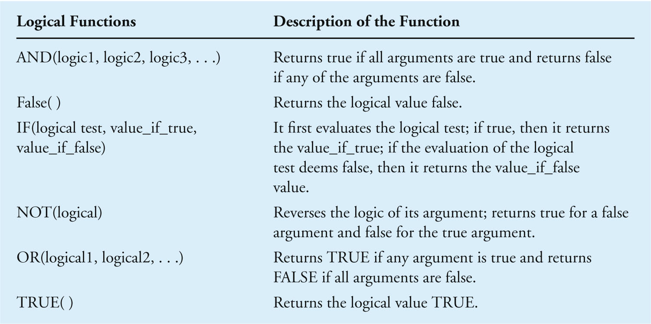
Excel’s Logical Functions
© 2011 Cengage Learning Engineering. All Rights Reserved.
© 2011 Cengage Learning Engineering. All Rights Reserved.
14-<number>

Slide 44
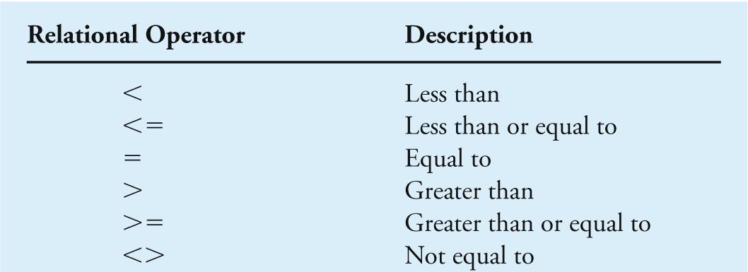
Excel’s Relational or Comparison Operators
© 2011 Cengage Learning Engineering. All Rights Reserved.
© 2011 Cengage Learning Engineering. All Rights Reserved.
14-<number>

Slide 45
Example 14.5 – Excel Logical Functions
Given: the pipeline shown is connected to a control (check) valve that open when the pressure in the line reaches 20 psi. Various readings were taken at different times and recorded.
Find: Using Excel’s logical functions, create a list that shows the corresponding open and closed position of the check valve
Check valve
© 2011 Cengage Learning Engineering. All Rights Reserved.
© 2011 Cengage Learning Engineering. All Rights Reserved.
14-<number>

Slide 46
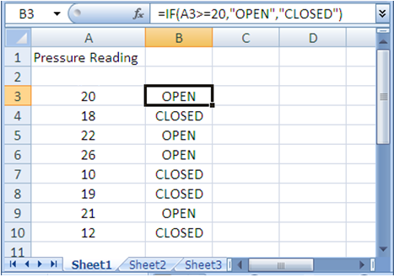
Example 14.5 – Excel Logical Functions (continued)
Solution: Check valve opens when pressure in line reaches 20 kPa
Check valve
(kPa)
Formula using logical function IF and relative operator >=
Use Fill command to copy formula in cell B3 to cells B4 to B10
Type in the values in column A
© 2011 Cengage Learning Engineering. All Rights Reserved.
© 2011 Cengage Learning Engineering. All Rights Reserved.
14-<number>

Slide 47
Plotting with Excel
Use Excel to create charts such as
  Histograms (column or bar charts)
  Pie charts
  Line charts
  XY charts
Most charts we create as engineers are xy-type charts
Chart Wizard walk you through the necessary steps to create a chart
© 2011 Cengage Learning Engineering. All Rights Reserved.
© 2011 Cengage Learning Engineering. All Rights Reserved.
14-<number>

Slide 48
Example 14.6 – Plotting
Given: the results from Example 14.1
Find: create a graph showing the value of air density as a function of temperature.
© 2011 Cengage Learning Engineering. All Rights Reserved.
© 2011 Cengage Learning Engineering. All Rights Reserved.
14-<number>

Slide 49
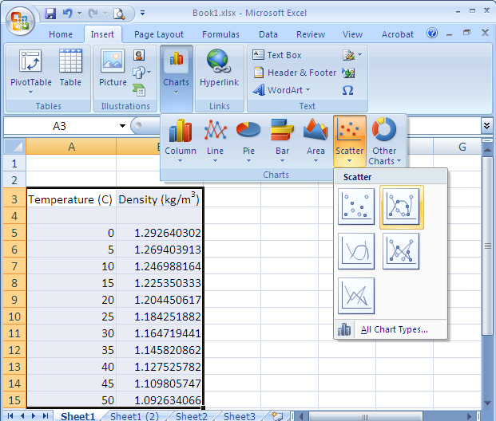
Example 14.6 – Plotting (continued)
Solution:
Click Insert tab
Select Chart Wizard icon
Click Scatter plot
Select XY plot with line
Select the data range
© 2011 Cengage Learning Engineering. All Rights Reserved.
© 2011 Cengage Learning Engineering. All Rights Reserved.
14-<number>

Slide 50
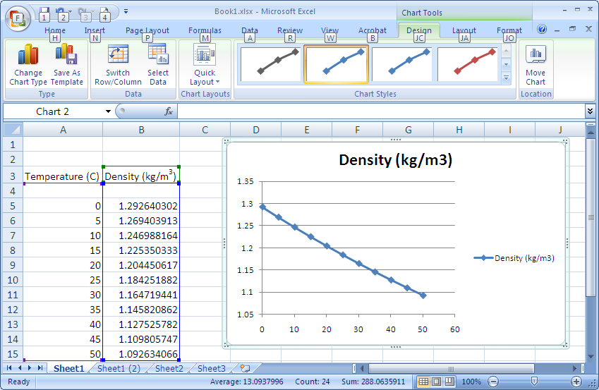
Example 14.6 – Plotting (continued)
Solution (continued): the chart is shown to the right of the data
© 2011 Cengage Learning Engineering. All Rights Reserved.
© 2011 Cengage Learning Engineering. All Rights Reserved.
14-<number>

Slide 51
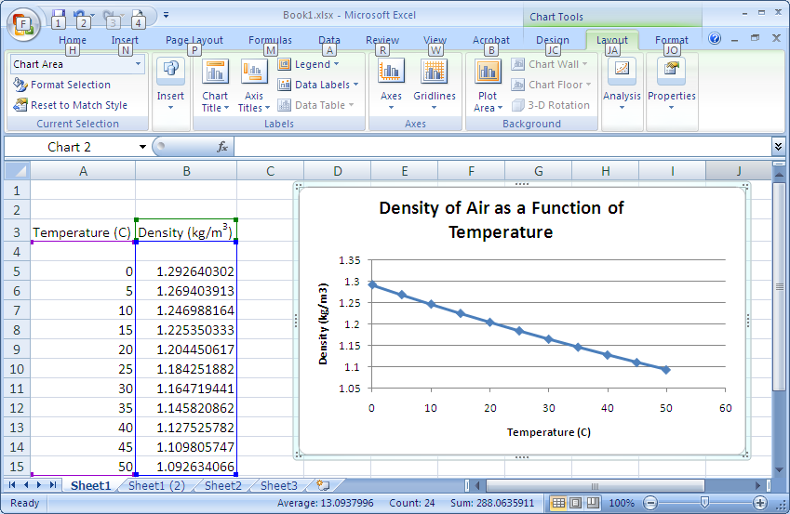
Example 14.6 – Plotting (continued)
Solution (continued): add axis and chart titles by clicking the Layout tab under Chart Tool menu and make necessary modifications
Layout tab
Chart Title and Axis Title icons
© 2011 Cengage Learning Engineering. All Rights Reserved.
© 2011 Cengage Learning Engineering. All Rights Reserved.
14-<number>

Slide 52
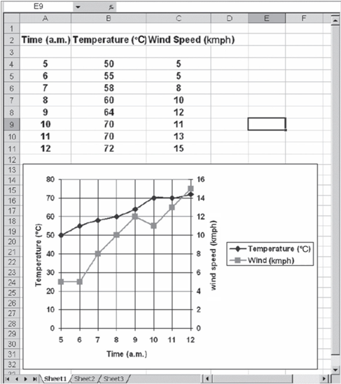
Plotting Two Data Sets with Different Ranges on the Same Chart
Temperature as a function of time
Scale for wind speed
Scale for temperature
Wind speed as a function of time
© 2011 Cengage Learning Engineering. All Rights Reserved.
14-<number>
© 2011 Cengage Learning Engineering. All Rights Reserved.

Slide 53

Example 14.7 – Plotting of Two Data Sets
Given: an empirical relationship between fuel consumption and car speed is given below. Note: V is the speed of the car if mph and the given relationship is valid for 20 ≤ V ≤ 75.
Find: plot the fuel consumption and car speed relationship in both km per liter and liters per km.
© 2011 Cengage Learning Engineering. All Rights Reserved.
© 2011 Cengage Learning Engineering. All Rights Reserved.
14-<number>

Slide 54

Example 14.7 – Plotting of Two Data Sets (continued)
Solution (continued):
Using Excel and the given formula, compute the fuel consumption in km per liter and liters per km
the fuel consumption formula
These values are inverse of those in column B
© 2011 Cengage Learning Engineering. All Rights Reserved.
© 2011 Cengage Learning Engineering. All Rights Reserved.
14-<number>

Slide 55

Example 14.7 – Plotting of Two Data Sets (continued)
Solution (continued): refer to Example 14.6 to create the chart for the first set of data “km per liter”, then go to step 2.
3. Choose Select Data …
2. Right click on Chart area
© 2011 Cengage Learning Engineering. All Rights Reserved.
© 2011 Cengage Learning Engineering. All Rights Reserved.
14-<number>

Slide 56


Example 14.7 – Plotting of Two Data Sets (continued)
Solution (continued): in the Select Data Source,
5. type in series name, and choose the Series X values, and Series Y values
4. click on the Add button
© 2011 Cengage Learning Engineering. All Rights Reserved.
© 2011 Cengage Learning Engineering. All Rights Reserved.
14-<number>

Slide 57

Example 14.7 – Plotting of Two Data Sets (continued)
Solution (continued): Format the curve for the second data set
7. select Series “Gallons per Mile”
6. click on Format button under Chart Tools
8. click on Format Selection icon
© 2011 Cengage Learning Engineering. All Rights Reserved.
© 2011 Cengage Learning Engineering. All Rights Reserved.
14-<number>

Slide 58


Example 14.7 – Plotting of Two Data Sets (continued)
Solution (continued): in Format Data Series,
9. Select the Series Options tab,
10. Select the Secondary axis
11. Select Line Style tab
12. Pull down Dash type and make a selection
© 2011 Cengage Learning Engineering. All Rights Reserved.
© 2011 Cengage Learning Engineering. All Rights Reserved.
14-<number>

Slide 59

Example 14.7 – Plotting of Two Data Sets (continued)
Solution (continued): add title to the secondary axis
13. Click the Layout tab under Chart Tools menu
14. Click the Axis Titles icon to add title for secondary axis
© 2011 Cengage Learning Engineering. All Rights Reserved.
© 2011 Cengage Learning Engineering. All Rights Reserved.
14-<number>

Slide 60

Example 14.7 – Plotting of Two Data Sets (continued)
Solution (continued): Final results
© 2011 Cengage Learning Engineering. All Rights Reserved.
© 2011 Cengage Learning Engineering. All Rights Reserved.
14-<number>

Slide 61
Matrix Computation with Excel
Matrix is an array of numbers, variables, or mathematical terms
Size of a matrix is defined by its number of rows and columns
We denote matrix by a boldface letter in brackets [ ] and { }
© 2011 Cengage Learning Engineering. All Rights Reserved.
© 2011 Cengage Learning Engineering. All Rights Reserved.
14-<number>

Slide 62

Matrix – Definitions
3 by 1 (3x1) column matrix
3 by 3 (3x3) matrix
An element of a matrix
1 by 4 (1x4) row matrix
© 2011 Cengage Learning Engineering. All Rights Reserved.
© 2011 Cengage Learning Engineering. All Rights Reserved.
14-<number>

Slide 63

Example 14.8 – Matrix Algebra (continued)
Given: matrices
Find: Use Excel to perform the following operations:
[A] + [B] = ?
[A] – [b] = ?
[A][B] = ?
[A]{C} = ?
Read chapter 18 for more detailed discussion on matrix algebra
© 2011 Cengage Learning Engineering. All Rights Reserved.
© 2011 Cengage Learning Engineering. All Rights Reserved.
14-<number>

Slide 64

Example 14.8 – Matrix Algebra (continued)
Solution: Type in appropriate values and characters for each matrix
Note: these are boldface
© 2011 Cengage Learning Engineering. All Rights Reserved.
© 2011 Cengage Learning Engineering. All Rights Reserved.
14-<number>

Slide 65

Example 14.8 – Matrix Algebra (continued)
Solution (continued): compute [A] + [B]
Type this formula to add [A] and [B], then while holding down the Ctrl and the Shift keys press the Enter key
Type the heading for part (a)
Select the range B9 to D11
© 2011 Cengage Learning Engineering. All Rights Reserved.
© 2011 Cengage Learning Engineering. All Rights Reserved.
14-<number>

Slide 66

Example 14.8 – Matrix Algebra (continued)
Solution (continued): compute [A] – [B]; Repeat similar steps to calculate [A] – [B]. Use the formula =B3:D5-G3:I5.
Result of [A]+[B]
Result for [A] - [B]
© 2011 Cengage Learning Engineering. All Rights Reserved.
© 2011 Cengage Learning Engineering. All Rights Reserved.
14-<number>

Slide 67

Example 14.8 – Matrix Algebra (continued)
Solution (continued): compute [A][B]
Type the formula =MMULT(B3:D5,G3:I5). While holding down the Ctrl and the Shift keys press the Enter key
Type [A][B] =
Select the range for the result to be displayed
© 2011 Cengage Learning Engineering. All Rights Reserved.
© 2011 Cengage Learning Engineering. All Rights Reserved.
14-<number>

Slide 68

Example 14.8 – Matrix Algebra (continued)
Solution (continued): compute [A]{C}; Repeat similar steps to calculate [A]{C}. Use the formula =MMULT(B3:D5,L3:L5).
Result for [A][B]
Result for [A]{C}
© 2011 Cengage Learning Engineering. All Rights Reserved.
© 2011 Cengage Learning Engineering. All Rights Reserved.
14-<number>

Slide 69

Example 14.9 – System of Linear Equations
Given: system of linear equations
Find: x₁, x₂, x₃
© 2011 Cengage Learning Engineering. All Rights Reserved.
© 2011 Cengage Learning Engineering. All Rights Reserved.
14-<number>

Slide 70

Example 14.9 – System of Linear Equations (continued)
Solution: The system of linear equations can be written into matrix form as shown. .
The solution to this problem is discussed in detail in Chapter 18
© 2011 Cengage Learning Engineering. All Rights Reserved.
© 2011 Cengage Learning Engineering. All Rights Reserved.
14-<number>

Slide 71

Example 14.9 – System of Linear Equations (continued)
Solution (continued): type the appropriate characters and values for [A], {B}, and {C}
© 2011 Cengage Learning Engineering. All Rights Reserved.
© 2011 Cengage Learning Engineering. All Rights Reserved.
14-<number>

Slide 72

Example 14.9 – System of Linear Equations (continued)
Solution (continued): compute the inverse matrix of [A]
Type the formula =MINVERSE(B3:D5), then while holding down the Ctrl and the Shift keys press the Enter key
Select the range of cells where [A]⁻¹ will be displayed
Type [A]⁻¹ =
© 2011 Cengage Learning Engineering. All Rights Reserved.
© 2011 Cengage Learning Engineering. All Rights Reserved.
14-<number>

Slide 73

Example 14.9 – System of Linear Equations (continued)
Solution (continued):
Result for [A]⁻¹
© 2011 Cengage Learning Engineering. All Rights Reserved.
© 2011 Cengage Learning Engineering. All Rights Reserved.
14-<number>

Slide 74

Example 14.9 – System of Linear Equations (continued)
Solution (continued): solving for {X}
Type the formula =MMULT(B9:D11,K3:K5), then while holding down the Ctrl and the Shift keys press the Enter key
Select the range of cells where the values of {X} will be displayed
Type this
© 2011 Cengage Learning Engineering. All Rights Reserved.
© 2011 Cengage Learning Engineering. All Rights Reserved.
14-<number>

Slide 75

Example 14.9 – System of Linear Equations (continued)
Solution (continued): Final results
Answer: values of x₁, x₂, and x₃
© 2011 Cengage Learning Engineering. All Rights Reserved.
© 2011 Cengage Learning Engineering. All Rights Reserved.
14-<number>

Slide 76
Curve Fitting with Excel
Curve fitting deals with finding an equation that best fits a set of data
More applications in numerical methods and other future engineering classes
© 2011 Cengage Learning Engineering. All Rights Reserved.
© 2011 Cengage Learning Engineering. All Rights Reserved.
14-<number>

Slide 77
Curve Fitting with Excel Procedures
Plot data using steps described in previous sections
With the mouse pointer over the data points, right-click the mouse button
Select Add Trendline
In Add Trendline dialog box
  choose the Trend/Regression type desired
  click the Options tab and toggle on
    Set intercept =
    Display equation on chart
© 2011 Cengage Learning Engineering. All Rights Reserved.
© 2011 Cengage Learning Engineering. All Rights Reserved.
14-<number>

Slide 78





Example 14.10 – Curve Fitting
Given: From Chapter 10, we learned that a spring force is given by the equation below. The force-deflection data are plotted as shown.
© 2011 Cengage Learning Engineering. All Rights Reserved.
© 2011 Cengage Learning Engineering. All Rights Reserved.
14-<number>

Slide 79

Example 14.10 – Curve Fitting (continued)
Find: use Excel to obtain an equation that best fits the data.
Solution: Use the XY (Scatter) plot (without connecting points to create the plot blow
© 2011 Cengage Learning Engineering. All Rights Reserved.
© 2011 Cengage Learning Engineering. All Rights Reserved.
14-<number>

Slide 80

Example 14.10 – Curve Fitting (continued)
Solution (continued): With the mouse pointer on the data points, right-click the mouse button. Then select Add Trendline
Select Add Trendline
© 2011 Cengage Learning Engineering. All Rights Reserved.
© 2011 Cengage Learning Engineering. All Rights Reserved.
14-<number>

Slide 81

Example 14.10 – Curve Fitting (continued)
Solution (continued): in Format Trendline,
Select Trend/ Regression Type
Toggle Set Intercept = 0 and Display Equation on Chart
© 2011 Cengage Learning Engineering. All Rights Reserved.
© 2011 Cengage Learning Engineering. All Rights Reserved.
14-<number>

Slide 82

Example 14.10 – Curve Fitting (continued)
Solution (continued): Final display of trendline
© 2011 Cengage Learning Engineering. All Rights Reserved.
© 2011 Cengage Learning Engineering. All Rights Reserved.
14-<number>

Slide 83

Example 14.10 – Curve Fitting (continued)
Solution (continued): Final display of trendline
Edit the equation as desired
© 2011 Cengage Learning Engineering. All Rights Reserved.
© 2011 Cengage Learning Engineering. All Rights Reserved.
14-<number>

Slide 84

Example 14.10 – Curve Fitting (continued)
Solution (continued): comparison between the measured and predicted spring force is given below
© 2011 Cengage Learning Engineering. All Rights Reserved.
© 2011 Cengage Learning Engineering. All Rights Reserved.
14-<number>

Slide 85

Example 14.11 – Curve Fitting
Given: a set of data points.
Find: the equation that best fits the data shown
© 2011 Cengage Learning Engineering. All Rights Reserved.
© 2011 Cengage Learning Engineering. All Rights Reserved.
14-<number>

Slide 86

Example 14.11 – Curve Fitting (continued)
Solution: Plot the data as described in previous sections, with the mouse pointer on the data points right-click the mouse button. Then select Add Trendline (see Example 14.10 for more detail).
Select Add Trendline
© 2011 Cengage Learning Engineering. All Rights Reserved.
© 2011 Cengage Learning Engineering. All Rights Reserved.
14-<number>

Slide 87

Example 14.11 – Curve Fitting (continued)
Solution (continued): in Format Trendline,
Select Trend/ Regression Type
Toggle Display Equation on Chart and Display R-squared value on Chart
© 2011 Cengage Learning Engineering. All Rights Reserved.
© 2011 Cengage Learning Engineering. All Rights Reserved.
14-<number>

Slide 88

Example 14.11 – Curve Fitting (continued)
Solution (continued): The resulting quadratic curve, equation and R² value. R² is the coefficient of determination; R² = 1  a perfect fit, and R²  0  an extremely poor fit
© 2011 Cengage Learning Engineering. All Rights Reserved.
© 2011 Cengage Learning Engineering. All Rights Reserved.
14-<number>

Slide 89

Example 14.11 – Curve Fitting (continued)
Solution (continued): comparison between actual and predicted y values
© 2011 Cengage Learning Engineering. All Rights Reserved.
© 2011 Cengage Learning Engineering. All Rights Reserved.
14-<number>

Slide 90
Summary
You should know that a spreadsheet is a tool that can be used to solve an engineering problem
  use a spreadsheet to present the results of an analysis in a chart form
  input your own formulas
  use the built-in functions provided by the spreadsheet
You should know how to move around in a workbook and input into different cells.
© 2011 Cengage Learning Engineering. All Rights Reserved.
© 2011 Cengage Learning Engineering. All Rights Reserved.
14-<number>

Slide 91
Summary (continued)
You should know how to edit the content of a cell.
You should know how to select multiple cells and create a range.
You should realize you can name a range and use the name in formulas or in plotting data.
You should understand how to refer to a cell by its address.
© 2011 Cengage Learning Engineering. All Rights Reserved.
© 2011 Cengage Learning Engineering. All Rights Reserved.
14-<number>

Slide 92
Summary (continued)
You should know the difference among a cell’s relative, absolute, and mixed address.
You should know when to use the proper cell address when creating formulas.
You should be familiar with Excel’s built-in functions.
You should know how to insert cells, columns, and rows in an existing worksheet.
© 2011 Cengage Learning Engineering. All Rights Reserved.
© 2011 Cengage Learning Engineering. All Rights Reserved.
14-<number>

Slide 93
Summary (continued)
You should know how to create a proper engineering chart using Excel.
You should know how to perform matrix operations with Excel.
You should know how to perform curve fitting with Excel.
© 2011 Cengage Learning Engineering. All Rights Reserved.
© 2011 Cengage Learning Engineering. All Rights Reserved.
14-<number>

