Slide 1
LEADERSHIP & MANAGEMENT
by ÖZLEM YILMAZ

Slide 2
LEADERSHIP...
...leadership is about coping w/producing the change
  covers setting the direction of change by putting a vision and strategy
  being able to generate highly energized behavior of people; inspires & motivates people by satisfying basic human needs

Slide 3
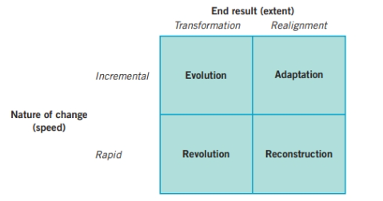
TYPES OF CHANGE...
Get on the balcony & identify (frame key Qs & issues) the adaptive challenge!
  Adaptation, builds on the prior strategy rather than fundamental change; change in product design, methods of production, launch of new products
  Reconstruction (turnaround), restructuring- changes in organizational structure-cost structure, acquisition, reinvestment, has the aim of fast recovery
  Revolution, rapid & major strategic and cultural change (involve strategic direction, top mngt change, culture change)
  Evolution, gradual transformation

Slide 4
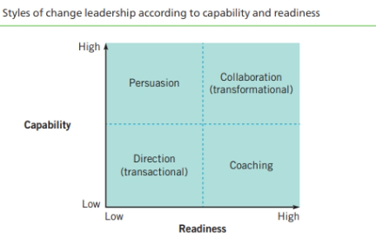
Capabılıty & readıness to change
  Regulate distress, let the organization feel the external pressure within a range, challenge current roles & unproductive norms
  Maintain disciplined attention, demonstrate collaboration and solve problems
  Give work back to employees, support rather than control
  Protect leadership voices from below, ask ‘what is this guy talking about? Have we missed sth?’

Slide 5
«if you think your teacher is tough wait till you get a boss»

Slide 6
«if you think your teacher is tough wait till you get a boss»
Bill Gates is not known for engaging or adaptive communication. Rather, he is well known to be rude, abrasive, and sometimes dismissive of others’ ideas. He once stated his hiring practice as, “I don’t hire bozos,” who will tell me how to run my business, and demonstrated foresight in his hiring by actively selecting dedicated, hard-working individuals at the initial development stages of Microsoft.
Confrontational taskmaster; Microsoft was a high-stress environment because Bill drove others as hard as he drove himself. He was growing into the taskmaster who would prowl the parking lot on weekends to see who’d made it in. People were already busting their tails, and it got under their skin when Bill hectored them into doing more. Bill liked to hash things out in intense, one-on-one discussions; he thrived on conflict and wasn’t shy about instigating it. Being a task-oriented leader he helped the team understand their goal by providing a series of steps that structure their initial meetings. He said “I believe that if you show people the problems and if you show them the solutions they will be moved to act”.

Slide 7
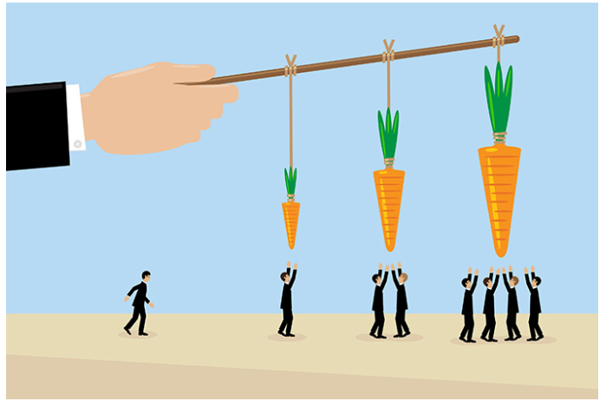
Transactional Leadership...
...was first described by Max Weber in 1947, then by Bernard Bass in 1981
...is most often used by the managerial leaders
...focuses on controlling, organizing, and short-term planning
...consider rewards and punishments as the basis for actions
  if the follower does what is desired, a reward will follow
  if he does not, a punishment will follow
...the power of transactional leaders comes from their formal authority and responsibility/position power
...the main goal of the follower is to obey the instructions, telling style

Slide 8
Transformational Leadership...
...was first introduced by Dowton in 1973 and then by James MacGregor Burns, first started w political leaders then used for corporate leaders as well
..."is the process whereby a person engages with others and creates a connection that raises the level of motivation and morality in both the leader and the follower"
... was the first developed and validated theory to emphasis morals and values in leadership
... focuses on how leaders can create valuable and positive change in their followers
...focuses on treating employees as human beings rather than just numbers
Followers of a transformational leader respond by feeling trust, admiration, loyalty, and respect for the leader and are more willing to work harder than originally expected.

Slide 9
Transformational Leadership...
...talks about the kind of leader who is inspirational and charismatic, encouraging their followers to transform and become better in whatever they are doing
  ...charisma plays an important role, so does behavior
    transformational leaders appear competent to their followers
    they are role models for values and morals
    they ensure that goals are clear, they set high expectations, and they motivate their followers
  ...transformational leaders have the respect of their followers and their followers have a high degree of trust towards the leader

Slide 10
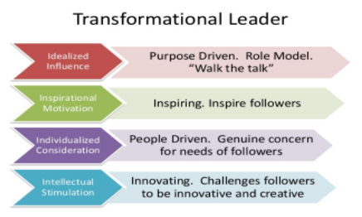
Transformational Leadership...
4 factors of transformational leadership by Bernard M. Bass;
...idealized influence, leaders appear competent to their followers, they are role models for values and morals, they ensure that goals are clear, they set high expectations, and they motivate their followers
...inspirational motivation; leaders set and communicate high expectations for their followers. This leader inspires his/her followers using motivation to get them on board with the mission and vision
...individualized consideration, leaders who take the time to talk to and listen to each of their followers and treats them with respect and dignity
...intellectual stimulation, leaders who encourage followers to seek out creativity and innovation

Slide 11
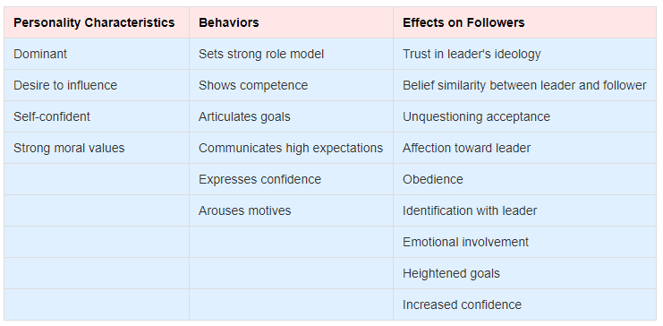
Transformational Leadership...
Followers of a transformational leader respond by feeling trust, admiration, loyalty, and respect for the leader and are more willing to work harder than originally expected.

Slide 12
Transformational Leadership...
Transformational leadership;
  requires vision, values, initiative and a drive to instill that vision and the values into the culture
  is a composition of many leadership elements which requires action from the leader
  also has the potential to be used negatively by leaders “faking it.”

Slide 13
Leadership STYLES...
Transactional leadership | Transformational Leadership
Leadership is responsive | Leadership is proactive
Designing systems & controls, works within the culture | Builds a vision, works to change the culture by implementing new ideas
Transactional leaders make employees achieve the objectives through rewards and punishment | Transformational leaders motivate and empower people to achieve the objectives by appealing to higher ideals and moral values
Motivates followers by appealing to their own self-interest | Motivates followers by encouraging them to transcend their own interests for those of the group or unit

Slide 14
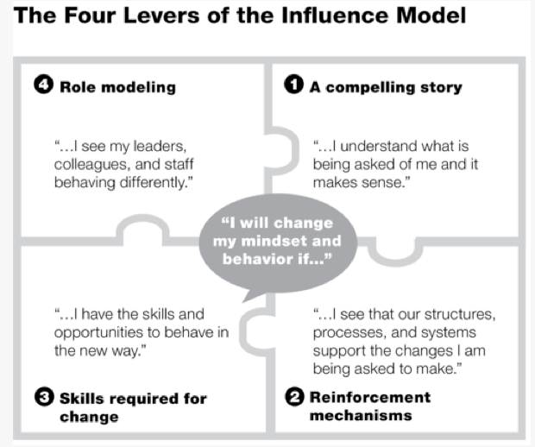

Slide 15
WHAT IS CULTURE?

Slide 16
Culture is the assumptions, beliefs, behaviors and routines that are the characteristics of A COMMUNITY

Slide 17
culture eats strategy for breakfast...
Peter drucker

Slide 18
WHAT IS CULTURE?
Organizational culture is
  ...“the way things are done” OR “how organizations ‘do things’.”
“We are what we repeatedly do.”
  ...repeated behavior or habits as the core of culture
  ...focuses our attention on the forces that shape behavior in organizations, and so highlights an important question: are all those forces (including structure, processes, and incentives) “culture” or is culture simply the behavioral outputs?
“Organizational culture is civilization in the workplace.”
  ...cultural norms define what is encouraged, discouraged, accepted, or rejected within a group
  When properly aligned with personal values, drives, and needs, culture can unleash tremendous amounts of energy toward a shared purpose and foster an organization’s capacity to thrive.

Slide 19
Culture is the organization’s immune system
Culture is a form of protection that has evolved from situational pressures. It prevents “wrong thinking” and “wrong people” from entering the organization in the first place. It says that organizational culture functions much like the human immune system in preventing viruses and bacteria from taking hold and damaging the body. The problem, of course, is that organizational immune systems also can attack agents of needed change, and this has important implications for on-boarding and integrating people into organizations.

Slide 20
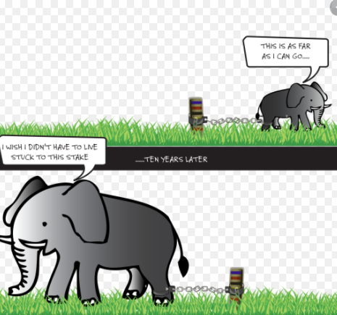
Learned helplessness is behavior exhibited by a subject after enduring repeated aversive stimuli beyond their control. It was initially thought to be caused from the subject's acceptance of their powerlessness: discontinuing attempts to escape or avoid the aversive stimulus, even when such alternatives are unambiguously presented. Upon exhibiting such behavior, the subject was said to have acquired learned helplessness

Slide 21
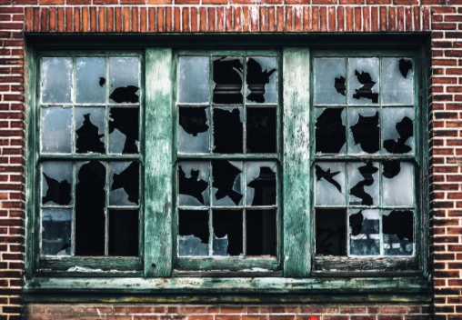
The broken windows theory is a criminological theory that states that visible signs of crime, anti-social behavior and civil disorder create an urban environment that encourages further crime and disorder, including serious crimes.
The theory was introduced in a 1982 article by social scientists James Q. Wilson and George L. Kelling
*from Wikipedia, the free encyclopedia

Slide 22
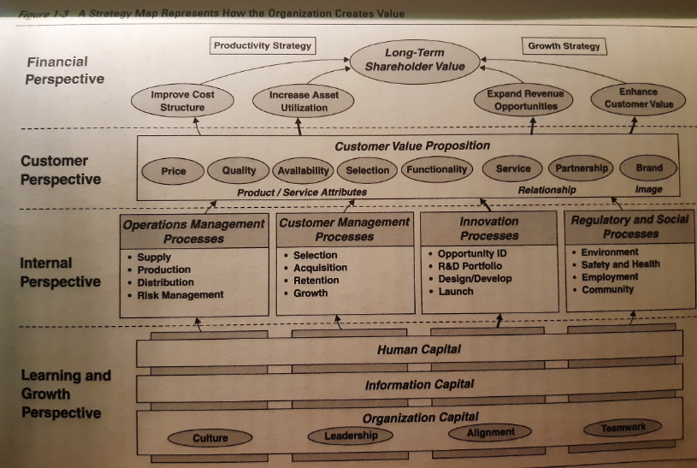
Mappıng a strategy…

Slide 24
REINFORCEMENT MECHANISMS...
Corporate Governance
Organizational Structure
Performance Management
Talent Management
People Development
Remuneration & Reward & Recognition

Slide 25
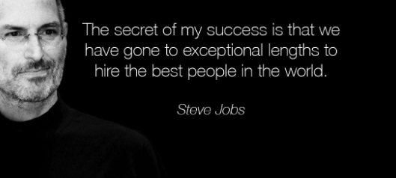

Slide 26
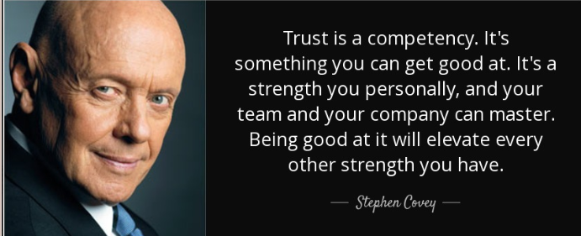
WHAT IS COMPETENCY?
Competency is the capability to apply or use the set of related knowledge, skills, and abilities required to successfully perform ‘critical work functions’ or tasks in a defined work setting.
Competencies= Skills + Knowledge + Abilities + Characteristics
Competencies specify the “how” (as opposed to the what) of performing job tasks, or what the person needs to do the job successfully.

Slide 27
What ıs talent?
According to McKinsey, the talent is sum of;
a person’s abilities
her/his instinct gifts,
skills, knowledge, experience
intelligence
judgement, attitude, character, drive
her/his ability to learn and grow
TALENT= COMPETENCE + COMMITMENT + CONTRIBUTION
  being competent
  being committed to the causes and goals of the organization
  be able to and willing to contribute to the success of the organization

Slide 28
WHAT IS TALENT MANAGEMENT?
TM introduced by McKinsey consultants, late 1990s
TM;
  is defined as the critical success factor in corporate world
  focuses on;
    differentiated performance & potential: A, B, C players that are influencing the performance and success of the organization
    identifying key positions

Slide 29
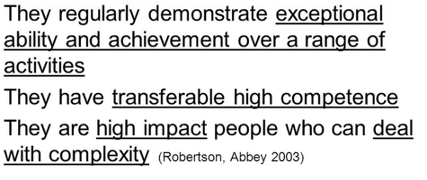
WHAT IS TALENT MANAGEMENT?
Talent management is the full scope of HR processes to attract, develop, motivate and retain high-performing & high quality employees.
TM;
  is a constant and continuous process, concentrating on today & future
  focuses on high-quality employees to improve their performance & grow their optimal capability in strategic key positions
  is the science of using strategic human resources planning improve business value
  has a direct link with the business strategy

Slide 30
“When people are financially invested, they want a return. When people are emotionally invested, they want to contribute.”
Simon Sinek - “Start With Why”

Slide 31
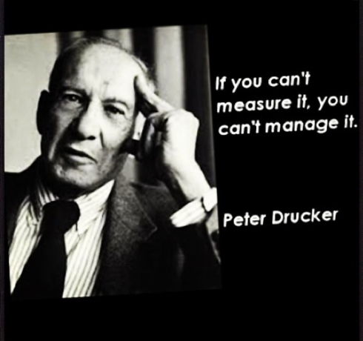

Slide 32
WHAT IS PERFORMANCE MANAGEMENT?
A simple definition of performance management;
  ‘the translation of plans into results-execution’
PM is the answer of the Q of companies;
  How are we going to win- and keep winning?
It is an umbrella concept;
  It integrates operational and financial information into a single decision support and planning framework.

Slide 33
Why ıs PM ımportant?
It is the process of managing an organization’s strategy by deductive & inductive methods
  Deductive; cascading the corporate goals to department, team and individual goals
  Inductive; the outcomes of individual goals to team and department results, and finally corporate goals’ results
Performance management makes executing the strategy everyone’s number-one-job- it makes employees behave like they are the business owners.

Slide 34
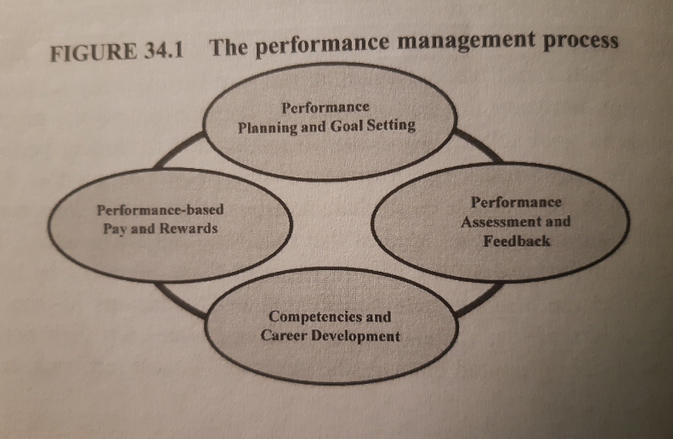

Slide 35
PLANNING AND GOAL SETTING
…defining individual’s goals and desired performance
    using both quantitative and qualitative factors
    linked to the performance expectations of teams, departments and corporation
    communication is critical
Goals/Targets should be;
  SMART
    S
    M
    A
    R
    T

Slide 36
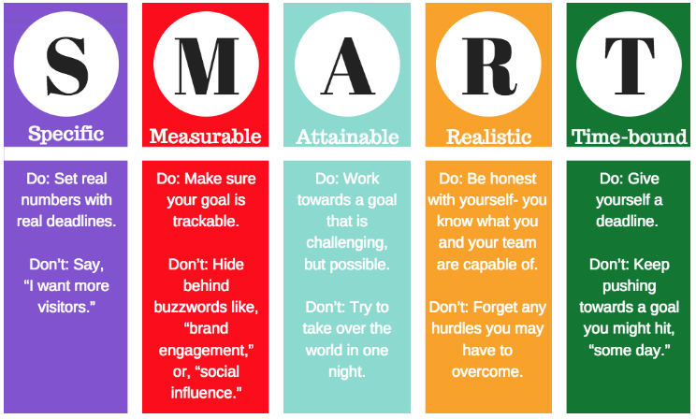

Slide 37
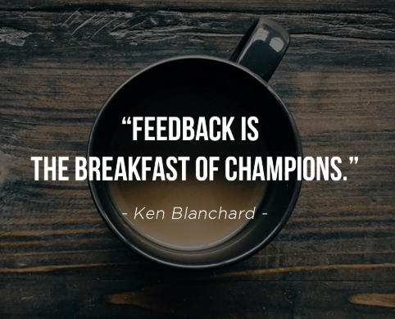
ASSESSMENT AND FEEDBACK
…tracking results
    discussing how well things are going and addressing factors that are inhibiting success
    the discussion of ‘what was accomplished’ also needs to include the process used ‘how they were accomplished’
    preferably twice in a year; a mid-year and year-end assessment & feedback
    an ongoing communication

Slide 38
PAY & REWARDS…
…determining the level of the rewards appropriate to individual’s performance and contributions
    rewards may consist of pay increases, bonus, payouts, special awards
      pay increase, it becomes one of the parameters to define the increase %
      bonus/pay out/incentive for an individual contribution or collaborative performance
    unsatisfactory performance also has an effect on the income, either at the increase % and/or bonus payment

Slide 39
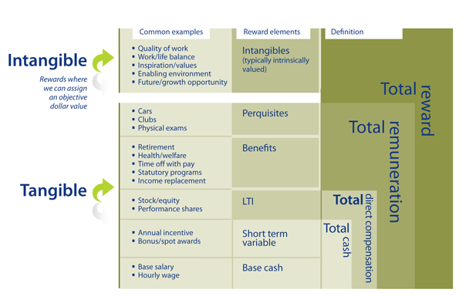

Slide 40
remuneration…
Remuneration refers to all forms of financial returns and tangible services and benefits employee receive as a part of employment relationship.
Forms of Pay & Benefits;
  Base/ Cash compensation
  Allowances (legal & fringe benefits)
  Incentives
  Bonus
  Long Term Incentives

