Slide 1
Query Performance Analysis

Slide 2
Introduction to DBMS

Slide 3
DBMS Main Components
Query Processor
Storage Manager
Disk Storage

Slide 4
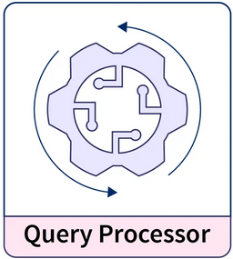

Slide 5
Query Processor
Its responsible for executing the query without any failure.
It consists of:
Data Manipulation Language (DML) compiler.
Data Definition Language (DDL) interpreter.
Query Evaluation/Execution Engine.

Slide 6
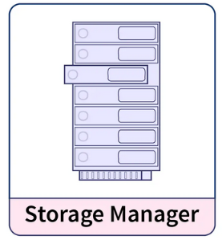

Slide 7
Storage Manager
It’s an interface between the stored data and the user queries.
It consists of:
Authorization and Integrity Manager (executing DCL statements)
Transaction Manager.
File Manager.
Buffer manager.

Slide 8
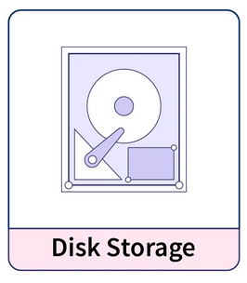

Slide 9
Disk Storage
Implementing the data structure to store various types of data.
It consists of:
Data Files.
Data Dictionaries.
Indices.
Statistical Data.

Slide 10
How to write a fast query:
Minimize the use of wildcard characters.
Avoid Sub-queries.
Only select the columns you need.
Use EXISTS instead of IN.
The less data you process the better (apply filters as soon as possible).
Move complex operations later in the pipeline.

Slide 11
Benchmarking A Query:
Execution plan

Slide 12
All the queries were tested using:
CPU: Ryzen 5 3600@3.0Ghz.
RAM: 16GB DDR4@2400MHZ.
SSD: ADATA SU630 QLC read/write speeds of up to 520/450MB/s.

Slide 13
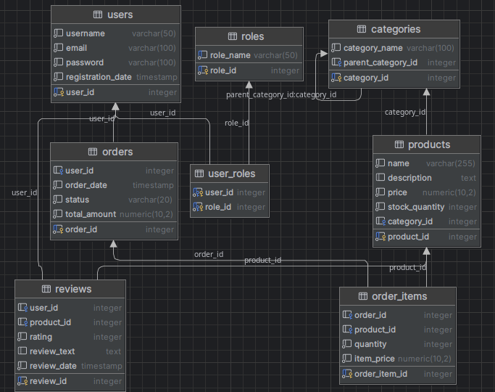
How to read execution plans:

Slide 14
How to read execution plans:
SELECT DISTINCT username
FROM users
WHERE user_id IN (
SELECT DISTINCT user_id
FROM orders
);
Executed in 3.7 Sec

Slide 15
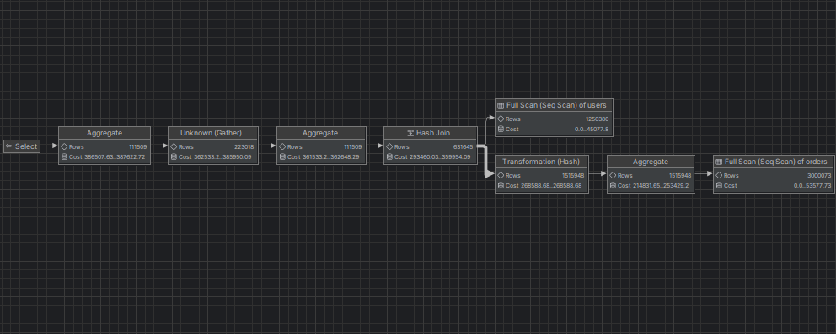
How to read execution plans:

Slide 16
How to read execution plans:
SELECT DISTINCT username
FROM users u
WHERE EXISTS (
SELECT 1
FROM orders o
WHERE o.user_id = u.user_id
);
Executed in 2.4 Sec

Slide 17
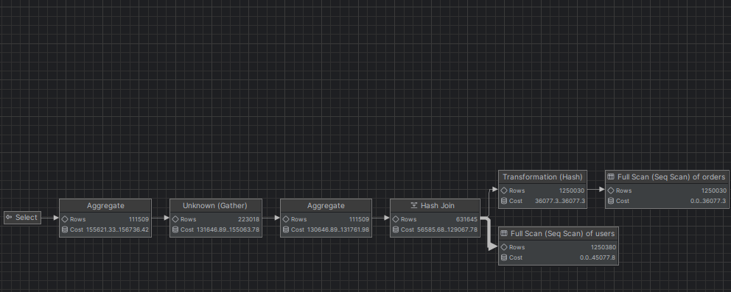
How to read execution plans:

Slide 18
Structural Factors To Improve Queries Performance

Slide 19
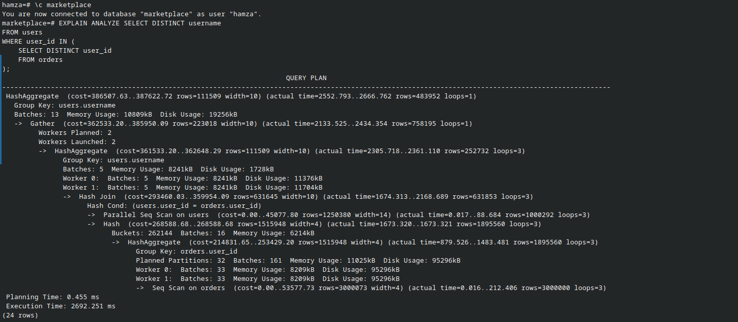
Consistent Gets:

Slide 20
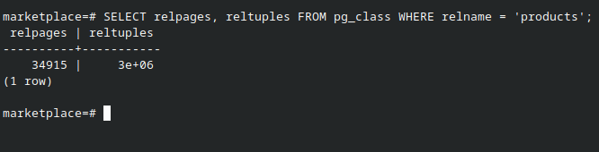
Disk Pages:

Slide 21
Clustering Factor:
A measure of how well the data in a table is physically ordered or clustered with respect to the order of the index. It provides information about how efficiently the data is organized on disk in relation to the order specified by the index.

Slide 22
Prepared Statements:
Prepared statements in PostgreSQL, like in many other relational database management systems (RDBMS), are a way to optimize and reuse SQL queries. They are particularly useful when you have SQL queries that you need to execute multiple times with different parameter values. Prepared statements offer several benefits, including improved performance.

Slide 23
Indexing:
This Query shows every username that ordered 10 or more products from the same category.
SELECT
u.username,
c.category_name,
COUNT(p.product_id) AS product_count
FROM
users u
JOIN
orders o ON u.user_id = o.user_id
JOIN
order_items oi ON o.order_id = oi.order_id
JOIN
products p ON oi.product_id = p.product_id
JOIN
categories c ON p.category_id = c.category_id
WHERE
o.status = 'Delivered'
GROUP BY
u.username, c.category_name
HAVING
COUNT(p.product_id) > 10
ORDER BY
product_count DESC;

Slide 24
Indexing:

Slide 25
Materialized Views:
SELECT
p.product_id,
p.name AS product_name,
COUNT(oi.order_id) AS order_count
FROM
products p
JOIN
order_items oi ON p.product_id = oi.product_id
GROUP BY
p.product_id, p.name
ORDER BY
order_count DESC;
CREATE MATERIALIZED VIEW product_order_counts AS
SELECT
p.product_id,
p.name AS product_name,
COUNT(oi.order_id) AS order_count
FROM
products p
JOIN
order_items oi ON p.product_id = oi.product_id
GROUP BY
p.product_id, p.name;

Slide 26
Materialized Views:

Slide 27


Slide 28
TimescaleDB:
Hypertables.
Data Compression.
Indexing Strategies (Time and space based indexing).

Slide 29
Thanks!
Any Questions?

