Slide 1
MyFitnessPlus
Project Progress Review Presentation
A Comprehensive Fitness Tracking Web Application
February 2026

Slide 2
Agenda
1. Project Overview
2. Stakeholder Identification (Onion Model)
3. Functional & Non-Functional Requirements
4. Use Case Diagram
5. System Architecture & Technology Stack
6. Component Structure & Data Organisation
7. Key Diagrams (Sequence, Activity)
8. Algorithms & Calculations
9. Updated Time Schedule
10. Summary & Next Steps

Slide 3
Project Overview
What is MyFitnessPlus?
Purpose
Key Features
• Full-stack fitness tracking web application
• Helps users plan meals, workouts & track progress
• Traffic-light system for progress visualisation
• Goal setting & achievement tracking
• Personal dashboard with daily/weekly summaries
• User Authentication (Register/Login/Logout)
• Interactive Dashboard with summary cards
• Weekly Meal Prep planner with macro tracking
• Structured Workout Plans (7-day schedule)
• Goals Tracker with progress percentages
• Progress Monitoring (RAG traffic light system)

Slide 4
Stakeholder Identification
Onion Model
External Environment
Core Product
Wider Business
Developer, Project Owner
The System
The System
Core Product
End Users (fitness enthusiasts), Testers, UI/UX review
Dev Team
Wider Business
Module Supervisor, University, Peer Reviewers
External
Fitness industry trends, Regulatory (data privacy), Competitor apps

Slide 5
Stakeholder Roles & Interests
Developer / Project Owner
End Users (Fitness Enthusiasts)
Module Supervisor / University
External (Industry / Competitors)
• Designs, develops & tests the application
• Makes all technical & scope decisions
• Responsible for meeting deadlines
• Primary audience for the application
• Need intuitive UI & useful features
• Their feedback shapes feature priority
• Sets project requirements & grading criteria
• Provides guidance & milestone check-ins
• Ensures academic standards are met
• Fitness market trends influence features
• GDPR / data privacy regulations apply
• Competitor analysis shaped feature set

Slide 6
Functional Requirements
Implemented Features ✅
Authentication & User Management
Core Features
✅ User registration with validation (name, email, password)
✅ User login with JWT token-based authentication
✅ Persistent login sessions via localStorage
✅ Protected routes / authorisation middleware
✅ Logout functionality & token invalidation
✅ Auto-redirect based on auth state
✅ Dashboard with daily summary & weekly highlights
✅ Weekly Meal Prep planner (calorie & protein tracking)
✅ Structured Workout Plan (7-day, exercises with sets/reps)
✅ Goals Page (progress %, status tracking, achievements)
✅ Progress Page (RAG traffic-light system, 6 categories)
✅ Responsive navigation bar & landing page

Slide 7
Functional Requirements
Pending / In Progress 🔧
Data Persistence & Backend
Enhancements
🔧 Persist meal plans to database (currently mock data)
🔧 Persist workout plans to database
🔧 Persist goals & progress data to database
🔧 CRUD API routes for meals, workouts, goals
🔧 User-specific data storage & retrieval
🔧 User profile editing (name, weight, preferences)
🔧 Custom meal & workout creation (user input)
🔧 Historical progress charting over time
🔧 Notification/reminders for goals
🔧 Mobile responsive refinements
🔧 Deployment to production (cloud hosting)

Slide 8
Non-Functional Requirements
🔒 Security
⚡ Performance
🎨 Usability
🔧 Maintainability
• JWT token-based authentication
• Bcrypt password hashing (salt rounds: 10)
• Protected API routes with middleware
• Input validation with express-validator
• React SPA with client-side routing
• Minimal API calls, local state management
• Optimised re-renders with React hooks
• Concurrent dev server (backend + frontend)
• Clean, modern dark-themed UI
• Intuitive navigation with visual feedback
• Traffic light system for quick understanding
• Consistent design language across pages
• Modular component-based architecture
• Separation of concerns (MVC pattern)
• Centralised API service layer
• Context API for state management

Slide 9
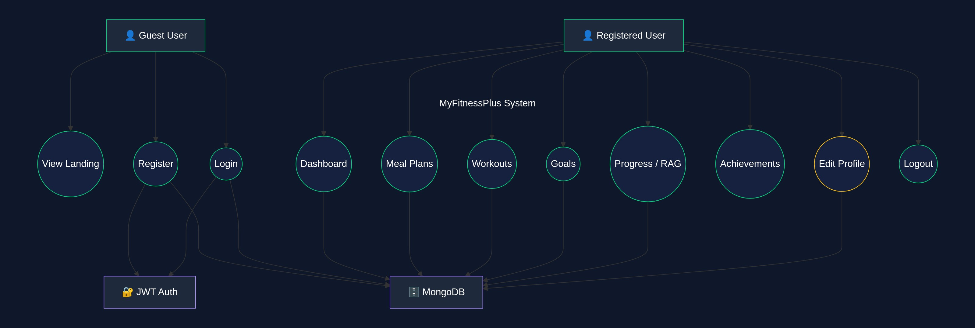
Use Case Diagram
System interaction modelling

Slide 10
Overall System Architecture
3-Tier Client-Server Architecture
Presentation Tier
Application Tier
Data Tier
React 18 SPA
Node.js + Express
MongoDB + Mongoose
• React Components (Pages & UI)
• React Router v6 (Client Routing)
• Context API (State Management)
• Axios (HTTP Client)
• CSS Stylesheets (Responsive Design)
• Express.js REST API Server
• JWT Authentication Middleware
• Express-Validator (Input Validation)
• CORS Middleware
• Route Controllers (Auth, Health)
• MongoDB Database (NoSQL)
• Mongoose ODM (Schema Modelling)
• User Model (name, email, password)
• Bcrypt (Password Hashing)
• Future: Meal, Workout, Goal models

Slide 11
Technology Stack
Frontend
Backend
Dev Tools
React 18.2 (UI Library)
React Router DOM 6.21 (Routing)
Axios 1.6 (HTTP Client)
Context API (State Management)
CSS3 (Custom Styling)
Create React App (Build Tool)
Node.js (Runtime)
Express 4.18 (Web Framework)
MongoDB (NoSQL Database)
Mongoose 8.0 (ODM)
JWT (Authentication)
Bcrypt.js (Password Hashing)
Nodemon (Hot Reload - Server)
Concurrently (Parallel Dev)
Express-Validator (Validation)
dotenv (Environment Config)
CORS (Cross-Origin Requests)
Git (Version Control)

Slide 12
Component Structure
Frontend & Backend Architecture
Frontend (React)
Backend (Node/Express)
📁 src/
├── App.js (Router & Layout)
├── components/
│ ├── Navbar.js (Navigation)
│ └── ProtectedRoute.js (Auth Guard)
├── context/
│ └── AuthContext.js (Auth State)
├── pages/
│ ├── Landing / Login / Signup
│ ├── Dashboard / Progress
│ ├── MealPrep / Workout / Goals
├── services/
│ └── api.js (Axios HTTP Client)
└── data/
└── mockData.js (Placeholder Data)
📁 server/
├── server.js (Express App Entry)
├── config/
│ └── database.js (MongoDB Connect)
├── middleware/
│ └── auth.js (JWT Verification)
├── models/
│ └── User.js (Mongoose Schema)
└── routes/
└── auth.js (Register/Login/User)
📁 root/
├── package.json (Server Dependencies)
└── .env (Environment Variables)

Slide 13
Data Organisation
Database Schema & Data Flow
User Model (MongoDB)
Client-Side Data (Mock)
Data Flow
{ _id: ObjectId,
name: String (required),
email: String (unique, lowercase),
password: String (bcrypt hashed),
createdAt: Date (auto),
updatedAt: Date (auto)
}
• progressData – 6 categories with RAG scores
• mealPrepData – 7-day meal plan, macros
• workoutData – Weekly plan, exercises, sets/reps
• goalsData – Goals with % progress + achievements
• dashboardData – Daily summary + weekly highlights
→ Will migrate to DB-backed API endpoints
1. User submits credentials
2. Express validates input
3. Mongoose queries MongoDB
4. JWT token generated & sent
5. Token stored in localStorage
6. Axios sends token in headers
7. Protected routes verify JWT
8. User data returned to client

Slide 14
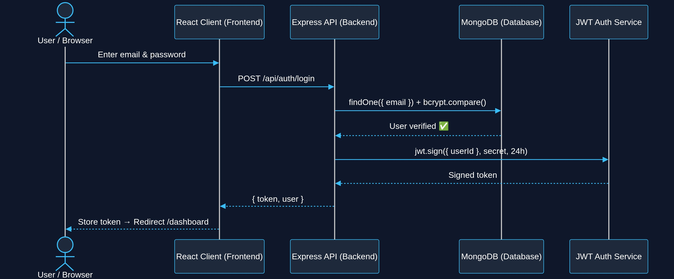
Sequence Diagram
Authentication Flow (Login)

Slide 15
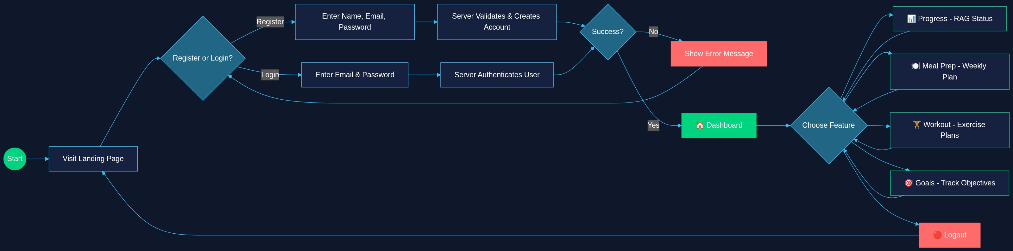
Activity Diagram
User Journey Through the Application

Slide 16
Algorithms & Calculations
🚦 Traffic Light (RAG) System
🍽️ Nutrition Calculations
🔐 Authentication Algorithm
Scoring Algorithm:
score = (current / target) × 100
Classification:
🟢 Green → score ≥ 80% (On Track)
🟡 Amber → 50% ≤ score < 80%
🔴 Red → score < 50% (Behind)
Overall Score:
avg of all 6 category scores
Daily Totals:
totalCal = Σ meal.calories
totalProtein = Σ meal.protein
Progress Bar:
width = (consumed / target) × 100%
Weekly Average:
avgCal = Σ dailyCal / 7
avgProtein = Σ dailyProtein / 7
Password Hashing:
salt = bcrypt.genSalt(10)
hash = bcrypt.hash(pw, salt)
Login Verification:
match = bcrypt.compare(input, hash)
Token Generation:
token = jwt.sign(
{ user: { id } },
JWT_SECRET,
{ expiresIn: '24h' }
)

Slide 17
Updated Time Schedule
Progress since PPRS
Phase 1: Planning & Research
100%
Oct – Nov 2025
Phase 2: UI/UX Design & Prototyping
100%
Nov – Dec 2025
Phase 3: Frontend Development
100%
Dec 2025 – Jan 2026
Phase 4: Backend & Auth
90%
Jan – Feb 2026
Phase 5: Data Persistence (CRUD)
30%
Feb – Mar 2026
Phase 6: Testing & Refinement
10%
Mar – Apr 2026
Phase 7: Deployment & Documentation
0%
Apr – May 2026

Slide 18
Timeline Changes & Adjustments
What Changed
Impact & Mitigation
• Frontend development completed ahead of schedule
→ Clean component architecture accelerated this
• Backend auth took longer than planned (+1 week)
→ MongoDB connectivity & JWT flow needed iteration
• Data persistence phase pushed back by ~2 weeks
→ Prioritised getting auth right before CRUD
• Mock data approach adopted as interim solution
→ Allows frontend to function while backend catches up
• Overall project still on track for deadline
• Mock data ensures working demo at every stage
• Backend CRUD is the current priority (Feb–Mar)
• Testing phase may overlap with deployment to
save time in the final weeks
• Scope adjusted: advanced features (notifications,
charting) moved to 'nice to have' category

Slide 19
Summary & Next Steps
✅ What's Been Achieved
🔜 Next Steps
• Complete frontend with 7 pages + navigation
• User authentication (register, login, logout)
• Dashboard, Meal Prep, Workout, Goals, Progress
• Traffic light progress monitoring system
• RESTful API structure with middleware
• Clean, maintainable codebase (modular React)
• Build CRUD API routes (meals, workouts, goals)
• Migrate mock data to MongoDB collections
• Add user-specific data storage
• Implement progress history & charting
• Comprehensive testing (unit + integration)
• Deploy to cloud (Render / Vercel)

Slide 20
Thank You
Questions & Discussion
MyFitnessPlus — Your Personal Fitness Companion

