Slide 1

Ops Agent
Turning Ops Data Into Actionable Intelligence
AI-Powered Analytics Chatbot · Role-Aware · Self-Learning · Visual · Air-Gapped
OPS DASHBOARD ENGINEERING TEAM · JUNE 2026 · INTERNAL ARCHITECTURE PROPOSAL

Slide 2


Having Data Is Not Enough. Making Sense of It Is the Advantage.
What We Have Today
Raw rows and columns — no plain-English answers
Same data dump for every role
No memory across sessions
No self-service discovery for new team members
What We Actually Need
Answers in plain English, role-filtered per team
Reuse what was already answered
Charts, dashboards, and visual context
Follow-up questions that just work
In today's world, having data is not a competitive advantage. Making sense of data is. Ops Agent closes that gap.

Slide 3



One Intelligent Layer. Three Working Parts. Zero Rework.
Intelligence Layer
User Experience
Data Integration
Role-Aware Queries — Same question, different answer per role.
Self-Learning Cache — First answer is the hard part. After that: instant.
Dynamic Visuals — Ask for a chart in plain English.
Self-Service Discovery — Find what data exists without tickets or interruptions.
Device + Site Lookup — Serial number in, joined context out.
Dashboard Memory — Save once, reuse everywhere.
Sits on top of existing ops_db and 12+ services · No rework · Air-gapped via Circuit Proxy · No external dependencies

Slide 4





The System Pays the Full Cost Once. Every Interaction After Is Instant.
User 1 — First Query
User 2 — Similar Query
User 3: — Best Version
No cache match. NL2SQL runs. MySQL queried. Result stored as v1. User refines → stored.
Cache match (score ≥ 0.88). Served instantly. Zero DB call. Zero LLM call.
Gets best promoted version automatically. Zero DB call. Zero LLM call.
Score ≥ 0.88 — HARD HIT
Serve instantly · Zero MySQL · Zero LLM
Score < 0.70 — MISS
NL2SQL runs · Result stored · Never repeated

Slide 5


What Our Teams Will Actually Use This For
Data Discovery
1
"Are we ingesting TAC case data?" → Returns all ingestion sources, tables, and frequency. New engineer gets full data landscape in seconds.
Tool Discovery + Feedback Loop
2
"Can I do automated firmware rollback?" → Not found → logged to feedback queue. Dev team gets ranked backlog of most-requested missing tools.
Device Deep-Dive
3
"Everything about device SN-ABC12345" → Correlates EOL + firmware + CVE + TAC cases + oblation across 4 tables. One query.
Dashboard on Demand
4
"TAC cases dashboard, last 7 days" → Checks saved dashboards, proposes layout if new, auto-redirects to live dashboard page.

Slide 6
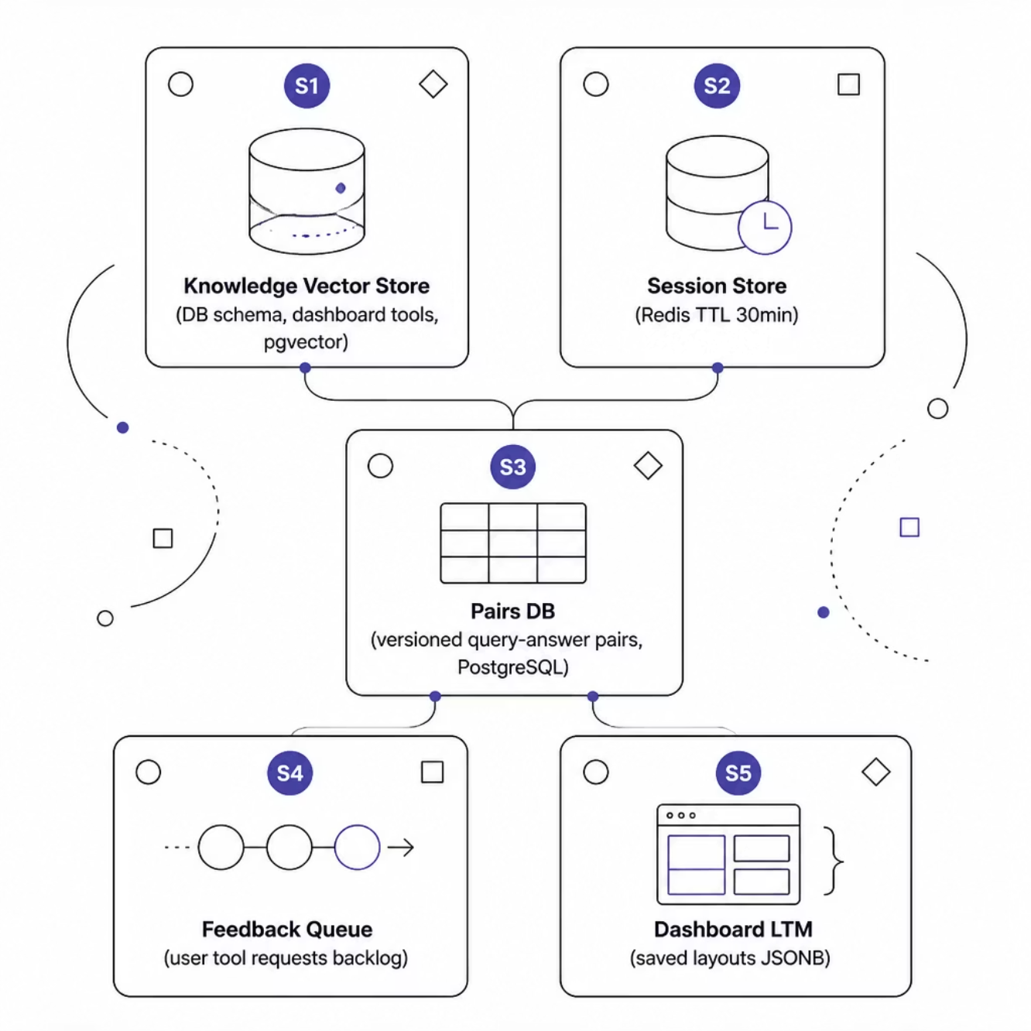

What We Are Building — And How We Get There
Ops Agent — 5 Stores · 14 Layers
Three intelligent paths: Analytics (hybrid search → NL2SQL → versioned cache), Knowledge (vector store → tool registry → feedback queue), and Dashboard (template selector → LTM → dashboard page). All on existing infrastructure.
Ask today: Green light for Phase 1 — NL2SQL pipeline + Schema Vector Store. No new infrastructure required. Builds on existing MySQL ops_data.

