Slide 1
Lane Detection System Using Matlab
Name: Muhammad Hamza Aslam
ID: F2017266041

Slide 2
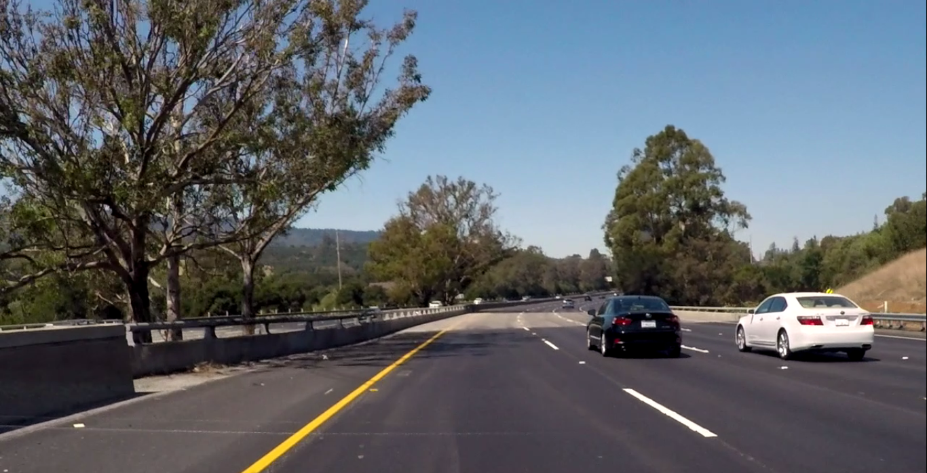
Pre-processing
The first step is to import the video file and initialize the variables to be use din the code.
while hasFrame(VideoFile)
frame = readFrame(VideoFile);
figure('Name','Original Image'), imshow(frame);
frame = imgaussfilt3(frame);
figure('Name','Filtered Image'), imshow(frame);

Slide 3
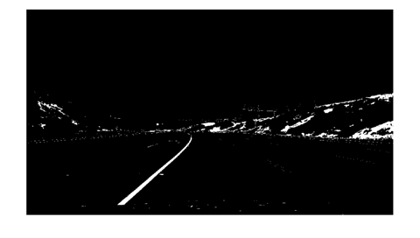
Masking the image for Yellow Color
%--------------Define Thresholds for masking Yellow Color-------------
%----------------------Define thresholds for 'Hue'---------------------
channel1MinY = 130;
channel1MaxY = 255;
%------------------Define thresholds for 'Saturation'------------------
channel2MinY = 130;
channel2MaxY = 255;
%---------------------Define thresholds for 'Value'--------------------
channel3MinY = 0;
channel3MaxY = 130;
%-----------Create mask based on chosen histogram thresholds-----------
Yellow=((frame(:,:,1)>=channel1MinY)|(frame(:,:,1)<=channel1MaxY))& ...
(frame(:,:,2)>=channel2MinY)&(frame(:,:,2)<=channel2MaxY)&...
(frame(:,:,3)>=channel3MinY)&(frame(:,:,3)<=channel3MaxY);
figure('Name','Yellow Mask'), imshow(Yellow);

Slide 4
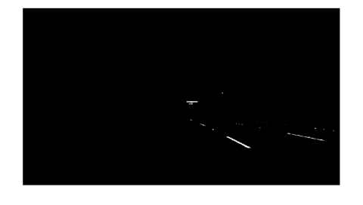
Masking the image for White Color
%--------------Define Thresholds for masking White Color--------------
%----------------------Define thresholds for 'Hue'---------------------
channel1MinW = 200;
channel1MaxW = 255;
%------------------Define thresholds for 'Saturation'------------------
channel2MinW = 200;
channel2MaxW = 255;
%---------------------Define thresholds for 'Value'--------------------
channel3MinW = 200;
channel3MaxW = 255;
%-----------Create mask based on chosen histogram thresholds-----------
White=((frame(:,:,1)>=channel1MinW)|(frame(:,:,1)<=channel1MaxW))&...
(frame(:,:,2)>=channel2MinW)&(frame(:,:,2)<=channel2MaxW)& ...
(frame(:,:,3)>=channel3MinW)&(frame(:,:,3)<=channel3MaxW);
figure('Name','White Mask'), imshow(White)

Slide 5
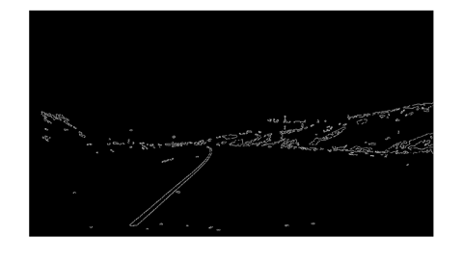
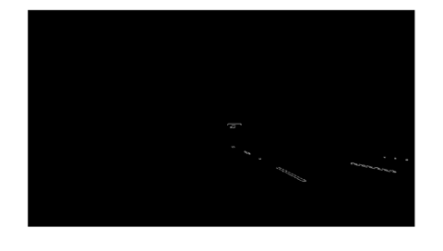
Edge Detection Using Canny Filter
frameW = edge(White, 'canny', 0.2);
frameY = edge(Yellow, 'canny', 0.2);
%----Neglecting closed edges in smaller areas---%
frameY = bwareaopen(frameY,15);
frameW = bwareaopen(frameW,15);

Slide 6
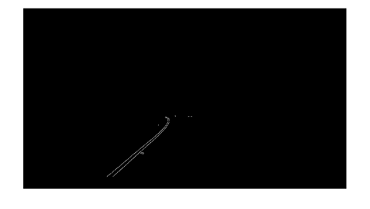
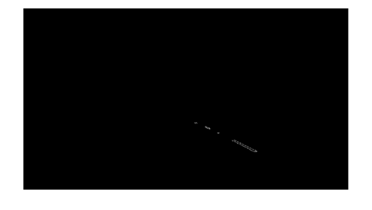
Extraction of Region of Interest
As guided in the pipeline for the implementation of the project 1 the region of interest is extracted using the 'roipoly' function and selecting the points from the frame.

Slide 7
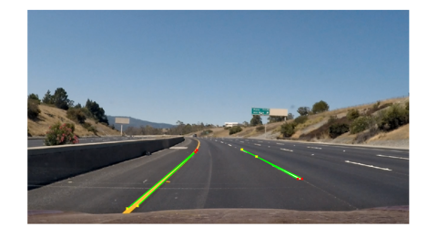
Hough Transform
Applying Hough Tansform to get straight lines from Image

Slide 8
Extrapolation of Lines
In this section the lines that are found in hough lines are extrapolated on the main filtered image.
Plotting best fitting line after Extrapolation

Slide 9
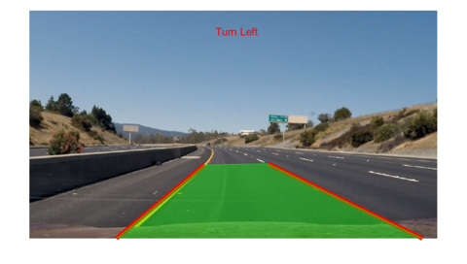
Turn Prediction
In this section, I have predicted where to turn by looking at the vanishing point found from the extrapolated lines.
Plotting Everything on the image

Slide 10
Thank You

