Slide 1
Most Watched Videos
Information Presentation

Slide 2
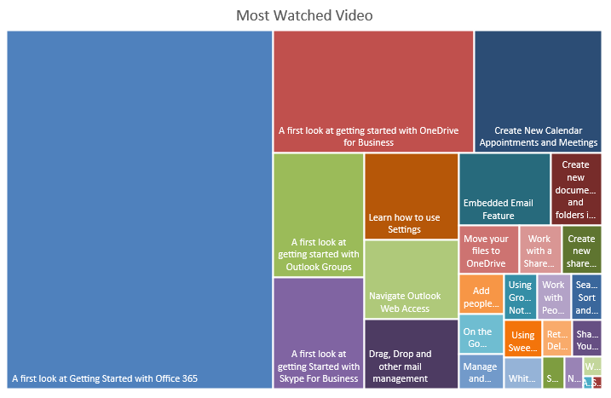

Slide 3
