Slide 1
Anonymity and privacy properties of blockchain-based voting systems

Slide 2

INTRODUCTION
I have made on my thesis project, which focuses on 'Anonymity and Privacy Properties of Blockchain-based Voting Systems'. In my scientific report, I have written a comprehensive :
Introduction
literature review
related work
Frontend
on this topic."
Notes:
Time-consuming: The traditional voting process is time-consuming, as voters have to physically go to polling stations to cast their votes, which can take several hours, especially during peak voting periods.
Inconvenient: The traditional voting process can be inconvenient for voters who have mobility issues, are elderly, or live in remote locations, making it difficult for them to access polling stations.
Inefficient: The traditional voting process can be inefficient, as it requires a large number of polling stations, ballot boxes, and personnel to manage the voting process, leading to long queues, delays, and errors.
Security concerns: The traditional voting process can be vulnerable to security threats, such as ballot stuffing, voter impersonation, and hacking of electronic voting machines.
Lack of transparency: The traditional voting process can lack transparency, as it can be challenging to ensure that every vote is counted accurately and fairly, especially when counting is done manually.

Slide 3
Review
Thesis Statement: The main purpose of this project is to examine the anonymity and privacy characteristics of blockchain-based voting systems, with an emphasis on Ethereum blockchain.
In the introduction, I explored the types and uses of blockchain technology, the concept of Homomorphic Encryption for privacy in e-voting, and the benefits and challenges of blockchain-based e-voting systems.
Literature Review: My literature review began with a brief history of voting systems, leading up to the current methods of voting. I then shifted focus to e-voting systems using blockchain technology, specifically Ethereum blockchain, and their implications for anonymity and privacy. I also highlighted some companies that are pioneering in this sector.
Related Work: In studying related work, I examined two existing blockchain-based voting systems that are similar to my topic but use different algorithms.
Notes:
Convenience: E-voting systems offer a convenient alternative to traditional voting methods, as voters can cast their votes remotely from their homes, offices, or other locations using electronic devices.
Accessibility: E-voting systems offer greater accessibility to voters who have mobility issues, are elderly, or live in remote locations, as they can vote from anywhere with an internet connection.
Efficiency: E-voting systems are more efficient than traditional voting methods, as they require fewer resources and personnel to manage the voting process, leading to quicker results.
Accuracy: E-voting systems are more accurate than traditional voting methods, as they can eliminate errors associated with manual vote counting, such as miscounts, lost ballots, or illegible handwriting.
Transparency: E-voting systems can be more transparent than traditional voting methods, as they can provide real-time updates on the voting process, enabling voters and election officials to monitor the process closely.

Slide 4
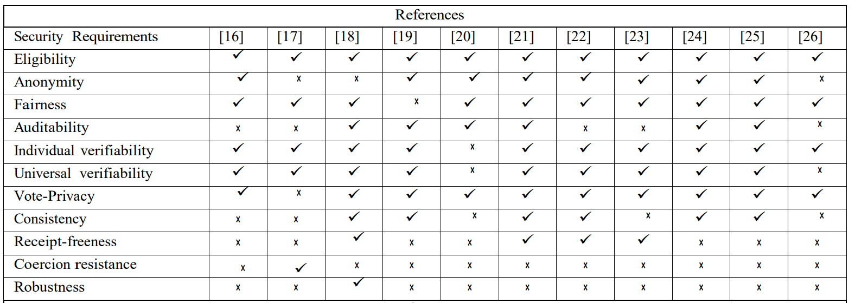
Achievements in Blockchain E-voting Systems
During my research, I encountered an informative table in the article 'A Survey of Blockchain Based on E-voting Systems.' This table examines and compares the security and privacy aspects of different blockchain-based e-voting systems. It offers a valuable overview of the progress achieved in the field of blockchain e-voting systems, particularly in meeting key security requirements:

Slide 5
Advancements Post Preliminary Research
After completing the introduction, literature review, and related work, I have focused on the engineering part of my project. This includes developing a frontend for our blockchain-based voting system."

Slide 6
Development of the Frontend
The development of the frontend was a primary focus during this phase of the project. I prioritized user accessibility and convenience in the design, keeping in mind the need for a seamless user interface and ease of navigation. Naturally, there were challenges, such as ensuring compatibility across different devices and browsers, but I was able to devise solutions through rigorous testing and iterative improvements.

Slide 7
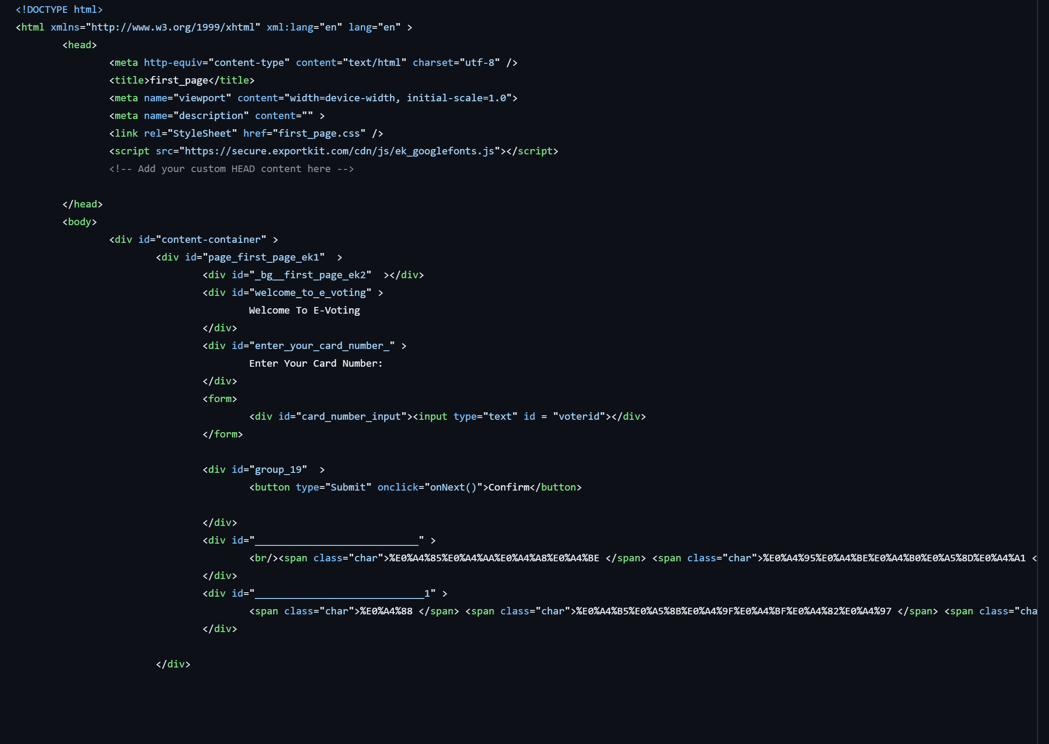
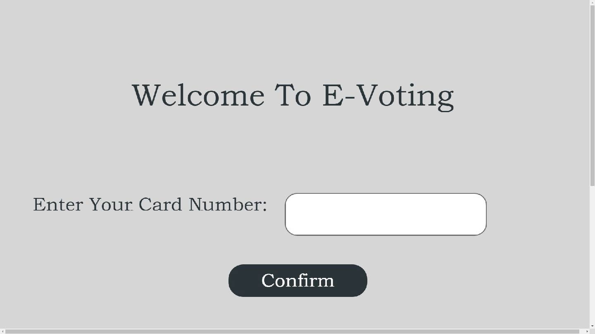
Frontend

Slide 8
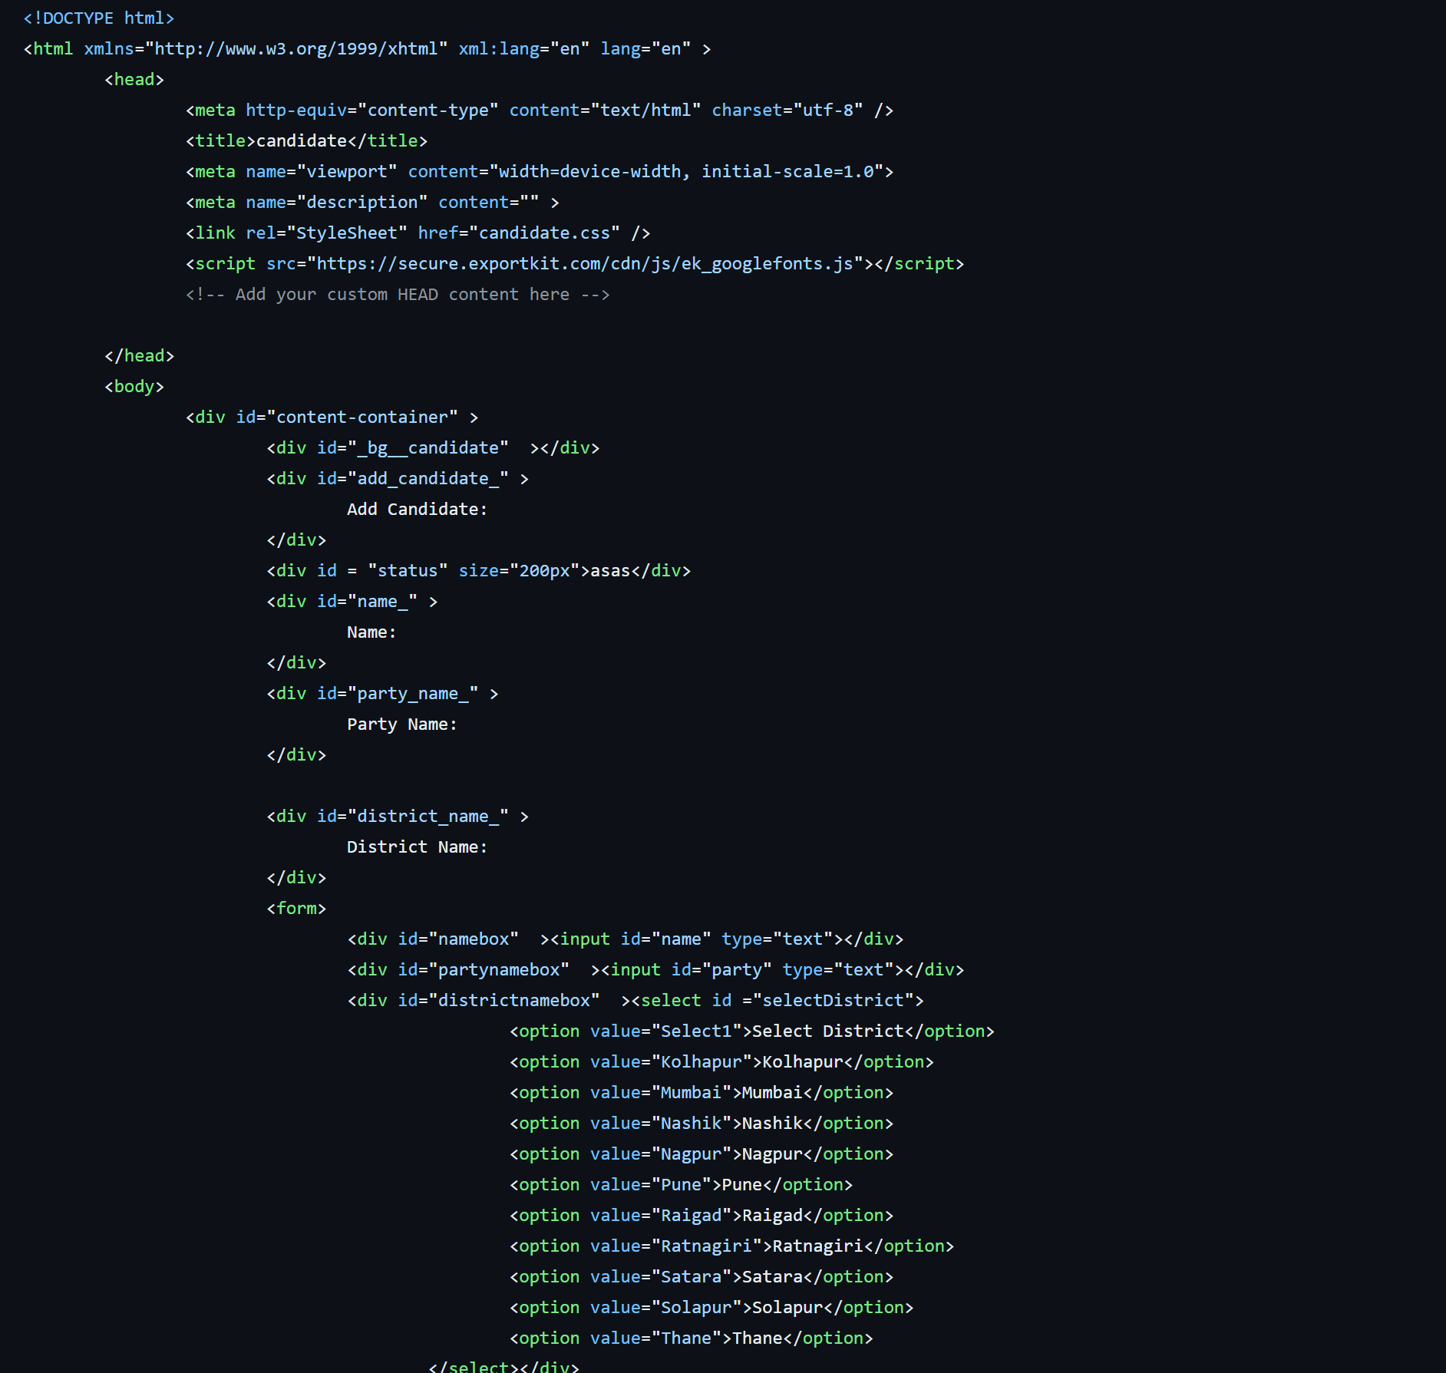
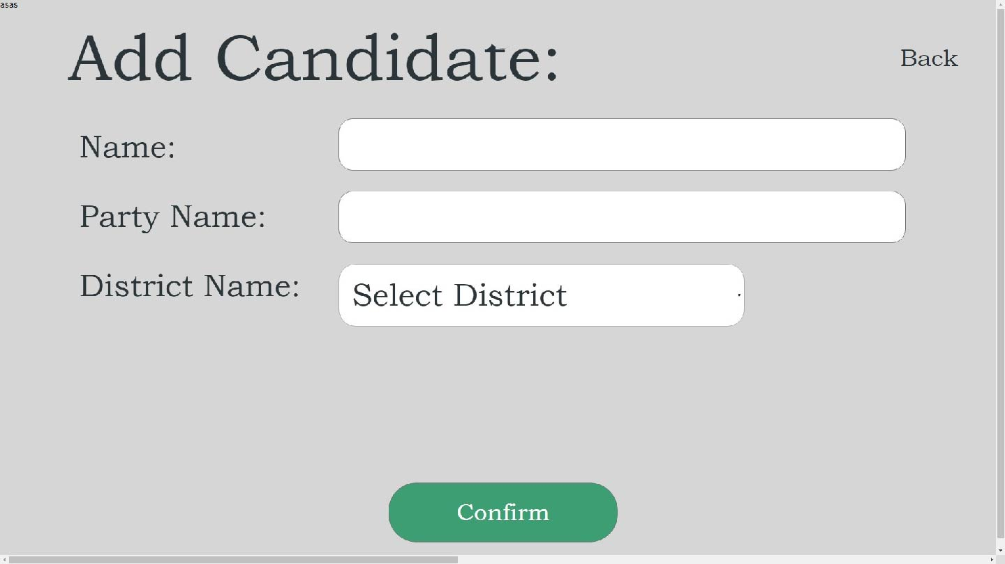
Frontend

Slide 9
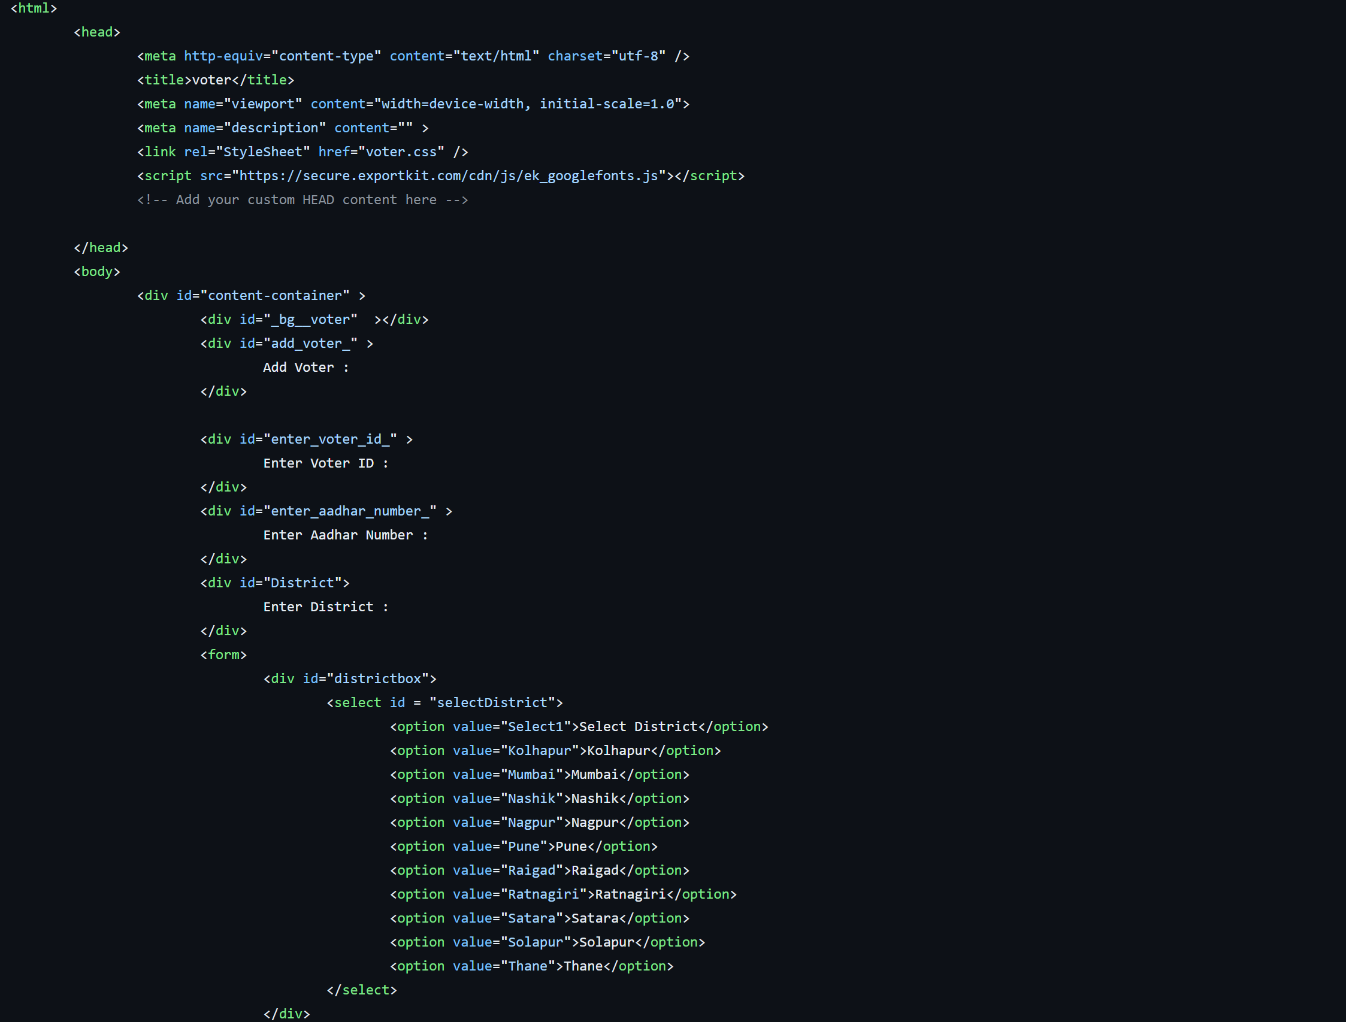
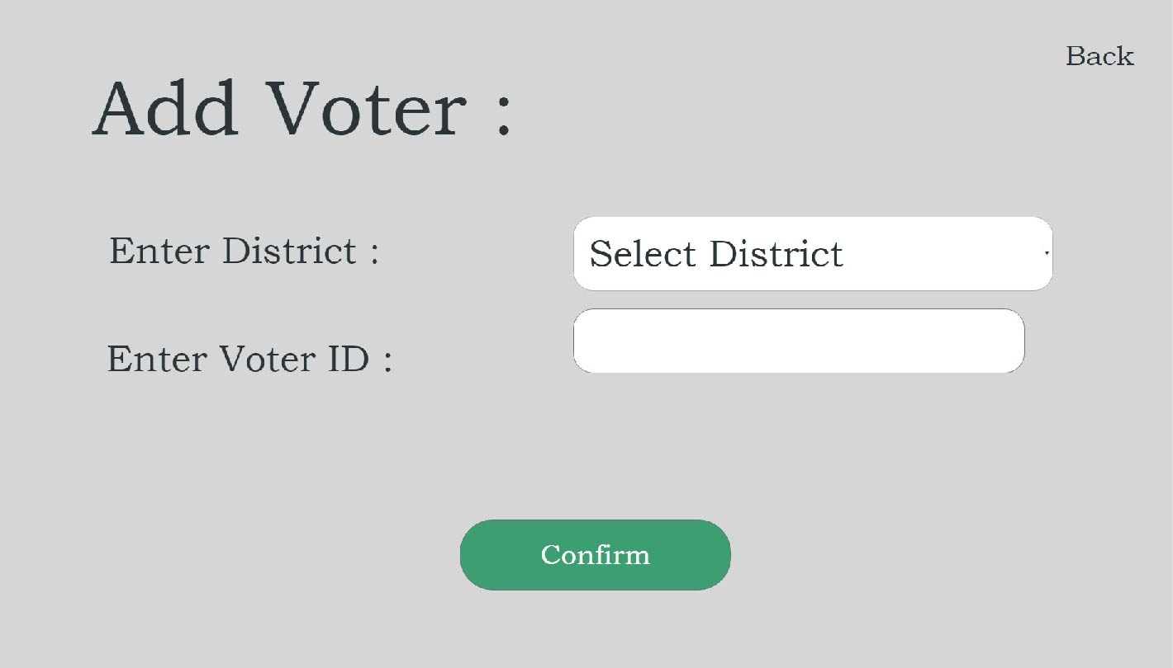
Frontend

Slide 10
Current Work
Right now, I'm working on building the backend of the voting system and connecting it to the Ethereum blockchain. This work is a bit tough because it needs a good understanding of how blockchain works and needs careful coding. To solve any problems that come up, I plan to do a lot of research, ask for advice from others, and test the system thoroughly.
Notes:
The use of blockchain technology in E-voting systems can help to address some of the challenges associated with traditional voting systems, such as the potential for fraud, errors in vote counting, and lack of transparency. By leveraging the security and transparency of blockchain, E-voting systems can help to improve the accuracy and integrity of election results.
However, it is important to note that the implementation of blockchain-based E-voting systems is still in its early stages, and there are several challenges that must be addressed before they can be widely adopted. These challenges include ensuring the privacy and anonymity of voters, preventing attacks on the network, and ensuring that the technology is accessible and user-friendly.

Slide 11
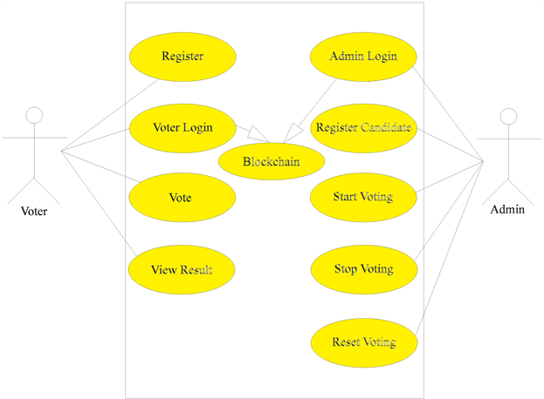
Class Diagram of the Voting System
Now, I'd like to present the class diagram of our voting system, focusing on the Registration, Login, and Vote components. This diagram visually depicts the structure of these key parts of the system

Slide 12
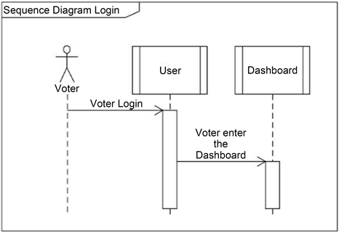
Class Diagram of the Voting System

Slide 13
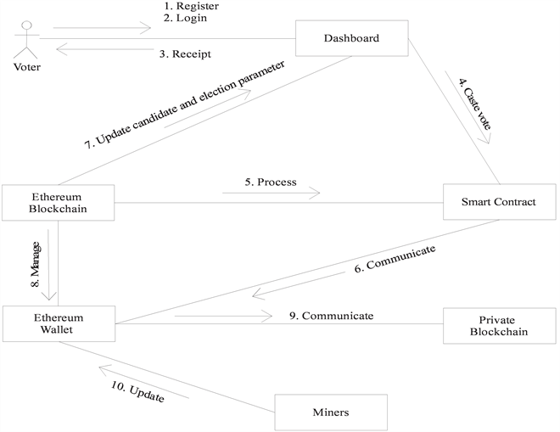
Class Diagram of the Voting System

Slide 14
Next Steps
I'm working on building the backend of our voting system now. I'm also figuring out how to connect it to the Ethereum blockchain, which is a tough but exciting part of the project. I aim to finish this by the end of July.
After that, I'll go back to my report. I'll write about the methods I used in the 'methodology' chapter. Then, in the 'conclusion and discussion' chapter, I'll talk about what the results mean and what could be done next. I plan to finish the report by the 15th of July.

Slide 15
Expected Results
Upon completion of my project, I expect to have a functional e-voting system that leverages the advantages of blockchain technology, specifically Ethereum. This system will not only ensure the transparency and fairness of the voting process but also protect the privacy and anonymity of voters.
My project aims to address some of the common challenges in e-voting systems, such as vote tampering and voter coercion. By harnessing the power of blockchain technology, we can potentially enhance the trustworthiness and security of e-voting systems.
The successful completion of this project could have significant implications for the field of e-voting. It could serve as a basis for further research into blockchain-based voting systems, inspire improvements in existing systems, and potentially contribute to the wider adoption of blockchain technology in various sectors beyond voting.

Slide 16
conclusion
In conclusion, my work on 'Anonymity and Privacy Properties of Blockchain-based Voting Systems' has advanced considerably since our last update. I have delved deep into the intricate world of blockchain technology, explored its application in e-voting systems, and started the engineering work on creating a secure and user-friendly voting platform.

Slide 17
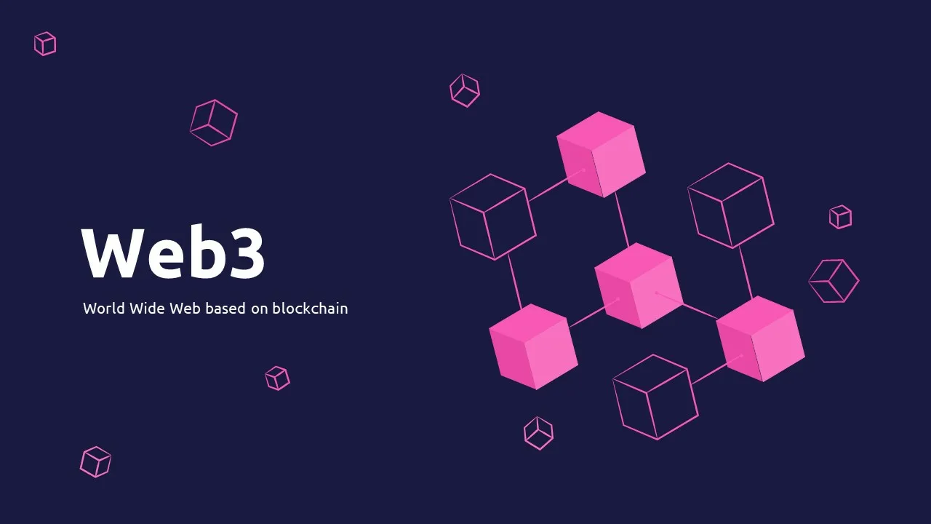
Thank you

