Slide 1
CYB102 GROUP CAPSTONE
SolarWinds IOC
Investigation
IOC
→ correlate
LOGS
→ validate
Detecting suspicious network activity using Splunk and threat intelligence
THREAT
→ respond
SPLUNK CORRELATION
VIRUSTOTAL VALIDATION
NIST INCIDENT RESPONSE
ACTION
Team 43
Yifan · Hamzah · Jessica · Daksh · Jeiss

Slide 2
01 · PROJECT OVERVIEW
From indicators to actionable incident context
The team correlated known SolarWinds indicators with internal proxy logs, then used external threat intelligence to validate suspicious activity.
2
5
HIGH
NIST
primary IOC findings highlighted
correlated events surfaced in Splunk
triage severity assigned
response framework applied
Objective
What the analysis demonstrated
Identify internal systems that communicated with known malicious SolarWinds infrastructure and determine the response priority.
Correlation of internal network logs with external IOC data
Threat validation using VirusTotal vendor detections
Asset prioritization and remediation using a structured IR process
Scope note: course-provided datasets in a simulated blue-team investigation.

Slide 3
02 · DATA & TOOLING
Evidence sources and analysis stack
Two datasets provided the context; Splunk enabled correlation, while VirusTotal provided external threat-intelligence validation.
DATA SOURCE 01
DATA SOURCE 02
ANALYSIS STACK
SolarWinds IOC Dataset
Network Proxy Logs
Splunk
Known malicious indicators associated with the SolarWinds campaign.
Internal network events used to identify which systems communicated with suspicious infrastructure.
Search, field extraction, and IOC-to-log correlation
Key fields
Key fields
VirusTotal
IP Address · Indicator type · Notes
Timestamp · IP Address · Computer Name
Independent validation of suspicious IP addresses using multiple security vendors

Slide 4
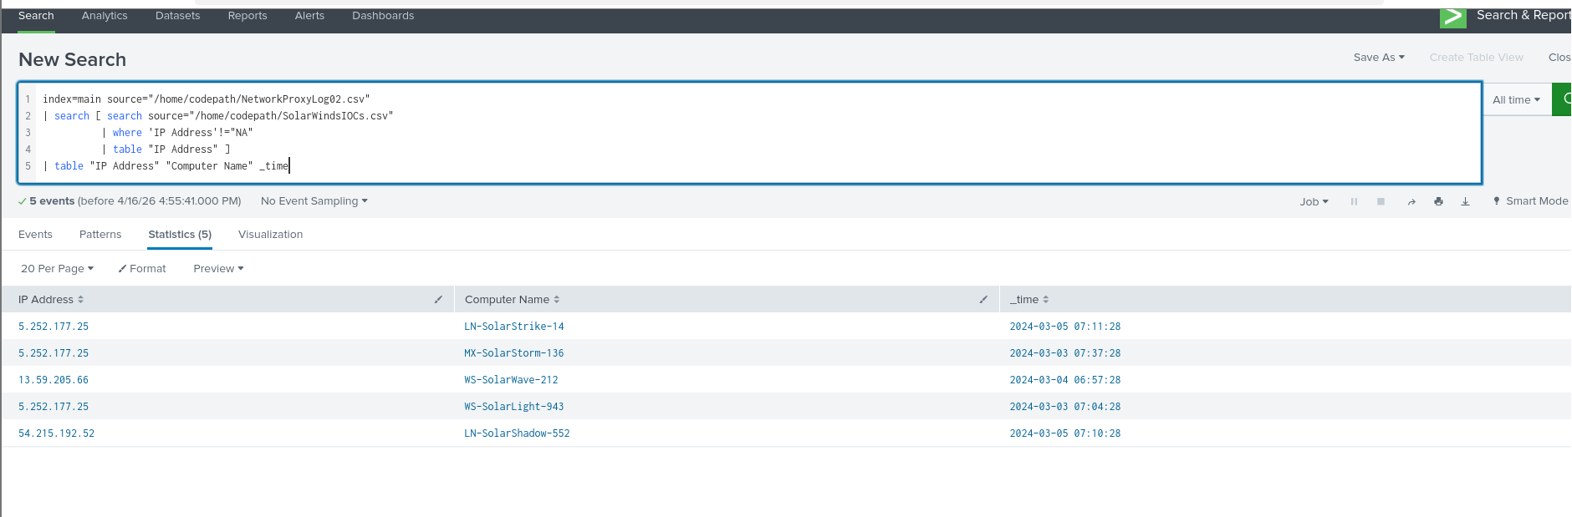
03 · INVESTIGATION METHOD
A repeatable correlation workflow
The analysis moved from raw datasets to validated, prioritized findings using a simple five-step process.
1
Ingest
2
Extract IOCs
3
Correlate
4
Validate
5
Prioritize
ORIGINAL SPLUNK EVIDENCE · 5 CORRELATED EVENTS
Query correlates proxy-log IPs with SolarWinds IOC data and returns IP, host, and timestamp for triage.

Slide 5
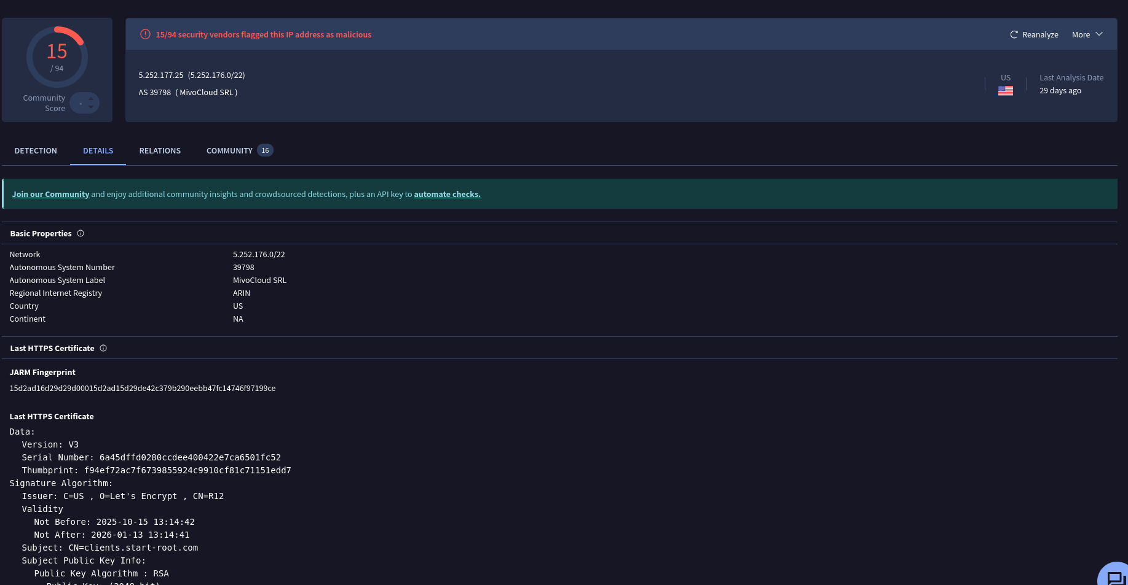
04 · FINDING 01
IOC match: 5.252.177.25
A proxy-log event matched a known SolarWinds indicator and was validated by multiple VirusTotal vendors.
SPLUNK CORRELATION
5.252.177.25
LN-SolarStrike-14
2024-03-05 07:11:28
Matched in both the internal proxy logs and the IOC dataset
VirusTotal showed 15 / 94 vendor detections at capture time
Indicates potential exposure to malicious infrastructure — not proof of compromise
ORIGINAL VIRUSTOTAL EVIDENCE

Slide 6
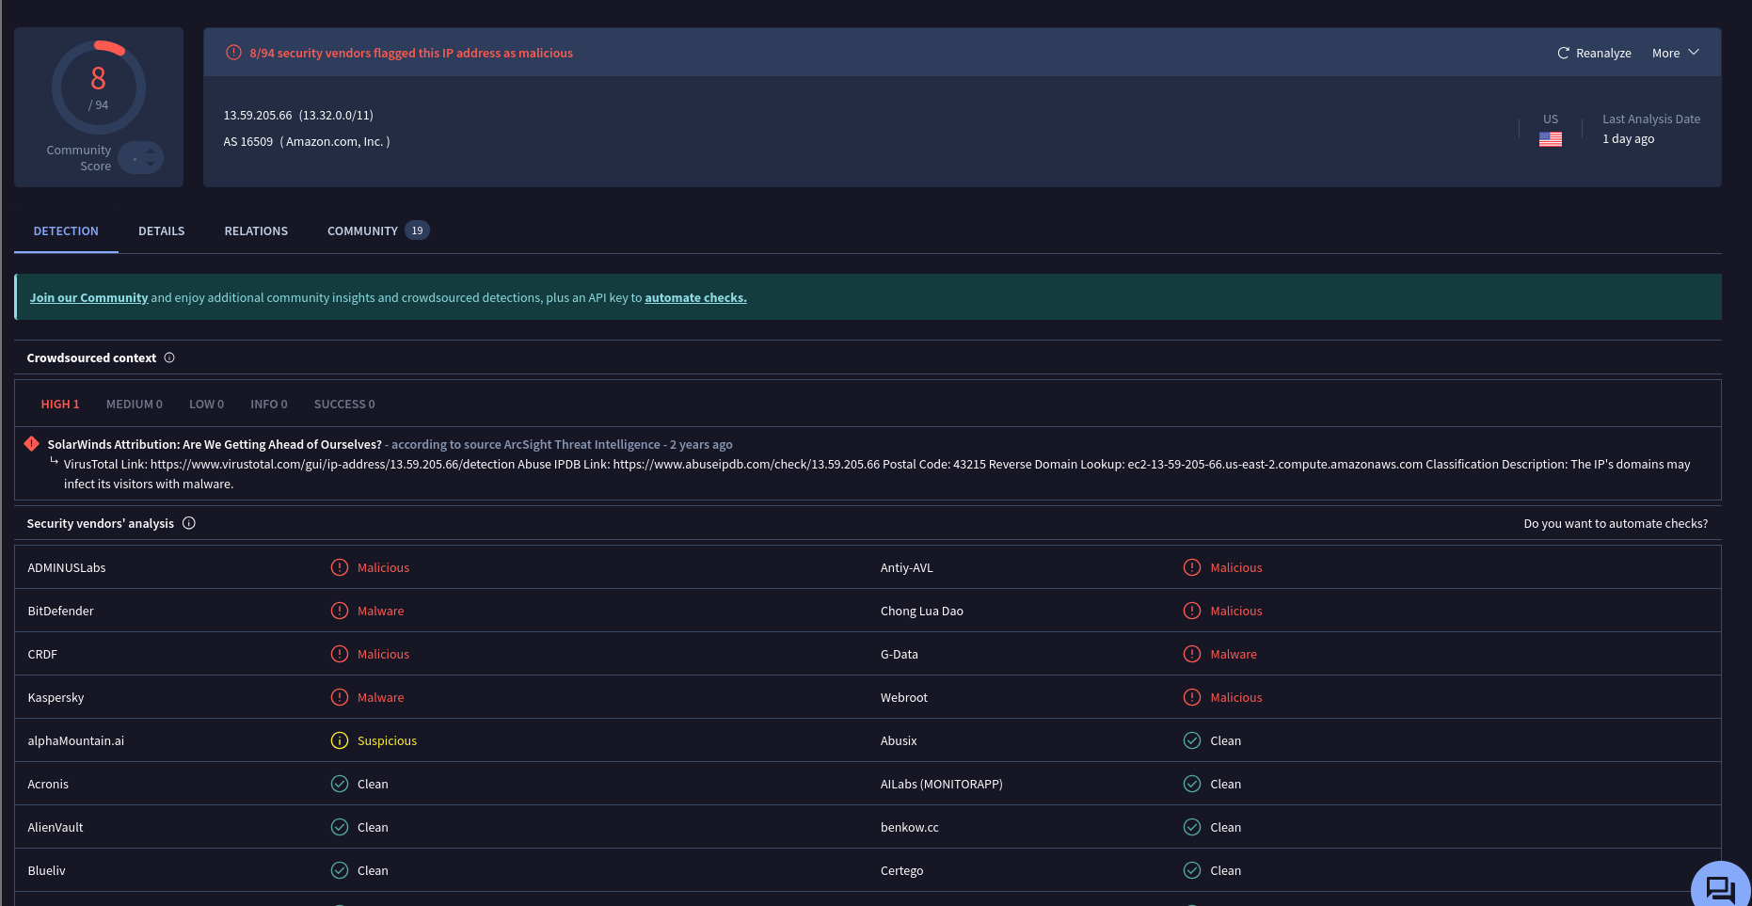
05 · FINDING 02
IOC match: 13.59.205.66
A second host communicated with another IOC; VirusTotal vendor detections reinforced the threat signal.
SPLUNK CORRELATION
13.59.205.66
WS-SolarWave-212
2024-03-04 06:57:28
Matched against the SolarWinds IOC list in Splunk
VirusTotal showed 8 / 94 vendor detections at capture time
A second affected system increased the investigation scope and response priority
ORIGINAL VIRUSTOTAL EVIDENCE

Slide 7
06 · IMPACT & TRIAGE
Why the incident was prioritized as HIGH severity
The evidence showed repeated communication between internal systems and known malicious infrastructure, requiring immediate containment and deeper investigation.
HIGH
AFFECTED ASSET 01
AFFECTED ASSET 02
LN-SolarStrike-14
WS-SolarWave-212
TRIAGE SEVERITY
Matched 5.252.177.25
Matched 13.59.205.66
Potential exposure to known malicious infrastructure across more than one internal system.
Evidence chain
1
Internal logs
2
IOC match
3
Threat validation
4
Triage
Host → external IP
External IP on SolarWinds list
Multiple VT vendors flag malicious
Prioritize containment & investigation
Priority: contain, investigate, and monitor.

Slide 8
07 · THREAT INTELLIGENCE & REMEDIATION
Turn validated indicators into containment actions
Threat intelligence strengthened confidence in the IOC matches; remediation focused on cutting off malicious communication and validating endpoint integrity.
Threat intelligence
Recommended remediation
VirusTotal vendor detections supported the SolarWinds IOC matches
Repeated IOC-to-host correlations increased confidence that the events were not isolated noise
Vendor counts are point-in-time observations and can change as threat intelligence evolves
01
Block malicious IPs
Firewall / proxy controls
02
Investigate affected hosts
Malware scan + endpoint review
03
Monitor outbound traffic
Look for repeat connections
Analyst conclusion
04
Improve detection rules
Alert on known IOC matches
Treat the affected hosts as potentially exposed and move quickly to containment and verification.

Slide 9
08 · INCIDENT RESPONSE PLAYBOOK
NIST-aligned response, adapted for IOC-driven log analysis
The team used the NIST incident-response lifecycle as the backbone for a repeatable investigation and case-management process.
01
02
03
04
05
Preparation
Detection & Analysis
Containment
Eradication
Recovery
Define sources, tools, and evidence fields
Correlate logs with IOC data
Block malicious IP communication
Investigate / clean affected hosts
Monitor and strengthen detections
Case-management record
Indicator
Asset
Timestamp
Threat verdict
Response action
5.252.177.25
LN-SolarStrike-14
2024-03-05 07:11:28
VT: malicious
Contain + investigate
Repeatable documentation keeps evidence, ownership, and remediation aligned across the response lifecycle.

Slide 10
09 · KEY TAKEAWAYS
What this investigation demonstrated
The strongest lesson was not a single IOC — it was the value of combining internal telemetry, external intelligence, and a disciplined response process.
01
Correlation creates context
02
Validation raises confidence
An IP is more useful when tied to a specific internal host and timestamp.
Threat-intelligence sources help distinguish likely malicious infrastructure from background noise.
03
Triage turns data into action
04
Process makes response repeatable
Multiple affected systems and validated IOCs justified a HIGH-priority response.
A NIST-aligned playbook helps teams contain, investigate, recover, and document consistently.
Portfolio takeaway
Splunk + IOC correlation + VirusTotal validation + NIST incident response = a complete blue-team investigation story.

Slide 11
SolarWinds IOC Investigation
LOGS
IOC
Thank you
Questions?
THREAT
Team 43
Yifan · Hamzah · Jessica · Daksh · Jeiss
ACTION
CYB102 · The Data Dig

