Slide 1

AD-HTC Integrated Biorefinery
Thermodynamic Design of an Anaerobic Digestion –
Hydrothermal Carbonization Power System
MEG 315 — Applied Thermodynamics · University of Lagos
Group 28
Based on: Potrč et al. (2025), Energies 18(2), 334

Slide 2


Project Overview
Designing a waste-to-energy system that converts biomass
into electricity and solid fuel through integrated thermodynamic cycles.
Feedstock
Dual-Process Conversion
Power Generation
Wet biomass — including cassava peel, sugarcane bagasse, and municipal organic waste — enters the AD reactor as primary feedstock.
AD produces biogas (CH₄ + CO₂) and digestate. HTC converts wet digestate into energy-dense hydrochar at 180–260°C.
Biogas drives a biogas ICE (Otto cycle) for electricity. Waste heat cascades to a Rankine steam cycle and heats the HTC reactor.

Slide 3


Understanding AD-HTC
Anaerobic Digestion (AD)
Hydrothermal Carbonization (HTC)
Process: Microorganisms break down organic matter in the absence of oxygen. Products: Biogas (55–65% CH₄ + CO₂) and digestate slurry. Temperature: Mesophilic operation at ~37°C (HRT = 25 days). Key Parameter: Organic Loading Rate (OLR) in kg VS/m³·day determines reactor sizing and biogas yield.
Process: Thermochemical conversion of wet digestate under subcritical water conditions. Conditions: T = 180–260°C, autogenous pressure (10–50 bar). Product: Hydrochar — HHV of 14,500–24,000 kJ/kg depending on feedstock. Advantage: No pre-drying required — processes wet digestate directly, improving overall energy efficiency.

Slide 4
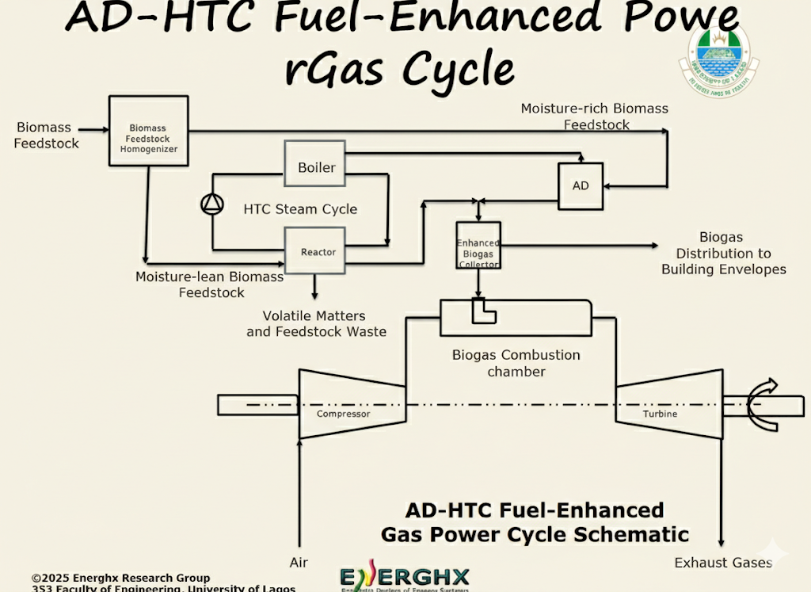
System Overview

Slide 5
Theory
It is an integrated AD–HTC facility used for model validation and parameter extraction. The system comprises three semi-continuous anaerobic digesters (AD) operating in parallel, each feeding into a centralized biogas collection manifold.
The recovered thermal energy in the biogas produced by the AD is routed to the hydrothermal carbonization (HTC) reactor, establishing a partially self-sustaining loop wherein AD-derived energy satisfies a portion of HTC’s thermal demand.
The HTC reactor is feed with biomass feedstock for in-direct heating supply from a steam cycle of the HTC system, including hot-water tank, boiler, heat exchanger, and throttle valve.The biogas produced by AD is used as fuel in a gas power cycle.
In this project, the cycle is modelled as an air-standard Otto cycle (internal combustion engine).The waste heat from the gas turbine exhaust is captured by a Heat Recovery Steam Generator (HRSG/Boiler) to produce superheated steam. This steam powers the HTC reactor through a Rankine-type heating loop

Slide 6

Core Subsystems
Fuel Processing
Biogas ICE — Otto Cycle
Rankine Steam Cycle
Wet biomass is fed into the AD reactor. Biogas (CH₄-rich) is extracted for the ICE. Digestate solids proceed to HTC to form hydrochar — both serving as system fuels.
The biogas-fuelled internal combustion engine operates on the Otto cycle (4-state T-s analysis). Compression ratio r = 10 drives isentropic compression; peak combustion T₃ = 1200 K. Net work per kg: W_net = cp(T₃−T₄) − cp(T₂−T₁).
Waste heat from ICE exhaust powers a steam bottoming cycle at P = 6.0 MPa (60 bar). Four states: A (pump in) → B (pump out) → C (turbine in) → D (turbine out), analyzed on the h-s Mollier diagram.

Slide 7
Process Thermodynamics
T-s Diagram — Otto Cycle (Biogas ICE)
h-s Mollier Diagram — Rankine Cycle
Biogas drives a 4-stroke ICE modelled as an ideal Otto cycle. The T-s map shows isentropic compression (1→2), constant-volume heat addition (2→3), isentropic expansion (3→4), and constant-volume exhaust (4→1).
Steam cycle fixed at P = 6.0 MPa (60 bar). Mollier (h-s) analysis captures pump work, boiler heat addition, turbine work output, and condenser rejection. Turbine efficiency η_st = 0.85.
State | Process | Key Relation
1 → Intake | Start of cycle | T₁ = 298 K, s₁ = 1.0 kJ/kg·K
2 → Compress | Isentropic (s=const) | T₂ = T₁ · rᵞ⁻¹ ≈ 748 K
3 → Combust | Const. volume (Q-in) | T₃ = 1200 K (peak)
4 → Exhaust | Isentropic (s=const) | T₄ = T₃/rᵞ⁻¹ ≈ 478 K
State | Process | Key Values
A — Pump In | Sat. liquid at p_cond | h_A = 359.9 kJ/kg
B — Pump Out | Compressed liquid | h_B = h_A + w_pump/η_p
C — Turbine In | Superheated steam | h_C = 3423.1 kJ/kg @500°C
D — Turbine Out | Wet/dry steam | h_D = h_C − η_st(h_C − h_Ds)

Slide 8
Heat Integration & Pinch Analysis
CHP waste heat cascades from ICE → AD → HTC

Slide 9

Heat Integration — Pinch Analysis
CHP
(ICE Exhaust)
AD
Reactor
HTC
Reactor
Surplus /
Deficit
Q_avail = 45% of thermal
Q_AD = ṁ·Cp·(37°C − T₁)
Q_HTC = ṁ_dig·Cp·(T_HTC−37°C)
ΔQ = Q_avail − Q_AD − Q_HTC
AD Heating Demand
HTC Reactor Demand
CHP Thermal Output
The digester must be maintained at mesophilic temperature (37°C). Heat required:
Q_AD = (ṁ_feed / 86400) × 4180 × (37 − T_amb)
For 10 t/day cow manure at T_amb = 25°C:
Q_AD ≈ 5.8 kW
HTC requires elevating wet digestate from 37°C to 180–260°C:
Q_HTC = (ṁ_digestate / 86400) × 4000 × (T_HTC − 37)
At T_HTC = 220°C, digestate = 8,730 kg/d:
Q_HTC ≈ 18.3 kW
CHP (ICE) recovers 45% of exhaust thermal energy:
Q_therm = ṁ_air × cp_gas × (T₄ − T₁) × 0.45
At m_air = 50 kg/s, r = 10, T₃ = 1200 K:
Q_therm ≈ 7,085 kW

Slide 10
Mass & Energy Balance
Quantifying every stream from feedstock to output

Slide 11
Mass Balance — Feedstock to Products
10 t/d
403 m³
2,016 kg
0.64
Biomass Feed
Biogas Volume
Hydrochar
OLR
Cow manure @ 10 t/day
AD output per day
HTC output per day
kg VS/m³·day
Daily Mass Flow Summary
Stream | Parameter | Formula | Value (10 t/day, Cow Manure)
Feed | Total Solids (TS) | ṁ_feed × TS% | 1,800 kg/day (18%)
AD | Volatile Solids (VS) | TS × VS% | 1,440 kg VS/day (80%)
AD → Biogas | Biogas Volume | VS × 0.280 m³/kg VS | 403 m³/day
Biogas | CH₄ Content | V_biogas × CH₄% | 242 m³ CH₄/day (60%)
AD → Digestate | Dry Digestate | VS × (1 − 0.60) | 576 kg/day
HTC | Hydrochar | Dry digestate × HTC yield (48%) | 277 kg/day
HTC | Hydrochar HHV | 14,500 kJ/kg | 4,016 MJ/day

Slide 12
Performance Targets
Optimised Energy Recovery
Energy Output Breakdown (kW)
~30%
~38%
Otto Cycle Efficiency
Rankine Cycle Efficiency
Combined System Performance
η_Otto = 1 − 1/r^(γ−1)
η_Rankine = w_net / q_boiler
w_net = (h_C − h_D) − w_pump/η_p

Slide 13


Interactive Dashboard — UI/UX Design
The Digital Dashboard
● MEG 315 — AD-HTC Dashboard
Translating complex thermodynamics into an intuitive, browser-based interface.
403 m³/d
5,720 kW
277 kg/d
29.6%
Biogas
Elec
Hydrochr
Otto η
Live KPI cards — biogas, electricity, hydrochar, OLR — update instantly with slider changes.
Energy Distribution (kW)
T-s Otto cycle and h-s Mollier diagrams render from real thermodynamic state calculations.
12-feedstock database: cow manure, cassava, palm EFB, rice husk, sugarcane bagasse, and more.
Pinch Analysis panel shows CHP heat surplus or deficit vs. AD + HTC demand in real time.
Elec
Thermal
HTC
Loss
T-s | h-s | Schematic

Slide 14
Feedstock Comparison — Key Properties
The system supports 12 biomass types. Feedstock choice drives biogas yield, hydrochar quality, and overall system efficiency.
Feedstock | TS % | VS % | Biogas Yield (m³/kg VS) | CH₄ % | HTC Yield % | HHV (kJ/kg)
Cow Manure | 18 | 80 | 0.280 | 60 | 48 | 14,500
Food / Kitchen Waste | 25 | 90 | 0.550 | 62 | 45 | 19,800
Sewage Sludge | 30 | 70 | 0.300 | 58 | 50 | 15,000
Corn Stover | 88 | 85 | 0.338 | 55 | 55 | 21,500
Rice Husk | 90 | 80 | 0.250 | 52 | 58 | 18,200
Sugarcane Bagasse | 50 | 90 | 0.310 | 54 | 52 | 20,100
Cassava Peel | 88 | 86 | 0.420 | 58 | 48 | 19,200
Palm EFB | 78 | 85 | 0.270 | 53 | 60 | 20,800

Slide 15


Project Conclusion
Thermodynamic Integration
Successfully coupled AD biogas production with a biogas ICE (Otto cycle) and a steam bottoming cycle (Rankine, P = 6.0 MPa), demonstrating viability of waste-to-energy conversion.
Zero-Waste Design
Digestate from AD feeds directly into the HTC reactor — eliminating solid waste and producing marketable hydrochar solid fuel (HHV up to 24,000 kJ/kg for wood chips).
Heat Integration via Pinch Analysis
CHP exhaust heat satisfies AD heating demand (~6 kW) and HTC reactor input (~18 kW), with substantial thermal surplus available for additional processes.
Future Work
Incorporate exergy (Second Law) analysis, dynamic OLR optimization, real feedstock gas composition sensing, and integration with a supply chain network model per Potrč et al. (2025).

Slide 16
Questions?
Thank you from Group 28.
MEG 315 — Applied Thermodynamics · University of Lagos

Slide 17
References
1. Potrč, S., Petrovič, A., Egieya, J. M., & Čuček, L. (2025). Valorization of biomass through anaerobic digestion and hydrothermal carbonization: Integrated process flowsheet and supply chain network optimization. Energies, 18(2), 334. https://doi.org/10.3390/en18020334
2. Moran, M. J., Shapiro, H. N., Boettner, D. D., & Bailey, M. B. (2018). Fundamentals of Engineering Thermodynamics (8th ed.). Wiley.
3. Çengel, Y. A., & Boles, M. A. (2014). Thermodynamics: An Engineering Approach (8th ed.). McGraw-Hill Education.
4. Libra, J. A., et al. (2011). Hydrothermal carbonization of biomass residuals: A comparative review of the chemistry, processes and applications of wet and dry pyrolysis. Biofuels, 2(1), 71-106.
5. Lettinga, G., & Hulshoff Pol, L. W. (1991). UASB-Process design for various types of wastewaters. Water Science and Technology, 24(8), 87-107.

