Slide 1
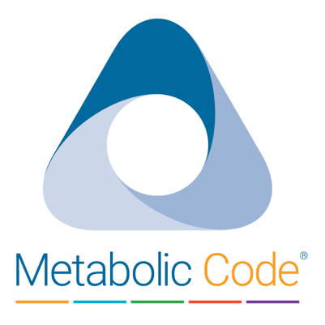
What is the Metabolic Code?
The Metabolic Code is a method for determining the state of your vitality and wellness. It was founded with the belief that people deserve vitality at every stage of life, and that your health is an outcome of the complex relationship between lifestyle decisions and how those decisions influence your metabolic health.
Talk to your physician today about the benefits of Metabolic Code.

Slide 2

Cracking The Code
The Metabolic Code examines your health in different layers to form an accurate view of who you are today while confronting the fundamental tenets of aging, metabolic, and lifestyle influences that could be disrupting your metabolism.
Talk to your physician today about the benefits of Metabolic Code.

Slide 3
Meet The Triads
Triad 1: Energy (Adrenal – Thyroid – Pancreas)
Triad 2: Resiliency (Gut – Immune – Brain)
Triad 3: Endurance (Cardio – Pulmonary – Neuro-Vascular)
Triad 4: Detoxification (Liver – Lymph – Kidneys)
Triad 5: Potency (Testosterone – Estrogen – Progesterone)
Talk to your physician today about the benefits of Metabolic Code.

Slide 4
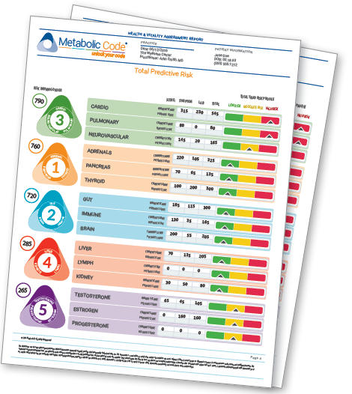
Get Your Report
The Metabolic Code Health Assessment and Vitality Report examines triad physiology and pathological patterns, reviews dysfunctions within each Triad, and recommends where you can improve on the Triad score using dietary, lifestyle and targeted nutritional supplements specific to your needs.
Talk to your physician today about the benefits of Metabolic Code.

