Slide 1
Memes
This powerpoint is about memes

Slide 2
ice
is cold

Slide 3
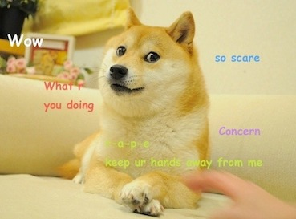
doge
Hello
from the other sliiiideee
heres some example text for my program
insert meme here

