Slide 1



Iteration based learning for identification of disturbance model parameters based on a Model Predictive Control Race car(1:43)
Hamza Imran Durrani
The Systems Control and Optimization Laboratory
Department of Microsystems Engineering - IMTEK
University of Freiburg, Germany

Slide 2
Contents
  Task introduction and objectives .
  Implementation of Extended Kalman Filter.
    Augmentation of model.
  Implementation of steady state LQR with and without the disturbance model.
    Different magnitudes of disturbances tested.
    Analysis of how the observer estimates the disturbances.
    Results
31.xx.2010
Forename Surname
- <number> -

Slide 3
Contents
  Implementation of a Model Predictive Controller with the following settings.
    Disturbance in augmented model but not in the Model predictive controller.
    Disturbance in the augmented model and given as parameters in the Model predictive controller.
  Varying disturbances simulated in the plant model and the performance of the MPC .
  Iterations carried out for the identification of the disturbance parameters (offline estimation).
31.xx.2010
Forename Surname
- <number> -

Slide 4
Task introduction and Objectives
  Main idea:-To improve the performance of the Race car.
  Idea chosen was to implement the paper of “Gabriele Pannocchia” named “Offsett-Free MPC”
  Verification of the modeling errors of the RC car by implementation of an “Offset Free MPC”.
  Better closed loop performance depending on unobserved disturbances is the ultimate target.
  Iteration based offline estimation for identifying disturbance parameters.
  Introduce versatility in the sense of offline estimation which can be done on various tracks to identify the best disturbance parameters.
31.xx.2010
Forename Surname
- <number> -

Slide 5
Implementation of LQR with and without disturbance models
  Summary of the implementation of extended Kalman filter with LQR
    Tested without an augmentation model.
    Tested with an augmentation model.
    Different fixed disturbances provided as the true value,and the observer analysis.
    Changing true value disturbance and analysis of how the EKF approximates it.
    Results
31.xx.2010
Forename Surname
- <number> -

Slide 6
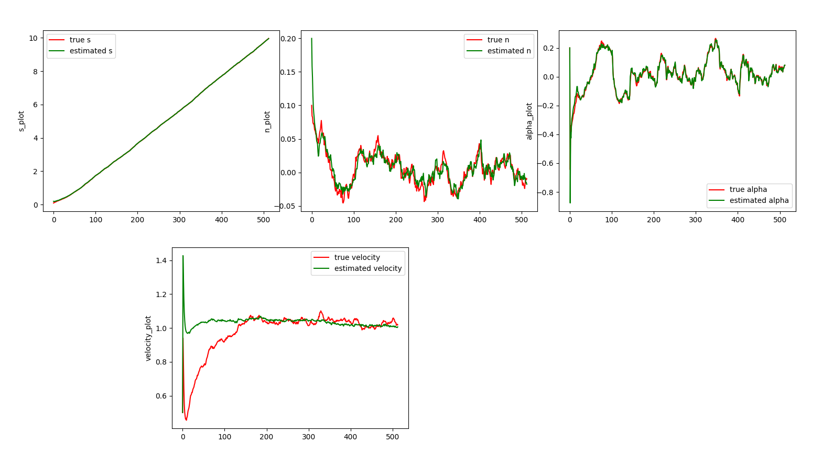
Implementation of LQR with and without disturbance models
  Results with a non augmented model
31.xx.2010
Forename Surname
- <number> -

Slide 7
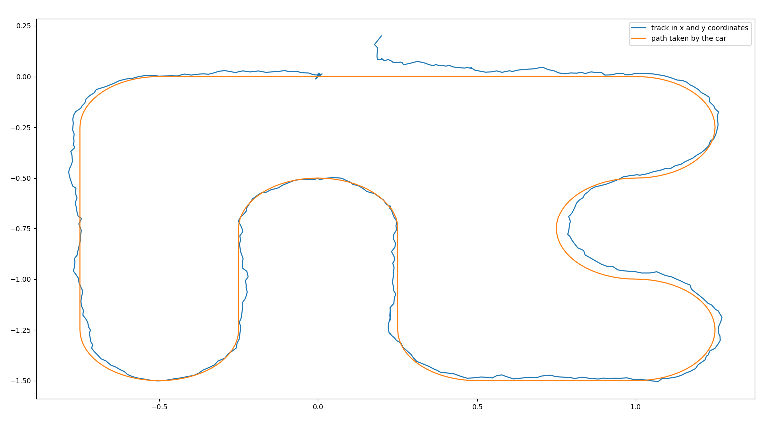
Implementation of LQR with and without disturbance models
  Results with a non augmented model
31.xx.2010
Forename Surname
- <number> -

Slide 8
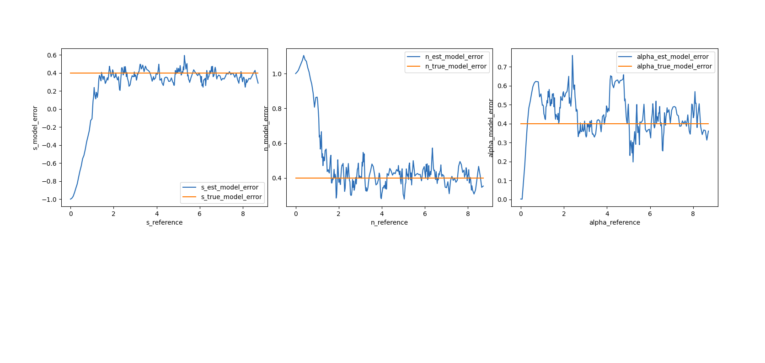
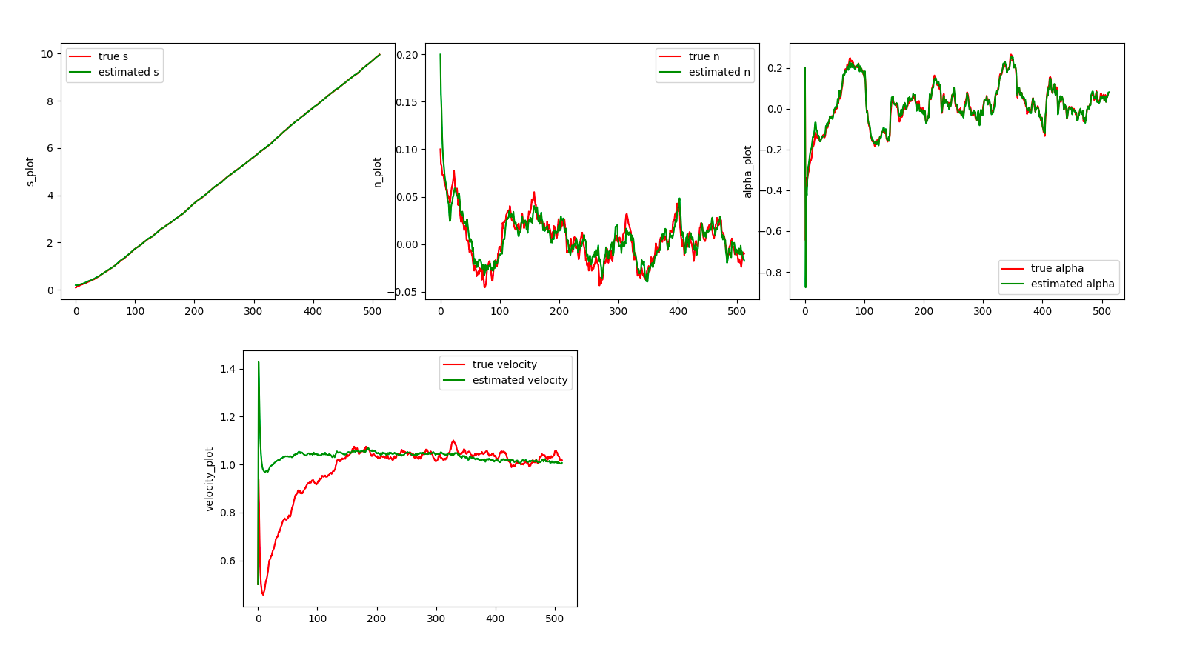
Implementation of LQR with and without disturbance models
  Results with an augmented model(fixed true disturbance of 0.4)
31.xx.2010
Forename Surname
- <number> -

Slide 9
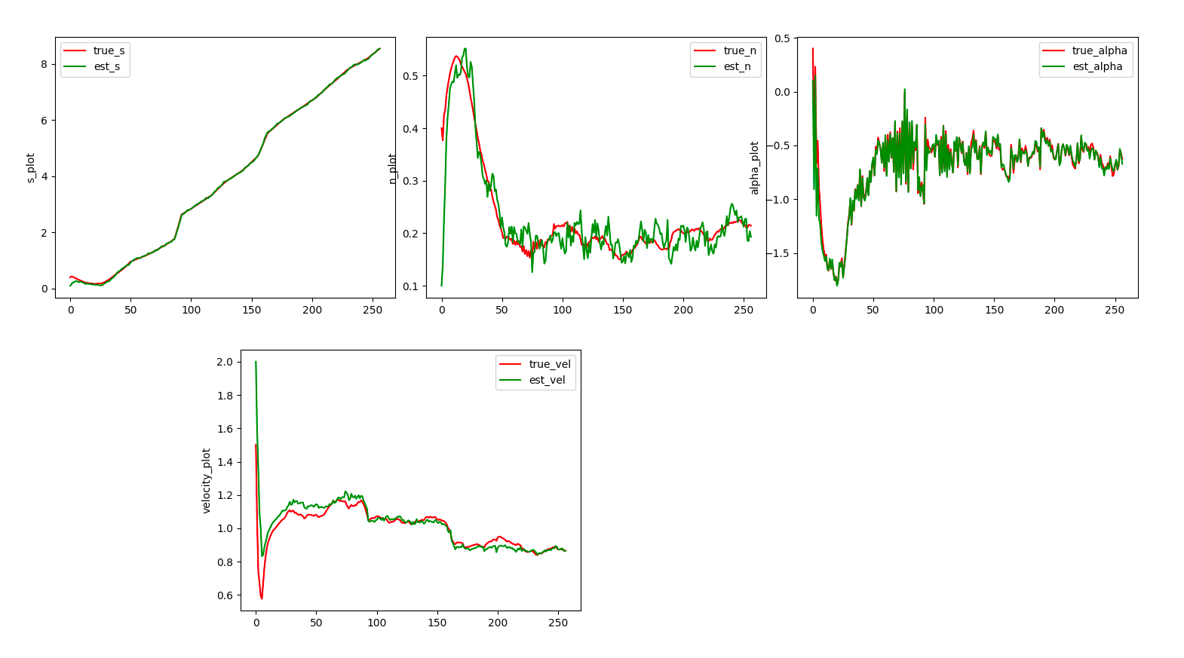
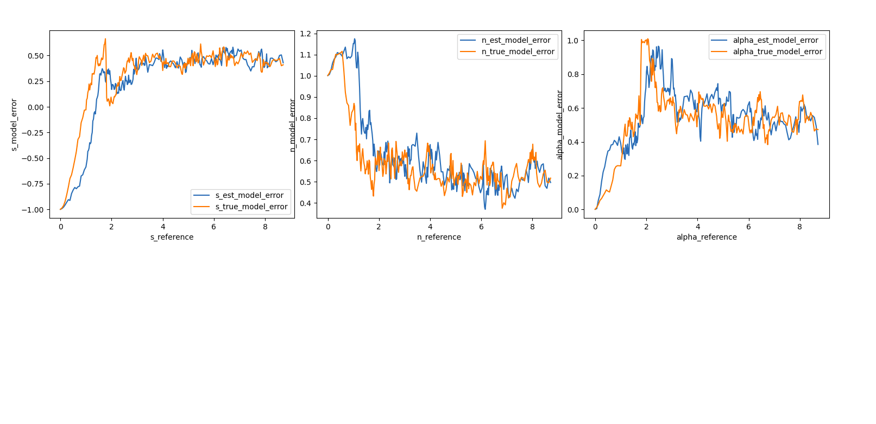
Implementation of LQR with and without disturbance models
  Results with an augmented model(varying true disturbance )
31.xx.2010
Forename Surname
- <number> -
31.xx.2010
Forename Surname
- <number> -

Slide 10
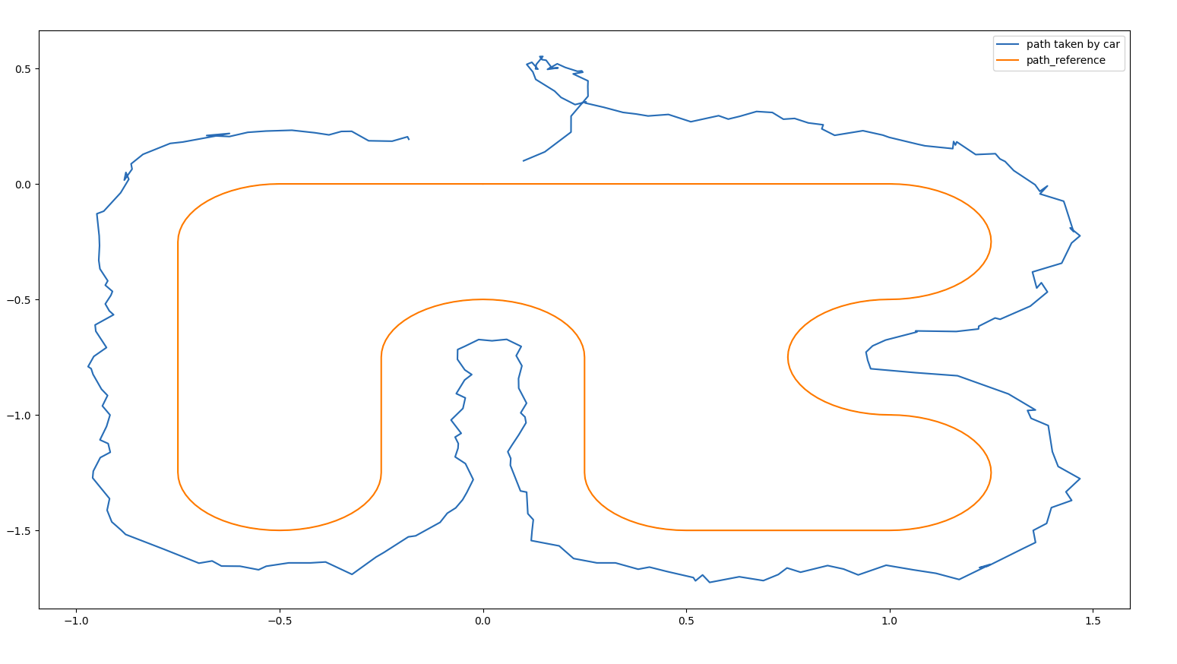
Implementation of LQR with and without disturbance models
  Track results with an augmented model(varying true disturbance),Tested with various other disturbance magnitudes as well.
31.xx.2010
-
Forename Surname
- <number> -

Slide 11
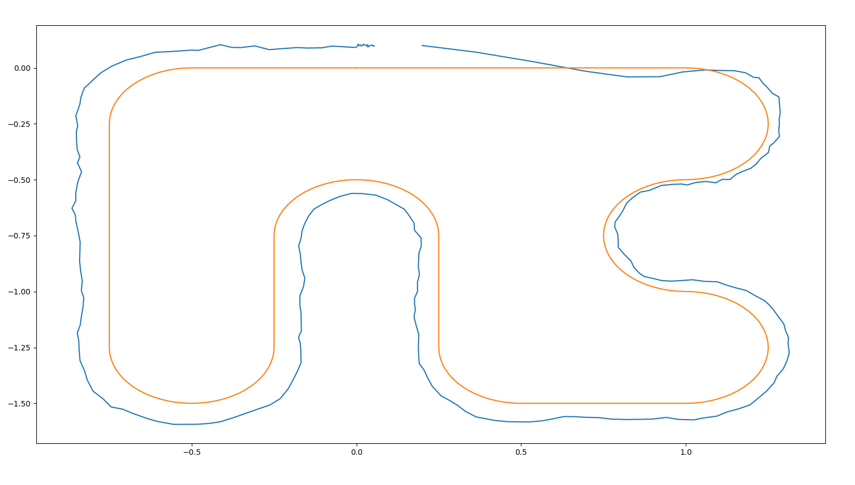
Implementation of MPC with fixed and varying disturbance models
  Track result of MPC with disturbance in the plant and observer model but not provided as a parameter to the MPC.
31.xx.2010
- -
Forename Surname
- <number> -

Slide 12
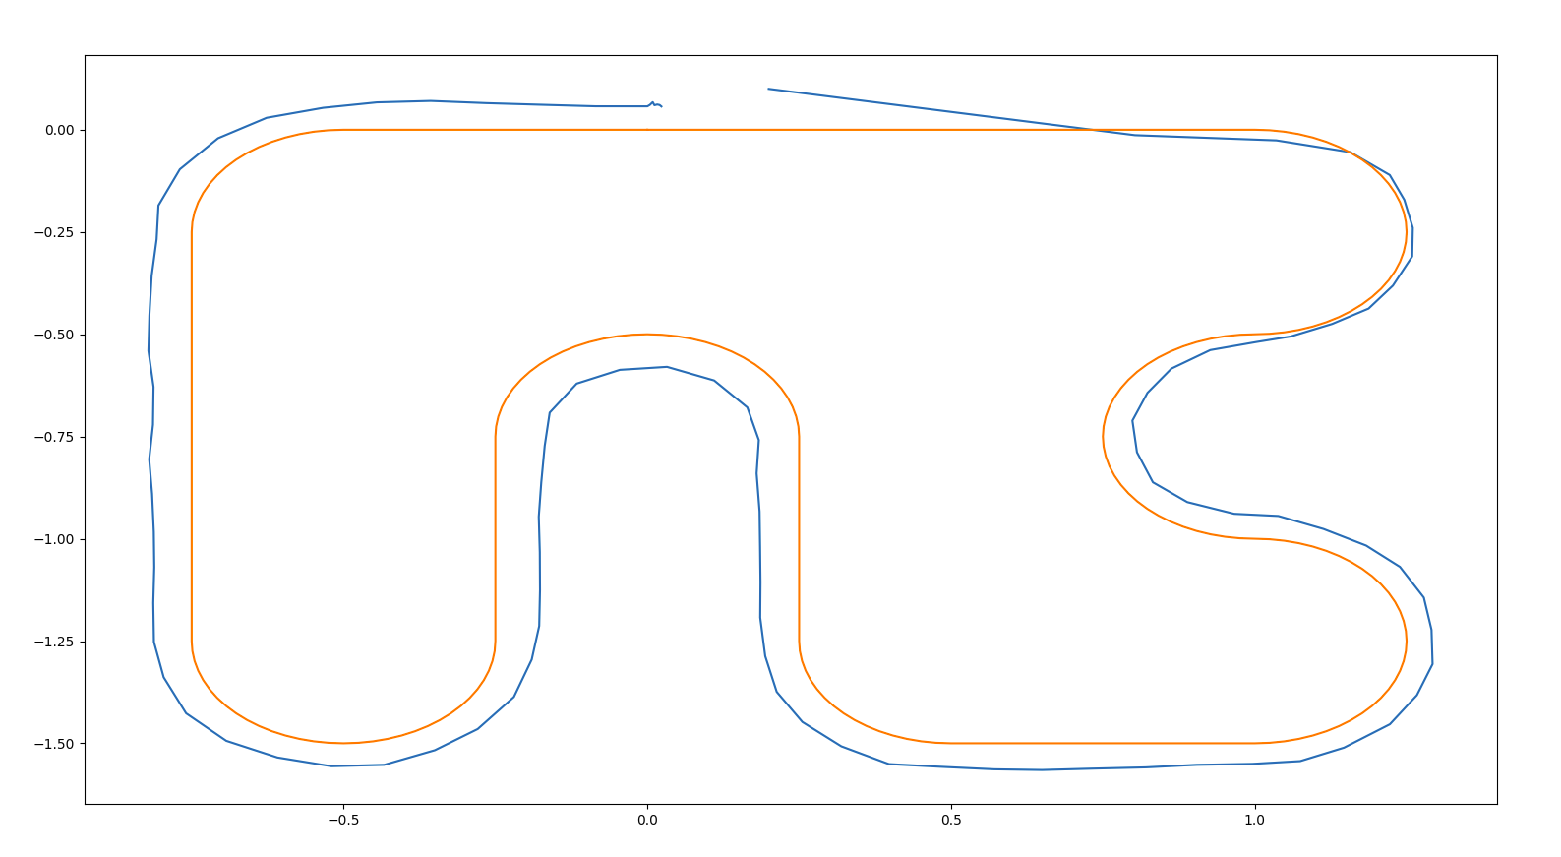
Implementation of MPC with fixed and varying disturbance models
  Track following showing a better result with the disturbance parameter being provided to the MPC
31.xx.2010
- -
Forename Surname
- <number> -

Slide 13
Offline estimation of disturbance parameter
  A big linear least square problem was minimized with respect to disturbance parameters and the states.
  Offline estimation was done and the values were put back in the closed loop system.
  The track performance showed a better trajectory.
31.xx.2010
- -
Forename Surname
- <number> -

Slide 14
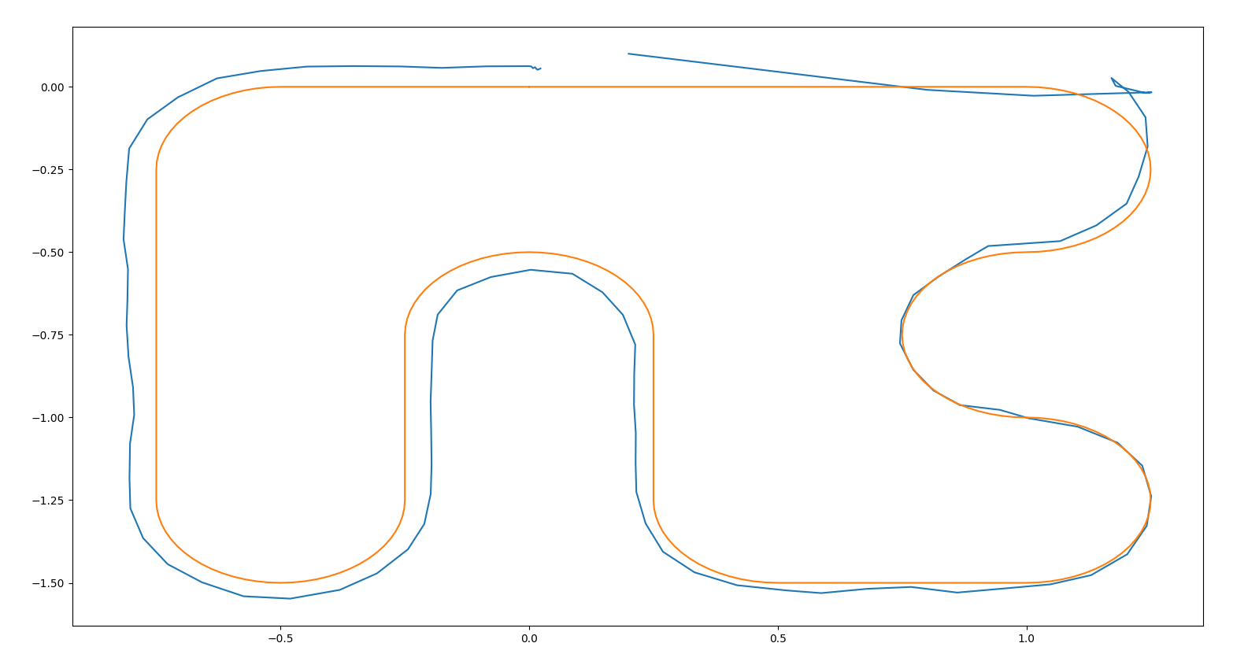
Offline estimation of disturbance parameter
  In certain corners showing better results but not completely satisfactory result(still working on it).
31.xx.2010
- -
Forename Surname
- <number> -

Slide 15
Next steps
  Model the disturbance parameters better. Right now there are affine terms.
  Simulation of the car to run on the track multiple times and interpolating the disturbances to the s reference points of the track.
  How to model the interpolation on the reference track?
31.xx.2010
Forename Surname
- <number> -
31.xx.2010
Forename Surname
- <number> -

Slide 16
Thank you for your time

