Slide 1



Iteration based learning for identification of disturbance model parameters based on a Model Predictive Control Race car(1:43)
Hamza Imran Durrani
The Systems Control and Optimization Laboratory
Department of Microsystems Engineering - IMTEK
University of Freiburg, Germany

Slide 2
Contents
  Task introduction and objectives .
  Implementation of Extended Kalman Filter.
    Augmentation of model.
    Constant disturbance in the plant model.
    Varying disturbance in the plant model.
  Implementation of steady state LQR with and without the disturbance model.
    Configuration
    Results
31.xx.2010
Forename Surname
- <number> -

Slide 3
Contents
  Implementation of a Model Predictive Controller with the following settings.
    Disturbance in augmented model but not in the Model predictive controller.
    Disturbance in the augmented model and given as parameters in the Model predictive controller.
  Offline estimation of the disturbance parameters by multiple laps of the car.
  Future steps.
31.xx.2010
Forename Surname
- <number> -

Slide 4
Task introduction and Objectives
  Main idea:-To improve the performance of the Race car.
  Idea chosen was to implement the paper of “Gabriele Pannocchia” named “Offsett-Free MPC”
  Verification of the modeling errors of the RC car by implementation of an “Offset Free MPC”.
  Better closed loop performance depending on unobserved disturbances is the ultimate target.
  Iteration based offline estimation for identifying disturbance parameters.
  Introduce versatility in the sense of offline estimation which can be done on various tracks to identify the best disturbance parameters.
31.xx.2010
Forename Surname
- <number> -

Slide 5
Implementation of the Extended Kalman Filter
  Augmented Model. D1, d2 and d3 being the disturbance parameters.
  Being added as an affine terms to the ode.
31.xx.2010
Forename Surname
- <number> -

Slide 6
Implementation of Extended Kalman Filter
  Fixed plant disturbance values tested ranging from 0.1 to 0.4.
  Varying plant disturbance values tested along the path.e.g.
Increasing
s(car path discretized points)
31.xx.2010
Forename Surname
- <number> -

Slide 7
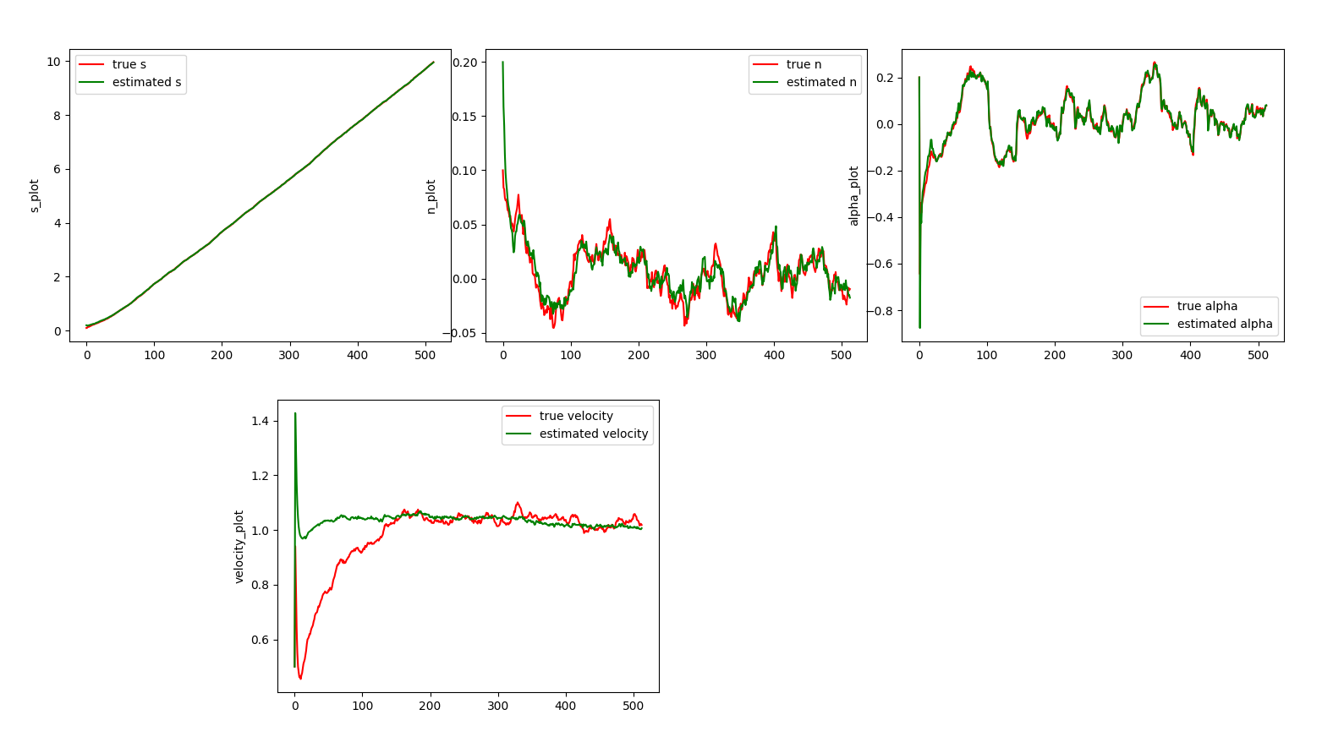
Implementation of LQR with and without disturbance models
  Configuration of LQR .
  x _steady state, u_steady state,Q and R.
  LQR(tested with disturbance not entering the controller).
[0.08138923, 0.091973
31.xx.2010
Forename Surname
- <number> -

Slide 8
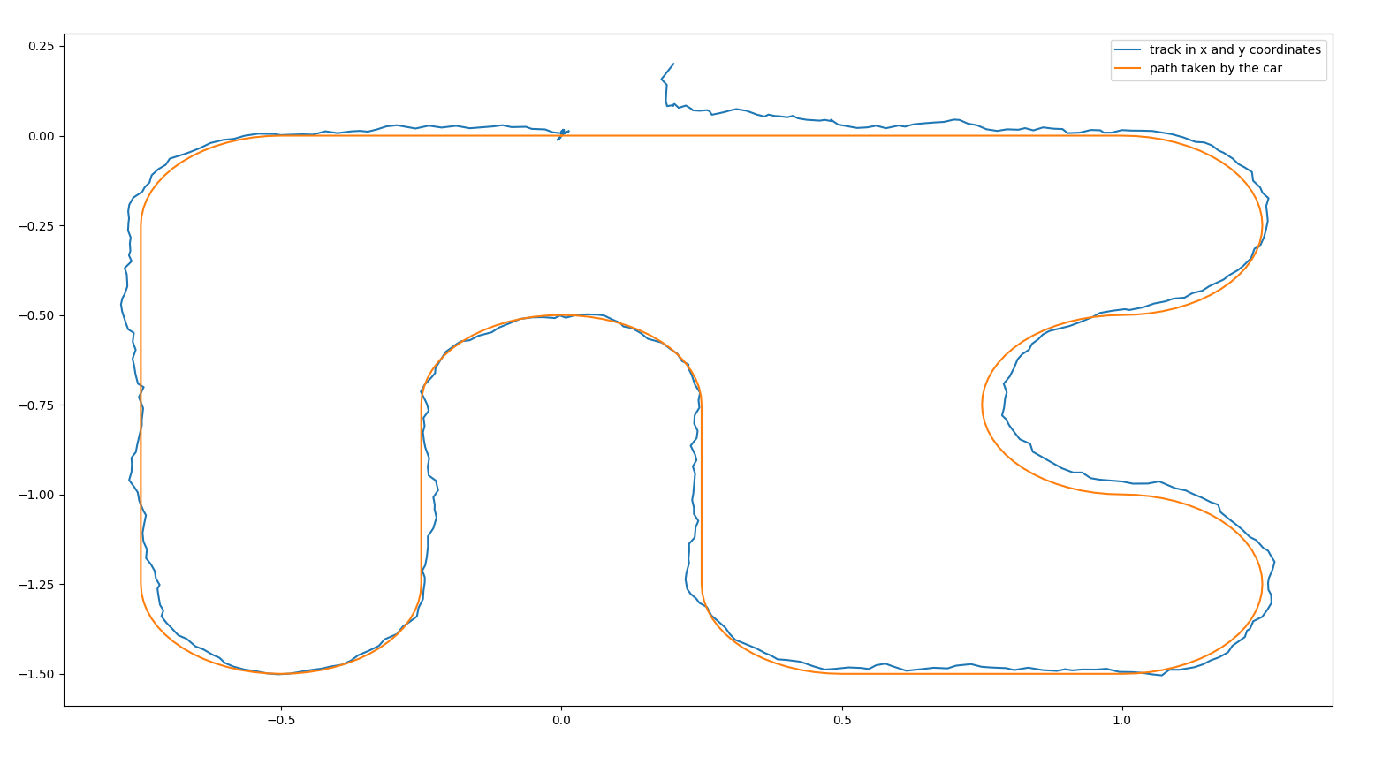
Implementation of LQR with and without disturbance models
  Results with a non augmented model
31.xx.2010
Forename Surname
- <number> -

Slide 9
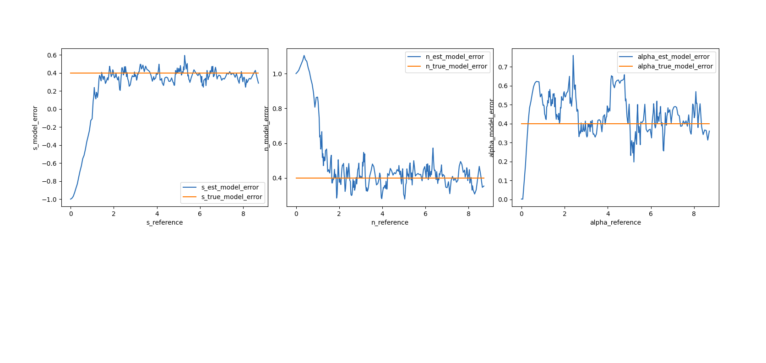
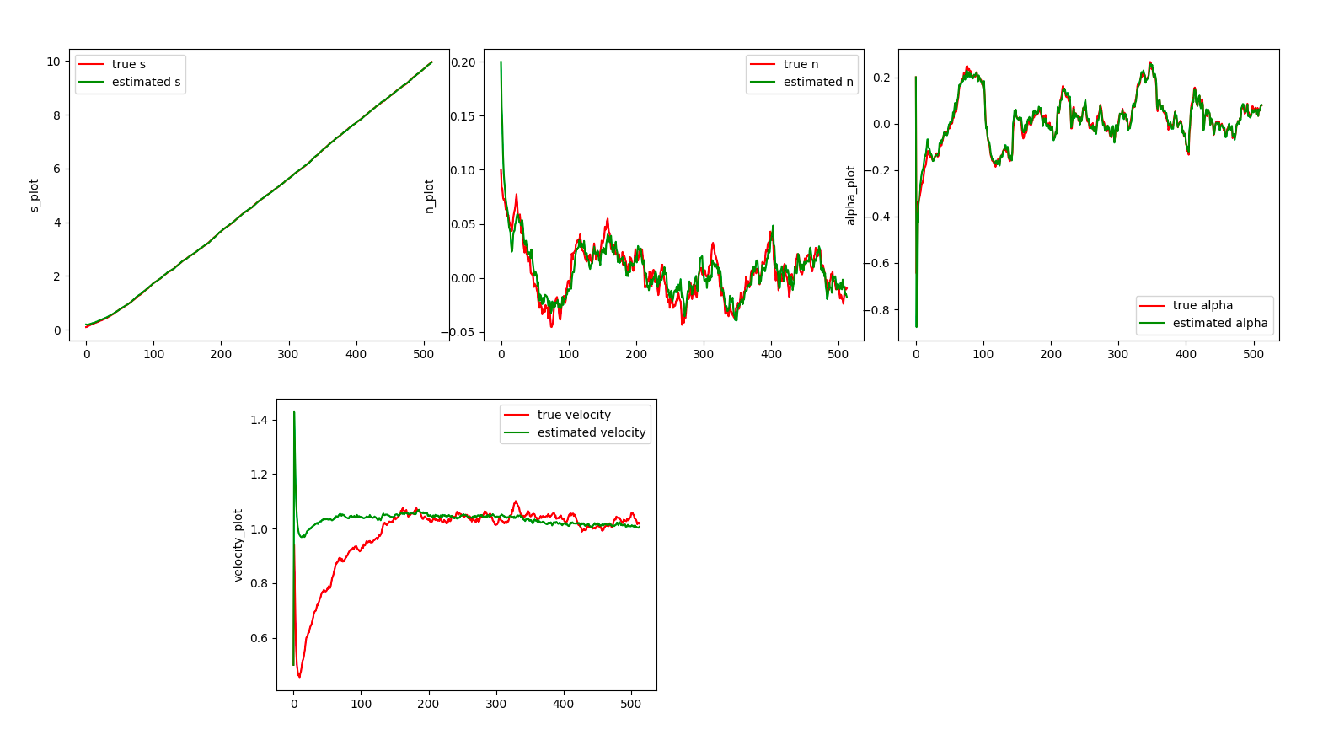
Implementation of LQR with and without disturbance models
  Results with an augmented model(fixed true disturbance of 0.4)
31.xx.2010
Forename Surname
- <number> -

Slide 10
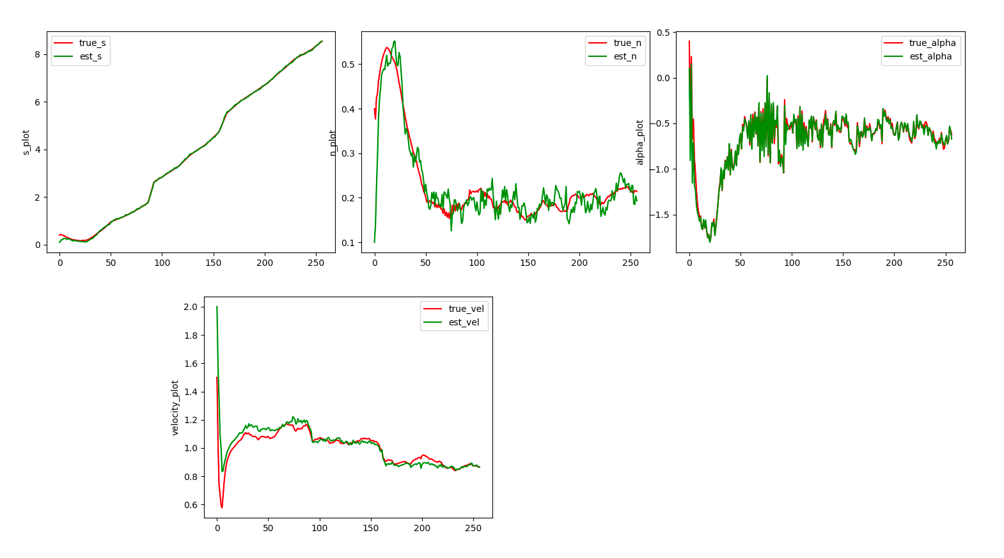
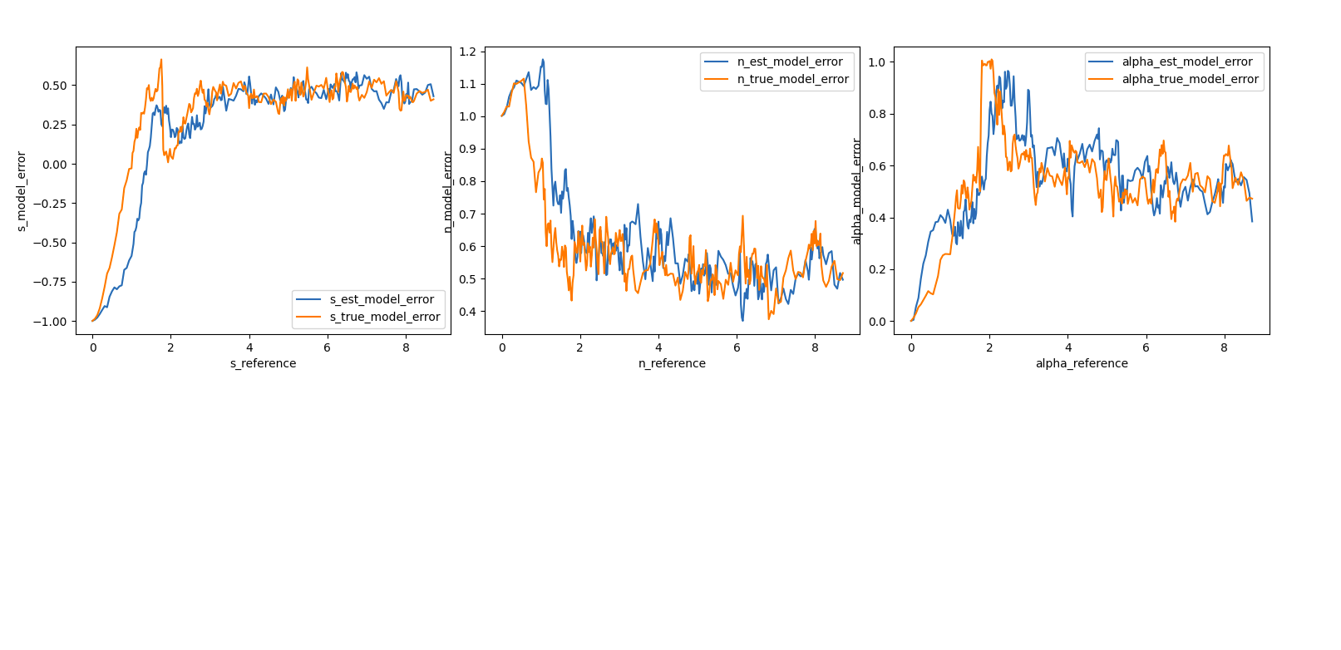
Implementation of LQR with and without disturbance models
  Results with an augmented model(varying true disturbance )
31.xx.2010
Forename Surname
- <number> -
31.xx.2010
Forename Surname
- <number> -

Slide 11
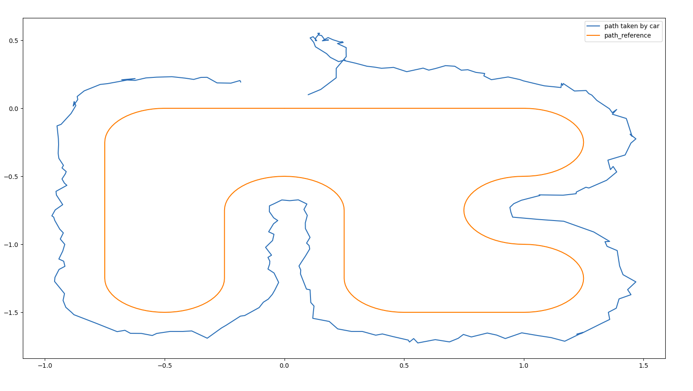
Implementation of LQR with and without disturbance models
  Track results with an augmented model(varying true disturbance),Tested with various other disturbance magnitudes as well.
31.xx.2010
-
Forename Surname
- <number> -

Slide 12
Implementation of MPC with fixed and varying disturbance models
  Multiple shooting is implemented on casadi.
  Configuration
  Without the disturbance parameter applied to the MPC controller
31.xx.2010
- -
Forename Surname
- <number> -

Slide 13
Implementation of MPC with fixed and varying disturbance models
  MPC NLP formulation
31.xx.2010
- -
Forename Surname
- <number> -

Slide 14
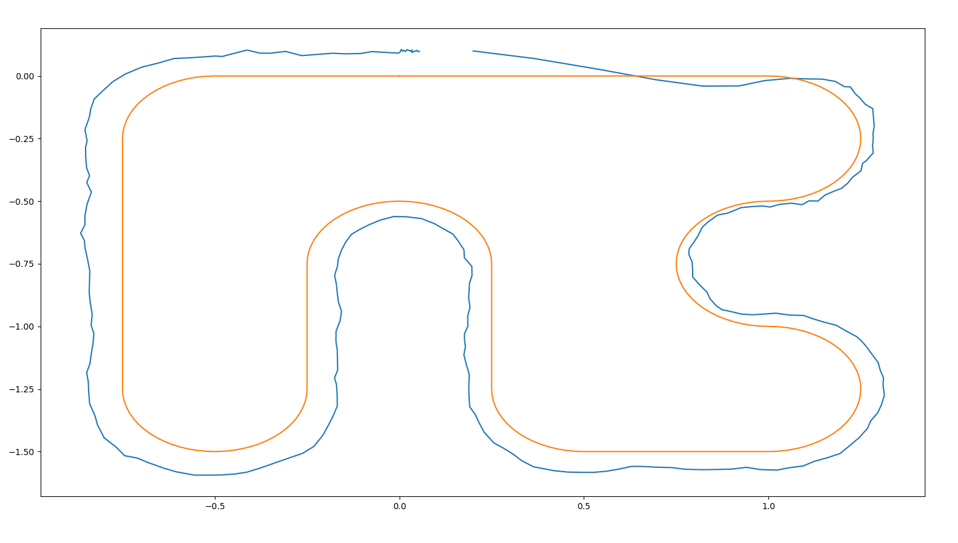
Implementation of MPC with fixed and varying disturbance models
  Track result of MPC with disturbance not being provided as a parameter to the MPC.
31.xx.2010
- -
Forename Surname
- <number> -

Slide 15
Implementation of MPC with fixed and varying disturbance models
  MPC settings with disturbance entering the controller
31.xx.2010
- -
Forename Surname
- <number> -

Slide 16
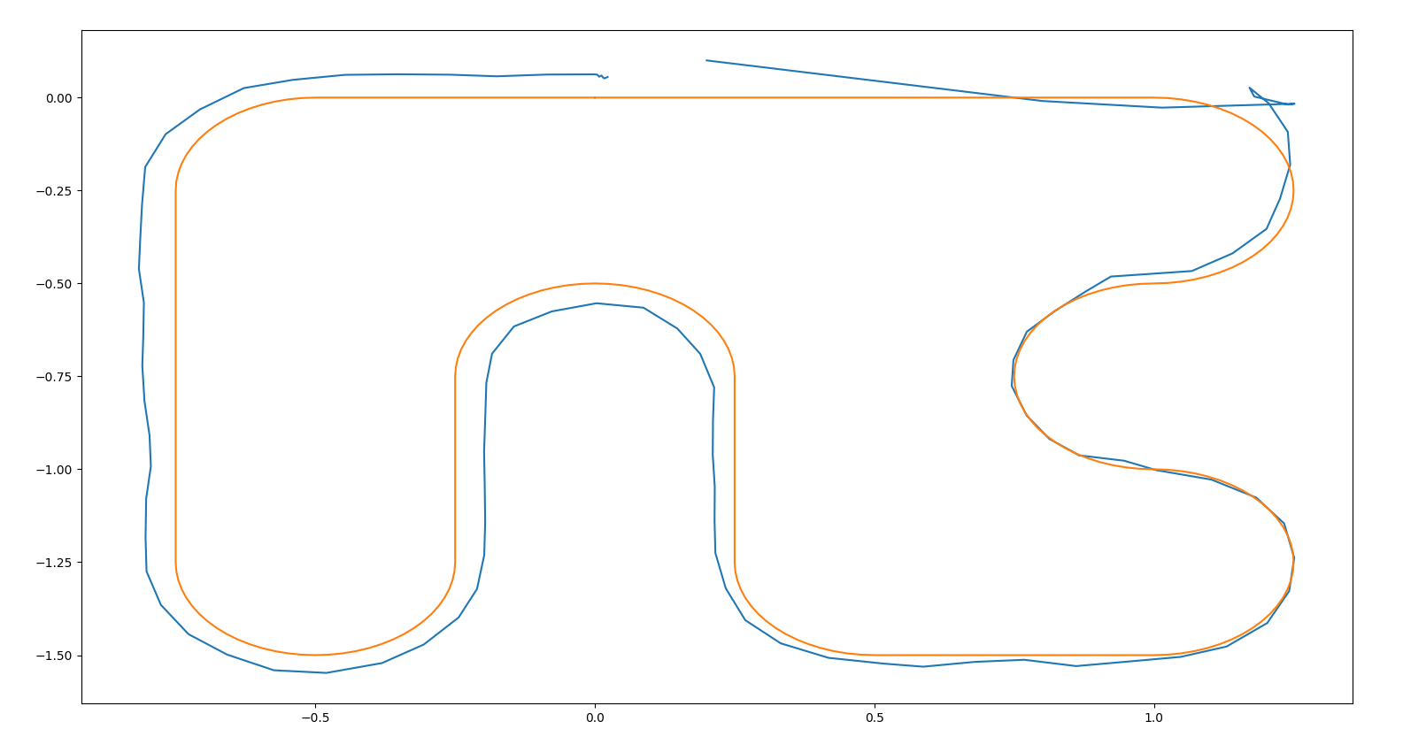
Offline estimation of disturbance parameter
  In certain corners showing better results but not completely satisfactory result(still working on it).
31.xx.2010
- -
Forename Surname
- <number> -

Slide 17
Offline estimation of disturbance parameter
  A big linear least square problem was minimized with respect to disturbance parameters and the states.
  Offline estimation was done and the values were put back in the closed loop system.
  The track performance showed a better trajectory.
31.xx.2010
- -
Forename Surname
- <number> -

Slide 18
Next steps
  Model the disturbance parameters better. Right now there are affine terms.
  Simulation of the car to run on the track multiple times and interpolating the disturbances to the s reference points of the track .
  This interpolated points have to be put back into the closed loop ans that the results have to be analyzed
  How to model the interpolation on the reference track?
31.xx.2010
Forename Surname
- <number> -
31.xx.2010
Forename Surname
- <number> -

Slide 19
Thank you for your time

