Slide 1
NBA STATS 2021 per Game
Работил: Хамза Јашари 185062

Slide 2
Класификација
RandomForestClassifier
XGBClassifier
KNN Classifier

Slide 3
Прецизноста со користење на класификаторите - оригинални податоци
RandomForest Classifier Accuracy: 0.7152 Precision: 0.7619 Recall: 0.9032
XGB Classifier Accuracy: 0.6848 Precision: 0.7379 Recall: 0.8843
K-nearest neighbors Accuracy: 0.7727
Precision: 0.8218
Recall: 0.9222

Slide 4
Прецизноста со користење на класификаторите – oversampling minor class
RandomForest Classifier Accuracy: 0.7818 Precision: 0.8392 Recall: 0.9023
XGB Classifier Accuracy: 0.6848 Precision: 0.7379 Recall: 0.8843
K-nearest neighbors Accuracy: 0.7182
Precision: 0.7624
Recall: 0.9167

Slide 5
Прецизноста со користење на класификаторите – undersampling major class
RandomForest Classifier Accuracy: 0.7576 Precision: 0.7973 Recall: 0.9219
XGB Classifier Accuracy: 0.6848 Precision: 0.7379 Recall: 0.8843
K-nearest neighbors Accuracy: 0.8000
Precision: 0.8095
Recall: 0.9770

Slide 6
Регресија
Linear Regression
KNN Regression
Mean Absolute Error: 0.4334
Mean Squared Error: 0.3579
Root Mean Squared Error: 0.5983
Mean Absolute Error: 0.5904
Mean Squared Error: 0.7954
Root Mean Squared Error: 0.8919

Slide 7
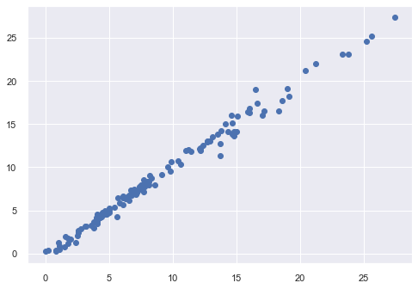
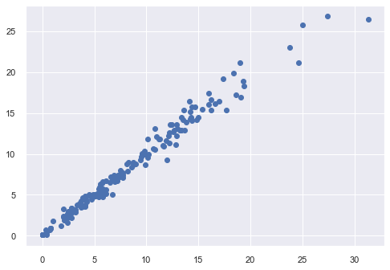
Linear Regression vs KNN Regression

Slide 8
Кластерирање
K-Means
DBSCAN
Hierarchical Clustering

Slide 9
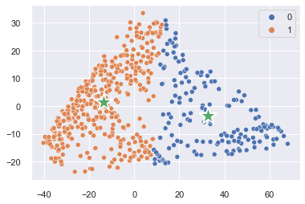
K-Means

Slide 10
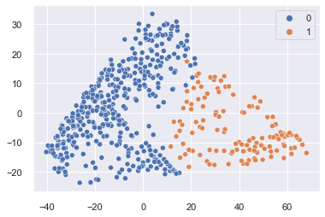
Hierarchical Clustering

Slide 11
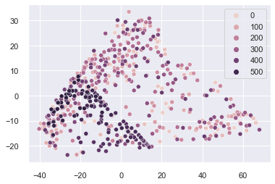
DBSCAN

Slide 12
Дополнтелни научни трудови
Predicting 2020–21 NBA’s Most Valuable Player using Machine Learning
https://towardsdatascience.com/predicting-2020-21-nbas-most-valuable-player-using-machine-learning-24aaa869a740

Slide 13
DATA SCIENCE

