Slide 1
E-Commerce Customer Segmentation Analysis
Analyzing 10,000 online retail transactions to discover customer groups
Name: Hamza Jawad
Date: 01 Sep 2025

Slide 2
Problem Statement:
This project analyzes online retail transaction data to uncover patterns in customer purchasing behavior. By applying RFM analysis and clustering, customers are segmented into distinct groups. The findings will provide actionable insights to optimize marketing strategies, improve customer retention, and maximize revenue growth, directly supporting the company’s goal of building stronger long-term customer relationships.

Slide 3
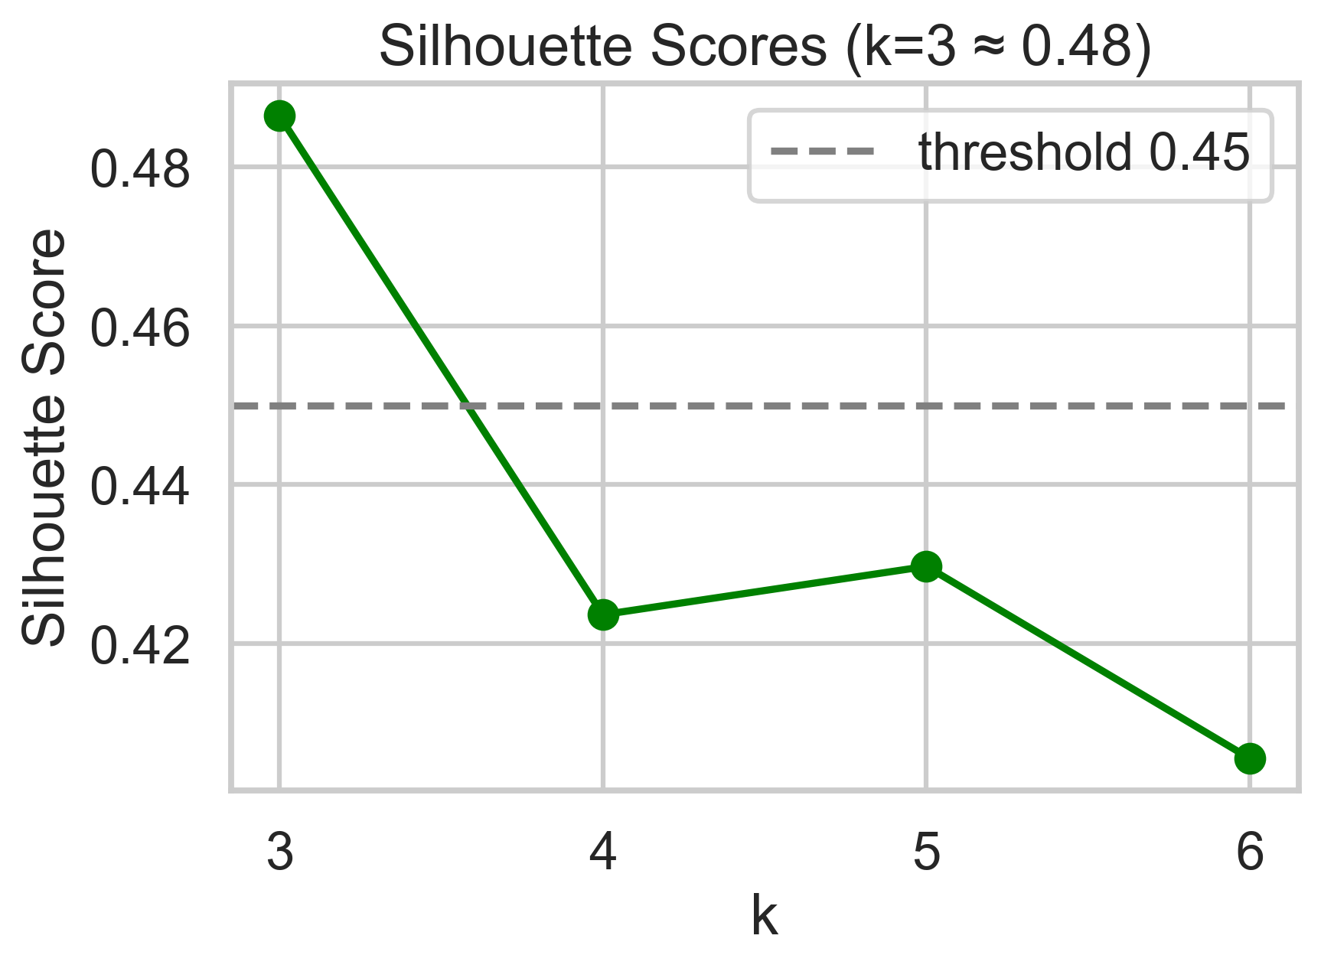
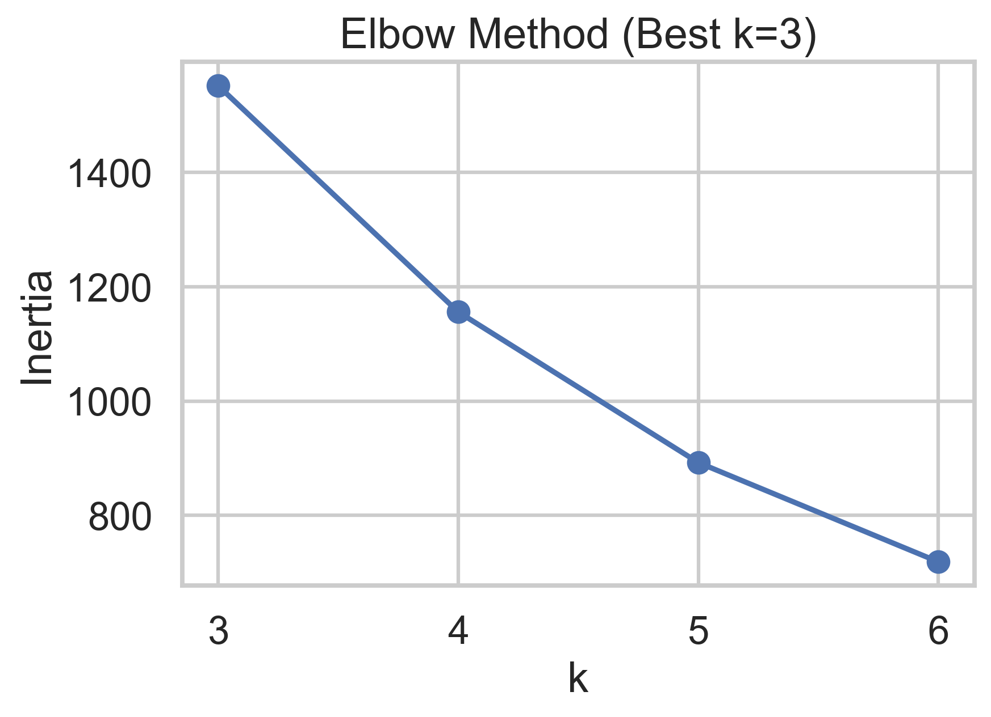
Three clusters fit best
Elbow suggests k=3 provides balance.
Silhouette score ≈ 0.48 shows moderate cluster quality.
Provides foundation for meaningful personas.

Slide 4
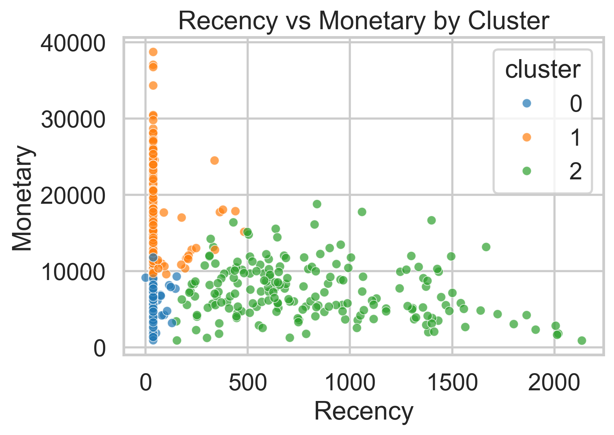
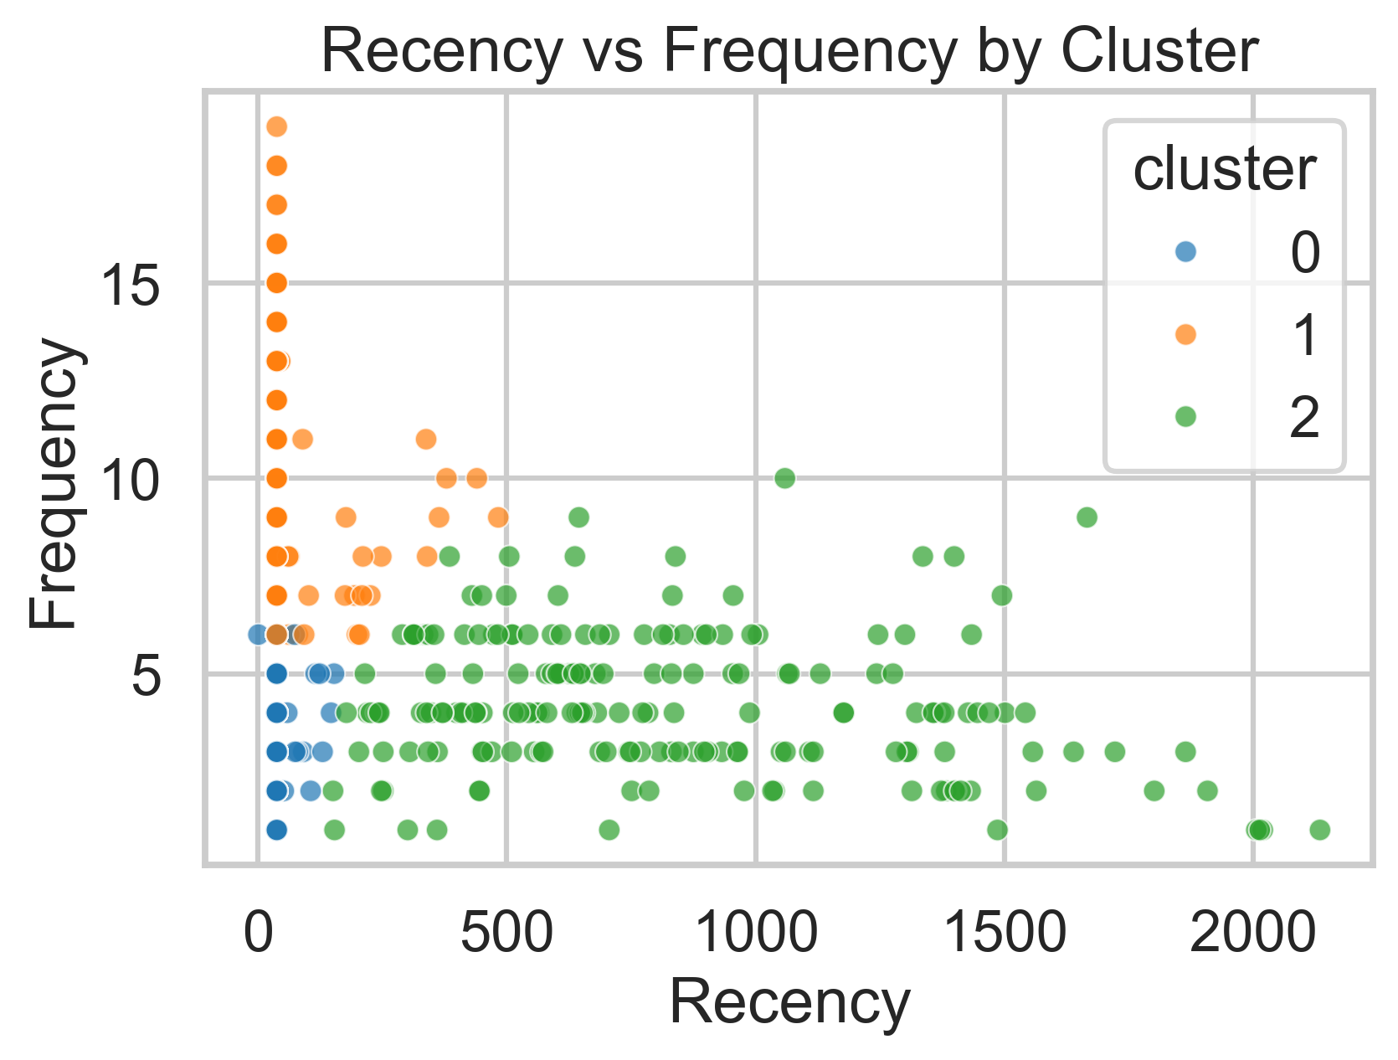
Customers form distinct groups
Cluster 0: High-spending loyal customers.
Cluster 1: Average frequency, moderate spending.
Cluster 2: Low activity, low value.

Slide 5
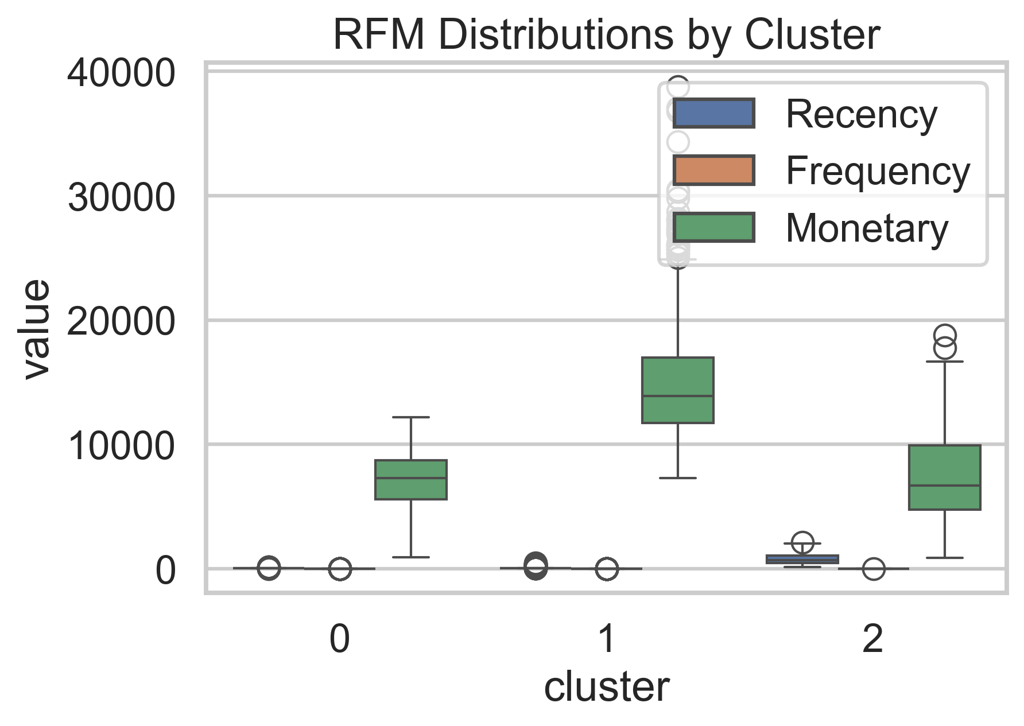
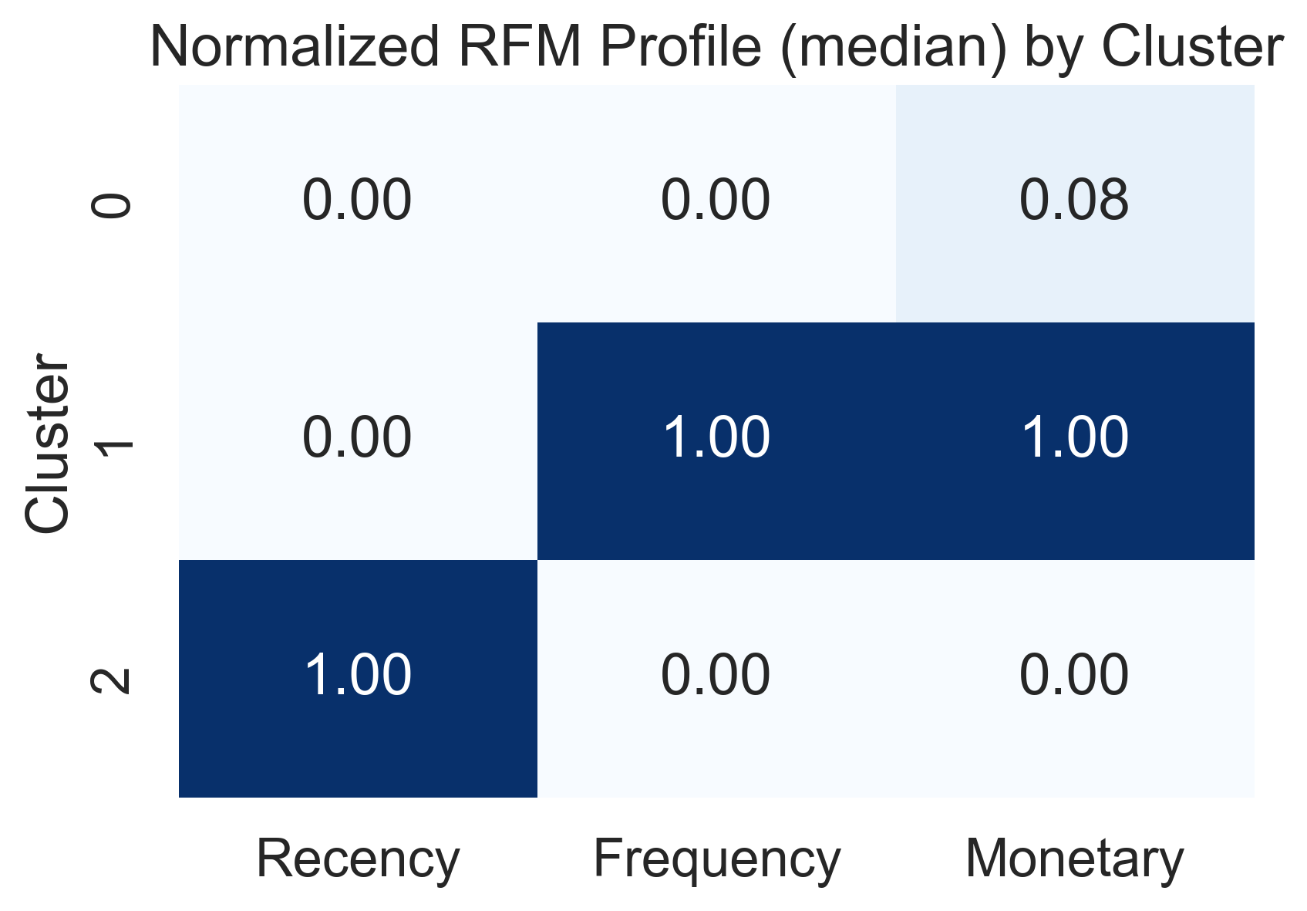
Spending and loyalty vary
Boxplots reveal monetary and frequency contrasts.
Heatmap shows normalized cluster strengths.
Cluster 0 dominates in value.
Cluster 2 highlights retention challenges.

Slide 6
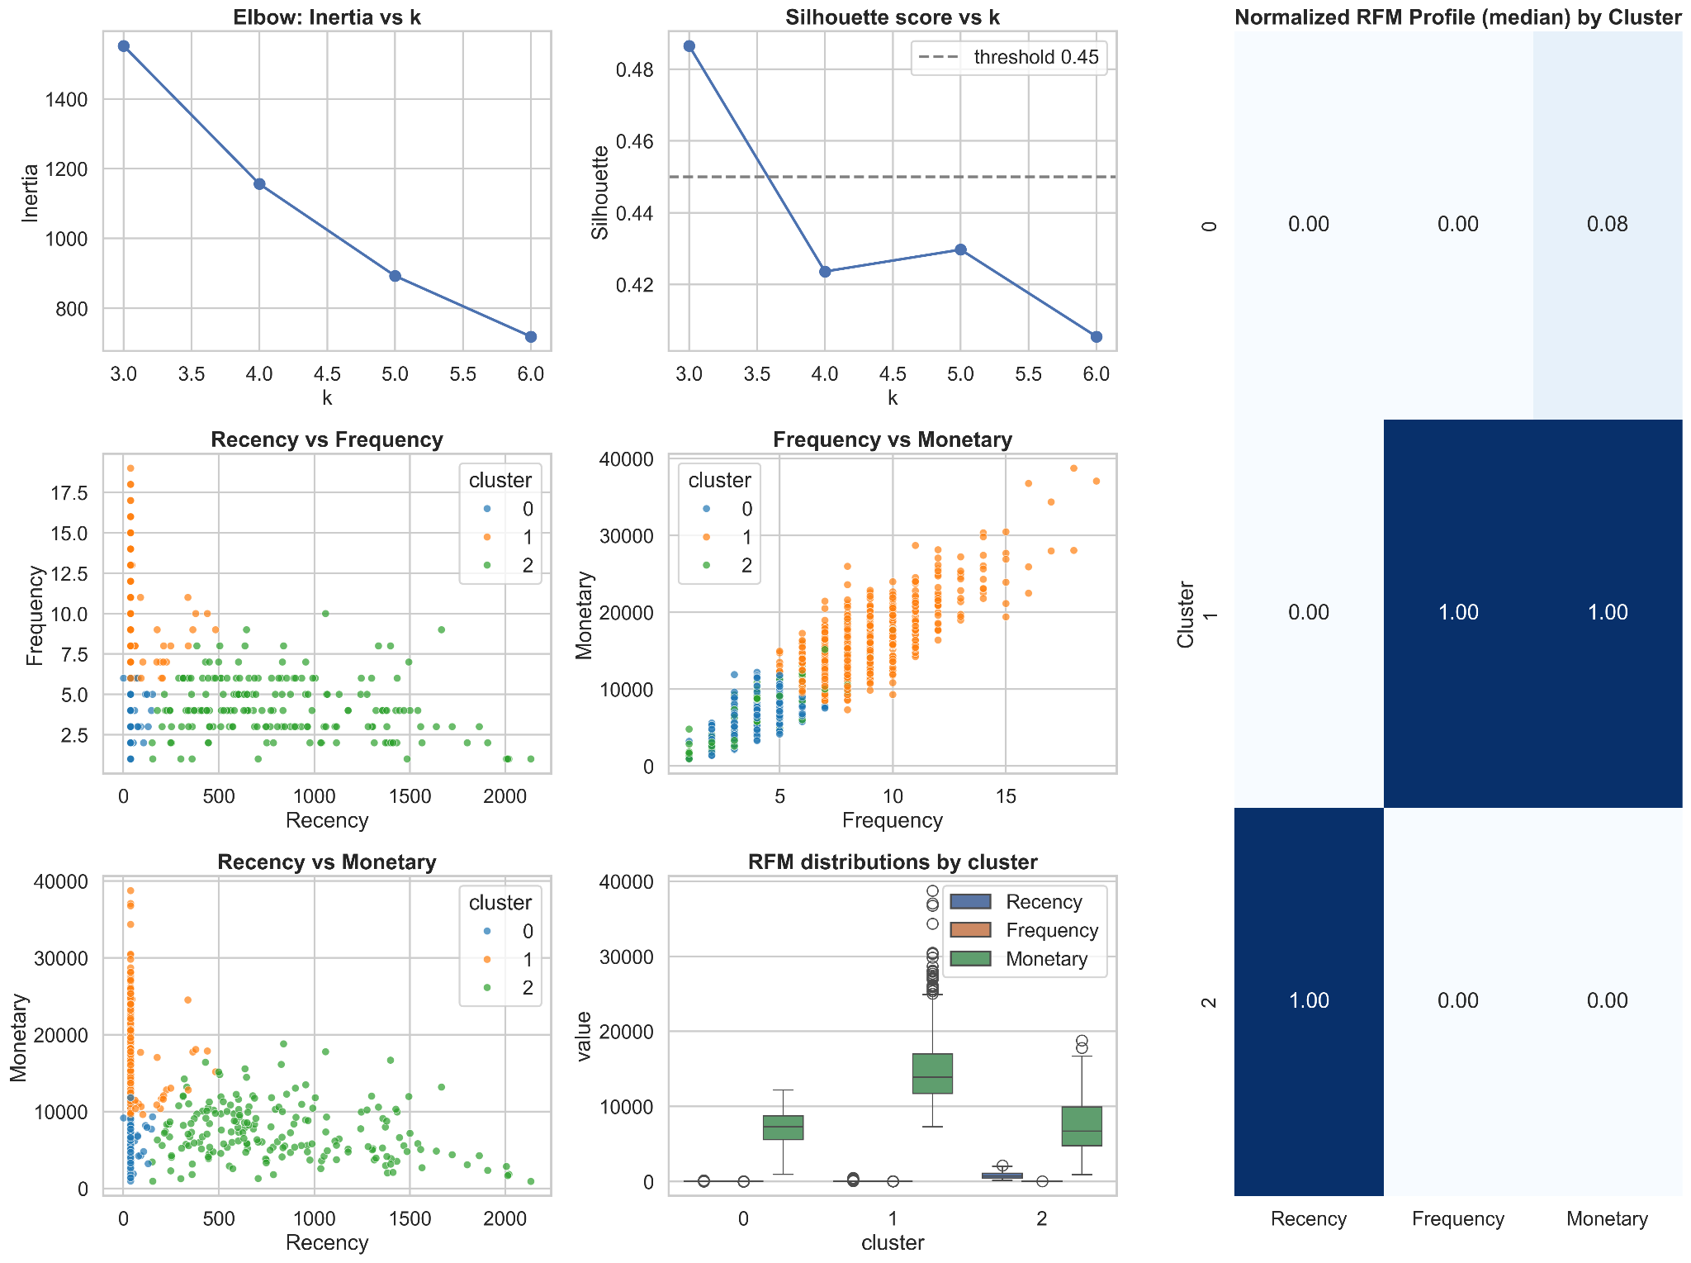
Dashboard

Slide 7
Conclusion:
Cluster 0 consists of loyal, high-value customers who generate the most revenue.
Cluster 1 represents moderate buyers with room for upselling opportunities.
Cluster 2 includes low-engagement customers who show minimal spending and require reactivation strategies.

Slide 8
Recommendations:
Loyalty programs and exclusive rewards should be introduced to retain Cluster 0 customers.
Targeted promotions and personalized offers can encourage Cluster 1 customers to increase purchase frequency and spending.
Reactivation campaigns, such as discounts or reminders, should be used to win back Cluster 2.
Flexible membership tiers could be added to appeal to customers with different engagement levels.

