Slide 1
Bellabeat Wellness Data Analysis
Analyzing Fitbit data to generate insights for Bellabeat strategy
Name: Hamza Jawad
Date: 10 Sep 2025

Slide 2
Problem Statement:
How do people use smart wellness devices?
What patterns appear in activity, sleep, and health?
How can Bellabeat use these insights for marketing growth?

Slide 3
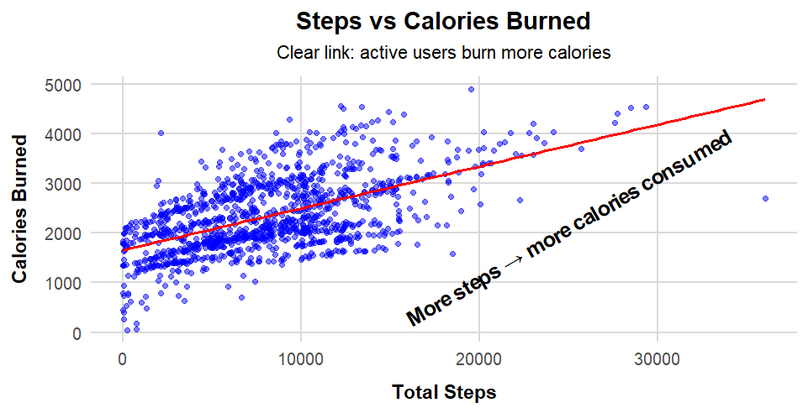
Daily Activity Levels
Highly active users walk ~13K steps, burn ~2,700 calories
Moderate users walk ~7K steps, burn ~2,300 calories
Less active users walk ~2.5K steps, burn ~1,800 calories
Clear link: More steps → higher calories consumed

Slide 4
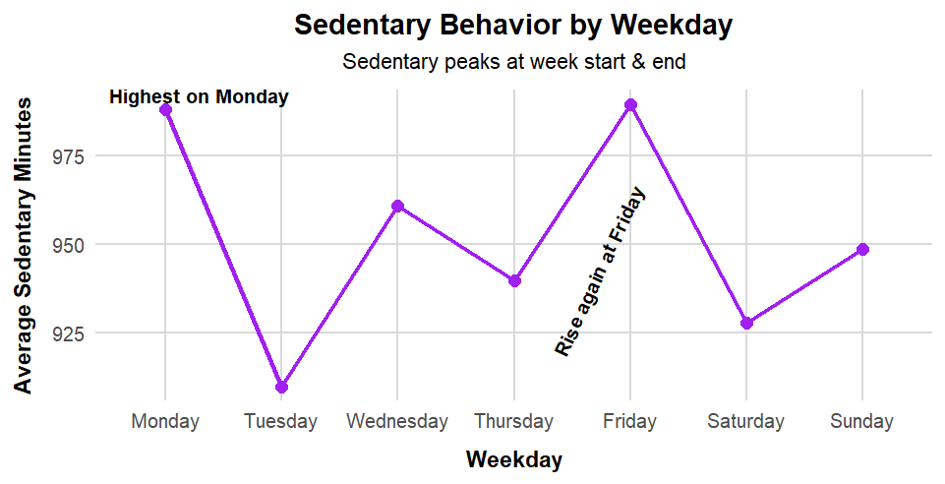
Sedentary Habits
People sit the most on Mondays and Fridays
Sitting is lowest on Tuesdays
Workdays drive longer sitting time
Opportunity: Promote “move more” challenges during the week

Slide 5
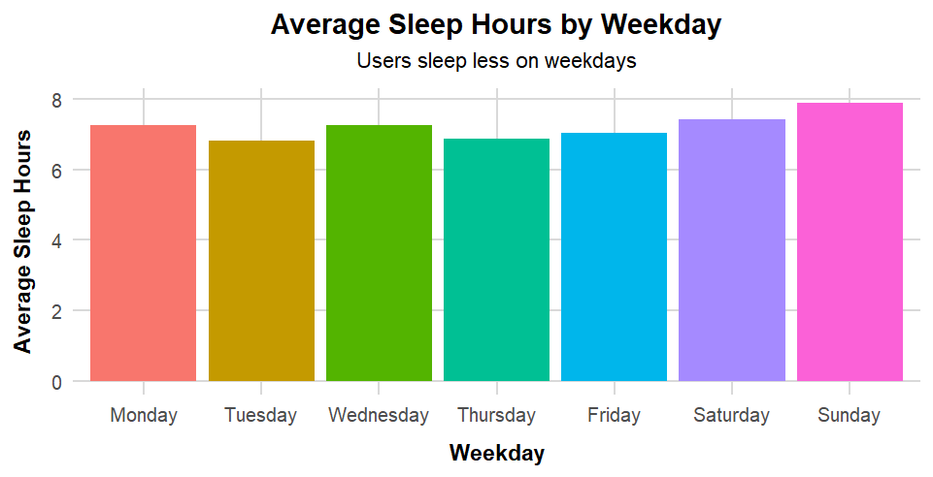
Sleep Habits
People sleep 7.2 hours daily
at average
More sleep on weekends, less on weekdays
Sleep quality is generally high (above 90%)
Bedtime habits affect actual sleep hours

Slide 6
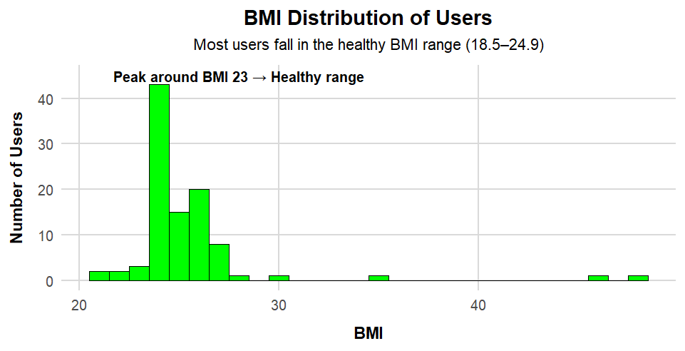
Weight & BMI Tracking
Average user BMI = 25 (borderline healthy)
Most users in healthy to moderate BMI range
64% log weight manually
Opportunity: Promote auto-tracking features to simplify health logging

Slide 7
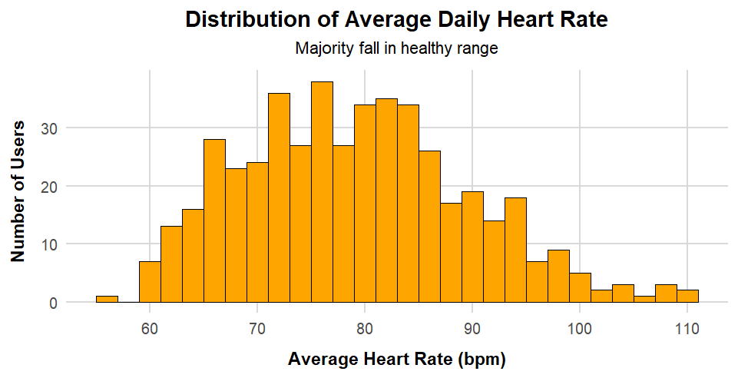
Heart Health
Average daily heart rate
= 79 bpm (healthy)
Wide range shows casual users and fitness-focused users
Heart tracking appeals to both groups

Slide 8
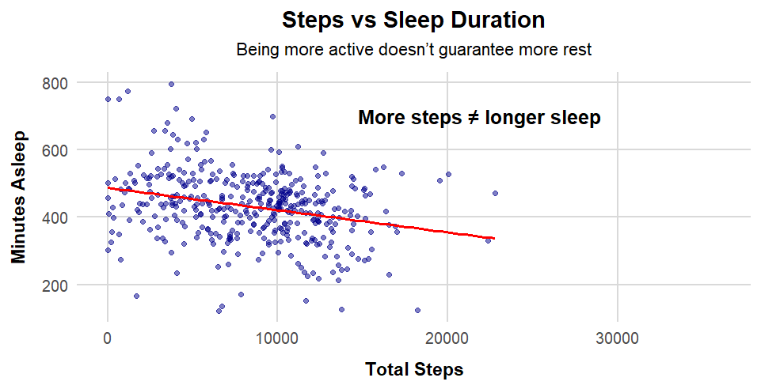
Steps vs Sleep
More steps do not always mean more sleep
Exercise is important, but sleep needs separate focus
Opportunity: Market Bellabeat as balance between activity and rest

Slide 9
Conclusion:
Activity: Higher on weekends, lower during weekdays
Sedentary Habits: Peaks on Mondays and Fridays
Sleep: Shorter on weekdays, longer on weekends
Health Tracking: Many users still log weight manually
Heart Rate & BMI: Most users remain in healthy ranges

Slide 10
Recommendations:
Boost weekday activity with reminders & fun challenges
Support better rest: Market Bellabeat as a sleep + stress partner
Simplify health logging: Promote automatic tracking (weight, heart)
Go holistic: Position Bellabeat as the all-in-one wellness brand

Slide 11


