Slide 1
Cyclistic Bike Usage Analysis: Members vs. Casual Riders Q1 2019–2020 Insights to Drive Membership Growth
Name: Hamza Jawad
Date: August 20, 2025

Slide 2
Problem Statement:
This project analyzes historical trip data from Q1 2019 and Q1 2020 to identify patterns and trends in how casual riders and annual members use Cyclistic bikes differently. The findings will be used to provide actionable recommendations for converting more casual riders into annual members, directly supporting Cyclistic’s goal of increasing long-term customer retention and revenue.

Slide 3
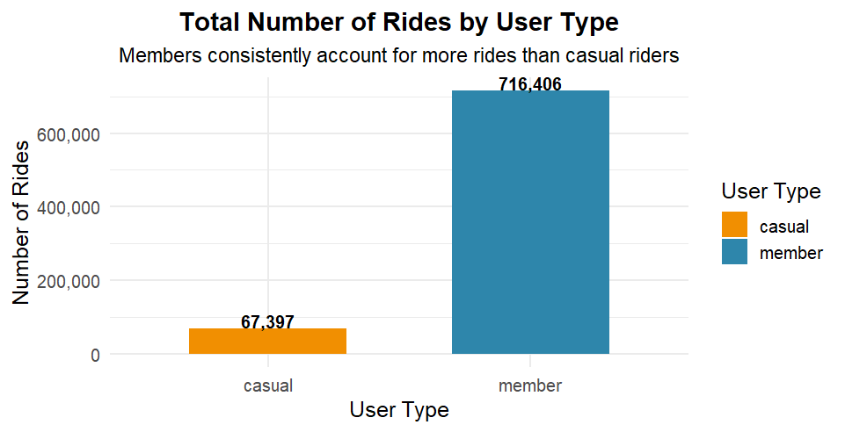
Members dominate bike usage
Members account for 91.4% of all rides.
Casuals contribute only 8.6%.
Members are the core revenue base.
Notes:
Data shows members dominate usage (over 91%).
Casual riders make up a small share, 8.6% of total rides.
Strong indication of loyalty and recurring value from members.
Reinforces the importance of retention and long-term membership.

Slide 4
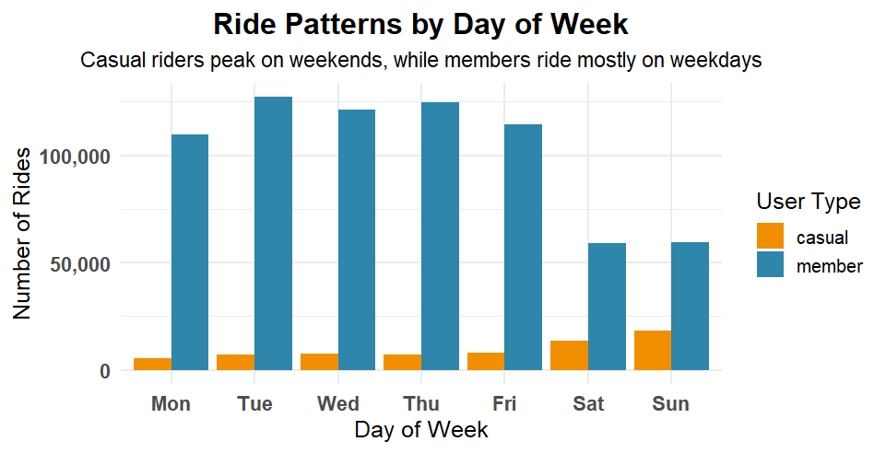
Casuals peak on weekends
Casuals peak on weekends (~2 times weekdays).
Members ride mainly weekdays.
Growth opportunity: Convert weekend casuals.
Notes:
Casuals: 18,512 rides on Sun, 13,399 on Sat vs. ~7K on weekdays.
Members: Consistent weekday demand (109K–127K rides/day).
Sharp drop on weekends (~59K/day).
Shows casual riders use bikes for leisure, while members use them for commuting.
Conversion strategy: Target casual weekend riders with membership promotions.

Slide 5
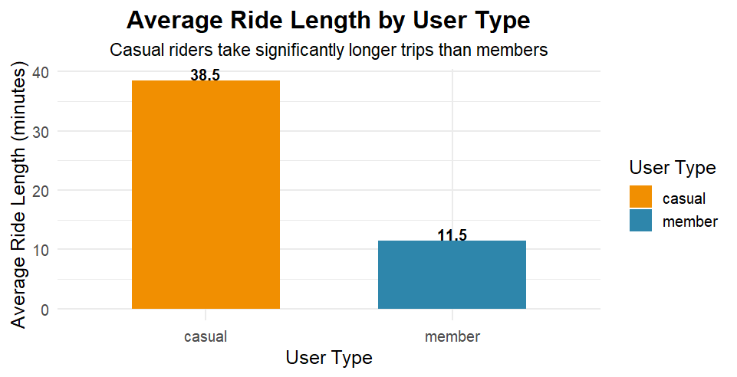
Casual trips last 3× longer
Casual riders average 38.5 mins, members just 11.5 mins.
Casual trips are nearly 3 times longer.
Shows leisure vs. comuting behavior.
Notes:
Casual riders take long trips, often for leisure or sightseeing.
Members make shorter rides, indicating daily commuting use.•
Opportunity: promote memberships to casuals by highlighting cost savings for long trips.

Slide 6
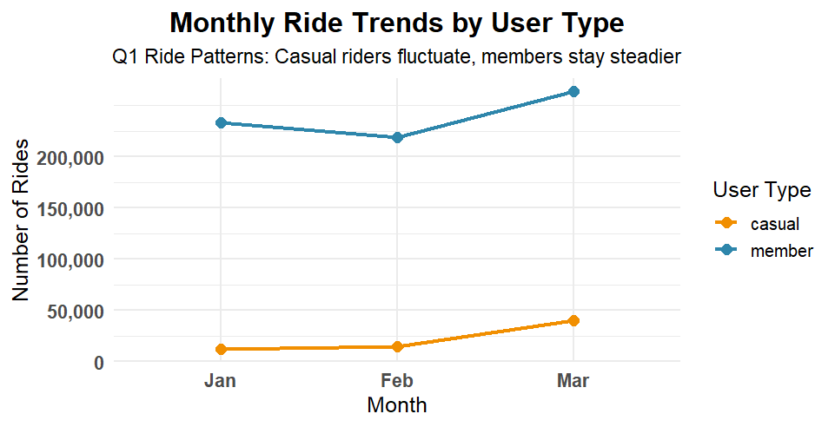
Casual use is seasonal
Members steady: 233K → 219K → 264K.
Casuals jump: 12K → 14K → 40K in March.
Casual use is seasonal and weather-driven.
Notes:
Members consistently ride throughout the quarter, showing reliability and loyalty.
Casual usage spikes as weather improves, tripling in March.•
Strategy: launch promotions before spring/summer to convert seasonal casuals into members.

Slide 7
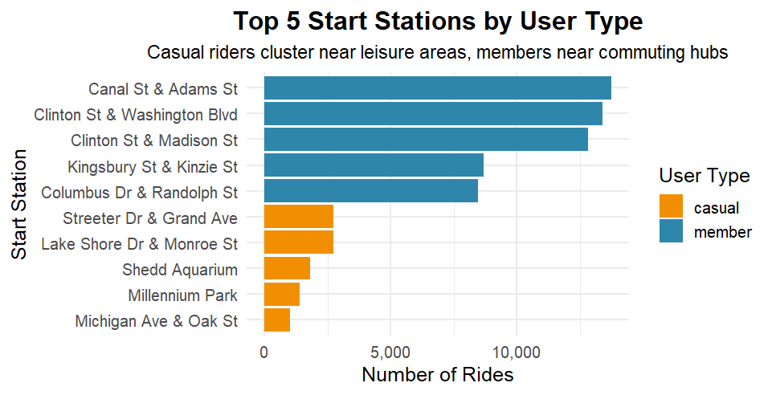
Tourists vs commuters by location
Casuals ride from tourist/leisure areas (Millennium Park, Shedd Aquarium).
Members start at commuter hubs (Clinton, Canal, Kingsbury).
Location targeting can drive conversions.
Notes:
Members’ rides begin near business centers and transit routes—clear commuting behavior.•
Casuals start from popular attractions, reflecting leisure usage.
Targeted marketing at leisure stations can capture casual riders and turn them into repeat members.

Slide 8
Conclusion:
Members dominate (91% of rides), showing loyalty and recurring value.
Casual riders differ: longer trips, seasonal spikes, tourist-heavy.
Growth opportunity: converting casuals into members.

Slide 9
Recommendations:
Seasonal Campaigns: Launch targeted membership drives ahead of spring/summer peaks.
Geo-Targeting: Focus on high-casual stations near leisure/tourist areas.
Value Proposition: Highlight cost savings of membership for long rides.
Flexible Plans: Introduce weekend/seasonal membership tiers to attract casual riders.

