Slide 1

Optimizing Customer Support Performance
Freshdesk Analytics & Workflow Enhancement
Created By: Hamza Jawad
Date: 11 Feb 2026

Slide 2
Executive Summary
• Support operations remain stable with predictable early-week ticket peaks
• 80% negative sentiment signals serious customer experience risk
• Nearly 50% High-Priority tickets indicate over-escalation and SLA pressure
• Automation and smarter routing can reduce recurring issues and improve satisfaction

Slide 3
Problem Statement
• 80% tickets show negative sentiment
• Nearly 50% marked as High Priority
• Billing and Login issues dominate volume
• Stable resolution time, but low satisfaction

Slide 4



Performance Snapshot
• Average Resolution Time: 85–97 minutes
• 80% Negative Customer Sentiment
• Nearly 50% Tickets Marked High Priority
• Stable operations, rising service pressure

Slide 5
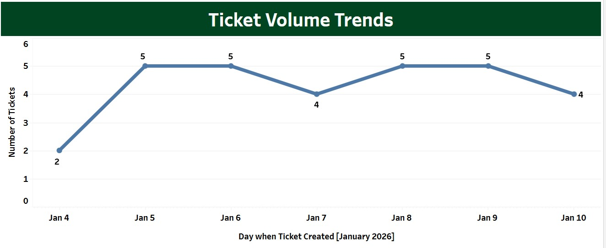
Ticket Volume Is Stable with Predictable Early-Week Peaks
• Daily ticket flow remains consistent
• Monday and Tuesday show highest spikes
• Indicates backlog or usage surge
• Workload patterns are predictable

Slide 6
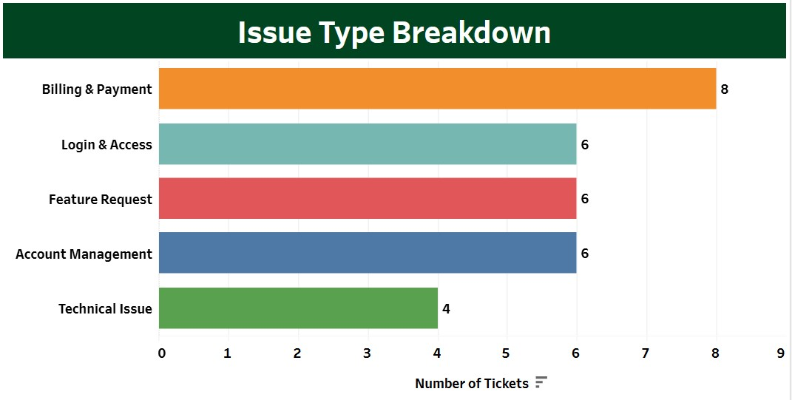
Billing and Payment Issues Drive Majority of Tickets
• Billing & Payment highest frequency category
• Login & Access issues block users completely
• Feature requests carry low urgency
• Recurring issues are preventable

Slide 7
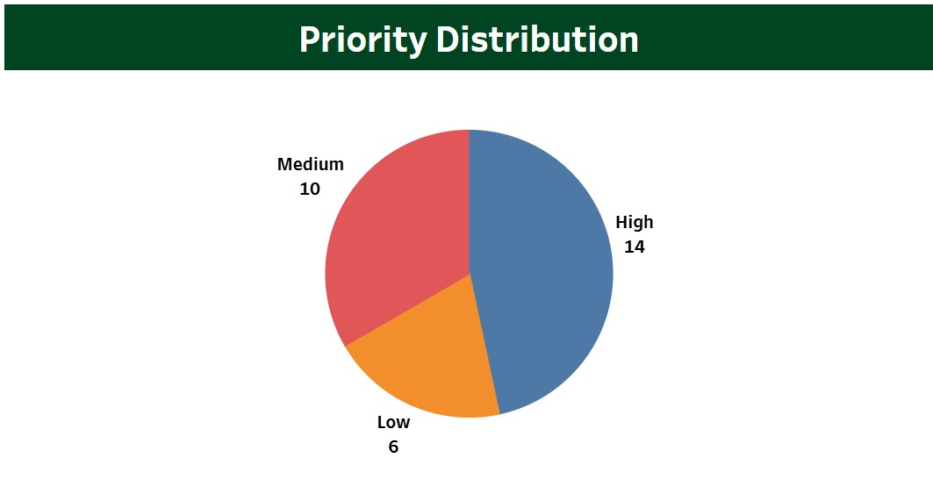
High Priority Overuse Creates SLA Pressure
• Nearly half of tickets tagged High Priority
• Possible over-escalation behavior
• High-priority tickets resolve slower
• Misclassification increases operational stress

Slide 8
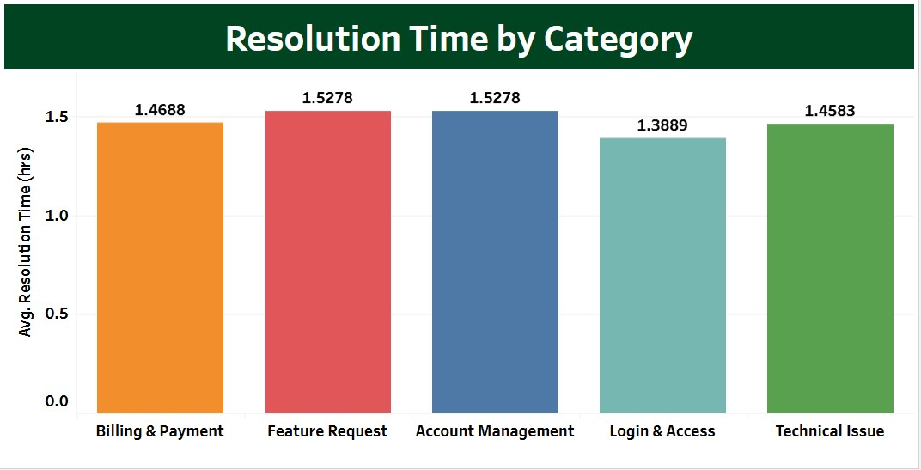
Resolution Speed Is Consistent but Not Improving Experience
• Average resolution time stable
• No major variation across categories
• Limited specialization or automation
• Speed alone not driving satisfaction

Slide 9
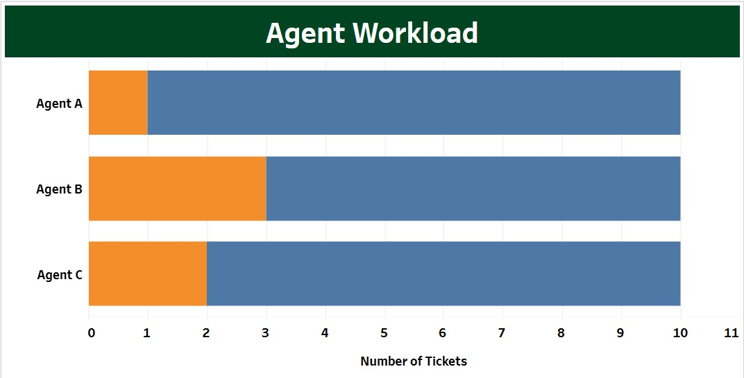
Customer Sentiment Signals Experience Risk
• 80% tickets reflect negative sentiment
• Frustration persists despite stable resolution times
• Indicates repeat issues or weak first-contact resolution
• Risk to customer trust and retention

Slide 10
Conclusion
• Support workload is stable but near growth threshold
• Recurring high-impact issues drive dissatisfaction
• Priority imbalance increases SLA pressure
• Proactive automation required for scalability

Slide 11
Recommendations
• Implement macros for recurring billing and login issues
• Introduce automated routing and smarter priority rules
• Deploy SLA-based escalation monitoring
• Expand customer self-service knowledge base

