Slide 1

Optimizing Customer Support: Reducing Repeat Call Volume
A Data-Driven Analysis of Internet & WiFi Support Trends
Presented by: Hamza Jawad

Slide 2
Goal: Reduce Call Volume & Improve Customer Satisfaction
The Problem: High repeat call rates are driving up operational costs and lowering customer trust.
The Objective: Pinpoint exactly which support topics and markets are causing customers to call back.

Slide 3
Process: Categorizing the "Why" Behind the Calls
Tech Stack: SQL (Cleaning & Querying), Tableau (Visualization).
Data Mapping: Mapped raw "Problem Type" codes to actual business categories (e.g., Internet Support, Account Management).
Analysis: Filtered logs to isolate repeat interactions—specifically calls occurring within 7 days of the initial contact.

Slide 4
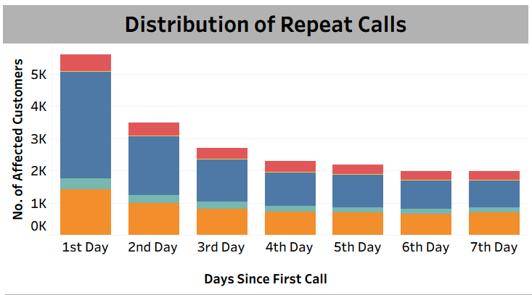
Most Repeat Calls Occur Within 24-48 Hours
The highest volume of repeat calls happens just 1 or 2 days after the initial contact.
Issues are not being "Fixed Right the First Time", forcing customers to call back immediately.
Solving the root cause on the first call would eliminate the massive bar on the left

Slide 5
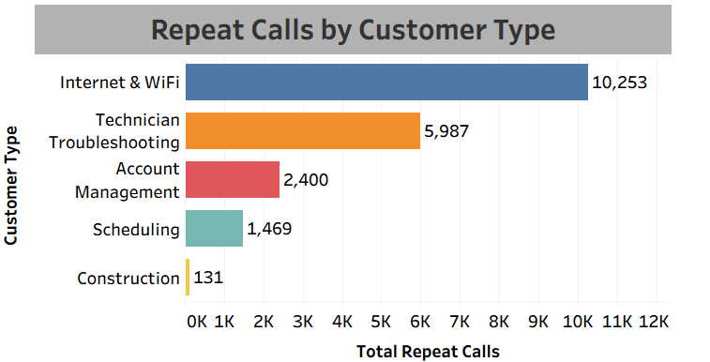
“Internet & WiFi" Issues Drive ~50% of Repeat Volume
Internet & WiFi generates 10,253 repeat calls, dwarfing all other categories.
Technical issues result in 2x more repeat calls than Technician Troubleshooting and 4x more than Account Management.
The problem is primarily technical/hardware related, not administrative.

Slide 6
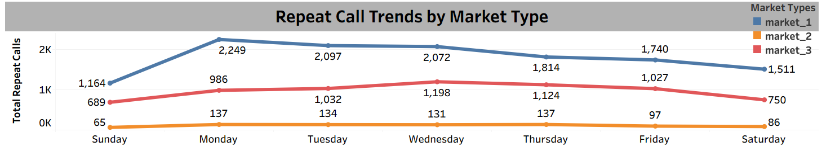
Market_1 Struggles with "Monday Surges"
Market_1 sees a massive spike of 2,249 calls on Mondays, likely due to outages or issues accumulating over the weekend.
Market_2 remains stable and low, suggesting better infrastructure or weekend coverage.
Market_1 requires immediate operational support to handle early-week volume.

Slide 7
Summary: Technical Failures in Market 1 Are the Core Issue
Root Cause identified: The data proves this is a Product/Hardware issue, not a personnel issue. "Internet & WiFi" instability is driving 50% of the volume.
Operational Bottleneck: Market_1 is disproportionately affecting company-wide metrics, specifically struggling to recover from weekend backlogs on Mondays.
Resolution Gap: The high volume of callbacks within 24 hours indicates that current troubleshooting scripts are providing temporary relief, not permanent fixes.

Slide 8
Recommendations
Target "Internet & WiFi": Audit the routers and equipment provided to customers. The high volume suggests widespread hardware or connectivity failures, not just user error.
Staffing Adjustment: Deploy "Swarm Teams" (extra tech support) to Market_1 on Mondays to tackle the backlog.
Training Focus: Shift training resources away from Account Management (low volume) and toward Advanced WiFi Troubleshooting (high volume).

