Slide 1
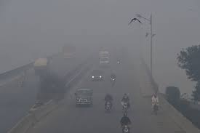
A Statistical Analysis of Pakistan Air Quality (2024–2025)
Assessment of Hazardous Smog: A Nationwide Risk Analysis
Created By: Hamza Jawad
Date: 10 Feb 2026

Slide 2
Is Smog Only a Lahore Problem?
Air pollution is a growing public health emergency in Pakistan
Smog is commonly blamed on Lahore alone
Recent data suggests pollution is widespread
Misdiagnosis leads to ineffective policy responses

Slide 3
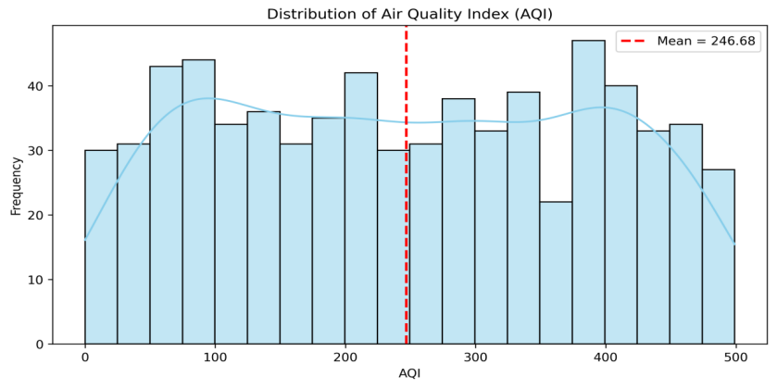
Nearly Half the Days Are Unsafe
47.86% of days exceed safe AQI levels
“Unhealthy” air is a near-daily probability
Citizens face frequent exposure to toxic air
Pollution is not an occasional event

Slide 4
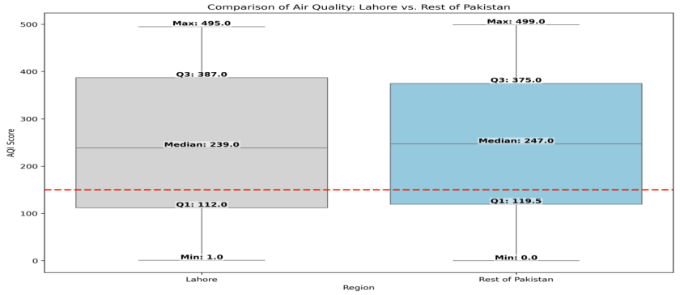
Lahore Is Not an Outlier
Lahore mean AQI ≈ 246
Rest of Pakistan mean AQI ≈ 247
AQI distributions overlap significantly
Pollution risk is nationally uniform

Slide 5
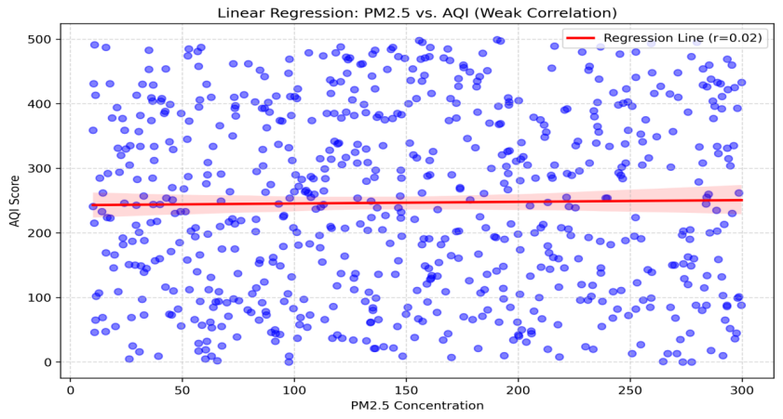
PM2.5 Is Not the Only Driver
Weak correlation b/w PM2.5 and AQI
High AQI can’t be explained by PM2.5 alone
Other contributors likely exist
Pollution sources are multifactorial

Slide 6
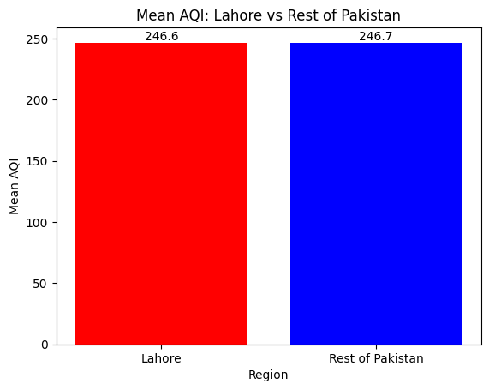
Data Confirms a National Crisis
No statistical difference b/w regions
Lahore and other cities share equal risk
Pollution is not city-specific
National-level response is required

Slide 7
Conclusion
Smog is a nationwide issue, not a Lahore-only problem
Nearly half the days pose health risks
Pollution levels are statistically similar across regions
Current narratives underestimate national exposure

Slide 8
Recommendations
Implement a Federal Clean Air Policy
Address crop burning and industrial emissions along with PM2.5 reduction
Shift focus from city-level to national strategies
Launch nationwide AQI alert systems

