Slide 1
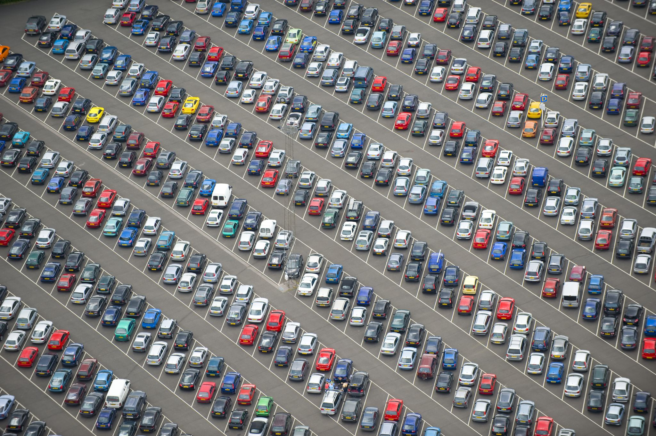
Parking Lot System using Stack (LIFO)
Stack-Based Parking Systems in DSA

Slide 2
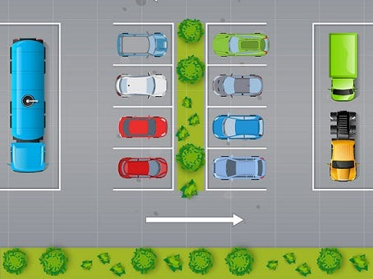

Slide 3
Introduction
Parking Lot System using Stack (LIFO) mirrors a real-world, linear parking scenario.
LIFO (Last In, First Out) means the last car to enter is the first one that can leave.
It simulates narrow or single-lane parking, where vehicles cannot overtake each other.
Only the topmost (last parked) car can exit directly without moving others.
Cars parked earlier must be temporarily moved to allow access to cars below.

Slide 4
Applications in DSA
Simulates real-world stack operations.
Helps understand memory management (like function call stacks).
Useful in backtracking algorithms (e.g., maze solving).
Demonstrates practical uses of push/pop operations in system design.

Slide 5
Why Stack?
Simple and efficient for linear access systems.
Ideal for LIFO-based entry/exit mechanisms.
Allows clear demonstration of data manipulation and algorithm tracing.

Slide 6
Stack Applications in Our Parking Lot Project
Managing Car Parking Order (LIFO):
Stack ensures Last-In-First-Out behavior.
The most recently parked car exits first, just like real- life narrow parking lots.
2. Efficient Car Exit Handling:
Only the car at the top of the stack can exit directly.
Single-entry/exit lanes.
3. Easy Status Tracking:
With the stack's top() function, we can instantly know which car parked last.
Useful for automated systems.

Slide 7
More Stack Utilities in Parking Management
4. Memory-Efficient Implementation:
Linked list-based stack saves memory by dynamically allocating space for cars.
5. Simplified Search and Display:
getTopNode() lets us traverse parked cars in order.
Helps implement features like "Show All Parked Cars" or "Find Car“
.6. Real-World Relevance:
Reflects actual parking lot constraints.
Helps simulate or manage tight urban parking spaces programmatically.

Slide 8
Workflow of Stack-Based Parking
Car enters push(car) to the stack.
Car exits:
a. If on top, pop()
b. If not, pop until found, store temporarily, then restore.
3. Visualize using two stacks: main and temporary.
4. Reinforce the idea of restricted access (only top accessible).

Slide 9
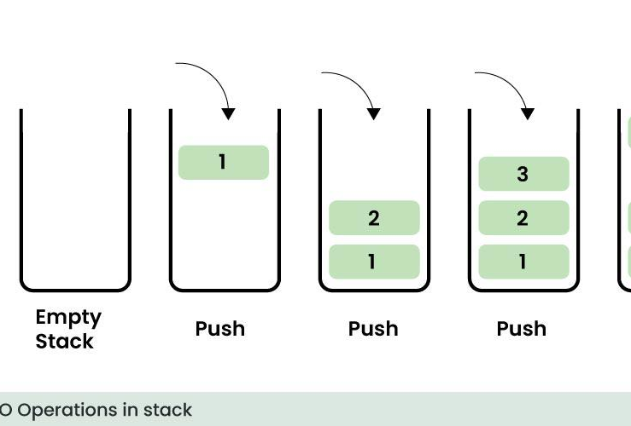

Slide 10
Summary & Takeaways
Stack-based parking is a great analogy for understanding LIFO.
Reinforces stack usage in constrained environments.
Practical example for teaching fundamental DSA concepts.

Slide 11

Screenshots of Code of Parking lot System:

Slide 12
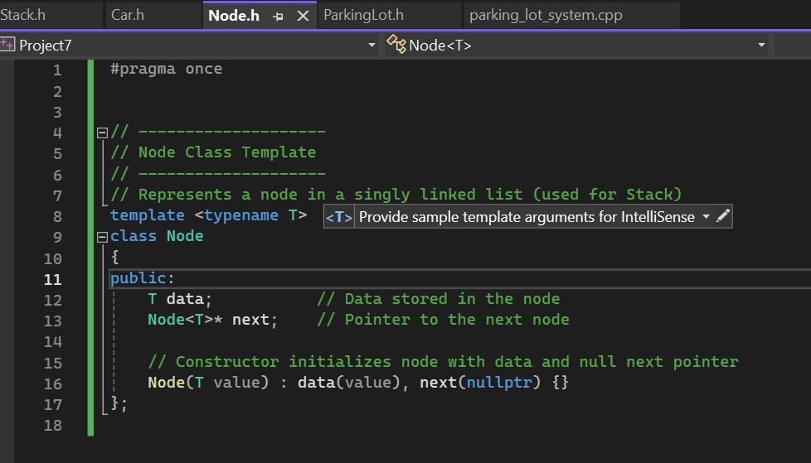
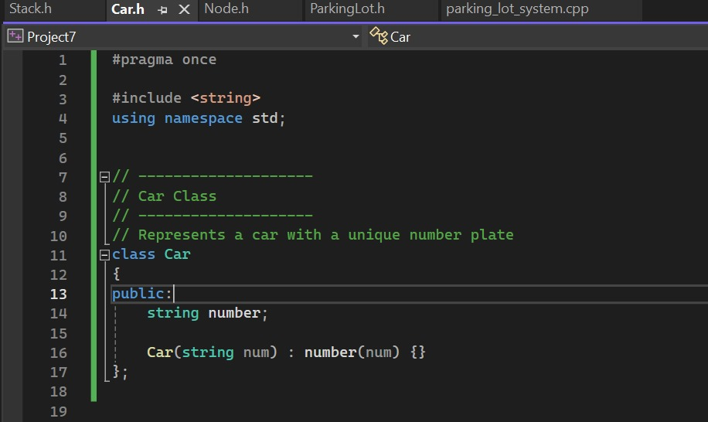

Slide 13
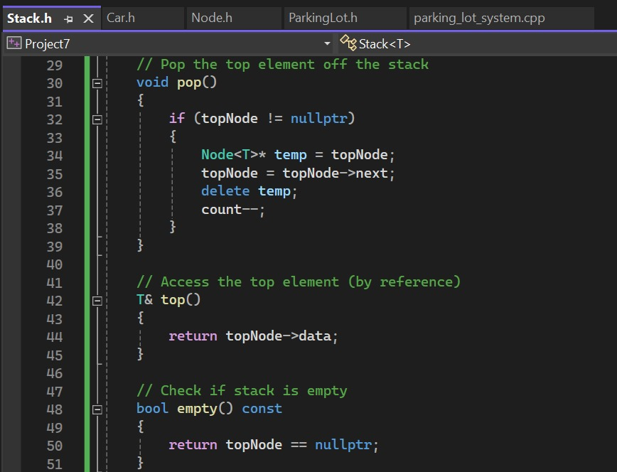
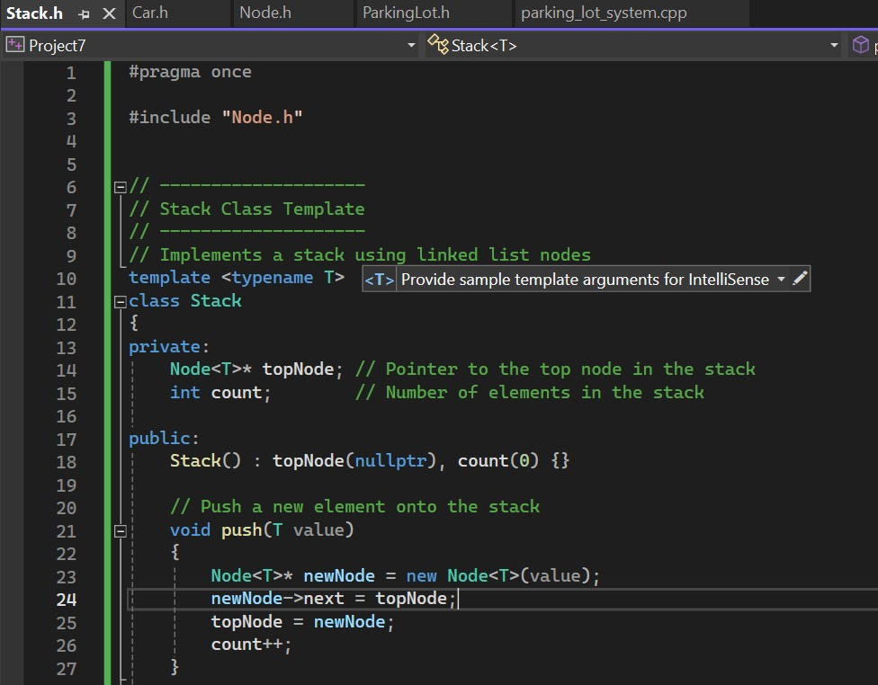

Slide 14
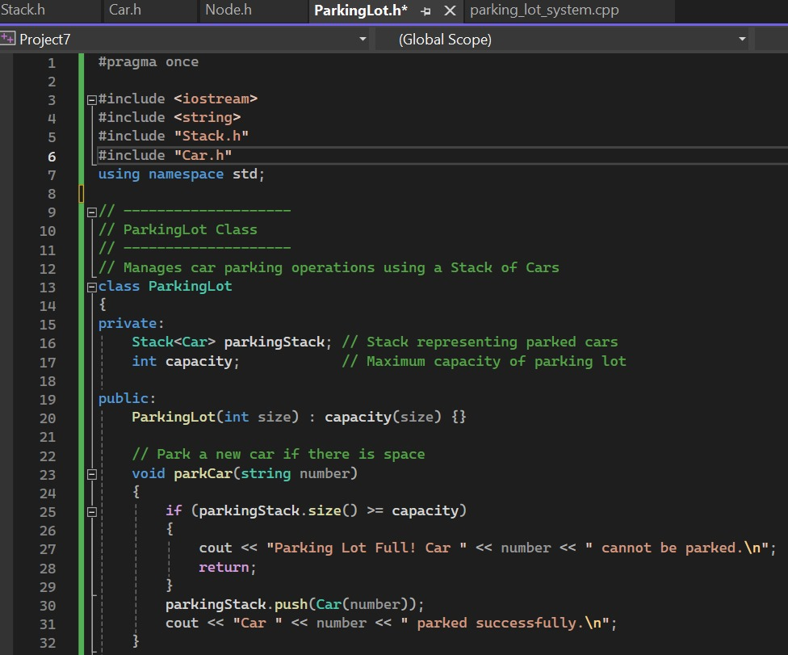
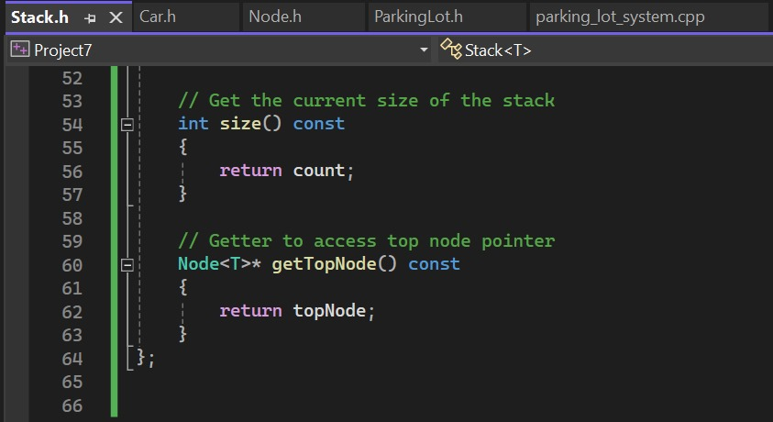

Slide 15
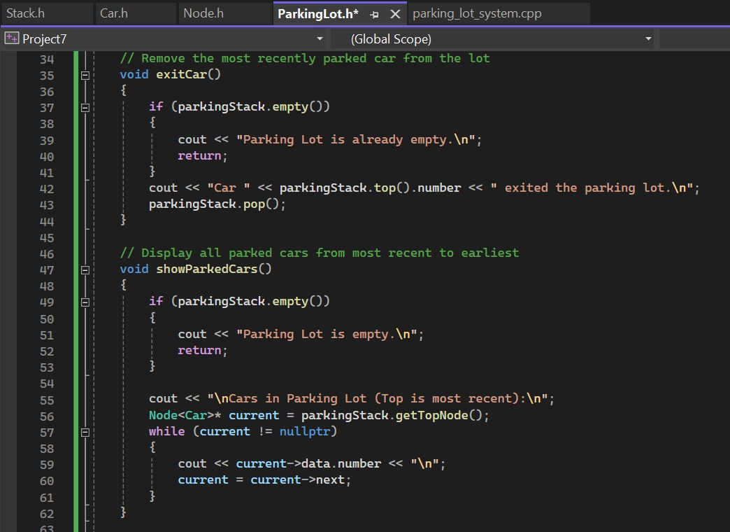
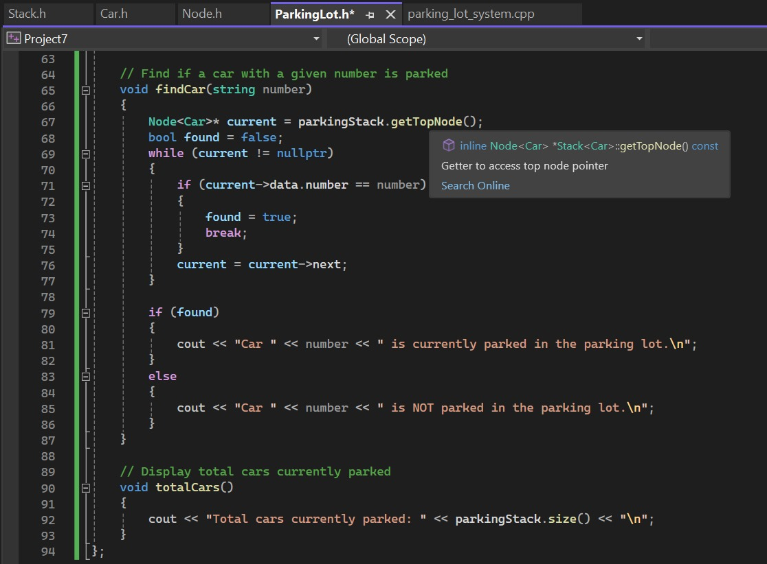

Slide 16
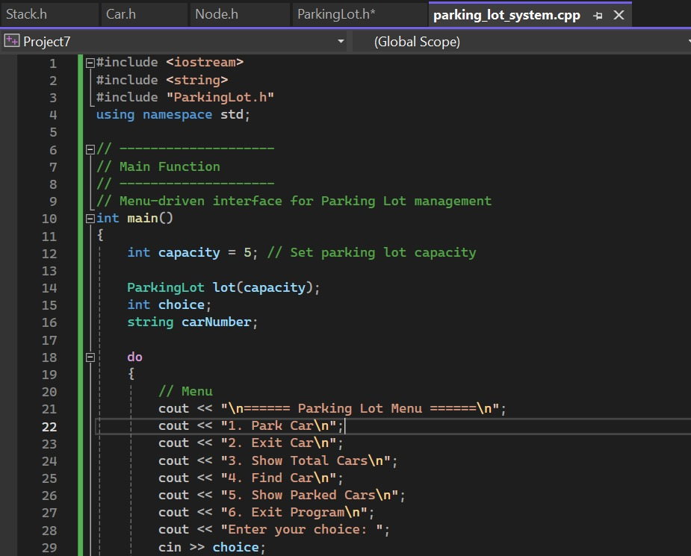
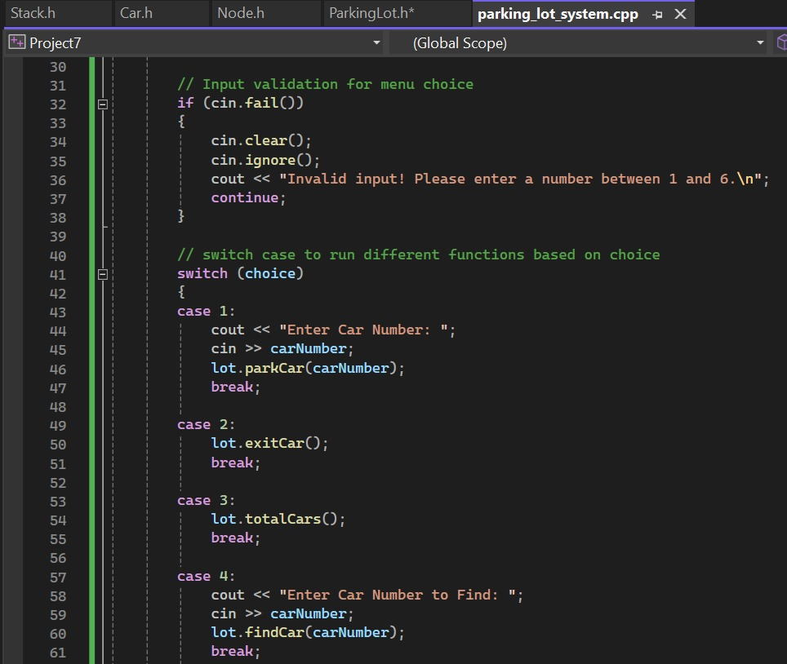

Slide 17
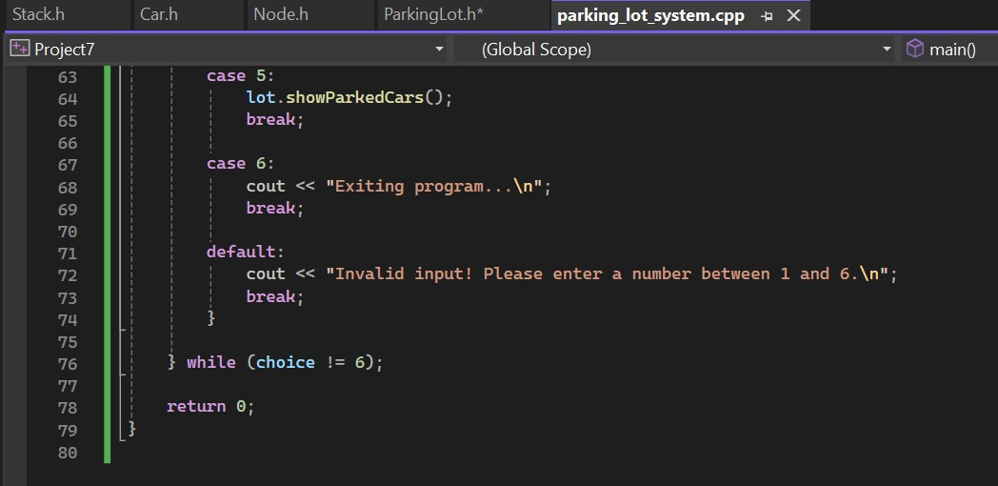

Slide 18
DEMO OUTPUT:

Slide 19
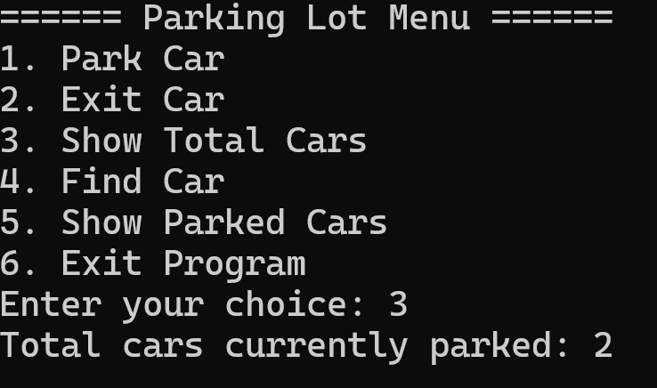
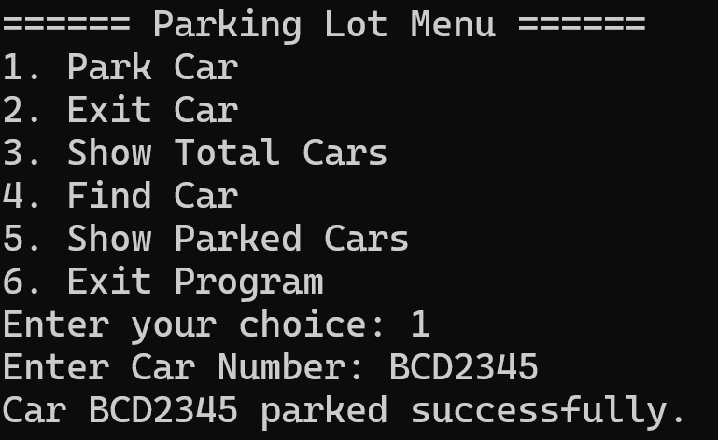
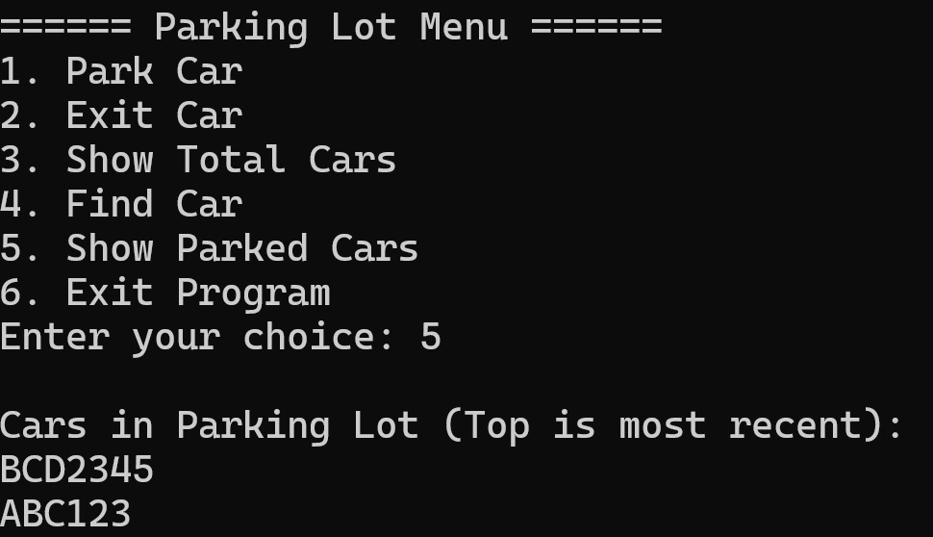
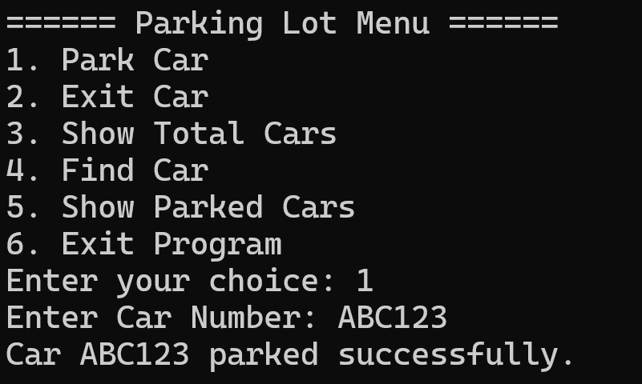

Slide 20
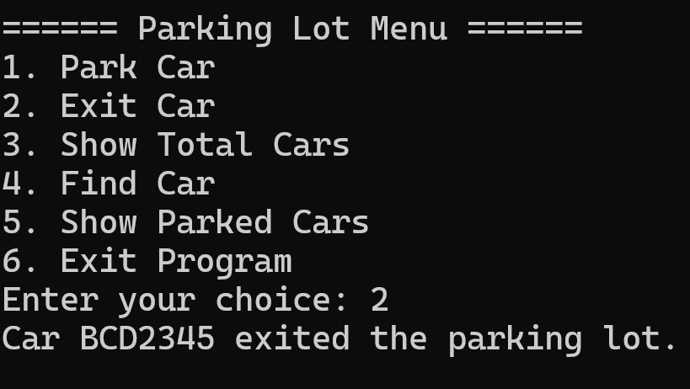
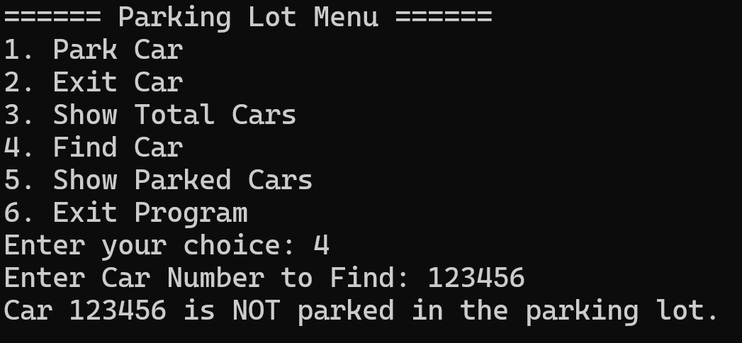
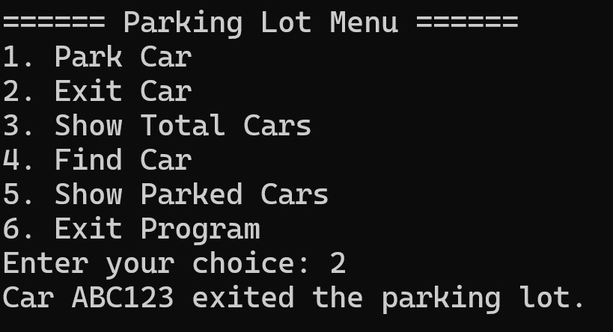
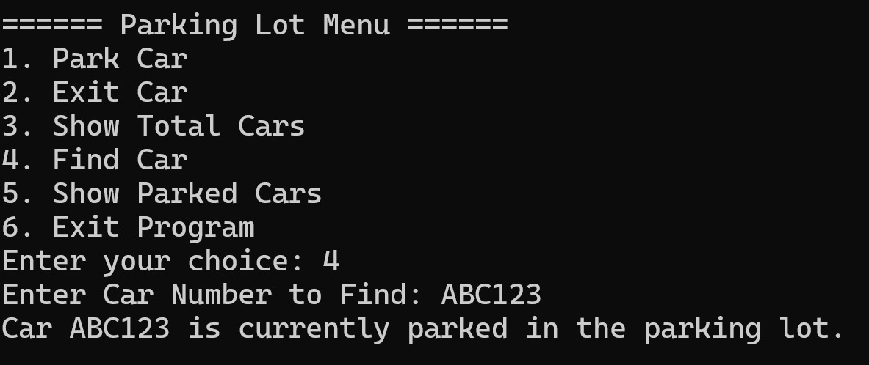

Slide 21
