Slide 1



HANDS-ON WORKSHOP
IMAGE ANALYSIS LAB
Development of Retrieval Augmented Generation (RAG) Pipeline for Multimodal Data
Trainer: Ifra Noor, Warda Waseem, Maria Muslim, Hamza Khan
12th Feb, 2026

Slide 2
OUTLINE
Introduction to Retrieval Augmented Generation (RAG) IFRA NOOR
How to apply RAG on various data types WARDA WASEEM
Integration of RAG in Healthcare Applications MARIA MUSLIM
RAG Implementation (Practical Session) HAMZA KHAN
Practical task for students YOU GUYS
CERTIFICATES WILL BE GIVEN AFTER TASK COMPLETION

Slide 3
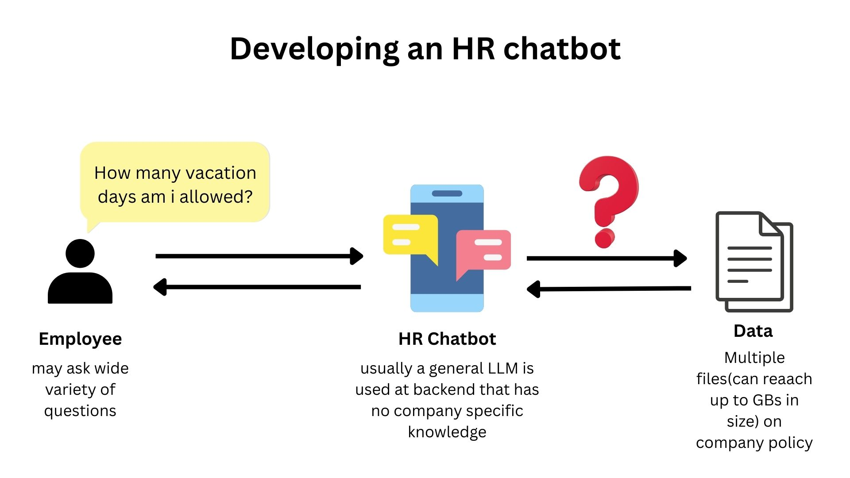
INTRODUCTION
01

Slide 4

CONTD…
PROBLEM: A typical can process a limited amount of text at a time due to CONTEXT LENGTH LIMITATION
02

Slide 5
WAYS TO HANDLE THIS
APPROACH | METHODOLOGY | WEAKNESS
AI Algorithm to Search | Rank documents and content based on: Filename Content | Must search through all GBs of files every time
Preprocessing | Summarize each file beforehand | Loss of important information
03

Slide 6
WHAT TO DO THEN?
RETRIEVAL
AUGMENTED
GENERATION
(RAG)
RAG is an efficient way to retrieve of relevant information from a DB and feed it to LLM as context for Generation
04

Slide 7
COMPONENTS OF RAG
Data source: Knowledge repository that provides factual information for answering user queries.
Document Processing: Make data clean, chunked, and structured.
Embedding Model: Convert chunks into numerical vectors that capture their semantic meaning.
Vector Database: Store and indexed embedding to enable fast similarity-based search.
Retriever: The system identifies and selects the most relevant information chunks for a given query.
Prompt construction: Combine Retrieved context with the user query to guide the model’s response.
Large Language Model: Reasoning happens here.
Post Processing: Refined final output through formatting, filtering, or citation handling when needed.
05

Slide 8
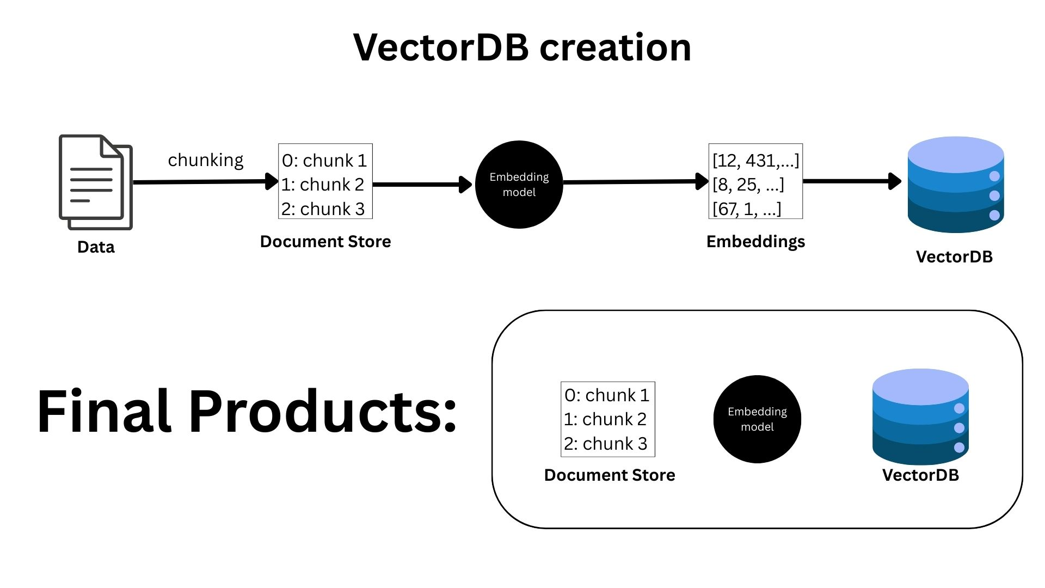
VECTORDB CREATION
06

Slide 9
CHUNCKING STRATERGY…
EXAMPLE
I went to the market to buy fruits and vegetables. The shop was crowded, and I had to wait in line for a long time. After coming home, I realized I forgot to buy milk. Later, I used a grocery app which made shopping faster and easier.
07

Slide 10

CHUNCKING STRATERGY…
CHUNK SIZE: 10
Chunk 1 (first 10 words)
I went to the market to buy fruits and vegetables. The
Chunk 2 (next 10 words)
shop was crowded, and I had to wait in
Chunk 3 (next 10 words)
line for a long time. after coming home, I
Continue…
Split only by length, not by meaning.
that’s why sentences can break in the middle, which may confuse retrieve.
FIXED-SIZE
08

Slide 11

CHUNCKING STRATERGY…
CHUNK SIZE: 10
chunk 1:
I went to the market to buy fruits and vegetables. the shop was crowded, and I had to wait in line for a long time.
chunk 2 (overlap):
and I had to wait in line for a long time. after coming home, i realized I forgot to buy milk. later, I used a grocery app which made shopping faster and easier.
Continue…
FIXED-SIZE
+
OVERLAP
Split by keeping length fixed. The sentences overlap and context is not lost.
09

Slide 12

CHUNCKING STRATERGY…
CHUNK SIZE: 10
chunk 1:
I went to the market to buy fruits and vegetables.
chunk 2:
the shop was crowded, and I had to wait in line for a long time.
chunk 3:
after coming home, I realized I forgot to buy milk.
Continue…
SENTENCE
BASED
CHUNCKING
Split by keeping each
sentence
separately.
10

Slide 13
CHUNCKING STRATERGY…
CHUNK SIZE: 10
chunk 1 (situation):
I went to the market to buy fruits and vegetables.
chunk 2 (problem):
the shop was crowded, and I had to wait in line for a long time.
chunk 3 (mistake):
after coming home, I realized I forgot to buy milk.
Continue…
STRUCTURE
BASED
CHUNCKING
Split by text by grouping the same ideas.
11

Slide 14
VECTORDB CREATION
12

Slide 15
WHAT ARE EMBEDDINGS
I went to the market to buy fruits and vegetables. The shop was crowded, and I had to wait in line for a long time. After coming home, I realized I forgot to buy milk. Later, I used a grocery app which made shopping faster and easier.
[0.21, 0.78, 0.45, 0.12, 0.66]
[0.63, 0.14, 0.88, 0.34, 0.51]
TEXT
NUMERICAL
REPRESENTATION
[0.72, 0.56, 0.19, 0.81, 0.27] [0.33, 0.69, 0.74, 0.22, 0.58]
13

Slide 16
EMBEDDING STRATERGY…
EMBEDDING MODEL | TYPE | STRATERGY
Paraphrase-mpnet-base-v2 | General Purpose | Dense vector Embedding
text-embedding-3-large | General Purpose | Sentence-level Embedding
Bio_ClinicalBERT | Biomedical BERT | Domain Specific contextual Embedding
CLIP / OpenCLIP | Multimodal Data | Joint text + image Embedding
14

Slide 17
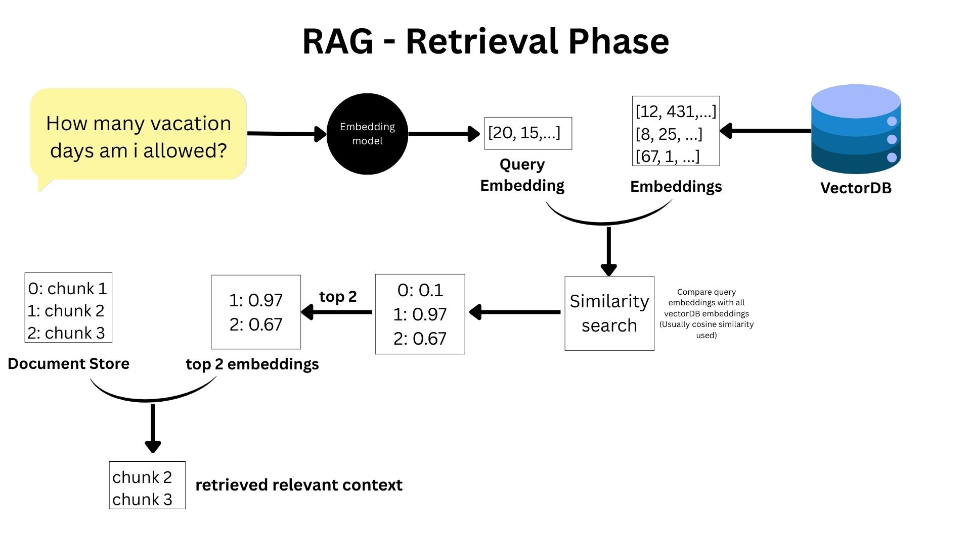
RETRIEVAL PHASE
Compare query embedding with
VectorDB embeddings.
Cosine Similarity
15

Slide 18

Cosine SIMILARITY
Cosine similarity measures similarity between two embeddings by checking Angle between them.
Given
vector A = [1,2], vector B = [2,4]
Cosine similarity: cosine similarity= A⋅B / ∥A∥∥B∥​
Calculation:
cosine similarity= 10 / $\sqrt{5}×\sqrt{20}$
= 10 / 10
= 1.0
Value range
1.0 → exactly the same meaning
0.0 → no similarity
–1.0 → opposite meaning (rare in text)
Exactly the same direction, so they represent identical meaning
16

Slide 19
RETRIEVAL PHASE
17

Slide 20
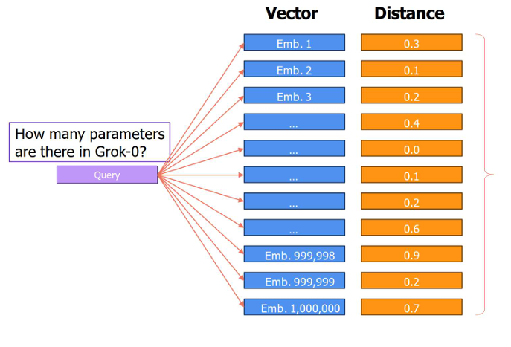
TOP-k STRATEGIES
1. K-NN: a naïve approach
Too SLOW!
If there are N embedding vectors and each has D dimensions, the computational complexity is in the order of O(N* D), TOO SLOW
18

Slide 21
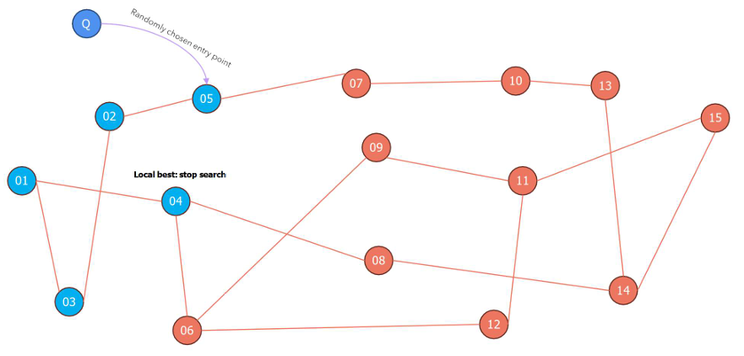
TOP-k STRATEGIES
2. Navigable Small Words for searching K-NN
We keep the search by
With randomly choosing starting point and then keep the Top-k among all the visited notes.
19

Slide 22
RETRIEVAL PHASE
20

Slide 23
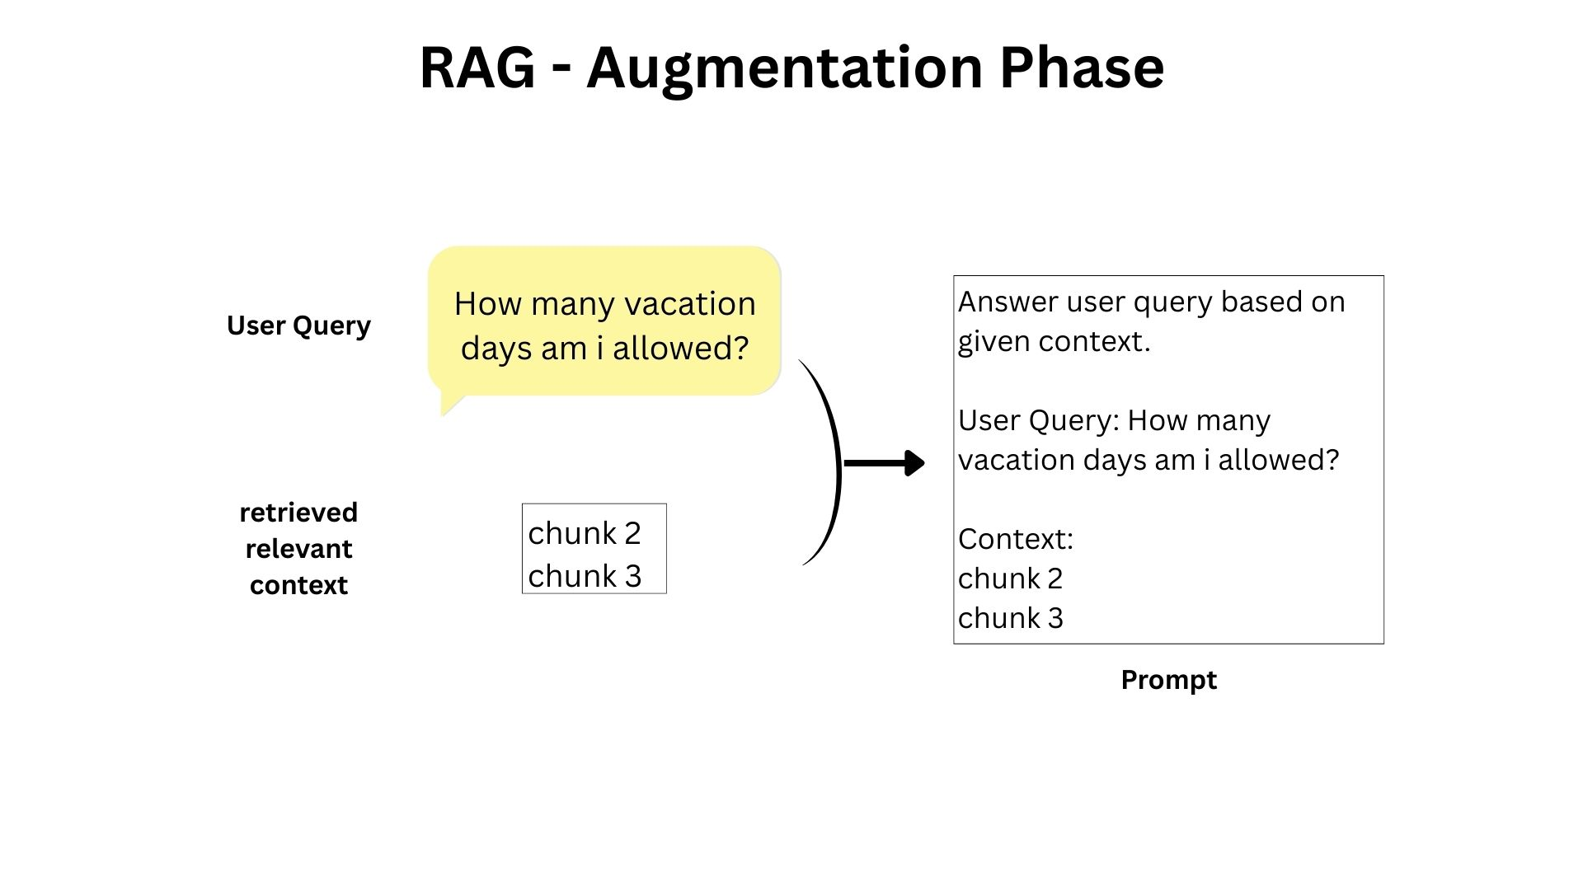
AUGMENTATION
21

Slide 24
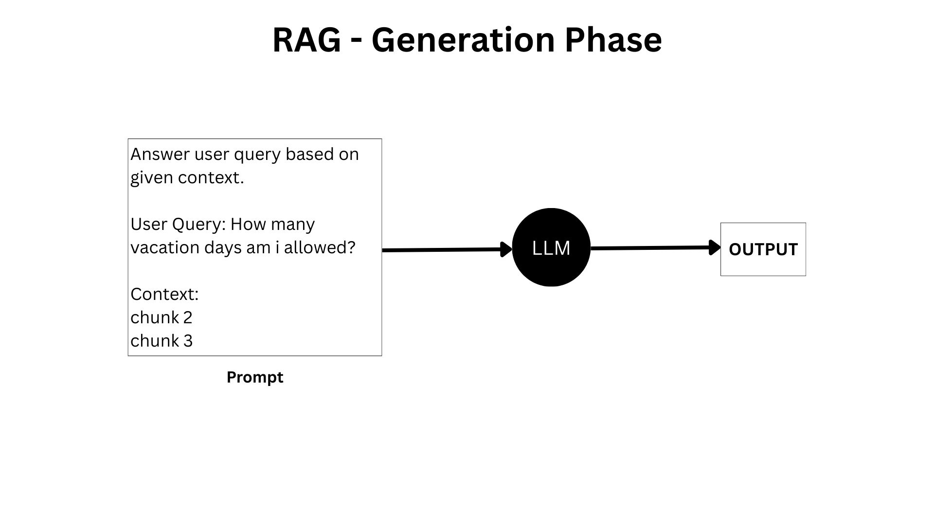
GENERATION
22

Slide 25
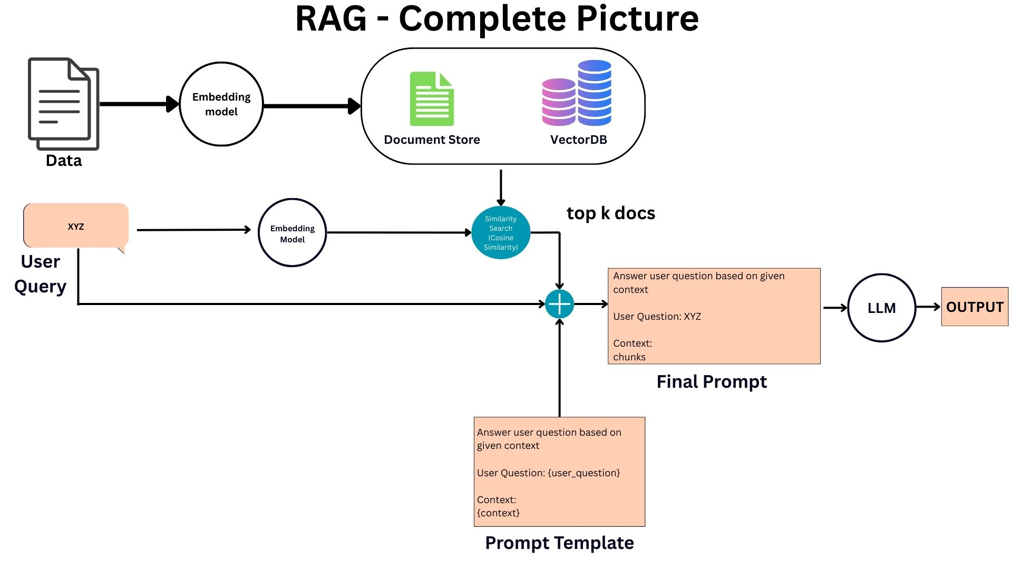
End-to-End RAG Pipeline
23

Slide 26
IMAGE ANALYSIS LAB
HOW TO APPLY RAG ON DIFFERENT DATA TYPES

Slide 27




Why Multimodal RAG?
WHY MULTIMODAL RAG?
Traditional RAG focuses on text only, but real-world data comes in many forms
Text
Images
Audio
Video
Documents, articles, reports
Photos, diagrams, charts
Speech, music, sounds
Recordings, presentations

Slide 28






MULTIMODAL RAG ARCHITECTURE
User Query
Embedding
Model
Vector
Database
Retrieved
Context
LLM
(text/image/audio)
Multimodal
Similarity Search
Top-K Results
Generation
Indexed Knowledge Base
• Documents (PDFs, Word, Web pages)
• Images (Product catalogs, Medical scans, Diagrams)
• Audio/Video (Transcripts, Podcasts, Training videos)

Slide 29
Why Multimodal RAG?
DETAILED RAG SYSTEM ARCHITECTURE
Ingestion Pipeline
Query Pipeline
1. Data Collection
1. Query Processing
Crawl, upload, stream
Parse and normalize input
2. Preprocessing
2. Embedding
OCR, transcription, cleanup
Encode query to vector
3. Chunking
3. Similarity Search
Split into semantic units
Find top-K matches
4. Reranking
4. Embedding
Score and filter results
Convert to vectors
5. Context Assembly
5. Indexing
Format for LLM prompt
Store in vector DB
6. Generation
LLM produces response

Slide 30

Why Multimodal RAG?
MULTIMODAL EMBEDDING ARCHITECTURE
Documents
Articles
Text
Encoder
(BERT/GPT)
Benefits
Shared Vector
Space
Cross-modal search
Photos
Diagrams
Vision
Encoder
(ViT/ResNet)
Unified similarity
768-dimensional
embeddings
Semantic matching
Speech
Music
Audio
Encoder
(Whisper)
Scalable indexing

Slide 31
Why Multimodal RAG?
VECTOR DATABASE ARCHITECTURE
Index Algorithms
HNSW
IVF
PQ
Hierarchical Navigable
Small World
Inverted File
Index
Product
Quantization
Fast, Accurate
Scalable
Memory Efficient
Key Capabilities
Approximate Nearest Neighbor (ANN) search
Metadata filtering and hybrid search
Horizontal scaling and sharding
Real-time indexing and updates

Slide 32
Why Multimodal RAG?
HOW MULTIMODAL RAG WORKS?
1
Encode
Convert all data types to vector embeddings
2
Store
Index vectors in a multimodal database
3
Retrieve
Query across modalities to find relevant data
4
Generate
Use retrieved context for informed responses

Slide 33
Why Multimodal RAG?
MULTIMODAL EMBEDDING MODELS
Models that can encode different data types into a shared vector space
Popular Models
Key Features
CLIP (OpenAI) - Images & Text
ImageBind (Meta) - 6 modalities
BLIP-2 - Vision-language tasks
Gemini Embeddings - Multi-format
Voyage Multimodal - Text & images
Cross-modal search capability
Unified vector representation
Semantic similarity matching
Context-aware retrieval

Slide 34
Why Multimodal RAG?
VECTOR DATABASE FOR MULTIMODAL DATA?
Pinecone
Managed, scalable, metadata filtering
Weaviate
Open-source, GraphQL, multi-tenancy
Qdrant
Rust-based, fast filtering, on-prem
Milvus
Distributed, GPU support, open-source

Slide 35
Real-World Use Cases
Why Multimodal RAG?
REAL WORLD USE CASES
Medical Diagnosis
E-commerce Search
Retrieve patient records, X-rays, and clinical notes for comprehensive analysis
Find products using text descriptions, images, or combination of both
Content Moderation
Legal Research
Detect harmful content across text, images, and video platforms
Search through documents, evidence photos, and audio transcripts

Slide 36

Why Multimodal RAG?
CHALLENGES & CONSIDERATION
Computational Cost
Processing and storing embeddings for multiple modalities requires significant resources
Data Alignment
Ensuring different modalities are properly synchronized and contextually linked
Quality Control
Maintaining accuracy across diverse data types and retrieval scenarios
Latency Optimization
Balancing retrieval quality with response time for real-time applications

Slide 37
IMAGE ANALYSIS LAB
Integration of RAG in Healthcare Applications

Slide 38
MAJOR ISSUES WHEN USING HEALTHCARE APPLICATIONS
PROBLEM:
  Medical QA requires step-by-step clinical reasoning
  Vanilla RAG retrieves facts but fails to reason explicitly
  CoT improves reasoning but hallucinates without grounding
  Medical images require contextual comparison
  Vision-Language Models lack clinical grounding and struggle with
  rare cases
24

Slide 39

RAG SOLUTION
Med-CoT-RAG
MIRA-RTRA-CoT-RAG
  Medical Query Input
  Query Reformulation (CoT-aware)
  Document Retrieval (RAG)
  Evidence-Grounded Chain-of-Thought
  Final Medical Answer
  Input Medical Image
  Image Feature Encoding
  Medical Image Retrieval
  Textual & Visual Evidence Fusion
  LLM-Based Answer Generation
25

Slide 40
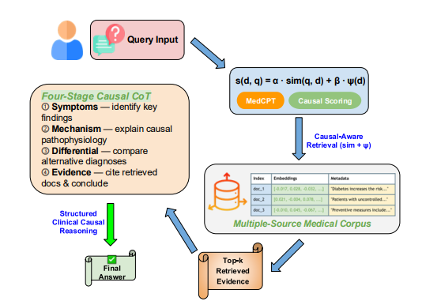
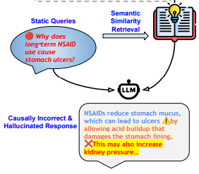
RAG Pipeline Understanding
CONVENTIONAL RAG
MED-CoT RAG
26

Slide 41
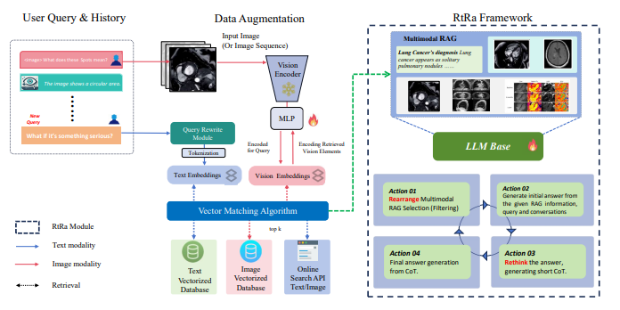
End-to-End RAG Pipeline
MIRA
27

Slide 42

Relevance to Medical Benefits
Reduced Hallucinations
Multimodal evidence grounding
Improved clinical reasoning
Visual explanations support
Transparent reasoning
28

Slide 43
Critical Concerns
  Higher inference cost and latency due to Chain-of-Thought reasoning.
  Heavy reliance on high-quality retrieval
  Performance sensitive to prompt design and retrieval accuracy
29

