Slide 1
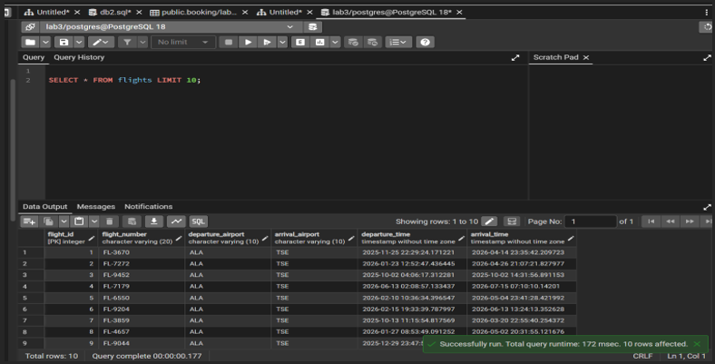
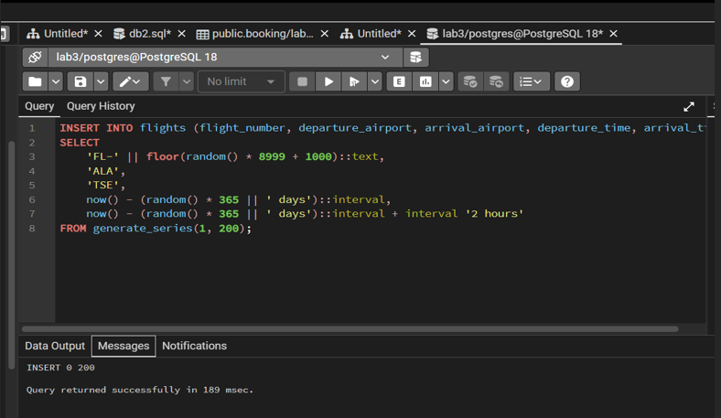
1-task
INSERT INTO flights (flight_number, departure_airport, arrival_airport, departure_time, arrival_time)
SELECT
'FL-' || floor(random() * 8999 + 1000)::text,
'ALA',
'TSE',
now() - (random() * 365 || ' days')::interval,
now() - (random() * 365 || ' days')::interval + interval '2 hours'
FROM generate_series(1, 200);

Slide 2
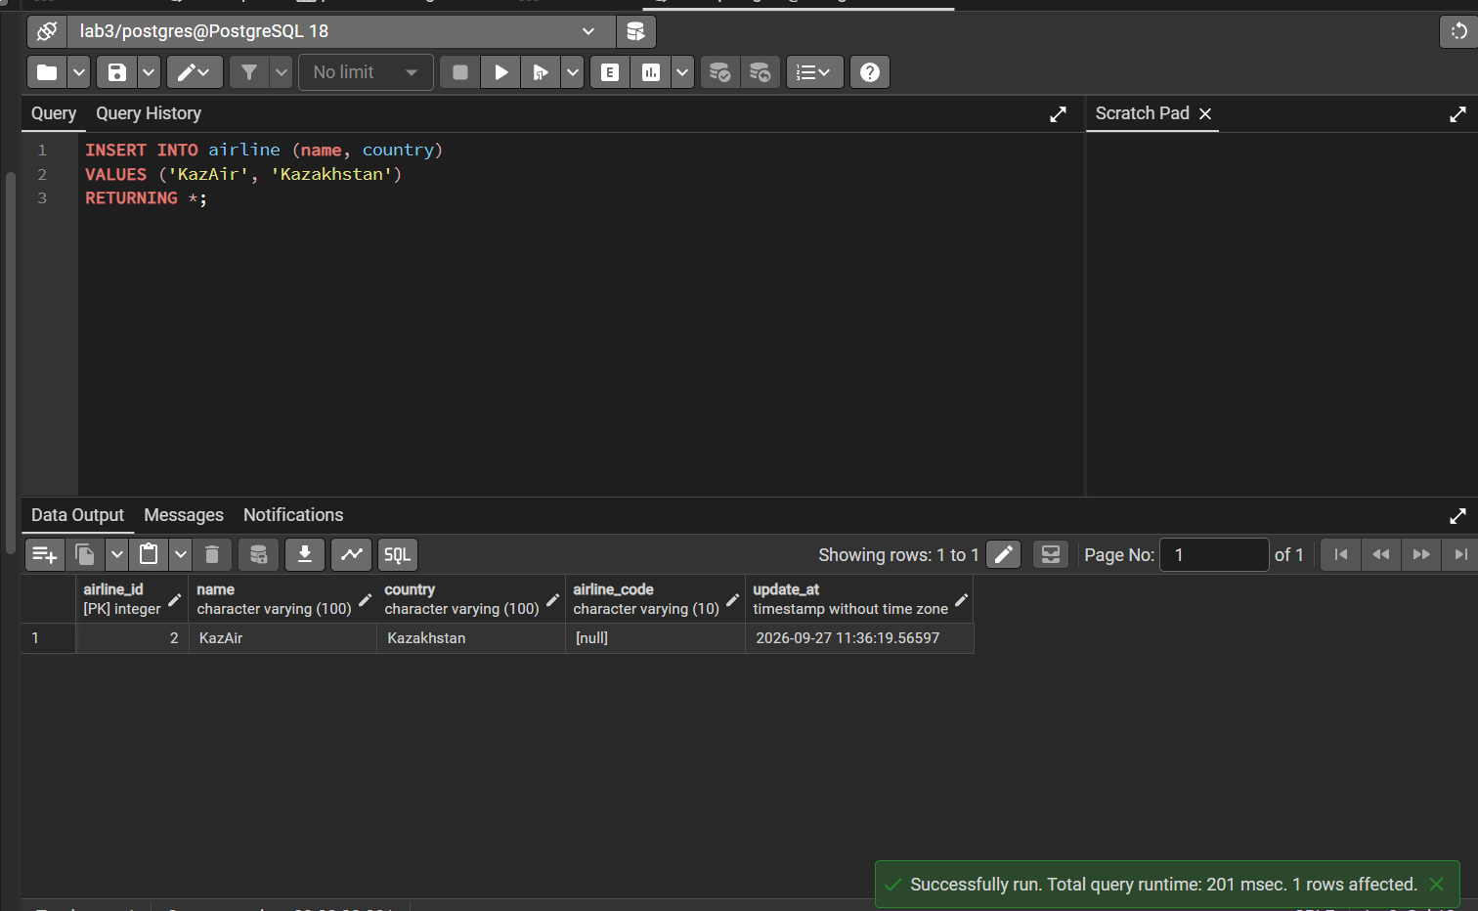
2-task

Slide 3
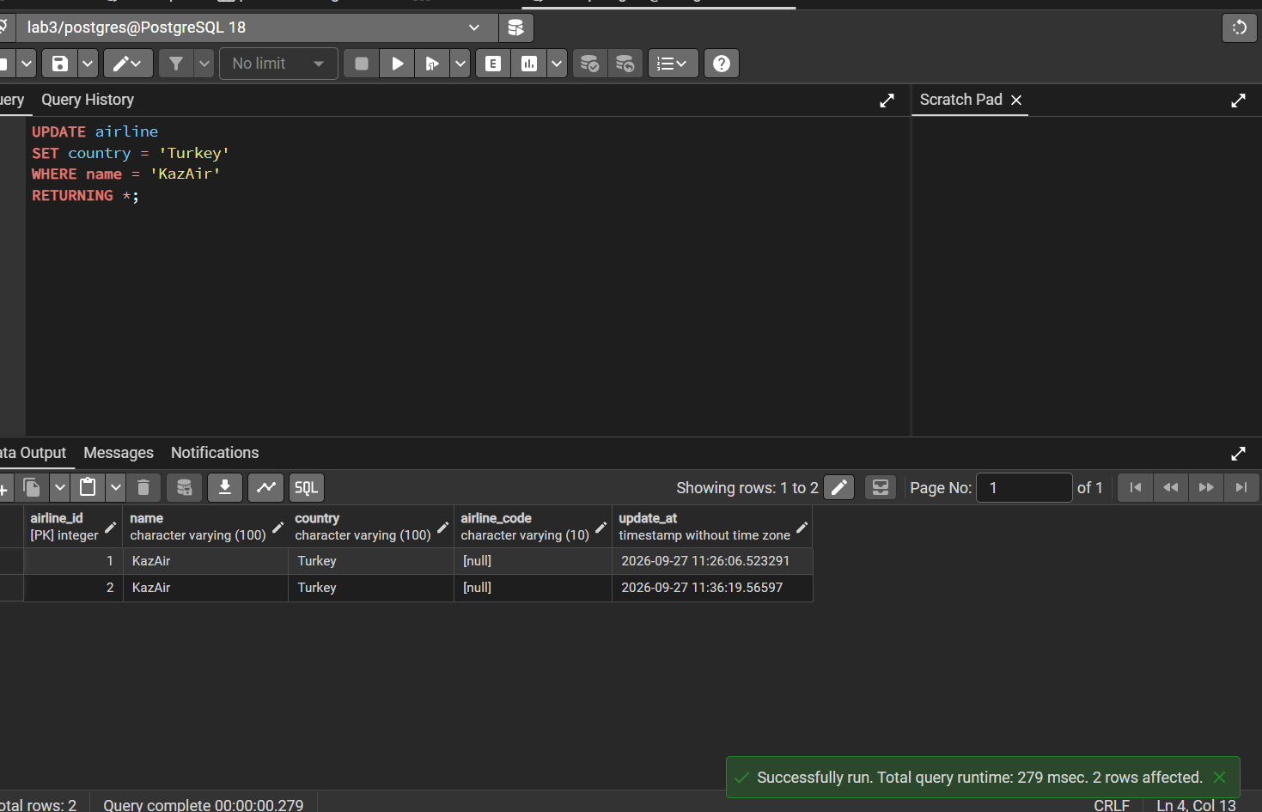
3-task

Slide 4
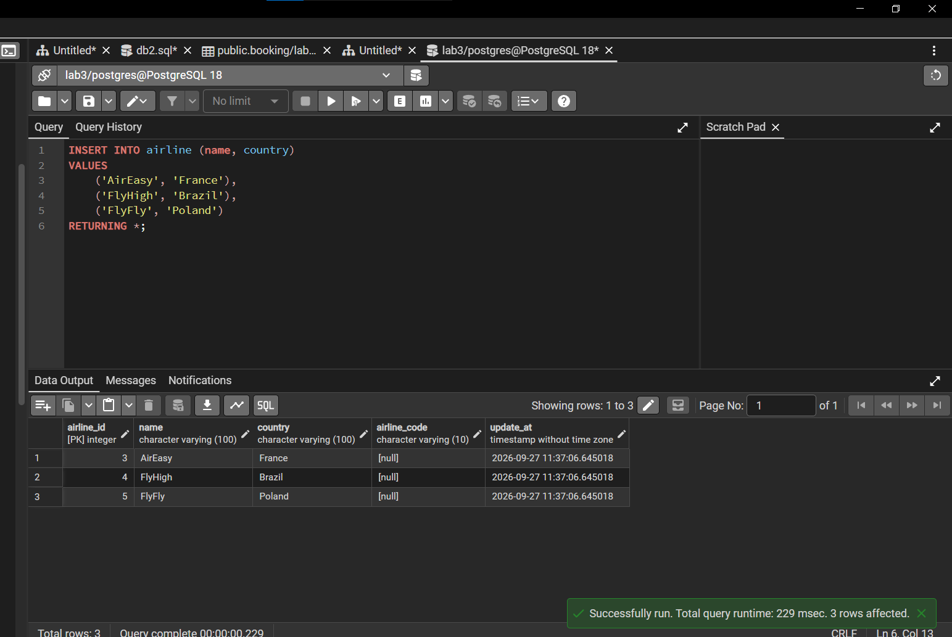
4-task

Slide 5
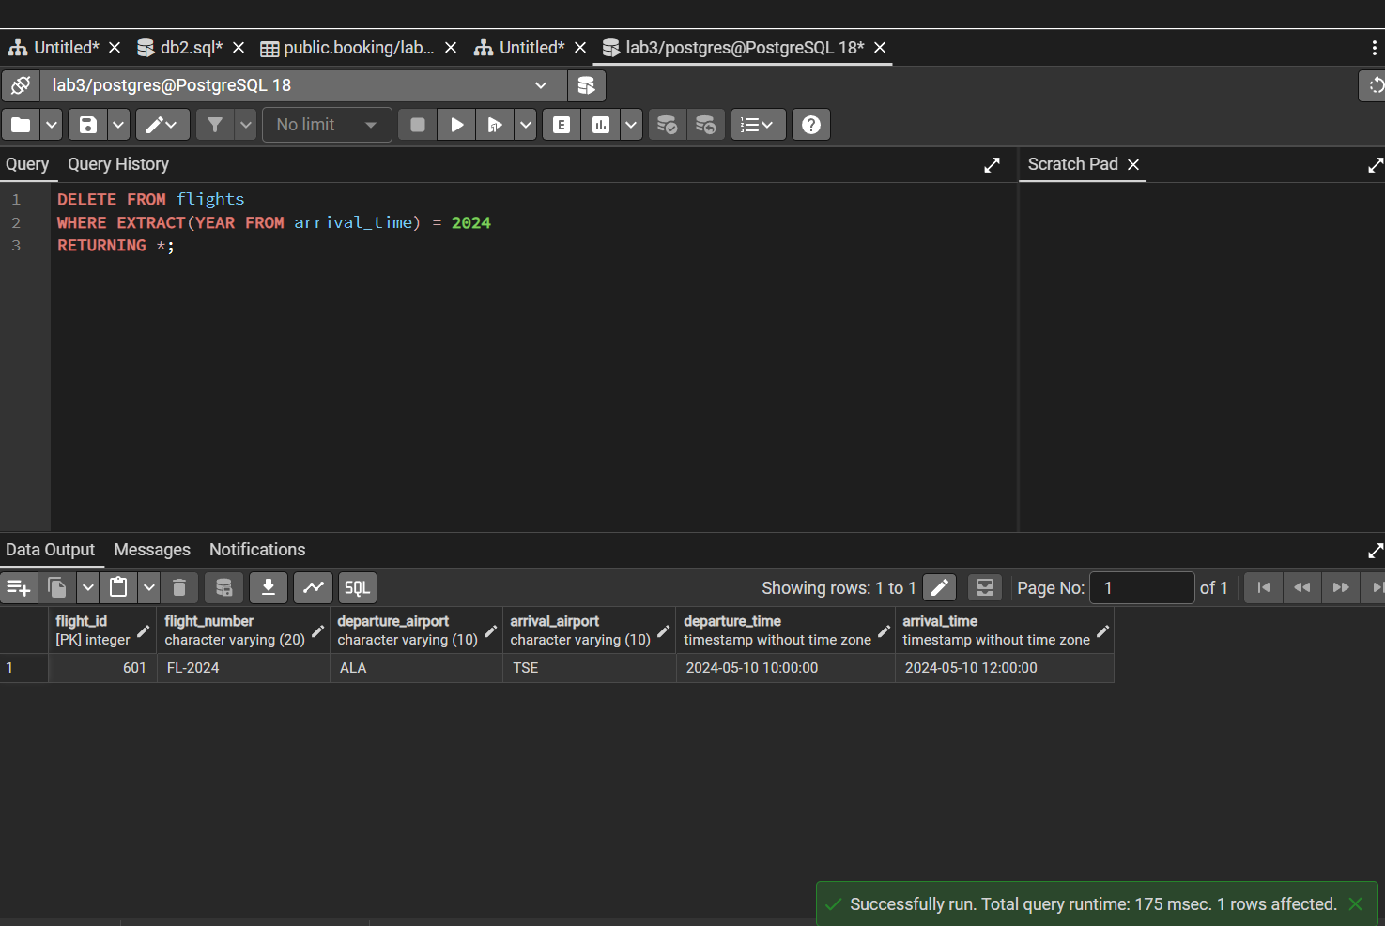
5-task

Slide 6
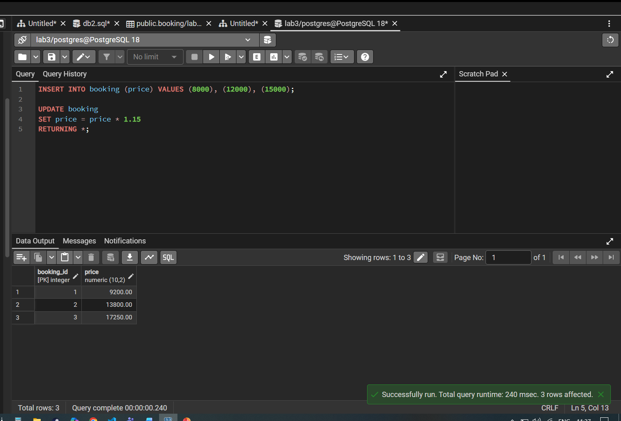
6-task

Slide 7
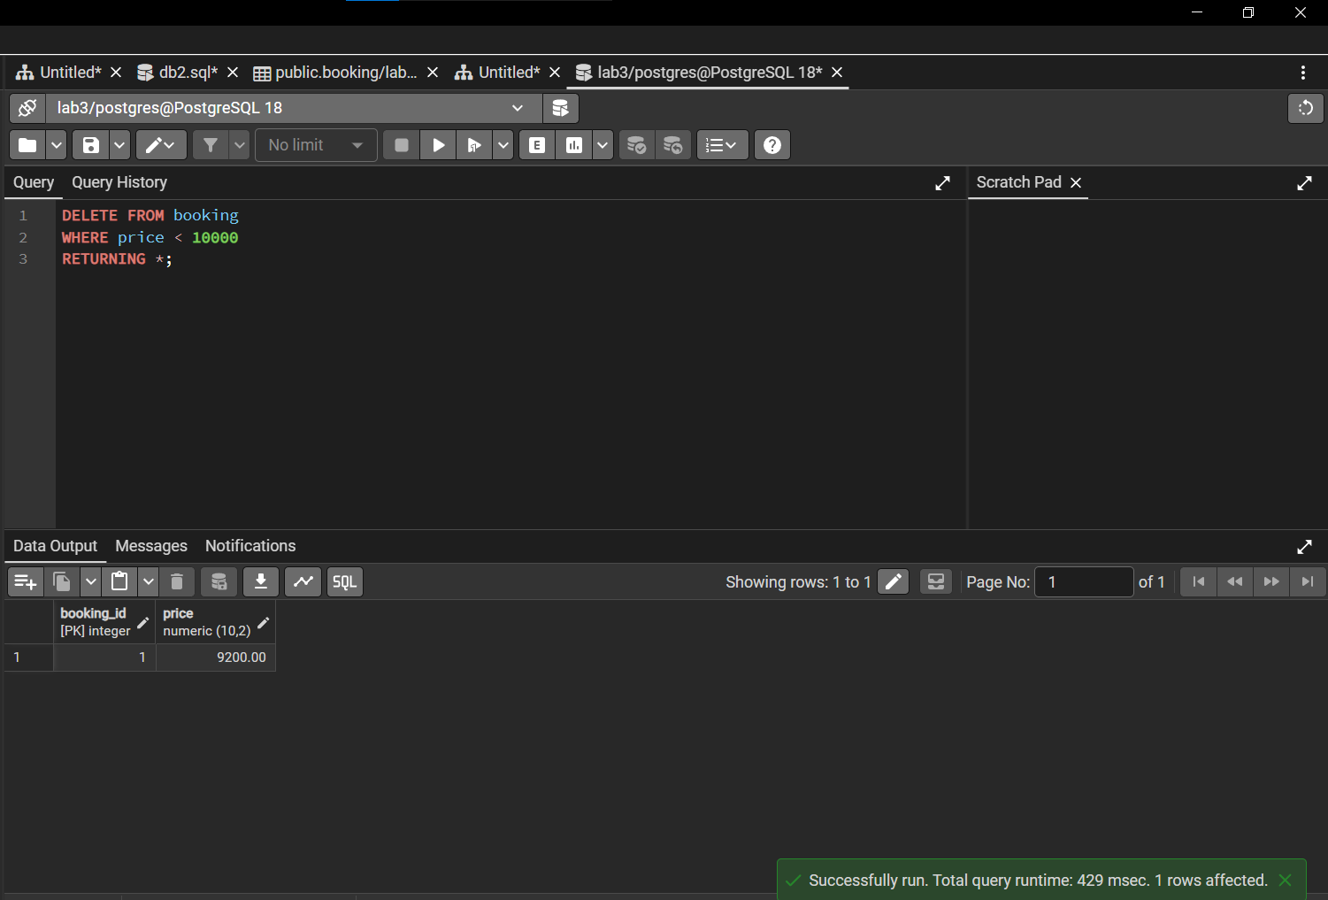
7-task

Slide 8
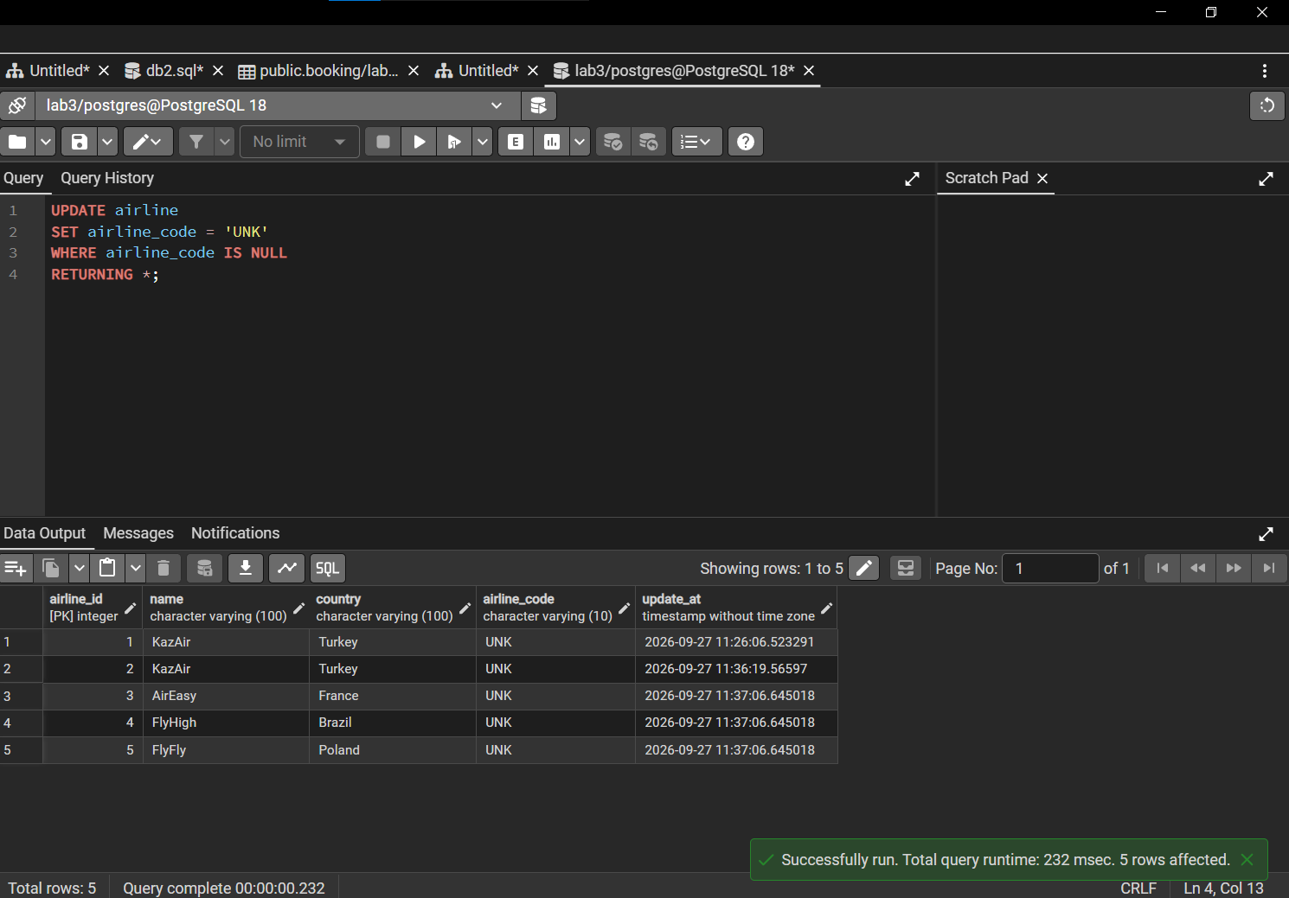
8-task

Slide 9
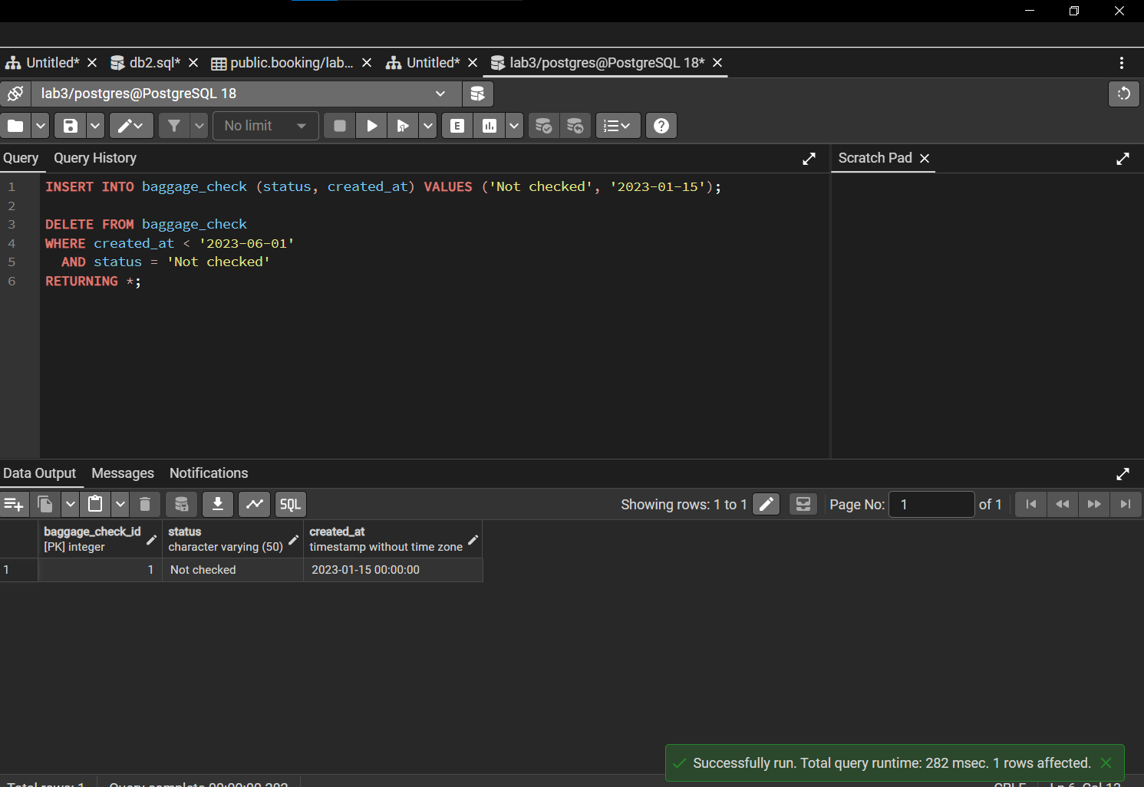
9-task

Slide 10
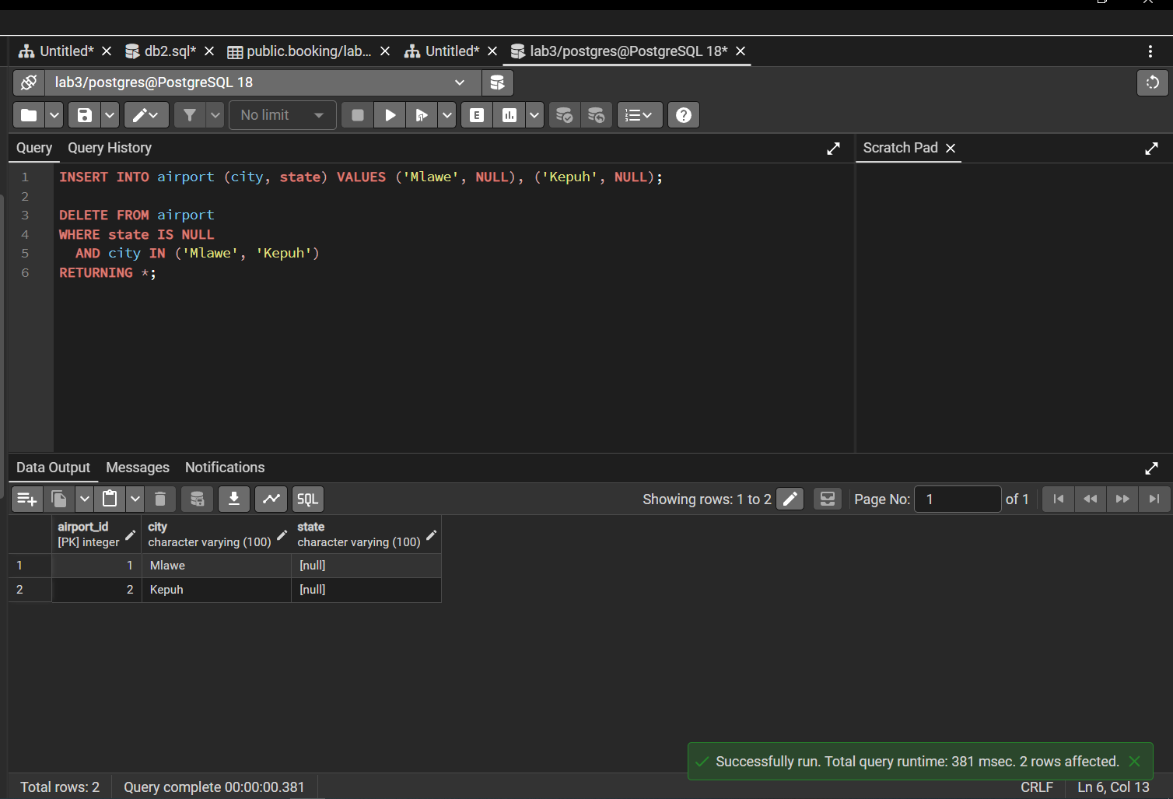
10-task

Slide 11
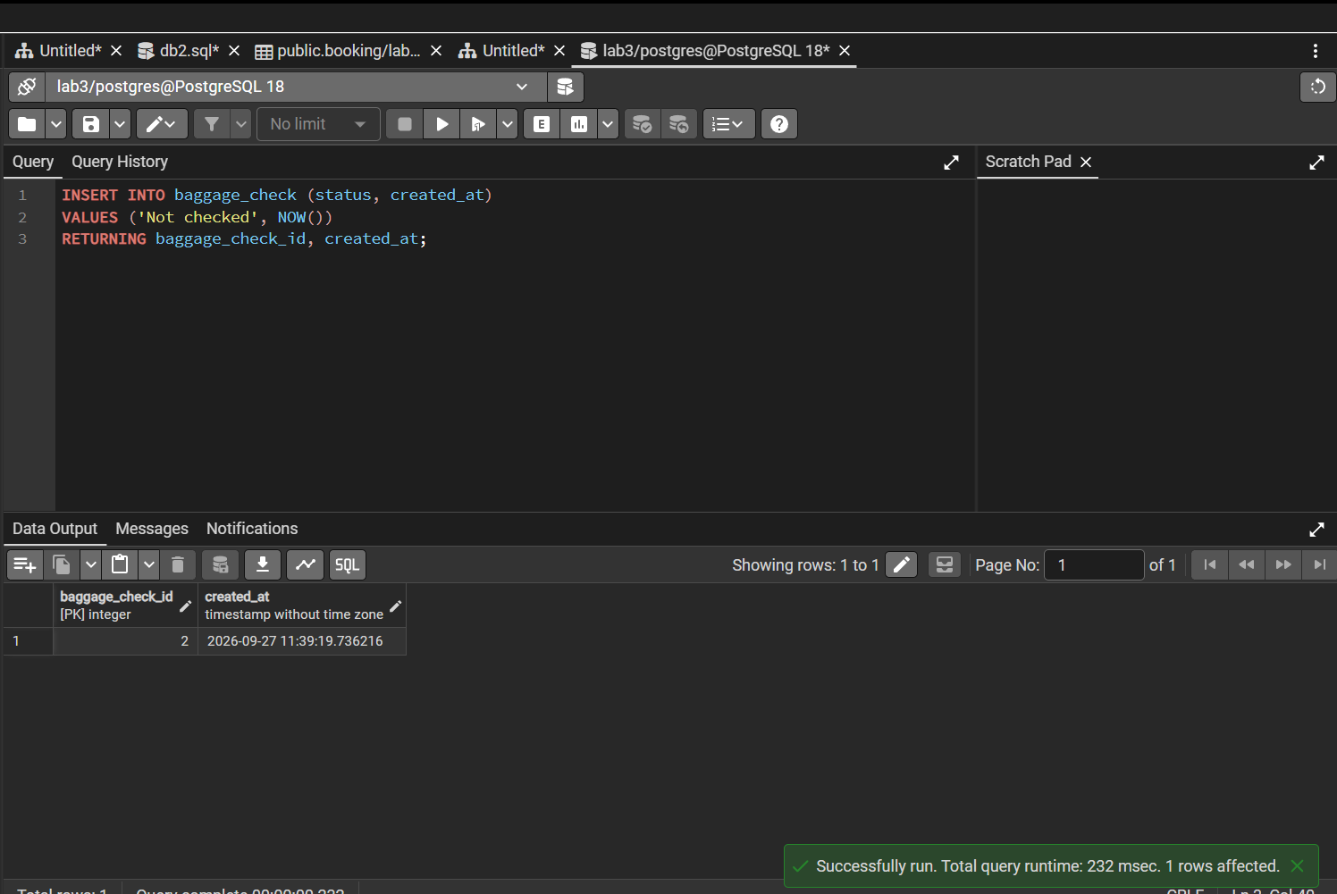
11-task

Slide 12
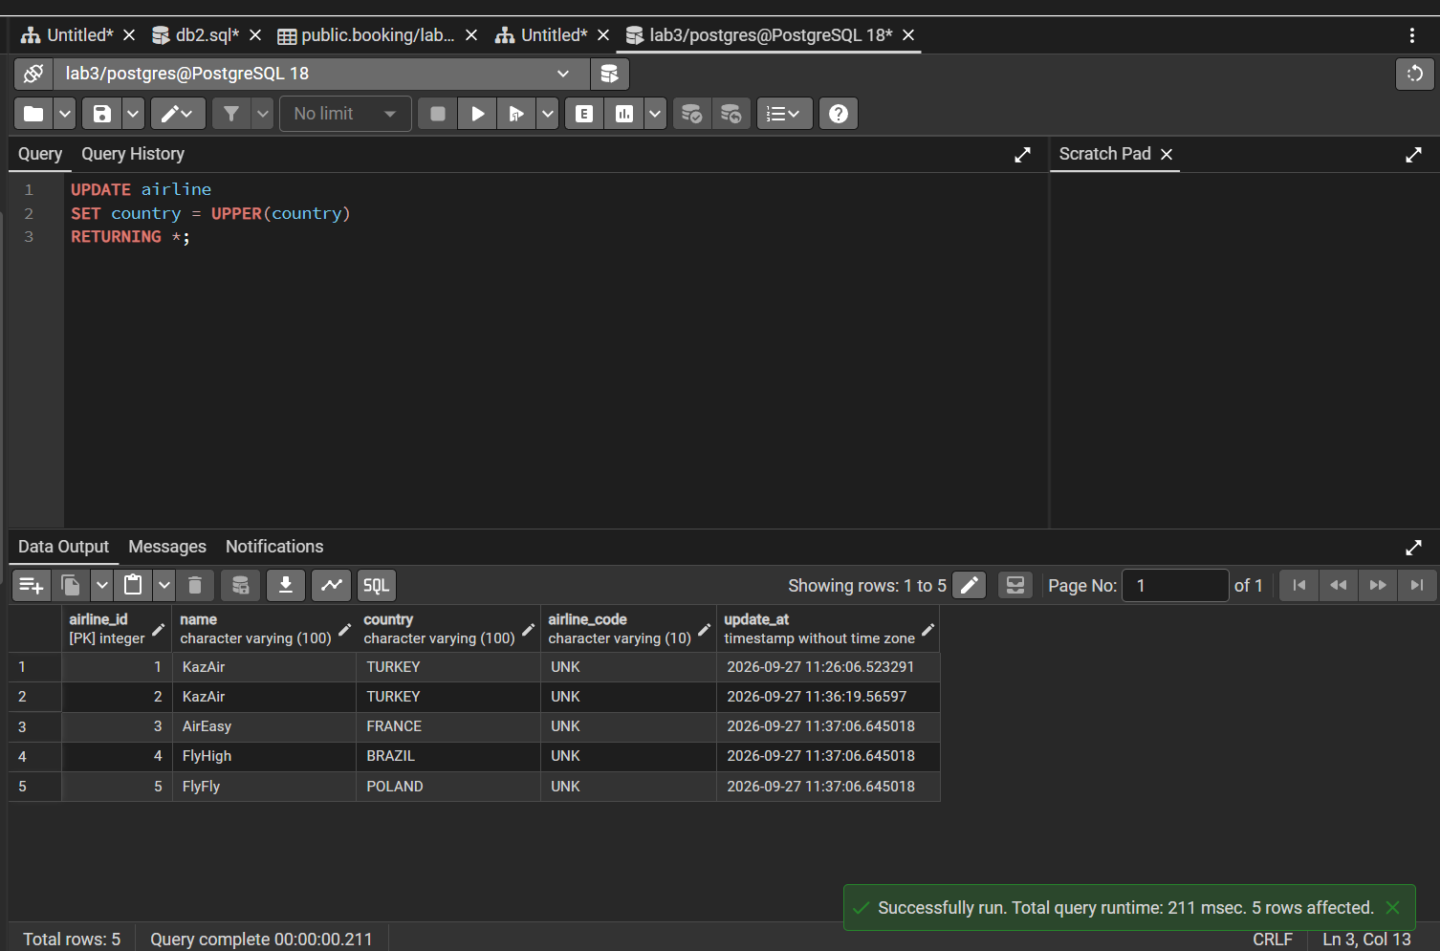
12-task

Slide 13
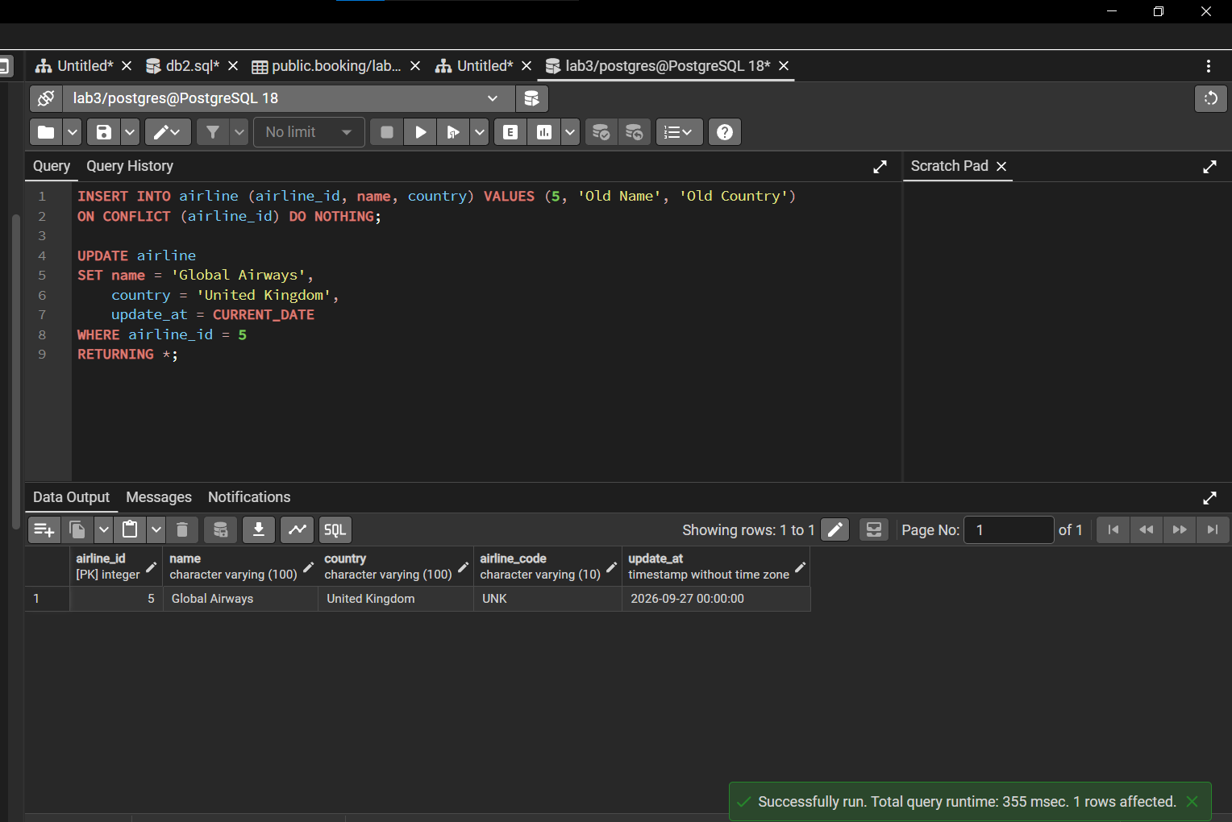
13-task

Slide 14
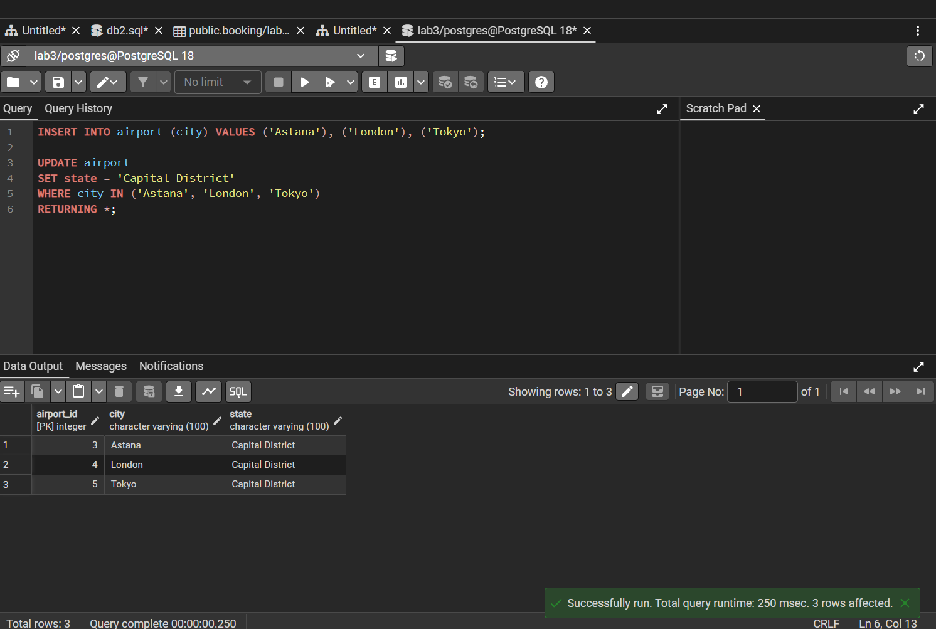
14-task

Slide 15
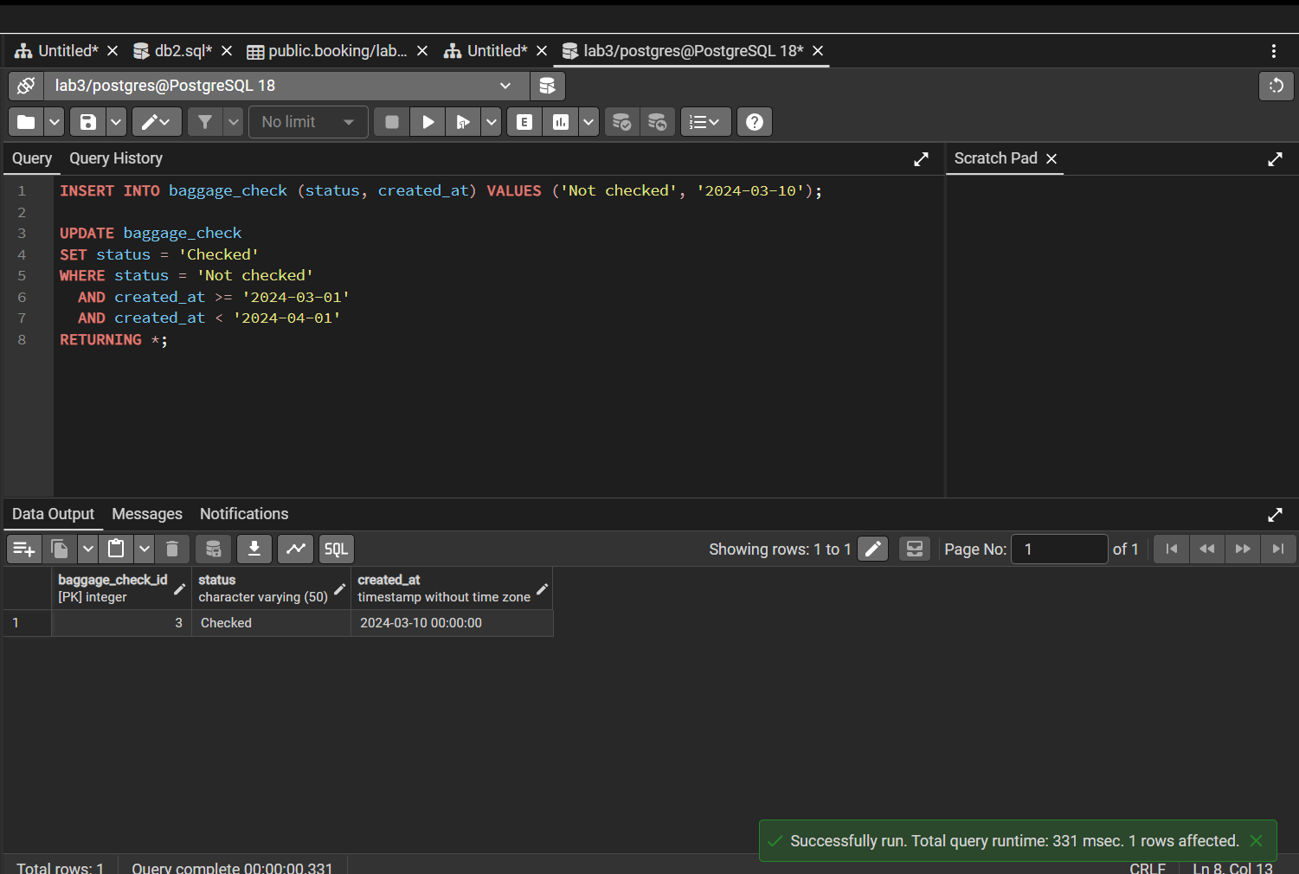
15-task

