Slide 1


Web fundamentals
Made by : HAMZA KEFI

Slide 2
OUTLINE
1.How does the web work?
2.What do you need to be a web developer?
3.Why did you choose to learn web development?

Slide 3
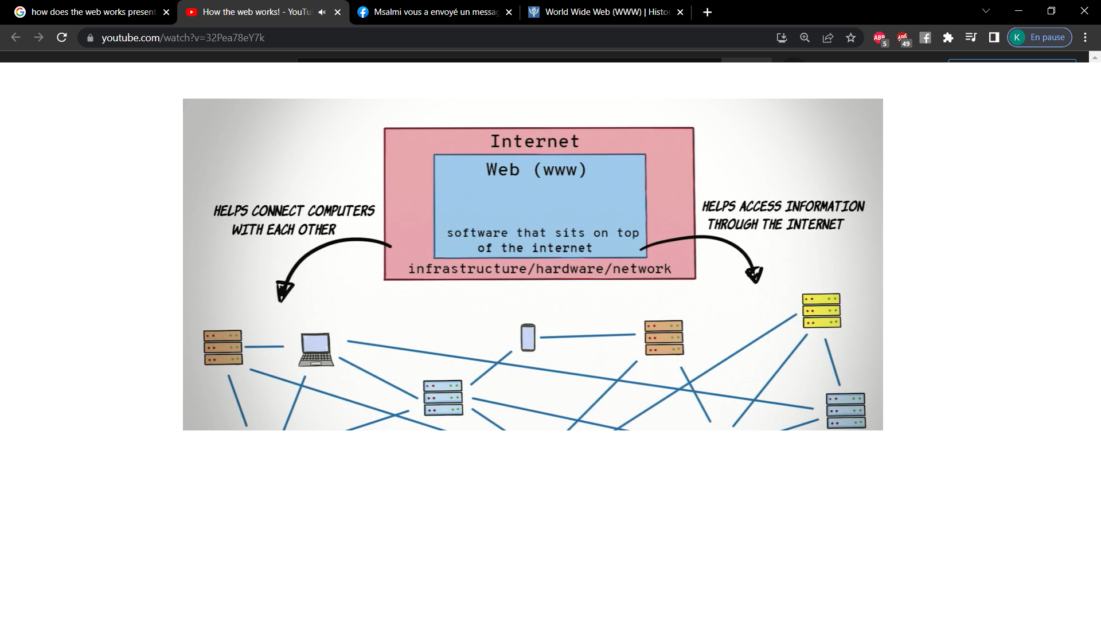
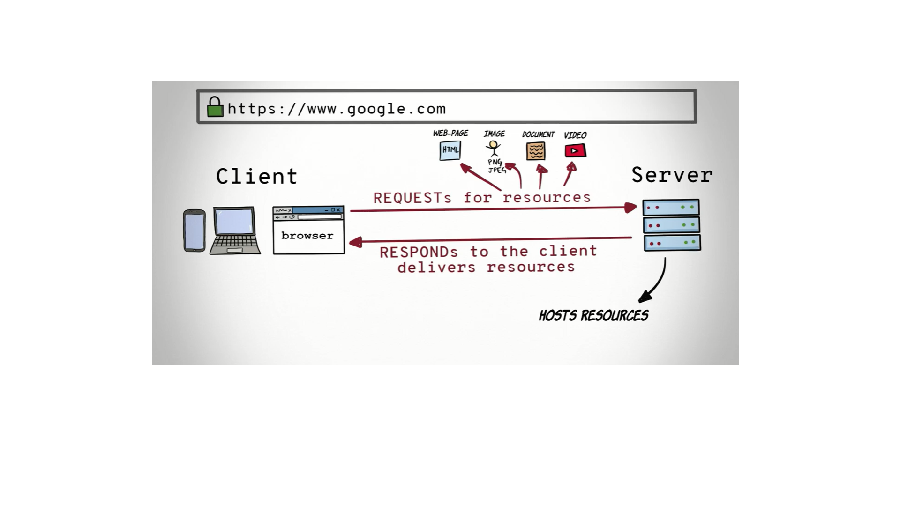
1.How does the web work?
The World Wide Web is a huge network of hyperlinked documents contain links to related supporting graphics, images, videos, and to other documents, and are usually grouped together as a web site or web pages .

Slide 4
2.What do you need to be a web developer?
Skills:
Attention to details
Excellent problem-solving skills
A logical approach to work
Keen interest in technology
The ability to explain technical matters clearly
Steps :
Learn the fundamentals of web development
Choosing a specialization(front-end/back-end/ full-stack)
Choosing a Programming Language
Study independently ,take acourse and/or certification
Build Web Development Projects

Slide 5
3.Why did you choose to learn web development?
I chose to learn Web development because :
Programming and developing are universal skills
The pay is high
The job outlook is strong
It gives you the opportunity to express yourself creatively on the internet
You may have more freedom ,you can work from home

