Slide 1
Presentation Title
Location, Date, Author

Slide 2
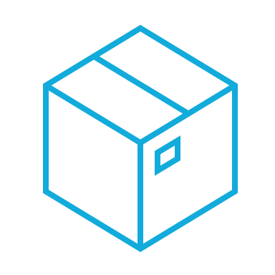


Flexible Vs Standard Environments
Standard
Flexible
Application instances run in a sandbox, using the runtime environment of a supported languages
Applications that need to deal with rapid scaling
It can scale to 0 instances
Pricing based on instance hours
Application instances run within Docker containers on Compute Engine virtual machines (VM)
It can scale to a minimum of 1 instance
You can modify the runtime through Dockerfile
Pricing based on resources usage (vCPU, memory, and persistent disk)
Vs

