Slide 1
Salary prediction using regression Analysis
CS-481
Team Members :
HAMZA MUSTAFA KHAN 15k-2832
SARIM BALKHI 15k-2828
Lecturer: Dr. Atif Tahir

Slide 2
SETTING THE RESEARCH GOAL
Thousands of people apply for different jobs on online job websites. These sites include Indeed, Rozee, etc. Every individual applicant has high salary expectation for his job.
The motivation behind this idea is that candidates do have a right to know about the salary at the time of the job posting so that they can decide whether to apply for the job or not.
The main focus of this research is to identify salary for job applicants against different job. This project aims to predict the salaries in this scenario using Regression Analysis.

Slide 3
Retrieving Data
The data is retrieved through web scraping from an online job portal namely, Indeed.com.
A package called BeautifulSoup, an HTML parser is used to gather the data.
The data comprises of job postings with attributes namely, city, job title, company name, location, summary and salary.
This data will help in predicting the salary of the job postings.

Slide 4
Data Preparation
Data is loaded into a Pandas dataframe and is cleaned.
One hot encoding and label encoding is applied so as to convert the data from categorical type to numerical type in order to perform analysis efficiently.
By using the existing attributes, another attribute "Higher Position" is created which indicates if the position belongs "Senior", "Head" or "Lead" category.

Slide 5
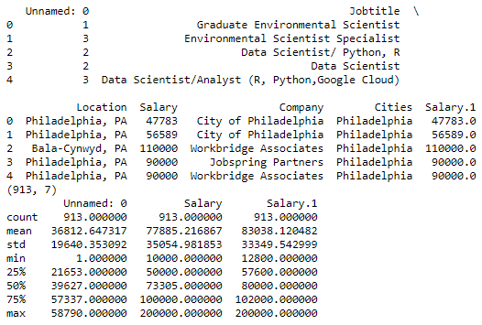
Data Exploration
This data is explored using descriptive analysis like head, shape, etc. Skewness and Kurtosis is determined. Several kinds of plots of salary have been plotted like distplot, probplot, etc. A heat map of the data is also generated.

Slide 6
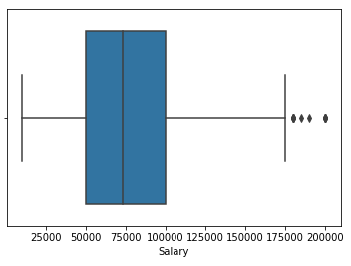
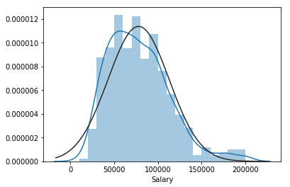
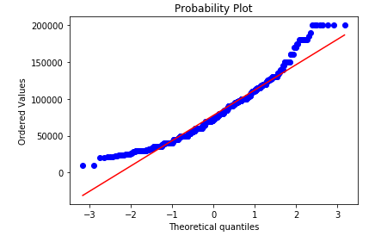
Box Plot
Dist Plot
Probability Plot

Slide 7
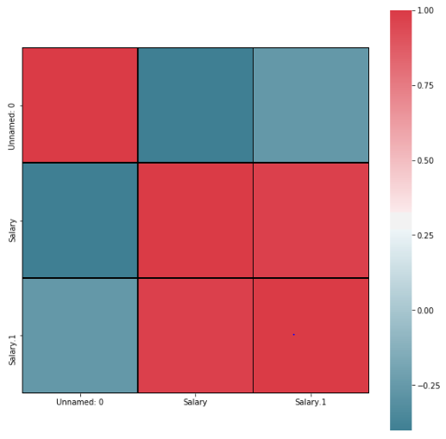
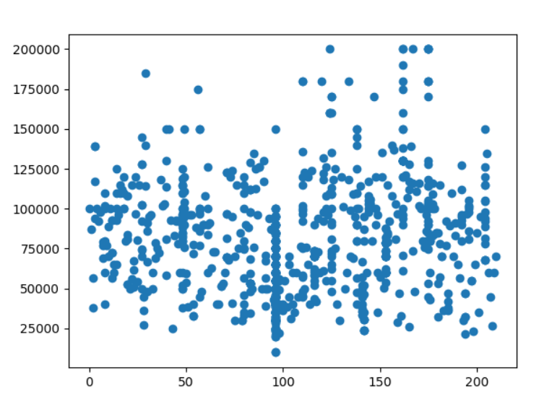
Heat map
Scatter plot

Slide 8
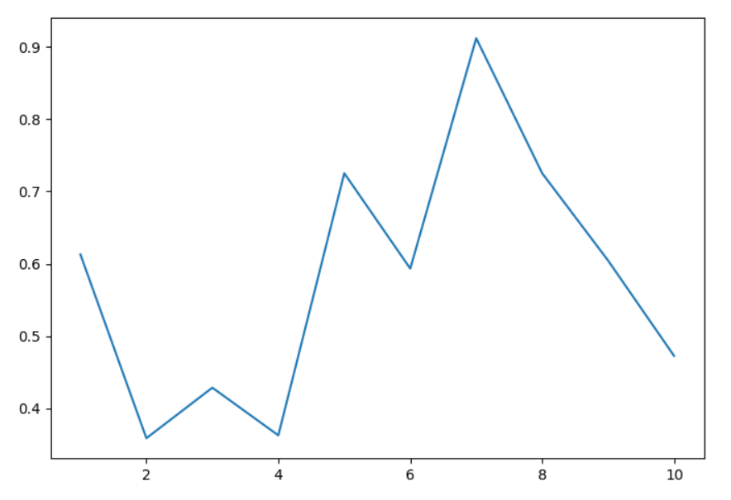
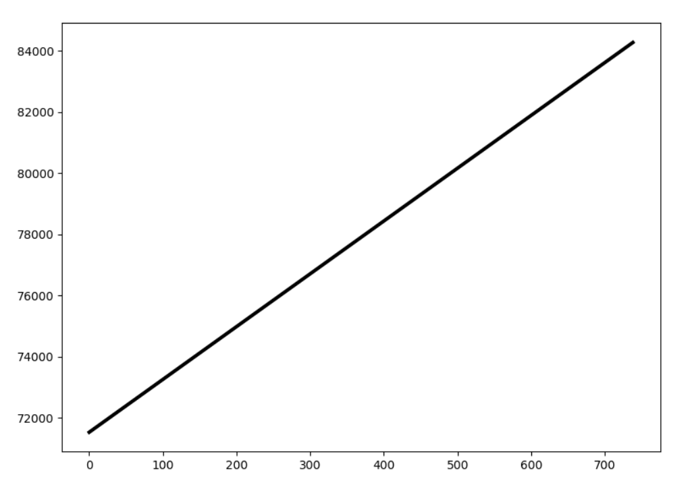
Data Modeling:
Linear Regression has been applied because our target data is continuous and the graph of probability plot indicated that the regression is linear. Hence, the classifier works best in the scenario.
Cross Validation Score
Regression Line of Job Location

Slide 9
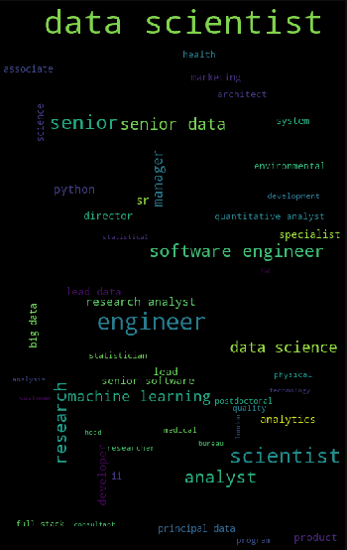
Automation and Presentation:
The data is composed of job posting and is presented with their salaries. Here a word cloud has been generated showing the most frequent words. Data scientist, software engineer, engineer, scientist, analyst were most recurring.
The Final results are in the form of predicted salaries.

Slide 10
Conclusion
Job postings of higher positions have higher salaries.
Managerial positions were the outliers.
Salary is proportional to Higher position.

