Slide 1
Next.js Introduction
By Hamza nasir.

Slide 2
What is page.tsx file.
In next.js application, page.tsx file serve as the main entry points for rendering pages within the app. Each page.tsx file corresponds to a specific route in the application, based on it location within the app or pages directory.
The .tsx extension indicates that the file uses typescript with jsx. Allowing developers to leverage type safety and the rich feature set of typescript while defining the page structure.

Slide 3
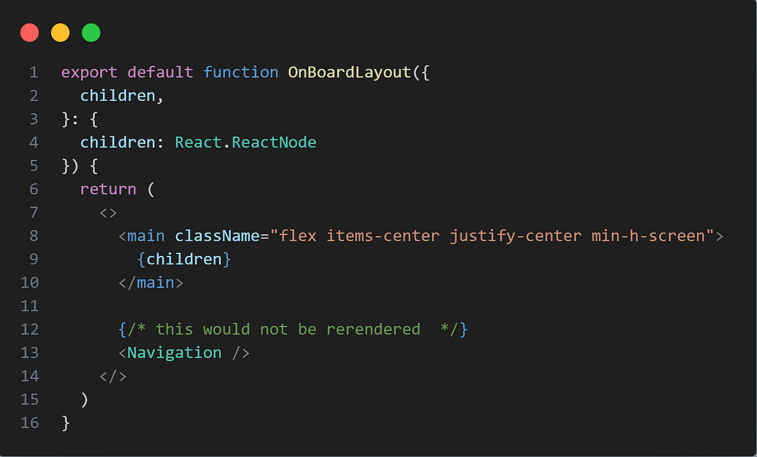
What is layout .tsx file.
A layout file defines ui elements that are shared across multiple pages in an application and wrap the entire app, ensuring consistency.
To display common components like header, footer And Navigation on every page, import them into layout file.

Slide 4
What is link tag in next.js.
the Link tag in Next.js is used for client-side navigation between pages.
We use the Link tag to improve the user experience by enabling faster page transitions without reloading the entire page.
<link href=“/page”>new page</link>
Imagine a library with different sections. If you had to exit and re-enter every time you wanted to switch sections, it would be frustrating.
Now, imagine being able to walk between sections without leaving the library. That’s how the Link tag in Next.js works. It allows you to navigate between pages on a website without reloading, making your experience faster and smoother.

Slide 5
How To Create nested pages.
In next.js creating nested pages is a straight forward process achieved by organizing files and folders within the app or pages directory, depending on the routing system you are using. To create nested routes, simply create subdirectories that represent the url structure you want to build. For instance, if you have a route /products/clothing, you would organize your file as app/products/clothing/page.tsx.
Each nested folders and the file defines a part of the path, making it easy to visualize and manage complex url structures.

Slide 6
Why we create nested pages.
Nested pages allows for clean, hierarchical urls (e.g /products/electronics ) that improves user experience and seo.
Each nested routes corresponds to its folder, promoting organized codes that’s easy to maintain and extend.
Next.js automatically generates routes based on folder structure , reducing the need for manual routing configuration.
You can assign different layouts or components to specific nested pages allowing for a tailord user experience per section.

Slide 7
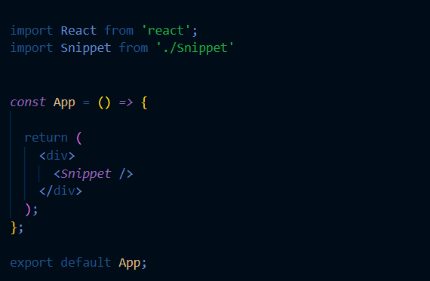
How to create components in next.js.
In next.js components are reusable building bloks used to create the ui of a web application,.
They are typically written as fuction or classes in js or ts that return jsx, which describes what should be rendered on the page.
Components can encapsulate specific piece of ui such as button, form or even entire page and can be combined nested or reused across multiple pages or other components to build complex ui.

Slide 8
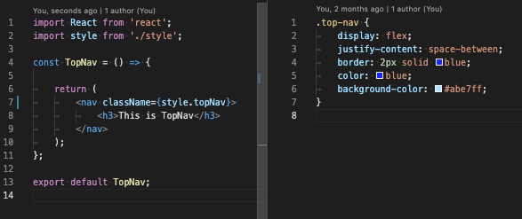
What is Module.css
In next.js module.css files are css modules that enable scoped and modular styling for components.
When using css modules , you create style in a .module.css file, which then automatically generates unique class names for each style, preventing class name collision across components.

Slide 9
What is tailwind css.
Tailwind css is a utility first css frameworks that enables rapid ui development by providing a wide range of low-level, reusable utility classes for styling html elements directly.
Unlike traditional css frameworks that focus on providing pre defined components e.g. buttons, cards.
Tailwind offers granular utilities like bg-blue-200 for background color, text-center for text alignment and p-4 for padding.
This approach allows developers to build complex design without written coustom css.

Slide 10
What is difference between tailwind and custom css.
Tailwind provides predefined utility classes (eg, bg-blue-200 and m-3) for quick styling.
Taiwind enforces consistency by standardizing spacing, color and typography across the project.
Tailwind supports responsive styling using breakpoint prefixes like sm: md: and lg: making responsive design easier.
Allows you to write css from scratch, providing maximum flexibility to create any design without being limited by a framework.
With custom css you can create reusable css classes or style components individually. Enabling greater control over style.
You define your css organization, which can be scoped per page or component, making it adaptable to various project structures.

Slide 11
Presentation created by Hamza Nasir.

