Slide 1
Introduction to Java

Slide 2
Java
Java is a class-based object oriented programming language and a platform.
Originally developed by James Gosling at Sun Microsystems and released in 1995.
Currently Java is owned by Oracle and more than 3 billion devices run Java.
Java runs on a variety of platforms, such as Windows, Mac OS, LINUX/UNIX and Raspberry Pi etc.
Java is used to develop Mobile apps, Web apps, Desktop apps, Games, Robotics, Embedded Applications, Enterprise Applications and much more.
Differernt Java Platforms / Editions are available : Java SE, Java EE, Java ME, and JavaFx
Companies who are using Java include; Google, Microsoft, Facebook, IBM, Amazon, Netflix, Pinterest, Uber, JetBrains, Many more...
Platform: Any hardware or software environment in which a program runs, is known as a platform. Since Java has a runtime environment (JRE) and API, it is called a platform.
Notes:
Desktop Applications such as acrobat reader, media player, antivirus, etc.
Web Applications such as irctc.co.in, javatpoint.com, etc.
Enterprise Applications such as banking applications.
1) Standalone Application
Standalone applications are also known as desktop applications or window-based applications. These are traditional software that we need to install on every machine. Examples of standalone application are Media player, antivirus, etc. AWT and Swing are used in Java for creating standalone applications.
2) Web Application
An application that runs on the server side and creates a dynamic page is called a web application. Currently, Servlet, JSP, Struts, Spring, Hibernate, JSF, etc. technologies are used for creating web applications in Java.
3) Enterprise Application
An application that is distributed in nature, such as banking applications, etc. is called an enterprise application. It has advantages like high-level security, load balancing, and clustering. In Java, EJB is used for creating enterprise applications.
4) Mobile Application
An application which is created for mobile devices is called a mobile application. Currently, Android and Java ME are used for creating mobile applications.
1) Java SE (Java Standard Edition)
It is a Java programming platform. It includes Java programming APIs such as java.lang, java.io, java.net, java.util, java.sql, java.math etc. It includes core topics like OOPs, String, Regex, Exception, Inner classes, Multithreading, I/O Stream, Networking, AWT, Swing, Reflection, Collection, etc.
2) Java EE (Java Enterprise Edition)
It is an enterprise platform that is mainly used to develop web and enterprise applications. It is built on top of the Java SE platform. It includes topics like Servlet, JSP, Web Services, EJB, JPA, etc.
3) Java ME (Java Micro Edition)
It is a micro platform that is dedicated to mobile applications.
4) JavaFX
It is used to develop rich internet applications. It uses a lightweight user interface API.

Slide 3
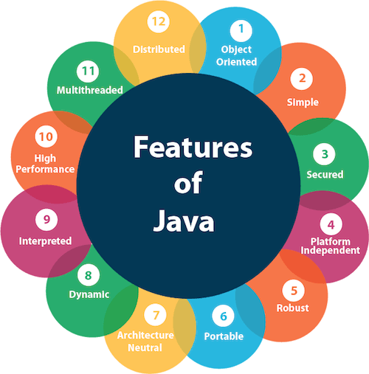
The principles for creating Java
The principles for creating Java programming were
Simple,
Robust,
Portable,
Platform-independent,
Secured,
High Performance,
Multithreaded,
Architecture Neutral,
Object-Oriented,
Interpreted, and
Dynamic".

Slide 4
Java is −
Object Oriented − In Java, everything is an Object. Java can be easily extended since it is based on the Object model.
Platform Independent − Unlike many other programming languages including C and C++, when Java is compiled, it is not compiled into platform specific machine, rather into platform independent byte code. This byte code is distributed over the web and interpreted by the Virtual Machine (JVM) on whichever platform it is being run on.
Simple − Java is designed to be easy to learn. If you understand the basic concept of OOP Java, it would be easy to master.
Secure − With Java's secure feature it enables to develop virus-free, tamper-free systems. Authentication techniques are based on public-key encryption.
Architecture-neutral − Java compiler generates an architecture-neutral object file format, which makes the compiled code executable on many processors, with the presence of Java runtime system.
Portable − Being architecture-neutral and having no implementation dependent aspects of the specification makes Java portable. Compiler in Java is written in ANSI C with a clean portability boundary, which is a POSIX subset.
Robust − Java makes an effort to eliminate error prone situations by emphasizing mainly on compile time error checking and runtime checking.
Multithreaded − With Java's multithreaded feature it is possible to write programs that can perform many tasks simultaneously. This design feature allows the developers to construct interactive applications that can run smoothly.
Interpreted − Java byte code is translated on the fly to native machine instructions and is not stored anywhere. The development process is more rapid and analytical since the linking is an incremental and light-weight process.
High Performance − With the use of Just-In-Time compilers, Java enables high performance.
Distributed − Java is designed for the distributed environment of the internet.
Dynamic − Java is considered to be more dynamic than C or C++ since it is designed to adapt to an evolving environment. Java programs can carry extensive amount of run-time information that can be used to verify and resolve accesses to objects on run-time.
Notes:
Java is a general-purpose programming language intended to let programmers write once, run anywhere. This means that compiled Java code can run on all platforms that support Java without the need to recompile.

Slide 5
History of Java
1) Initially it was designed for small, embedded systems in electronic appliances like set-top boxes.
2) Firstly, it was called "Greentalk" by James Gosling
3) After that, it was called Oak and was developed as a part of the Green project.
4) Why the name Oak?
4) Oak is a symbol of strength and chosen as a national tree of many countries like the U.S.A., France, Germany, Romania, etc.
5) In 1995, Oak was renamed as "Java" because it was already a trademark by Oak Technologies.
Why Java Programming named "Java"?
6) The team gathered to choose a new name. The suggested words were "dynamic", "revolutionary", "Silk", "jolt", "DNA", etc. They wanted something that reflected the essence of the technology: revolutionary, dynamic, lively, cool, unique, and easy to spell, and fun to say.
7) According to James Gosling, "Java was one of the top choices along with Silk". Since Java was so unique, most of the team members preferred Java than other names.
8) Java is an island in Indonesia where the first coffee was produced (called Java coffee). It is a kind of espresso bean. Java name was chosen by James Gosling while having a cup of coffee nearby his office.
9) Notice that Java is just a name, not an acronym.
10) Initially developed by James Gosling at Sun Microsystems (which is now a subsidiary of Oracle Corporation) and released in 1995.

Slide 6
Java Version History
JDK Alpha and Beta (1995)
JDK 1.0 (23rd Jan 1996)
JDK 1.1 (19th Feb 1997)
J2SE 1.2 (8th Dec 1998)
J2SE 1.3 (8th May 2000)
J2SE 1.4 (6th Feb 2002)
J2SE 5.0 (30th Sep 2004)
Java SE 6 (11th Dec 2006)
Java SE 7 (28th July 2011)
Java SE 8 (18th Mar 2014)
Java SE 9 (21st Sep 2017)
Java SE 10 (20th Mar 2018)
Java SE 11 (September 2018)
Java SE 12 (March 2019)
Java SE 13 (September 2019)
Java SE 14 (Mar 2020)
Java SE 15 (September 2020)
Java SE 16 (Mar 2021)
Java SE 17 (September 2021)
Java SE 18 (to be released by March 2022)

Slide 7
First Java Program
public class MyFirstJavaProgram {
/*
This is my first java program.
This will print 'Hello World' as the output
*/
public static void main(String []args) {
System.out.println("Hello World"); // prints Hello World
}
}

Slide 8
How to save the file, compile, and run the program
Open notepad and add the code as above.
Save the file as: MyFirstJavaProgram.java.
The name of the java file must match the class name. When saving the file, save it using the class name and add ".java" to the end of the filename.
Open a command prompt window and go to the directory where you saved the class. Assume it's D:\javapractice.
Type 'javac MyFirstJavaProgram.java' and press enter to compile your code.
If there are no errors in your code, the command prompt will take you to the next line (Assumption : The path variable is set).
Now, type ' java MyFirstJavaProgram ' to run your program.
You will be able to see ' Hello World ' printed on the window.

Slide 9
Parameters used in First Java Program
class keyword is used to declare a class in Java.
public keyword is an access modifier that represents visibility. It means it is visible to all.
static is a keyword. If we declare any method as static, it is known as the static method. The core advantage of the static method is that there is no need to create an object to invoke the static method. The main() method is executed by the JVM, so it doesn't require creating an object to invoke the main() method. So, it saves memory.
void is the return type of the method. It means it doesn't return any value.
main represents the starting point of the program.
String[] args or String args[] is used for command line argument. We will discuss it in coming section.
System.out.println() is used to print statement. Here, System is a class, out is an object of the PrintStream class, println() is a method of the PrintStream class. We will discuss the internal working of System.out.println() statement in the coming section

Slide 10
Ways to write a Java Program
By changing the sequence of the modifiers, method prototype is not changed in Java.
static public void main(String args[])
2)The subscript notation in the Java array can be used after type, before the variable or after the variable.
public static void main(String[] args)
public static void main(String []args)
public static void main(String args[])
3)You can provide var-args support to the main() method by passing 3 ellipses (dots)
public static void main(String... args)

Slide 11
Having a semicolon at the end of class is optional in Java
class A{
static public void main(String... args){
System.out.println("hello java4");
}
};

Slide 12
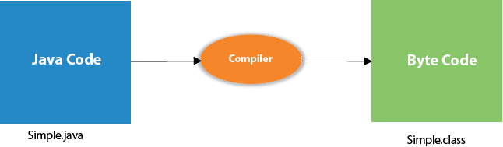
What happens at compile time?
At compile time, the Java file is compiled by Java Compiler (It does not interact with OS) and converts the Java code into bytecode.

Slide 13
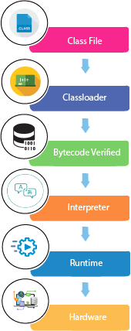
What happens at runtime?
At runtime, these steps are performed:
Classloader: It is the subsystem of JVM that is used to load class files.
Bytecode Verifier: Checks the code fragments for illegal code that can violate access rights to objects.
Interpreter: Read bytecode stream then execute the instructions.

Slide 14
Basic Syntax
About Java programs, it is very important to keep in mind the following points.
Java is case-sensitive: "MyClass" and "myclass" has different meaning
Case Sensitivity − Java is case sensitive, which means identifier Hello and hello would have different meaning in Java.
Class Names − For all class names the first letter should be in Upper Case. If several words are used to form a name of the class, each inner word's first letter should be in Upper Case.
Example: class MyFirstJavaClass
Method Names − All method names should start with a Lower Case letter. If several words are used to form the name of the method, then each inner word's first letter should be in Upper Case.
Example: public void myMethodName()
Program File Name − Name of the program file should exactly match the class name.
When saving the file, you should save it using the class name (Remember Java is case sensitive) and append '.java' to the end of the name (if the file name and the class name do not match, your program will not compile).
But please make a note that in case you do not have a public class present in the file then file name can be different than class name. It is also not mandatory to have a public class in the file.
Example: Assume 'MyFirstJavaProgram' is the class name. Then the file should be saved as 'MyFirstJavaProgram.java'
public static void main(String args[]) − Java program processing starts from the main() method which is a mandatory part of every Java program.

Slide 15
Java Identifiers
Names used for classes, variables, and methods are called identifiers.
In Java, there are several points to remember about identifiers. They are as follows −
All identifiers should begin with a letter (A to Z or a to z), currency character ($) or an underscore (_).
After the first character, identifiers can have any combination of characters.
A key word cannot be used as an identifier.
Most importantly, identifiers are case sensitive.
Examples of legal identifiers: age, $salary, _value, __1_value.
Examples of illegal identifiers: 123abc, -salary.

Slide 16
Java Modifiers
There are two categories of modifiers −
Access Modifiers − default, public , protected, private
Non-access Modifiers − final, abstract, strictfp
We will be looking into more details about modifiers in the next section

Slide 17
Java Variables
Following are the types of variables in Java −
Local Variables
Class Variables (Static Variables)
Instance Variables (Non-static Variables)

Slide 18
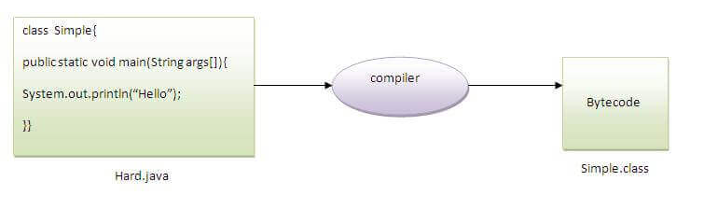
Question: Can you save a Java source file by another name than the class name?
Yes, if the class is not public.
To compile: | javac Hard.java
To execute: | java Simple

Slide 19
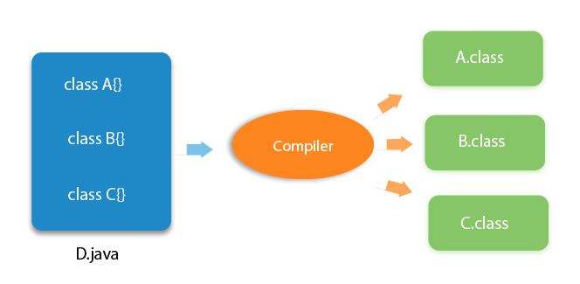
Question: Can you have multiple classes in a java source file?
Answer is Yes!

Slide 20
Java Arrays and Enums
Java Arrays
Arrays are objects that store multiple variables of the same type. However, an array itself is an object on the heap. We will look into how to declare, construct, and initialize in the upcoming chapters.
Java Enums
Enums were introduced in Java 5.0. Enums restrict a variable to have one of only a few predefined values. The values in this enumerated list are called enums.
With the use of enums it is possible to reduce the number of bugs in your code.
For example, if we consider an application for a fresh juice shop, it would be possible to restrict the glass size to small, medium, and large. This would make sure that it would not allow anyone to order any size other than small, medium, or large.

Slide 21
Java Enum Example
class FreshJuice {
enum FreshJuiceSize{ SMALL, MEDIUM, LARGE }
FreshJuiceSize size;
}
public class FreshJuiceTest {
public static void main(String args[]) {
FreshJuice juice = new FreshJuice();
juice.size = FreshJuice.FreshJuiceSize.MEDIUM ;
System.out.println("Size: " + juice.size);
}
}

Slide 22
Java Keywords
abstract | assert | boolean | break
byte | case | catch | char
class | const | continue | default
do | double | else | enum
extends | final | finally | float
for | goto | if | implements
import | instanceof | int | interface
long | native | new | package
private | protected | public | return
short | static | strictfp | super
switch | synchronized | this | throw
throws | transient | try | void
volatile | while

Slide 23
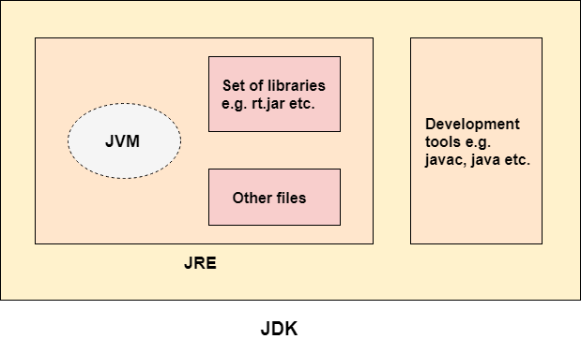
Difference between JDK, JRE, and JVM
JDK (Java Development Kit)
The Java Development Kit (JDK) is a software development environment which is used to develop Java applications
The JDK contains a private Java Virtual Machine (JVM) and a few other resources such as an interpreter/loader (java), a compiler (javac), an archiver (jar), a documentation generator (Javadoc), etc. to complete the development of a Java Application.
Standard Edition Java Platform
Enterprise Edition Java Platform
Micro Edition Java Platform

Slide 24
Difference between JDK, JRE, and JVM
JVM (Java Virtual Machine)
JVM is an abstract machine. It is called a virtual machine because it doesn't physically exist. It is a specification that provides a runtime environment in which Java bytecode can be executed.
It can also run those programs which are written in other languages and compiled to Java bytecode.
JVMs are available for many hardware and software platforms. JVM, JRE, and JDK are platform dependent because the configuration of each OS is different from each other. However, Java is platform independent.
JVM performs the following main tasks:
Loads code
Verifies code
Executes code
Provides runtime environment
JVM provides definitions for the:
Memory area
Class file format
Register set
Garbage-collected heap
Fatal error reporting etc.

Slide 25
Difference between JDK, JRE, and JVM
JRE (Java Runtime Environment )
A specification where working of Java Virtual Machine is specified. But implementation provider is independent to choose the algorithm. Its implementation has been provided by Oracle and other companies.
An implementation Its implementation is known as JRE (Java Runtime Environment).
The Java Runtime Environment is a set of software tools which are used for developing Java applications.
It contains a set of libraries + other files that JVM uses at runtime.

Slide 26
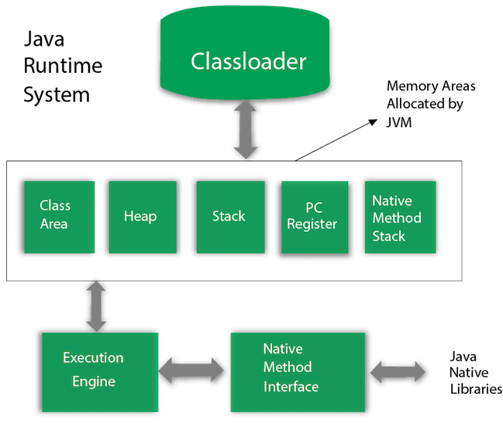
JVM Architecture
Let's understand the internal architecture of JVM. It contains classloader, memory area, execution engine etc.

Slide 27
Classloader
Classloader is a subsystem of JVM which is used to load class files. Whenever we run the java program, it is loaded first by the classloader.
There are three built-in classloaders in Java.
Bootstrap ClassLoader: This is the first classloader which is the super class of Extension classloader. It loads the rt.jar file which contains all class files of Java Standard Edition like java.lang package classes, java.net package classes, java.util package classes, java.io package classes, java.sql package classes etc.
Extension ClassLoader: This is the child classloader of Bootstrap and parent classloader of System classloader. It loades the jar files located inside $JAVA_HOME/jre/lib/ext directory.
System/Application ClassLoader: This is the child classloader of Extension classloader. It loads the classfiles from classpath. By default, classpath is set to current directory. You can change the classpath using "-cp" or "-classpath" switch. It is also known as Application classloader.

Slide 28
Memory Areas
Class(Method) Area: Class(Method) Area stores per-class structures such as the runtime constant pool, field and method data, the code for methods.
Heap: It is the runtime data area in which objects are allocated.
Stack: Java Stack stores frames. It holds local variables and partial results, and plays a part in method invocation and return. Each thread has a private JVM stack, created at the same time as thread. A new frame is created each time a method is invoked. A frame is destroyed when its method invocation completes.

Slide 29
Memory Areas
Program Counter Register: PC (program counter) register contains the address of the Java virtual machine instruction currently being executed.
Native Method Stack: It contains all the native methods used in the application.
Execution Engine: It contains:
A virtual processor
Interpreter: Read bytecode stream then execute the instructions.
Just-In-Time(JIT) compiler: It is used to improve the performance. JIT compiles parts of the byte code that have similar functionality at the same time, and hence reduces the amount of time needed for compilation. Here, the term "compiler" refers to a translator from the instruction set of a Java virtual machine (JVM) to the instruction set of a specific CPU.
Java Native Interface: Java Native Interface (JNI) is a framework which provides an interface to communicate with another application written in another language like C, C++, Assembly etc. Java uses JNI framework to send output to the Console or interact with OS libraries.

