Slide 1
Hospital management system
Group Members:
Muhammad Hamza Shahab (SE-004)
Rana Muhammad Ibrahim (SE-034)
Muhammad Abdullah Hayat (SE-041)
Muhammad Khurram Meraj (SE-045)

Slide 2
Pattern choices
Abstract Factory Pattern
Command Pattern
Singleton Pattern
Template Pattern
Observer Pattern

Slide 3
Abstract Factory Pattern
participants
Abstract Factory | Hospital
Concrete Factory | Endocrinology & Cardiology & Orthopedics
Abstract Product | RadiologicalTest & LabTest
Concrete Product | X-RAY - EKG & Thyroid – Cholesterol
Client | LabAttendant

Slide 4
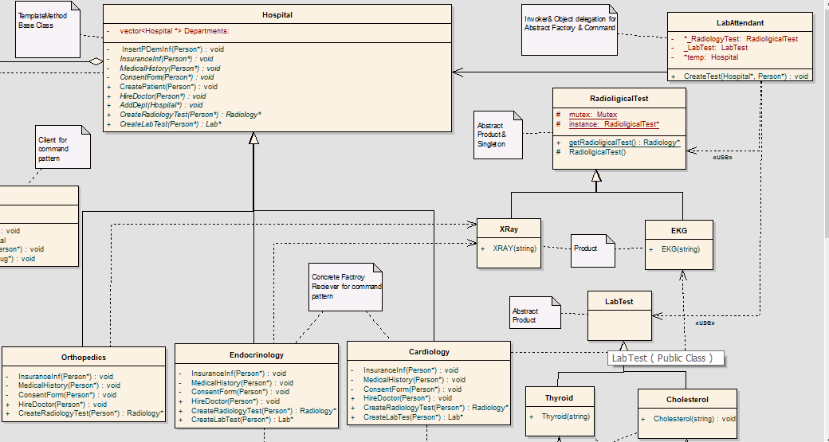

Slide 5
Command Pattern
participants
Command | RadiologicalTest & LabTest
Concrete Command | X-RAY - EKG & Thyroid - Cholesterol
Client | Doctor
Invoker | LabAttendant
Receiver | Endocrinology & Cardiology & Orthopedic

Slide 6
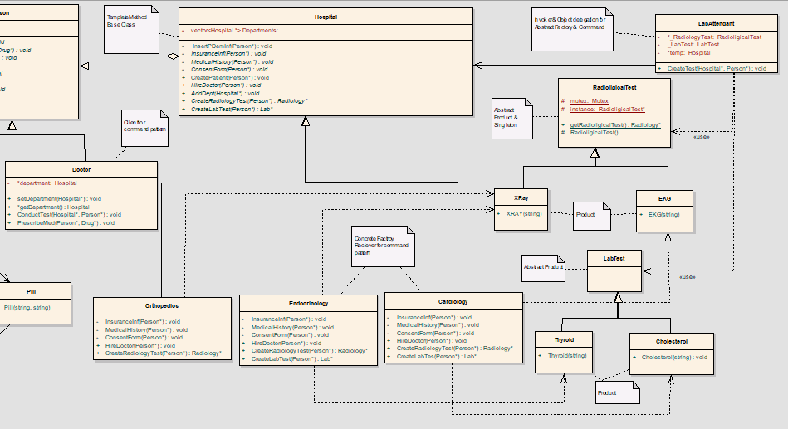

Slide 7
singleton Pattern
participants
Singleton | RadiologicalTest
Mutex | We couldn't include the Mutex and Thread libraries into our code. We constantly got lots of errors about compiler. To have a well-functioning code we didn’t include those two libraries. So, they are just dummy classes here. They are only here to say it could have been also "thread safe" as well.

Slide 8
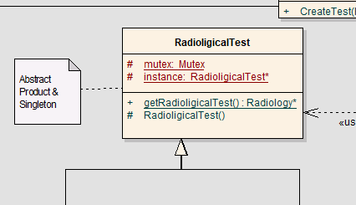

Slide 9
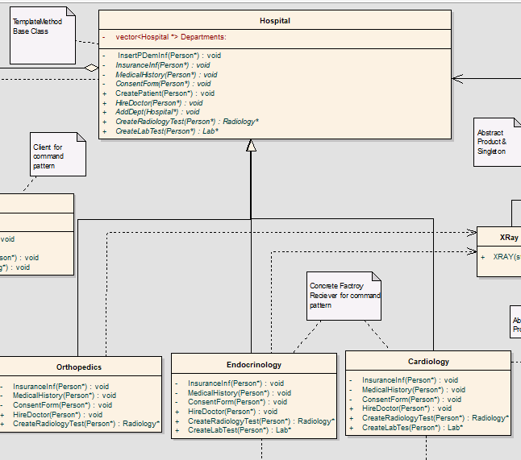
template Pattern
participants
Abstract Class | Hospital
Concrete Class | Orthopedics & Endocrinology & Cardiology

Slide 10
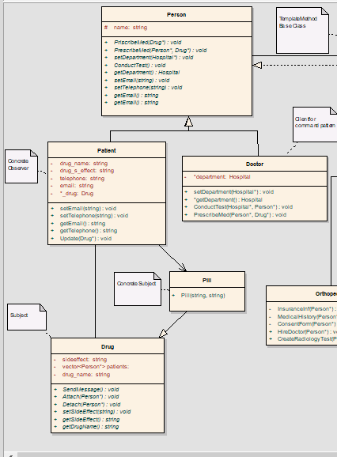
observer Pattern
participants
Subject | Drug
Observer | Person
Concrete Subject | Pill
Concrete Observer | Patient

Slide 11
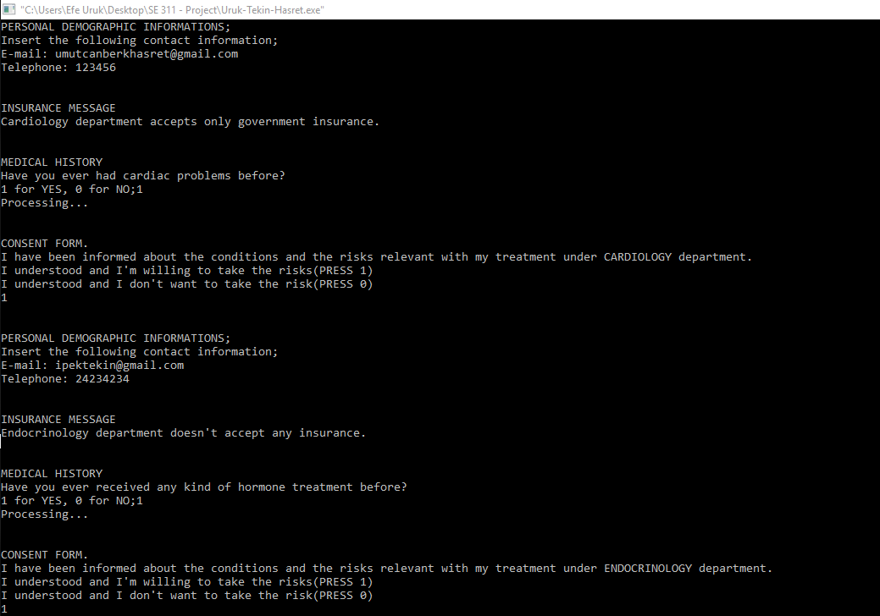
interface
Screen 1

Slide 12
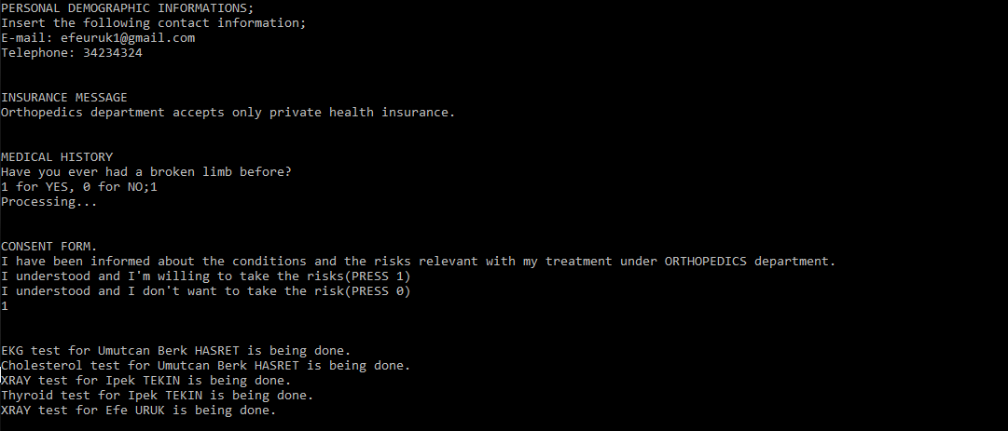
Screen 2

Slide 13
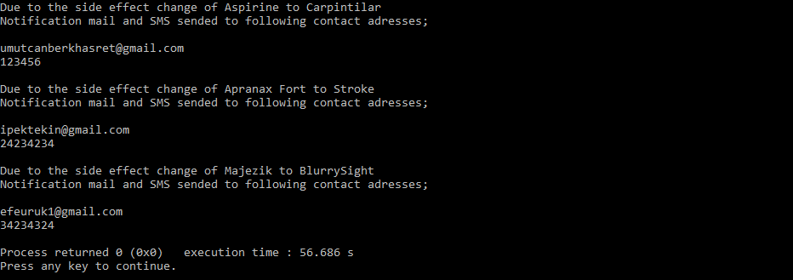
Screen 3

Slide 14
conclusion
In Hospital Management System, we tried to implement 5 patterns at once. First, we draw the UML and the hardest part was connection of 5 patterns in UML, we used Enterprise Architect to draw class diagram, then by adapting to structures, we started the implementation. We aimed to show that we understand design pattern.

Slide 15
THANK YOU!

