Slide 1
Welcome to MS PowerPoint
Name: Hamza Shahid
Roll# 24K-0869
Task: ICT Manual 2 Lab Task 1

Slide 2
Introduction
Easy to present anything
Made by a reliable company (Microsoft)
It is widely used everywhere around the world

Slide 3
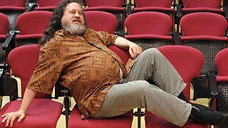
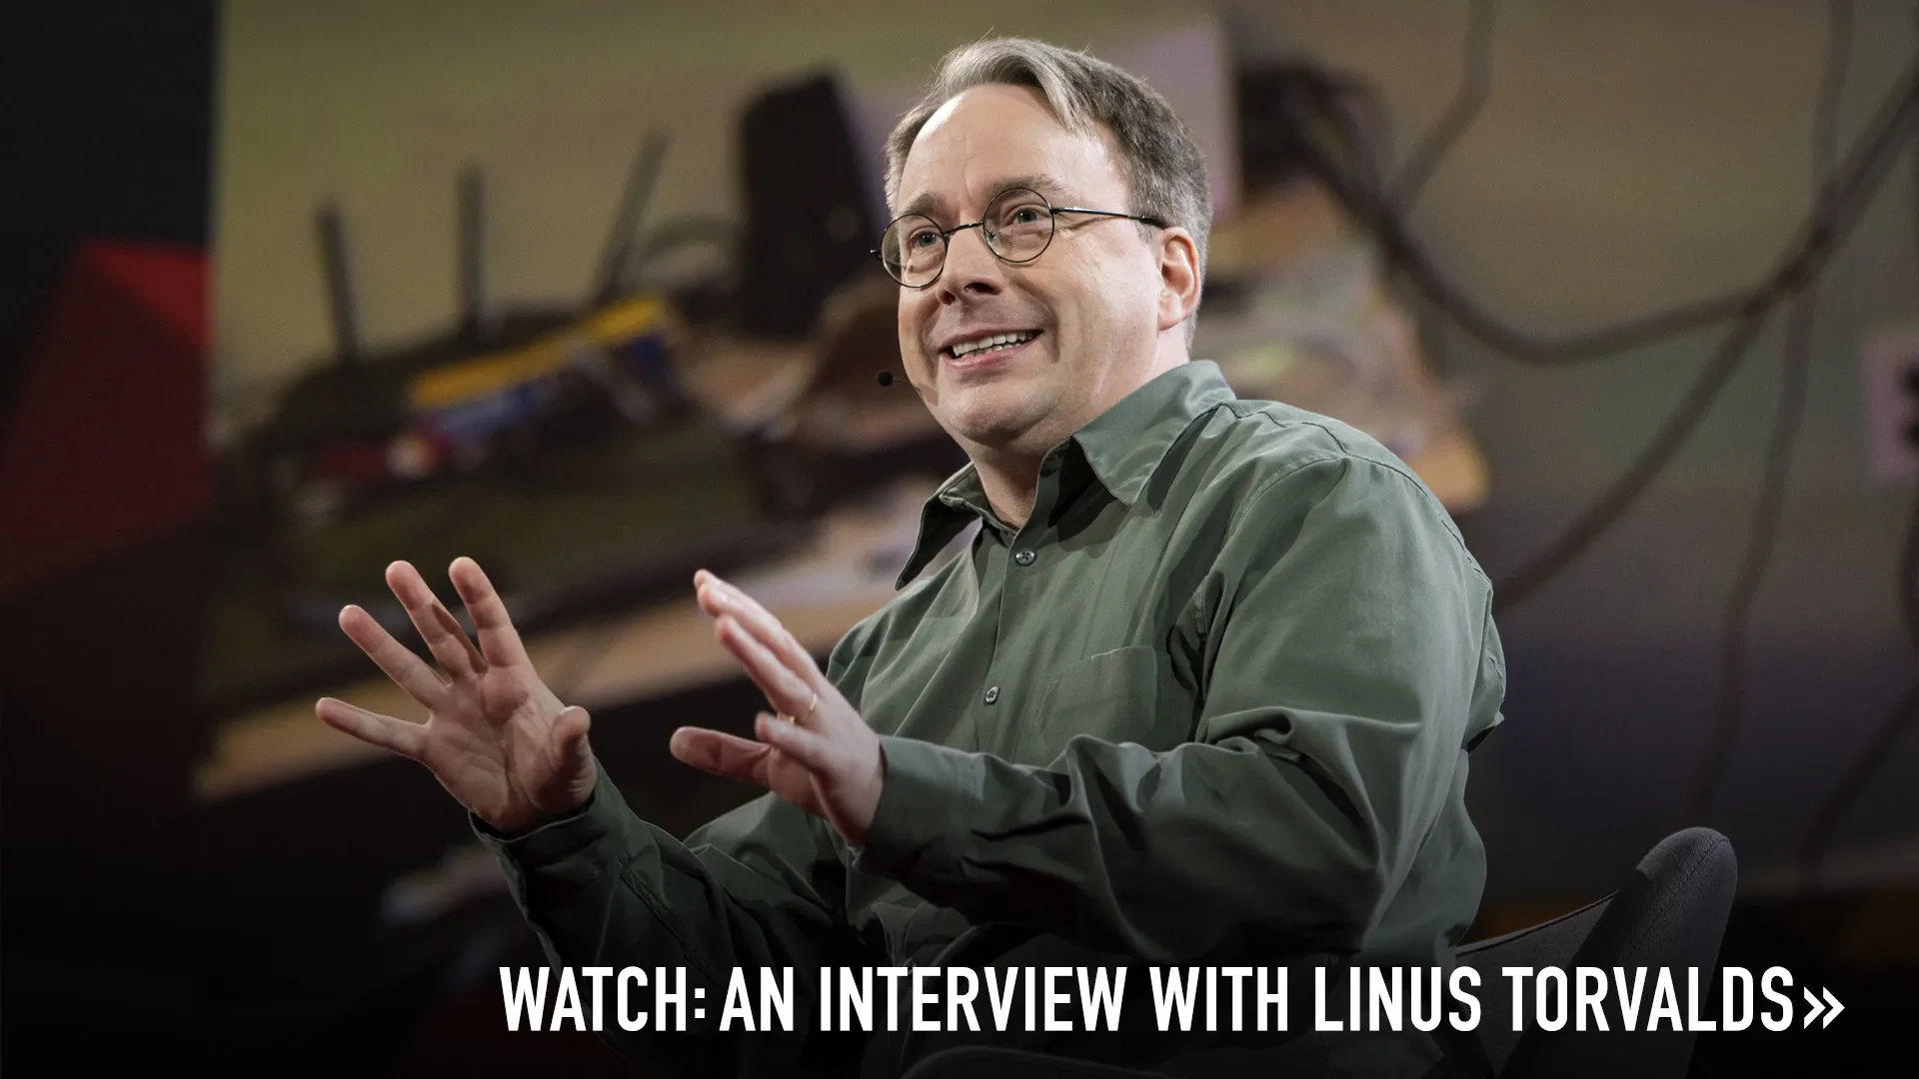
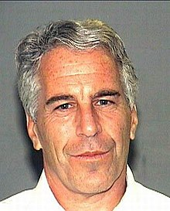
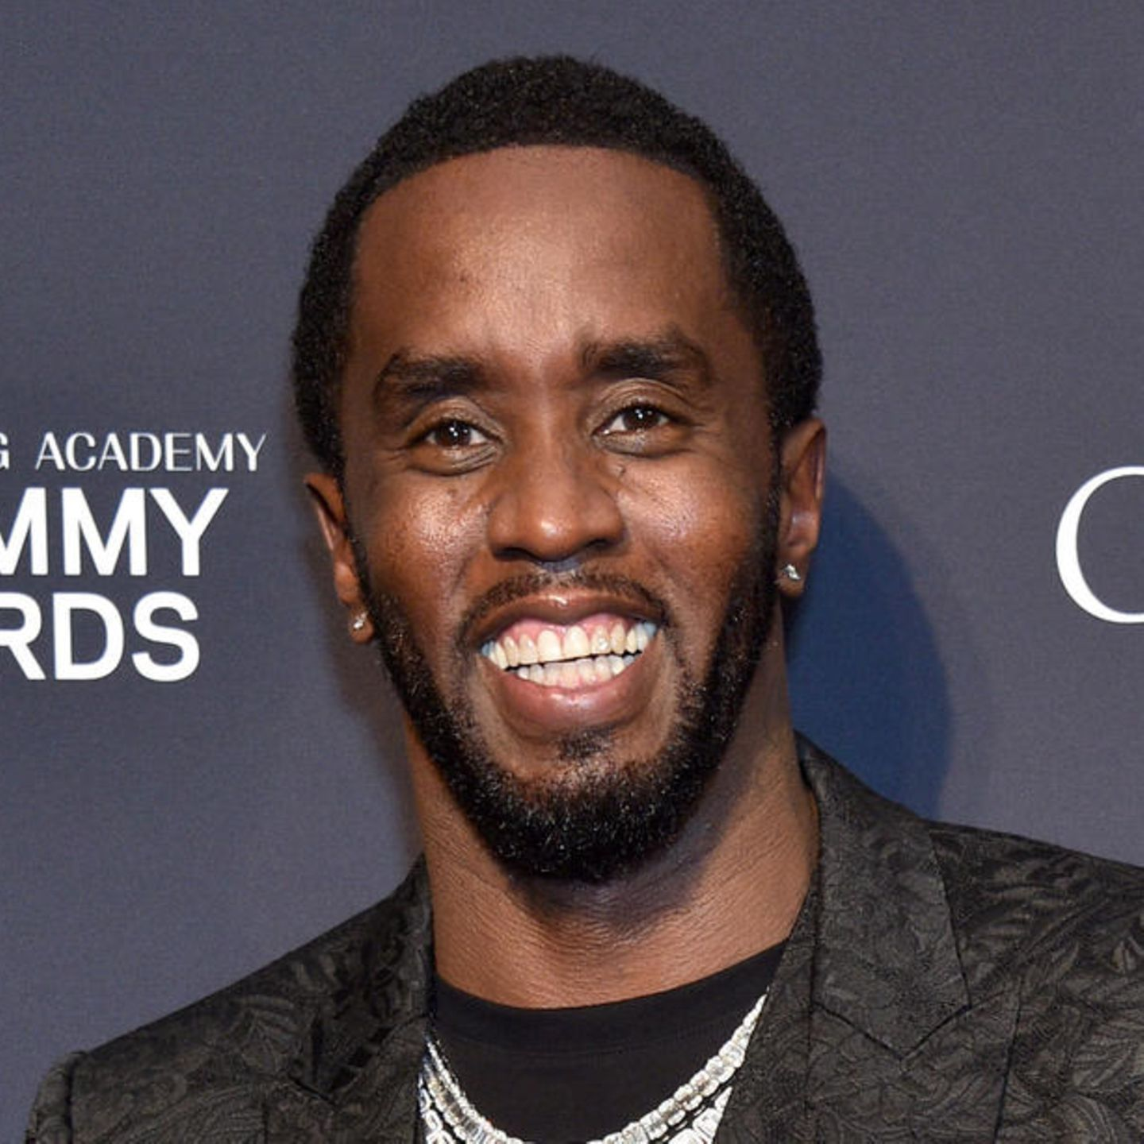
Our Team

