Slide 1
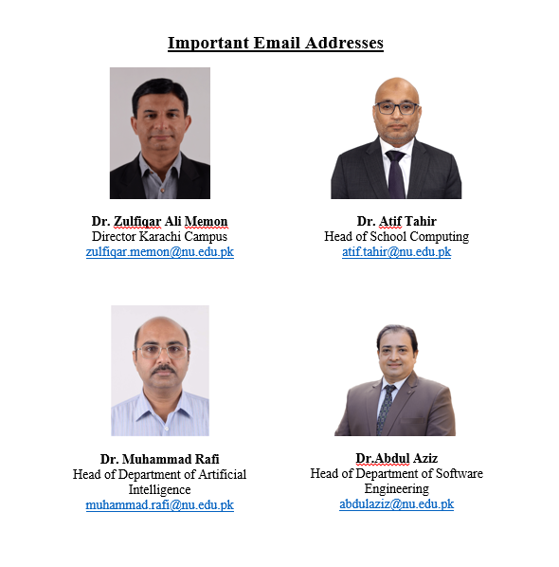
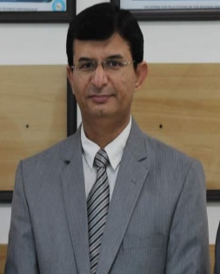

Slide 2
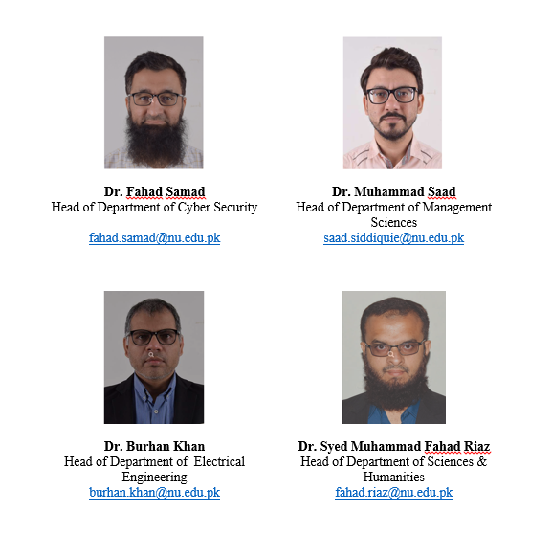

Slide 3
Senior Manager Academics, abdul.saeed@nu.edu.pk
Abdul Saeed
For Queries related to fees, accounts.khi@nu.edu.pk
For Queries related to IT helpdesk.khi@nu.edu.pk
For Queries related academics academic.khi@nu.edu.pk
For Queries related to Transport and cso.khi@nu.edu.pk
Career services
For Queries related to extracurricular studentaffairs.khi@nu.edu.pk
activities and student societies
Department Secretary EE (for class room issues) shams.nazir@nu.edu.pk
Shams Nazir
Department Secretary CS (for class room issues) waheeb.khan@nu.edu.pk
Waheeb
For Queries related to Library library.khi@nu.edu.pk
Afifa Iqbal

