Slide 1
Welcome to MS PowerPoint

Slide 2
Introduction
Easy to present anything
Made by a reliable company (Microsoft)
It is widely used everywhere around the world

Slide 3


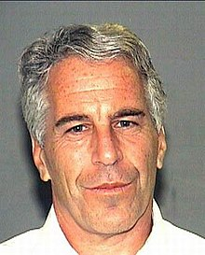
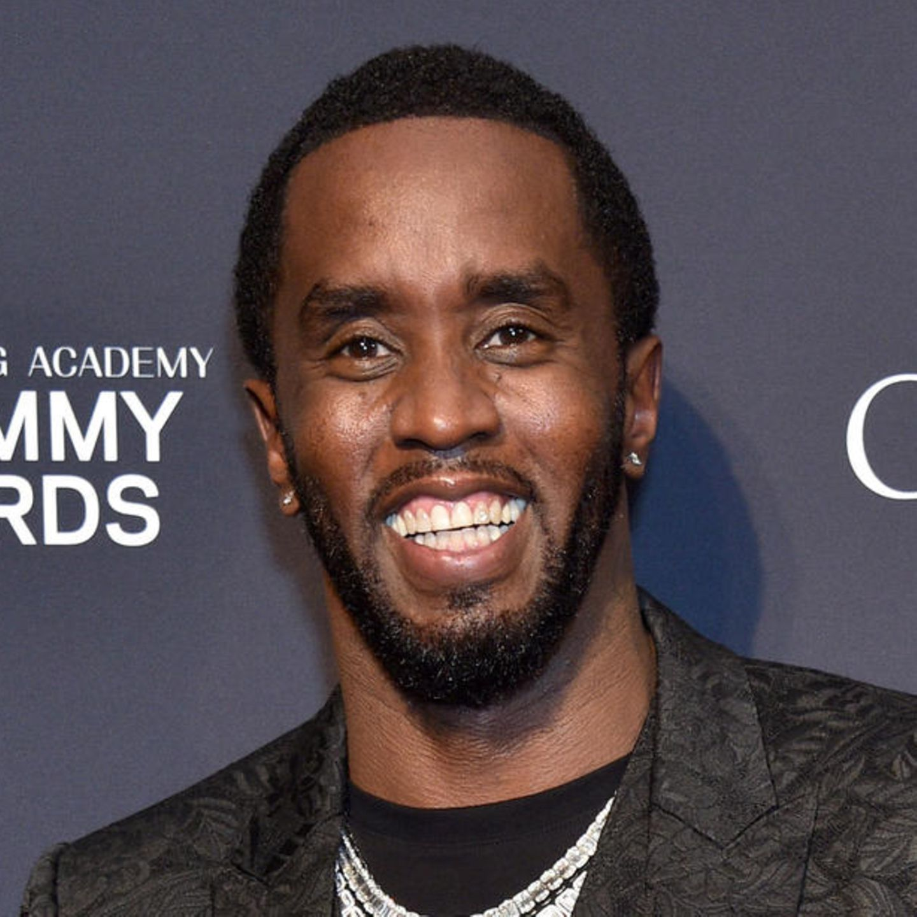
Our Team

