Slide 1

SE4033 Formal Methods for Software Engineering
Formal Methods for Software Engineering

Slide 2
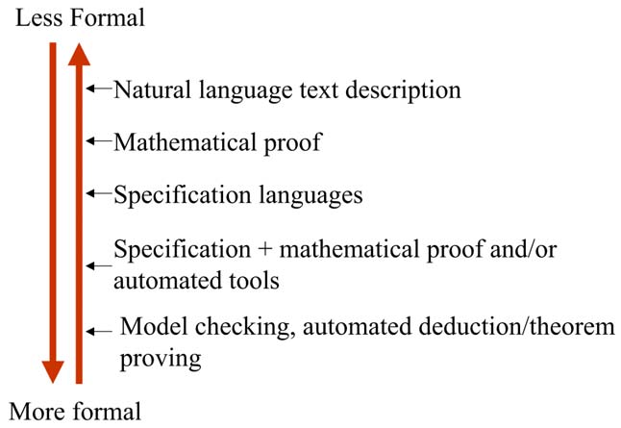
Formalization Spectrum

Slide 3
Logic
Logic or propositional calculus is based on statements, which have truth values
(true or false)

Slide 4
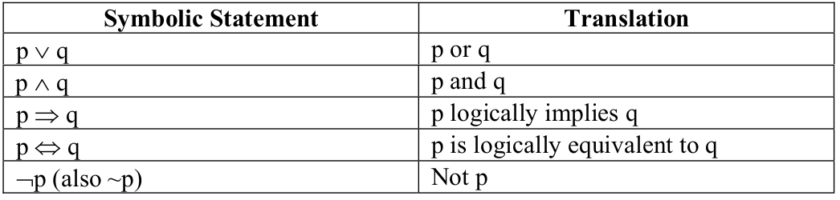
Logic

Slide 5
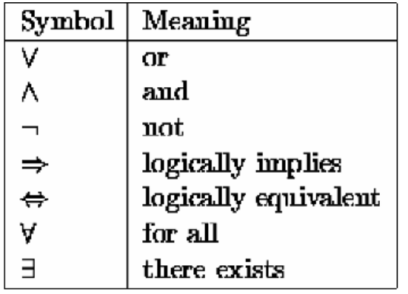
Formalization Spectrum

Slide 6

Quantification is non-logical constants that include names and entities
All men are mortal
$∀X. man\left(X\right)⇒mortal(X)$
Quantification

Slide 7
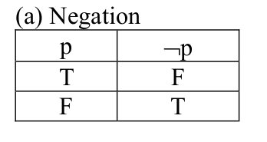
Logic

Slide 8
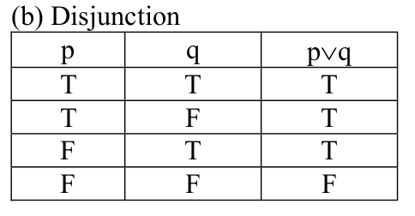
Logic

Slide 9
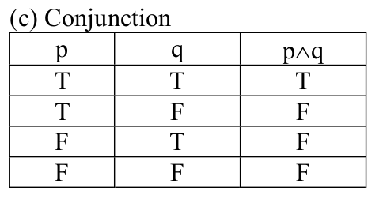
Logic

Slide 10
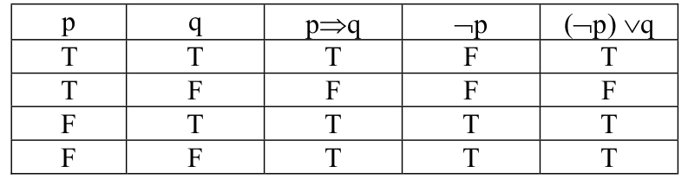
Logic

Slide 11
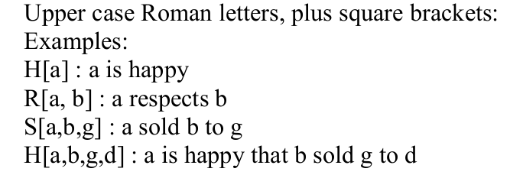
Predicates

Slide 12
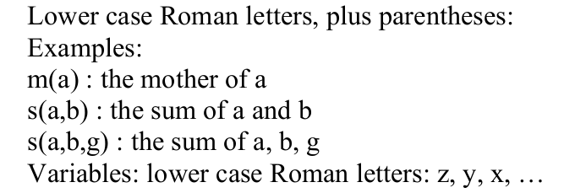
Function Signs

Slide 13
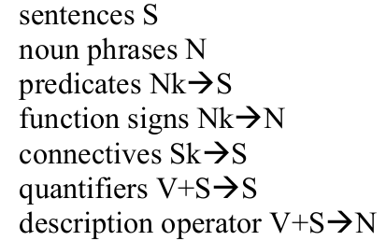
Elementary Logic

Slide 14
Registration System
Warning
Prerequisites

Slide 15

Warning
$CGPA<2⇒Inc\left(W\right)$ increment warning count if the cgpa is below 2

Slide 16

Prerequisites
$P[X,YY]$ x is a prerequisite of y
E.g. P[‘PF’,’OOP’]
C Course to register
P Course already clear (Pass)
$\left(∄\left(x,y\right)∈P\left[X,Y\right]∧C==Y\right) ∨\left(∃\left(x,y\right)∈P\left[X,Y\right]∧C==Y∧X∈P\right)⇒Register (C)$

Slide 17

Registration System
Warning
Prerequisites
$\left(W<2\right)$
$∧$
$\left((∄\left(x,y\right)∈P\left[X,Y\right]∧C==Y\right)$
$∨$
$\left(∃\left(x,y\right)∈P\left[X,Y\right]∧C==Y∧X∈P\right)$
$)⇒Register (C)$

Slide 18
Selection – if statement

Slide 19
Selection – case statement

