Slide 1



Introduction
Human Computer Interaction (HCI)

Slide 2
Textbook
Human-Computer Interaction” by Alan Dix (Author), Janet E. Finlay (Author), Gregory D. Abowd (Author), Russell Beale (Author), Prentice Hall 3rd Edition 2004, ISBN 978-0130461094, http://www.hcibook.com/e3/

Slide 3
Other books
Benyon D, Turner P, Turner S. Designing interactive systems. Harlow, England: Addison-Wesley; 2005.
Shneiderman, B. 2005 Designing the User Interface: Strategies for Effective Human-Computer Interaction. Addison-Wesley Longman Publishing Co., Inc.
McCracken, D. D., Spool, J. M., and Wolfe, R. J. 2003 User-Centered Web Site Development: a Human-Computer Interaction Approach. Pearson Education.

Slide 4
Grading
A combination of
Assignment (10%)
Quizzes (5%)
In Class participation (5%)
project (10%)
Midterm (30%)
Final (40%)

Slide 5
What is HCI? /1
Term “Human-Computer Interaction” (HCI) in widespread use since early 1980s
Roots in other disciplines
Systematic study of human performance already started in the beginning of last century
Ergonomics / Human Factors
Ergonomics is the process of designing or arranging workplaces, products and systems so that they fit the people who use them.
Previously man-machine interaction
Changed to human computer interaction with the introduction of information science & technology
Notes:
Ergonomics is the process of designing or arranging workplaces, products and systems so that they fit the people who use them.
in industry, human factors (also known as ergonomics) is the study of how humans behave physically and psychologically in relation to particular environments, products, or services. ... A human factors specialist typically has an advanced academic degree in Psychology or has special training.

Slide 6
What is HCI? /2
“Human-computer interaction is a discipline concerned with the design, evaluation and implementation of interactive computing systems for human use and with the study of major phenomena surrounding them”
Notes:
By interaction we mean any communication between a user and computer, be it direct or indirect.
Direct interaction involves a dialog with feedback and control throughout performance of the task.
Indirect interaction may involve batch processing or intelligent sensors controlling the environment.

Slide 7
What is HCI? /3
It has to do with quality of design from the user’s perspective
The study of interaction between people and digital systems
“Designing interactive products to support people in their everyday and working lives”

Slide 8
Disciplines involved in HCI
Psychology & Cognitive Science
Ergonomics: (Human Factors)
Computer Science & System Design

Slide 9

An ATM machine
Security code
Choice of actions
Retrieving money, etc.
Getting Receipts (optional)
Done

Slide 10


Slide 11
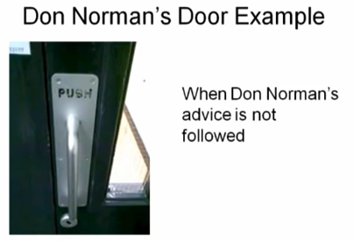

Slide 12
Foundations of HCI /1
Human Cognitive psychology:
the study of how people think and learn
The goal of cognitive psychology is to understand the psychological processes involved in the acquisition and use of knowledge by people.

Slide 13
Foundations of HCI /2
Human Cognitive psychology:
In order to design something for someone, we need to understand their capabilities and limitations

