Slide 1
Problem solving
Process of finding solution to unfamiliar task using knowledge.
Several theories:

Slide 2
Classical Approach
The classical approach to solving a problem is pretty simple. Given a problem at hand, use hit and trial method to check for various solutions to that problem. This hit and trial approach usually works well for trivial problems and is referred to as the classical approach to problem solving.

Slide 3
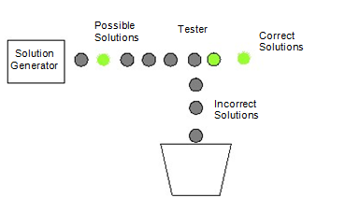
Generate and Test
This is a technical name given to the classical way of solving problems where we generate different combinations to solve our problem, and the one which solves the problem is taken as the correct solution. The rest of the combinations that we try are considered as incorrect solutions and hence are destroyed.

Slide 4
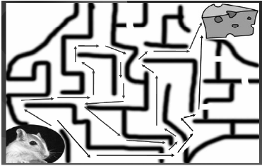
Problem solving (cont.)
Problem space theory
  problem space comprises problem states
  problem solving involves generating states using legal operators
  heuristics may be employed to select operators

Slide 5
Components of Problem Solving
They are namely:
Problem Statement,
Goal State,
Solution Space
and Operators.

Slide 6
Problem Statement
The two major things that we get to know about the problem is the Information about what is to be done and constraints to which our solution should comply.
For example, taking the same example of the mouse, problem statement will tell us things like, the mouse has to reach the cheese as soon as possible and in case it is unable to find a path within an hour, it might die of hunger.

Slide 7
Goal State
what should be the output of our procedure in order to solve the problem.
For example in the case of mouse, the ultimate aim is to reach the cheese. The state of world when mouse will be beside the cheese and probably eating it defines the aim. This state of world is also referred to as the Goal State or the state that represents the solution of the problem.

Slide 8
Solution Space
We have to go though a certain amount of states of nature to reach the solution.
For example when the mouse was in the lower left corner of the maze, represents a state i.e. the start state. When it was stuck in some corner of the maze represents a state. When it was stuck somewhere else represents another state When it was traveling on a path represents some other state and finally when it reaches the cheese represents a state called the goal state.
The set of the start state, the goal state and all the intermediate states constitutes something which is called a solution space.

Slide 9
Operators
The traveling inside a solution space requires something called as “operators”.
In case of the mouse example, turn left, turn right, go straight are the operators which help us travel inside the solution space.
In short the action that takes us from one state to the other is referred to as an operator.
So while solving a problem we should clearly know that what are the operators that we can use in order to reach the goal state from the starting state.
The sequence of these operators is actually the solution to our problem.

Slide 10
Problem solving (cont.)
Analogy
  analogical mapping:
    Similarities between the known domain and the new one are noted and
    operators from the known domain are transferred to the new one.

Slide 11
Emotion
Cannon: emotion is a psychological response to a stimuli
Emotion clearly involves both cognitive and physical responses to stimuli

Slide 12
Emotion (cont.)
The biological response to physical stimuli is called affect
Affect influences how we respond to situations
  positive → creative problem solving
  negative → narrow thinking
  “Negative affect can make it harder to do even easy tasks; positive affect can make it easier to do difficult tasks”
        (Donald Norman)

Slide 13
Emotion (cont.)
Implications for interface design
  stress will increase the difficulty of problem solving
  relaxed users will be more forgiving of shortcomings in design
  aesthetically pleasing and rewarding interfaces will increase positive affect

Slide 14
Individual differences
We should be aware of individual differences so that we can account for them as far as possible within our designs.
We all differ in looks, feelings, intellectual abilities, learning abilities and so on.
Individual differences complicate design
We must permit people with widely varying characteristics to satisfactorily and comfortably learn the task or job, or use the Web site.

Slide 15
Individual differences
long term
– gender, physical and intellectual abilities
short term
– effect of stress or fatigue
changing
– age
Ask yourself:
will design decision exclude section of user population?

