Slide 1
What is Interaction?
communication

Slide 2
Some Terms of Interaction
domain– the area of work under study
e.g. graphic design
goal – what you want to achieve
e.g. create a solid red triangle
task – how you go about doing it – ultimately in terms of operations or actions
e.g. … select fill tool, click over triangle

Slide 3
Donald Norman’s Model
Norman’s model concentrates on user’s view of the interface
goal
execution
evaluation
system

Slide 4
7 Stages of Action
Establishing the goal
Forming the intention
Specifying the action sequence
Executing the action
Perceiving the system state
Interpreting the system state
Evaluating the system state with respect to the goals and intentions

Slide 5
Using Norman’s Model
Some systems are harder to use than others
Gulf of Execution
user’s formulation of actions ≠ actions allowed by the system
Gulf of Evaluation
user’s expectation of changed system state ≠ actual presentation of this state

Slide 6
Physical Aspects of Interfaces
arrangement of controls and displays
controls grouped according to function or frequency of use, or sequentially
surrounding environment
seating arrangements adaptable to cope with all sizes of user
health issues
physical position, environmental conditions (temperature, humidity), lighting, noise,
use of colour
use of red for warning, green for okay, awareness of colour-blindness etc.

Slide 7
Common Interaction Styles
command line interface
menus
natural language
question/answer and query dialogue
form-fills and spreadsheets
WIMP
point and click
three–dimensional interfaces

Slide 8
Command line interface
Way of expressing instructions to the computer directly
function keys, single characters, short abbreviations, whole words, or a combination
suitable for repetitive tasks
better for expert users than novices
offers direct access to system functionality
command names/abbreviations should be meaningful!
Typical example: the Unix system, DOS , Telnet

Slide 9
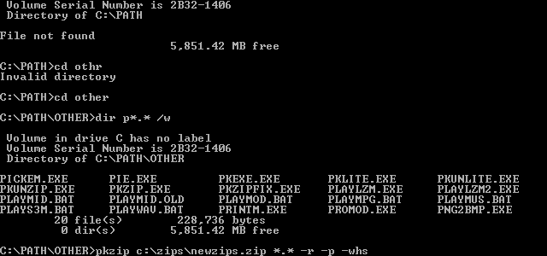
DOS

Slide 10
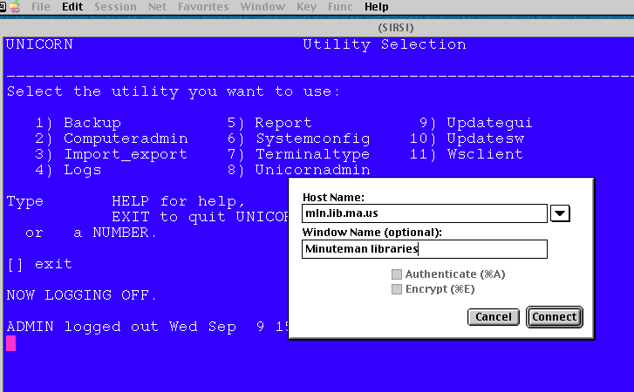
Telnet

Slide 11
Menus
Set of options displayed on the screen
Options visible
less recall - easier to use
rely on recognition so names should be meaningful
Selection by:
numbers, letters, arrow keys, mouse
combination (e.g. mouse plus accelerators)
Often options hierarchically grouped
sensible grouping is needed
Notes:
1

Slide 12
Natural language
Familiar to user
speech recognition or typed natural language
Problems
vague
ambiguous
hard to do well!

Slide 13
Query Interfaces
Question/answer interfaces
user led through interaction via series of questions

Slide 14
Form-fills
Primarily for data entry or data retrieval
Screen like paper form.
Data put in relevant place
Requires
good design
obvious correction facilities

Slide 15
Form-fills

Slide 16
Spreadsheets
first spreadsheet VISICALC, followed by Lotus 1-2-3 MS Excel most common today
sophisticated variation of form-filling.
grid of cells contain a value or a formula
formula can involve values of other cells e.g. sum of all cells in this column
user can enter and alter data spreadsheet maintains consistency

Slide 17
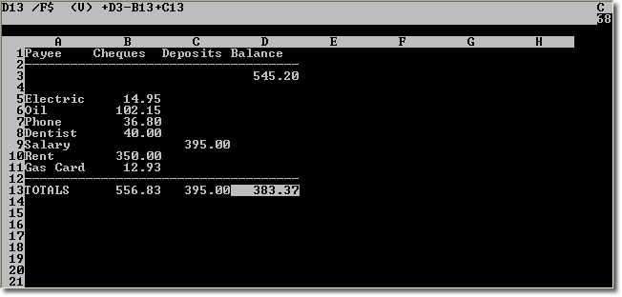
VISICALC

Slide 18
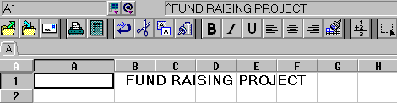
Lotus 1-2-3

Slide 19
MS Excel

Slide 20
WIMP Interface
Windows
Icons
Menus
Pointers
… or windows, icons, mice, and pull-down menus!
default style for majority of interactive computer systems, especially PCs and desktop machines

Slide 21
Windows
Areas of the screen that behave as if they were independent
can contain text or graphics
can be moved or resized
can overlap each other, or can be laid out next to one another (tiled)

Slide 22
Windows
scrollbars
title bars

Slide 23


Icons
small picture or image
represents some object in the interface
often a window or action

Slide 24
Pointers
important component
WIMP style relies on pointing and selecting things
uses mouse, trackpad, joystick, trackball, cursor keys or keyboard shortcuts
wide variety of graphical images

Slide 25
Pull-down Menu

Slide 26
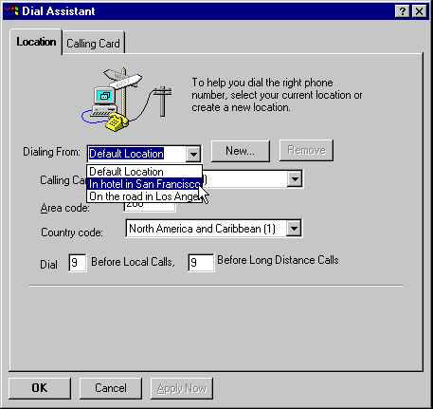
Drop-down Menu

Slide 27
Fall-down Menus

Slide 28
Pop-up Menus

Slide 29
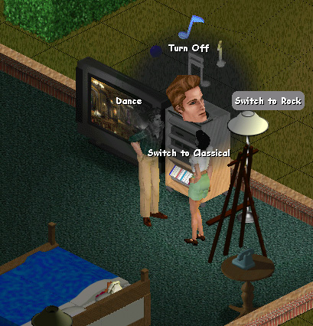
Pie Menu

Slide 30
Keyboard Accelerators
Alt
+
T

Slide 31
Buttons
individual and isolated regions within a display that can be selected to invoke an action
Special kinds
radio buttons – set of mutually exclusive choices
check boxes – set of non-exclusive choices

Slide 32
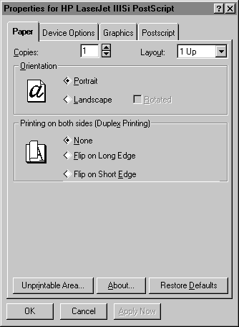
Radio Buttons

Slide 33
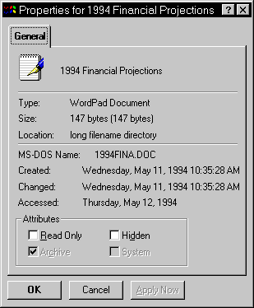
Check Boxes

Slide 34
Toolbars
long lines of icons … … but what do they do?
fast access to common actions
often customizable:
choose which toolbars to see
choose what options are on it

Slide 35
Customization

Slide 36
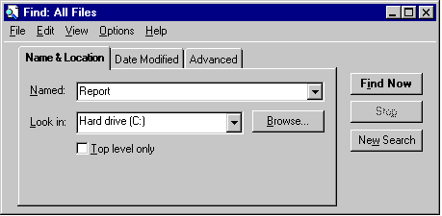
Dialogue Boxes
information windows that pop up to inform of an important event or request information.

