Slide 1
screen design and layout
✓
Dix , Alan
Finlay, Janet
Abowd, Gregory
Beale, Russell
basic principles
grouping, structure, order
alignment
use of white space
ABCDEFHIJKLM
NOPQRSTUVWXYZ

Slide 2
available tools
grouping of items
order of items
decoration - fonts, boxes etc.
alignment of items
white space between items

Slide 3
grouping and structure
logically together ⇒ physically together
Billing details:
Name
Address: …
Credit card no
Delivery details:
Name
Address: …
Delivery time
Order details:
item quantity cost/item cost
size 10 screws (boxes) 7 3.71 25.97
…… … … …

Slide 4
decoration
use boxes to group logical items
use fonts for emphasis, headings
but not too many!!
ABCDEFHIJKLM
NOPQRSTUVWXYZ

Slide 5
alignment - text
you read from left to right (English and European)
⇒ align left hand side
boring but
readable!
Willy Wonka and the Chocolate Factory
Winston Churchill - A Biography
Wizard of Oz
Xena - Warrior Princess
Willy Wonka and the Chocolate Factory
Winston Churchill - A Biography
Wizard of Oz
Xena - Warrior Princess
fine for special effects but hard to scan

Slide 6
alignment - names
Usually scanning for surnames ⇒ make it easy!
✗
✓
Alan Dix
Janet Finlay
Gregory Abowd
Russell Beale
Dix , Alan
Finlay, Janet
Abowd, Gregory
Beale, Russell
✓
Alan Dix
Janet Finlay
Gregory Abowd
Russell Beale

Slide 7

alignment - numbers
think purpose!
which is biggest?
532.56
179.3
256.317
15
73.948
1035
3.142
497.6256

Slide 8

alignment - numbers
visually:
long number = big number
align decimal points
or right align integers
627.865
1.005763
382.583
2502.56
432.935
2.0175
652.87
56.34

Slide 9
multiple columns
scanning across gaps hard:
sherbert 75
toffee 120
chocolate 35
fruit gums 27
coconut dreams 85

Slide 10
multiple columns - 2
use leaders
sherbert 75
toffee 120
chocolate 35
fruit gums 27
coconut dreams 85

Slide 11
multiple columns - 3
or greying (vertical too)
sherbert 75
toffee 120
chocolate 35
fruit gums 27
coconut dreams 85

Slide 12
multiple columns - 4
or even (with care!) ‘bad’ alignment
sherbert 75
toffee 120
chocolate 35
fruit gums 27
coconut dreams 85

Slide 13
White space to separate

Slide 14
space to structure

Slide 15
space to highlight

Slide 16

physical controls
grouping of items
  defrost settings
  type of food
  time to cook
defrost settings
type of food
time to cook

Slide 17
physical controls
grouping of items
order of items
    type of heating
    temperature
    time to cook
    start
1) type of heating
1
2) temperature
3) time to cook
2
4) start
3
4

Slide 18
physical controls
grouping of items
order of items
decoration
  different colours
  for different functions
  lines around related
  buttons
different colours for different functions
lines around related
buttons (temp up/down)

Slide 19
physical controls
grouping of items
order of items
decoration
alignment
  centered text in buttons
  ? easy to scan ?
centred text in buttons
? easy to scan ?

Slide 20
physical controls
grouping of items
order of items
decoration
alignment
white space
  gaps to aid grouping
gaps to aid grouping

Slide 21
Navigation Design

Slide 22
goal seeking
goal
start

Slide 23
goal seeking
goal
start
progress with local knowledge only ...

Slide 24
goal seeking
goal
start
… but can get to the goal

Slide 25
goal seeking
goal
start
… try to avoid these bits!

Slide 26
four golden rules
knowing where you are
knowing what you can do
knowing where you are going
  or what will happen
knowing where you’ve been
  or what you’ve done

Slide 27
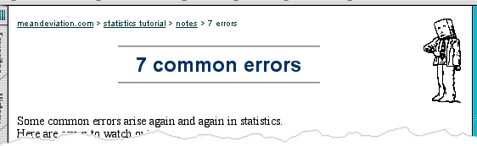
where you are – breadcrumbs
shows path through web site hierarchy
top level category
sub-category
web site
this page
live links
to higher
levels

Slide 28
user action and control
entering information
knowing what to do
affordances

Slide 29
entering information
Name:
Alan Dix
Address:
Lancaster
forms, dialogue boxes
  presentation + data input
  alignment
logical layout
  groupings
  natural order for entering information
    top-bottom, left-right (depending on culture)
    set tab order for keyboard entry
✓
Name:
Alan Dix
Address:
Lancaster
?
Name:
Alan Dix
Address:
Lancaster

Slide 30
knowing what to do
what is active what is passive
  where do you click
  where do you type
consistent style helps
  e.g. web underlined links
labels and icons
  standards for common actions

Slide 31
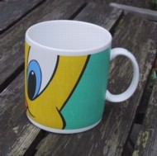
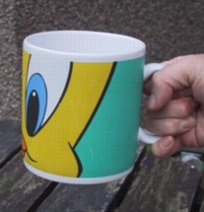
affordances
mug handle
The psychological idea of
affordance says that things
may suggest by their shape
and other attributes what you
can do to them.
  shape and size suggest actions
    pick up, twist, throw
for screen objects
  button–like object ‘affords’ mouse click
culture of computer use
  icons ‘afford’ clicking
  or even double clicking … not like real buttons!
‘affords’
grasping

Slide 32
appropriate appearance
presenting information
aesthetics and utility
colour and 3D
localisation & internationalisation

Slide 33
presenting information
purpose matters
  sort order (which column, numeric alphabetic)
  text vs. diagram
  scatter graph vs. histogram
use paper presentation principles!
but add interactivity
  softens design choices
    e.g. re-ordering columns
name
name
size
size
size
chap1
chap10
chap11
chap12
chap13
chap14
…
chap10
chap5
chap1
chap14
chap20
chap8
…
17
12
51
262
83
22
…
12
16
17
22
27
32
…

Slide 34

aesthetics and utility
aesthetically pleasing designs
  increase user satisfaction and improve productivity
beauty and utility may conflict
  mixed up visual styles ⇒ easy to distinguish
  clean design – little differentiation ⇒ confusing
  backgrounds behind text
  … good to look at, but hard to read

Slide 35
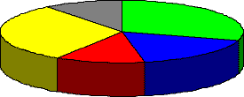
colour and 3D
both often used very badly!
Colour
  colour over used because ‘it is there’
  beware colour blind!
  use carefully to reinforce other information
3D effects
  good for physical information and some graphs
  but if over used …
  e.g. text in perspective!! 3D pie charts

Slide 36
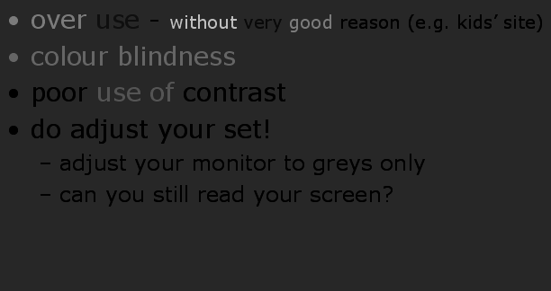
bad use of colour
over use - without very good reason (e.g. kids’ site)
colour blindness
poor use of contrast
do adjust your set!
  adjust your monitor to greys only
  can you still read your screen?

Slide 37
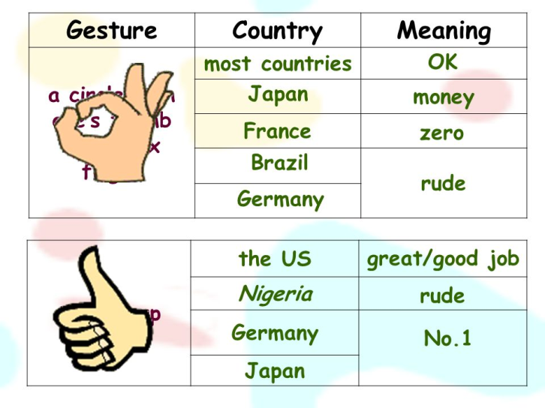
across countries and cultures
localisation & internationalisation
  changing interfaces for particular cultures/languages
globalisation
  try to choose symbols etc. that work everywhere
deeper issues
  cultural assumptions and values
  meanings of symbols

