Slide 1



chapter 5
interaction design basics

Slide 2
HCI Focus of Design
Some of HCI is focused on understanding: the study of the way people interact with technology.
However, a large part of HCI is about doing things and making things that is called a design

Slide 3
what is design?
achieving goals within constraints

Slide 4
Goal
What is the purpose of the design we are intending to produce?
  Who is it for?
  Why do they want it?
For example, if we are designing a wireless personal movie player, we may think about young affluent users wanting to watch the latest movies whilst on the move and download free copies, and perhaps wanting to share the experience with a few friends.

Slide 5
Constraints
How much can it cost?
How much time do we have to develop it?
Are there health and safety issues?
In the case of the personal movie player: does it have to withstand rain?

Slide 6
Trade-off
Choosing which goals or constraints can be relaxed so that others can be met.
  For example, we might find that an eye-mounted video display, a bit like those used in virtual reality, would give the most stable image whilst walking along.
However, this would not allow you to show friends, and might be dangerous if you were watching a attention-grabbing part of the movie as you crossed the road.

Slide 7
golden rule of design
understand your materials

Slide 8
for Human–Computer Interaction
understand your materials
understand computers
  limitations, capacities, tools, platforms
understand people
  psychological, social aspects
  human error
and their interaction …

Slide 9
To err is human
accident reports ..
  aircrash, industrial accident, hospital mistake
  enquiry … blames … ‘human error’
but …
  concrete lintel breaks because too much weight
  blame ‘lintel error’ ?
  … no – design error
  we know how concrete behaves under stress
human ‘error’ is normal
  we know how users behave under stress
  so design for it!
treat the user at least as well as physical materials!

Slide 10
The process of design
Often HCI professionals complain that they are called in too late.
  A system has been designed and built, and only when it proves unusable do they think to ask how to do it right!
  In other companies usability in seen as equivalent to testing called checking.

Slide 11
The process of design
what is
wanted
analysis
design
implement
and deploy
prototype

Slide 12
Requirements
What is wanted?
  The first stage is establishing what exactly is needed. As a precursor to this it is usually necessary to find out what is currently happening.
  For example, how do people currently watch movies? What sort of personal appliances do they currently use?

Slide 13
Requirements
There are number of techniques used of this in HCI:
  Interviewing people,
  Videotaping them,
  Looking at the documents and objects that they work with,
  Observing them directly.

Slide 14
Analysis
The results of observation and interview need to be ordered in some way to bring out key issues and communicate with later stages of design.

Slide 15
Design
We need to record out design choices in some way and there are various notations and method to do this.
Its about designing the concept of the system called conceptual design.

Slide 16
Iteration and prototyping
Humans are complex and we cannot expect to get design right first time.
We therefore need to evaluate a design to see how well it is working and where there can be improvements.
OK?
design
prototype
evaluate
done!
re-design

Slide 17
Implementation and deployment
We need to create and deploy design.
This will involve writing code, perhaps making hardware, writing documentation and manuals

Slide 18
user focus
know your user
personae
cultural probes

Slide 19
know your user
who are they?
probably not like you!
talk to them
watch them
use your imagination

Slide 20
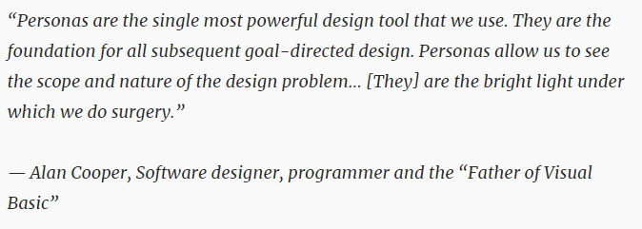
persona
description of an ‘example’ user
use as surrogate user
details matter

Slide 21
example persona
Betty is 37 years old, She has been Warehouse Manager for five years and worked for Simpkins Brothers Engineering for twelve years. She didn’t go to university, but has studied in her evenings for a business diploma. She has two children aged 15 and 7 and does not like to work late. She did part of an introductory in-house computer course some years ago, but it was interrupted when she was promoted and could no longer afford to take the time. Her vision is perfect, but her right-hand movement is slightly restricted following an industrial accident 3 years ago. She is enthusiastic about her work and is happy to delegate responsibility and take suggestions from her staff. However, she does feel threatened by the introduction of yet another new computer system (the third in her time at SBE).

Slide 22

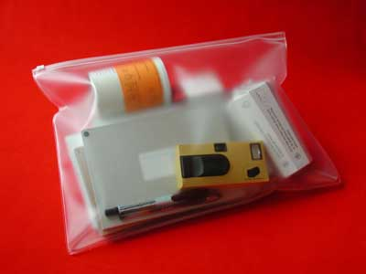
cultural probes
direct observation
  sometimes hard
    in the home
    psychiatric patients, …
probe packs
  items to prompt responses
    e.g. glass to listen at wall, camera, postcard
  given to people to open in their own environment
  they record what is meaningful to them

Slide 23
scenarios
stories for design
use

Slide 24
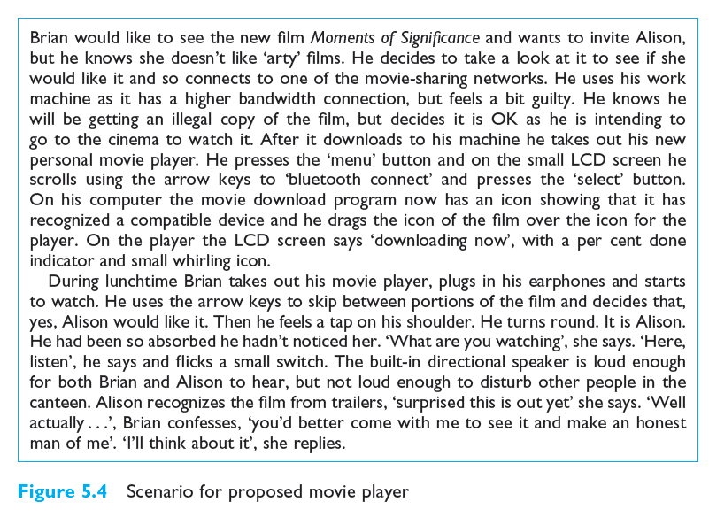
scenario – movie player

